Slide 1
Strategic Segmented Marketing: Member Engagement
Intern Project by Matt Dunning

Slide 2
Key Questions
How can BJ’s leverage member data to ensure member engagement efforts are spent on the right members at the right time?
What kind of engagement strategies can be adopted for each member segment to maximize ROI?

Slide 3
Current Method
BJs currently leverages a Latent Class Model (LCM) to discover hidden groups within the data, and segment members based on these classes
The purpose of my analysis is to test whether a K-means clustering analysis will be more effective in increasing member engagement

Slide 4
How Can This Be Accomplished?
Step 1
Use an econometric framework to objectively measure these three ideas on a numerical scale: Recency, Frequency, and Monetary Value. This is known as an RFM framework.
Recency: When was the last time a member made a purchase with BJs?
Frequency: How regularly does this member make a purchase with BJs?
Monetary Value: How much money does this member spend over a period of time at BJs? (Excluding Gas Sales)

Slide 5
How Can This Be Accomplished Pt. 2
Step 2
After member data is structured into an RFM framework it can be fit to a K-means clustering algorithm to segment members into clusters.
Members will be segmented into clusters with other members who show similar engagement characteristics

Slide 6
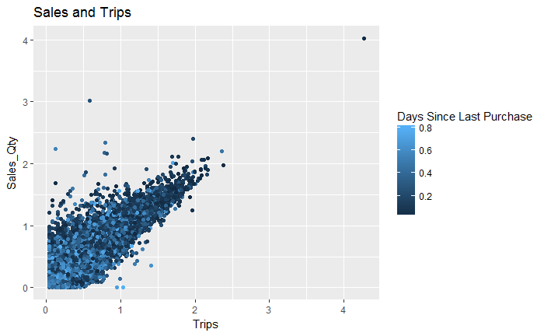
The Data

Slide 7
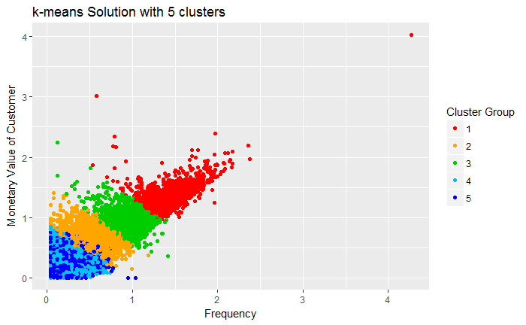
Clustering Results

Slide 8
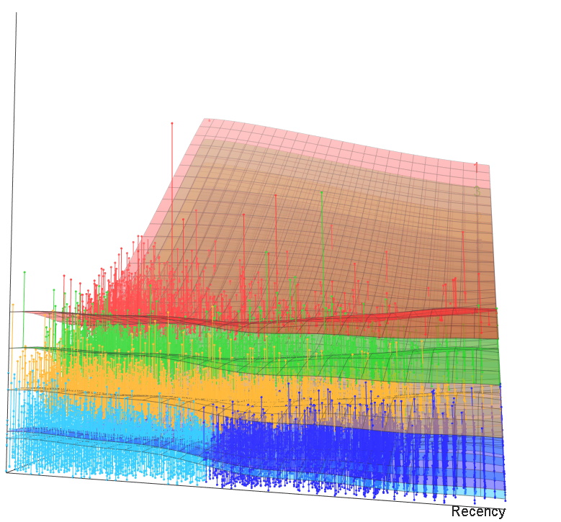
Interpreting Member Clusters
Monetary Value
Cluster 1: Champion Members
Spend the most per trip, highest amount of trips, made purchase recently
Cluster 2: Higher Spend, High Trip Members
Above average spend, visit often, made a purchase recently
Cluster 3: Average Trip and Spend Members
Made purchase recently, average sales, average trips
Cluster 4: New Members
Most recent purchase, Low Trips Amount, Low sales
Cluster 5: Lost Members
Last purchase long ago, purchased few and spend little
1
2
3
4
5

Slide 9
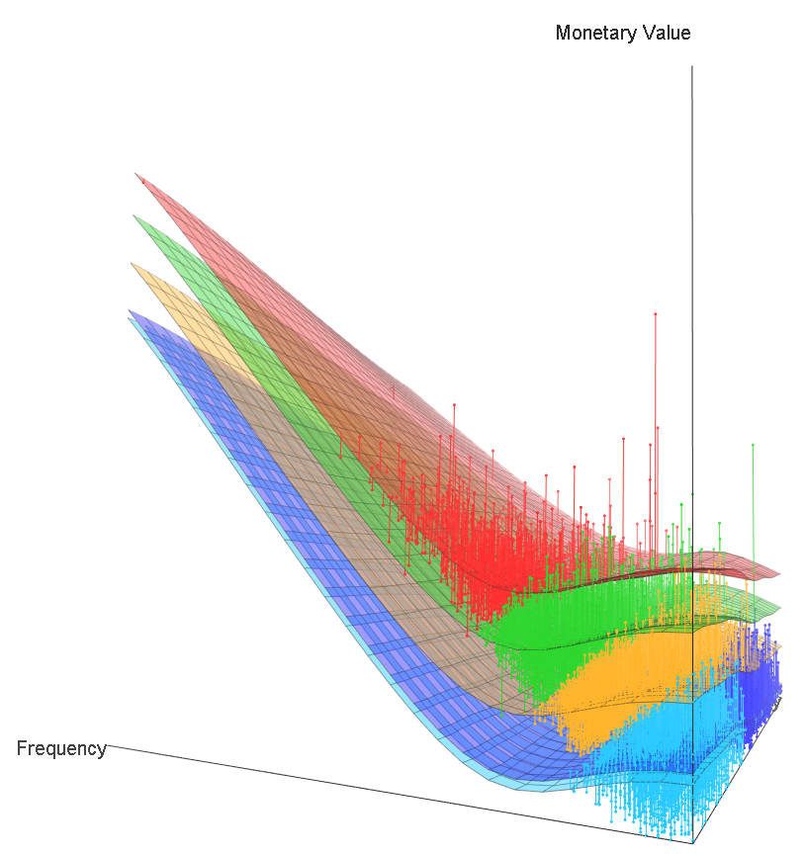
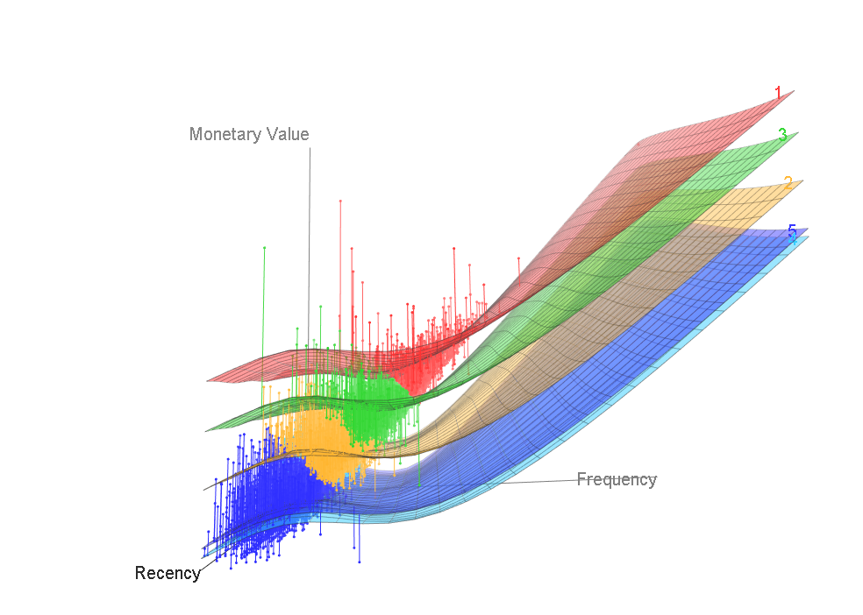
Interpreting Member Clusters
1
1
2
2
3
3
5
Days Since Last Trip
4
5

Slide 10
Summary Statistics
Member Clusters
 | 1 | 2 | 3 | 4 | 5
Proportion of Population | 8.7% | 20.2% | 27.7% | 22.0% | 21.4%
Proportion of Sales | 20.7% | 27.4% | 25.6% | 13.2% | 13.0%
Proportion of Trips | 20.0% | 27.2% | 25.3% | 14.0% | 13.6%

Slide 11
3
2
2
3
3
2
4
5
1
1
4
4
5
5

Slide 12
Champion Members
Members in cluster 1 (referred to as champion members):
High value members who spend most and visit most often
Have made a purchase recently
1
Marketing Strategies:
Upsell high value products
Front of club offers
Meat (beef)
Laundry Items
Engage in more costly engagement strategies
No Price Incentives
ROI is maximized when this member cluster is targeted with most engagement – bring back most value
Make them feel important
Give early offers on new products
Free online shipping
1

Slide 13
Higher Spend, High Trip Members
Members in cluster 2:
Loyal members who have above average value and trips
Above average response rates
Shop routinely with above average baskets
Price sensitive to items they routinely buy
Will occasionally make large purchases and purchase higher value items
Goal: Engage and Retain
Marketing Strategies:
Engage with offers on high value and FOC items
Market new products, offers, and promotions
Test out promos on this group – may indicate potential success for other groups
Avoid member churn
Make them feel special with renewal offers before members expire
Offer rewards membership if not already enrolled
2
2

Slide 14
Average Trip and Spend Members
Members in cluster 3:
Average trip amount, average spend, more recent purchase
Goal: Achieve increase in their spend for an average basket
3
Marketing Strategies:
Aggressive price incentives
Likely to respond positively to value offers
Discount coupons on high value items
“$5 off $50” type deals
Bundle offerings
E.g. Milk and eggs bundle, TV and sound system bundle, etc.
Weekly/Monthly “challenges”
Spend ‘X’ amount during time period ‘t’ and receive ‘Y’ amount off purchase when redeemed
3

Slide 15
New Members
Members in cluster 4:
Members who have made a purchase very recently and a small number of trips
Most likely new members who just began membership
Marketing Strategies:
Provide on-boarding support
Give them insights to value and why they chose BJs
Build relationship with member
Everyday value compared to other retailers
Member benefits
Build Brand Awareness
B&J and Wellsley Farms products
Offers for trip driving categories
4
4

Slide 16
Lost Members
Members in cluster 5:
Low value members who do not shop regularly and have not shopped in a while
Lowest ROI from marketing
Likely to have membership at competitor
Marketing Strategies:
Recreate brand value
Revive interest with reach out campaign, trial offer
Avoid sending costly campaigns to this cluster
5
5

Slide 17
Next Steps
Test clustering analysis by applying engagement strategies corresponding to member cluster
Compare engagement results with existing Latent Class Model

