Slide 1


Automated quality assessment for mr images for further study in Alzheimer's disease patients
Marc Dupuis
Co-Advisor: Dr. Mark Austin (Ixico Ltd.)
Co-Advisor: Dr. Anil Bharath (Imperial College)

Slide 2
Table of contents
Introduction
Background
Objectives
Methods
Preprocessing
Entropy criterions
Classification
Results
Preprocessing
Information gain
Classification
Implementation
Conclusion
Q&A
Notes:
Very brief run through (10 seconds)

Slide 3
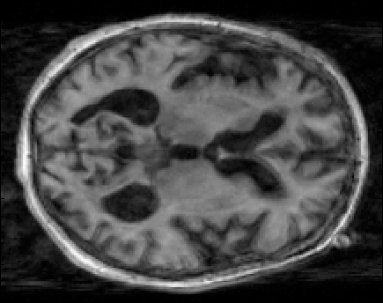
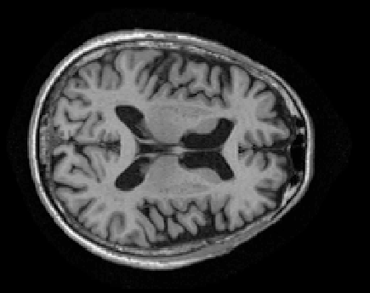
Introduction
Alzheimer’s Disease
Ixico’s Work
Role of automatic quality assessment
Bad Image
Good Image
Good Quality
Measure Brain
Volume
Quality Check
MR Scan
Bad Quality
Discard
Notes:
What is AD and how is it diagnosed? Shrinkage of the brain etc.
What does Ixico have to do with AD? They have algorithms to measure brain volume. BUT image has to be good quality.
Hence automatic image QC to (1) save time and (2) automate process from A to Z

Slide 4
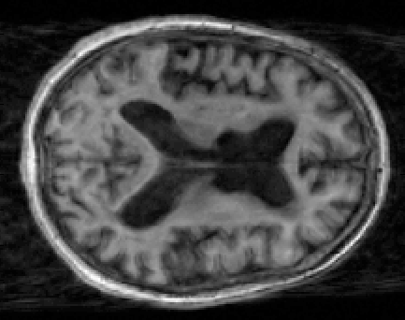
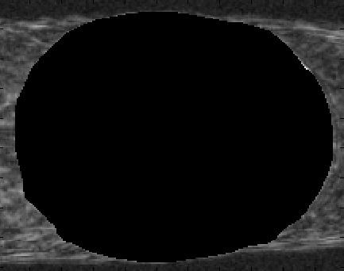
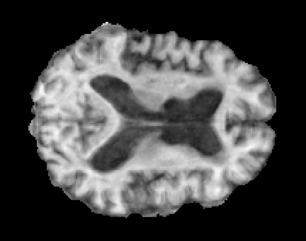
Background
No-reference quality measure
Existing quality measures: sharpness, flatness, natural scene statistics and intensity
Quality metrics rely on background or full image
Notes:
A lot of quality measure rely on a reference image. Explain what reference images are and why we can’t use them.
Some of the previously studied measures are… But most of these haven’t been studied from a practical standpoint with the exception of the intensity measure
Most existing quality measures rely on the background and sometimes the full image. Explain why.

Slide 5
Objectives
Study the brain region (vs. background) as a source of quality measure.
Study entropy criteria as a new quality index.
Implement a classifier that minimizes the loss of good data.
Notes:
- Enumerate objectives and clarify the points

Slide 6
Methods
Data: All images were graded as « pass » or « fail » by professional physicians.
ADNI Raw Data (NIfTI)
Data
Preprocessing
Preprocessing
Reorient
Normalize
Register
Segment
1
Thresholding
Opening and Dilation
Differential Image Calculation
Entropy Criterion Calculation
DE Entropy
Features:
Shannon entropy
Tsallis entropy
Focus criterion
2
MxN Feature Matrix
Classification
Results
Boosting
3
Results
Notes:
- Workflow can be separated into three sections. Explain very briefly each one with an emphasis on why we did 1.

Slide 7
Results – Classification
Model | Correct Classification (%) | ROC Area
Random Forest | 97.69 | 0.907
Bayesian Network | 94.83 | 0.882
Neural Network | 97.23 | 0.879
Adaptive Boosting | 97.82 | 0.877
ADTree | 97.42 | 0.861
LMT | 97.55 | 0.857
KNN | 97.42 | 0.800
SVM | 97.55 | 0.735
Decision Stump | 97.82 | 0.704
C4.5 | 97.55 | 0.696
Notes:
Briefly introduce the classifiers that were used.
The two that stuck out are the RF and BN. Not because of their success rate, but because of the ROC area.

Slide 8
Results – Implementation
There are three solutions:
Maximize the success rate
Miminize false negatives and manually check the rest
Classify images as: pass, fail, uncertain
Notes:
Classification seems good, but now needs to be implemented.
Explain each one a few different ways so that everyone can grasp the idea.

Slide 9
Results – Implementation 1
Model | Correct Classification (%)
Random Forest | 97.69
Bayesian Network | 94.83
Neural Network | 97.23
Adaptive Boosting | 97.82
ADTree | 97.42
LMT | 97.55
KNN | 97.42
SVM | 97.55
Decision Stump | 97.82
C4.5 | 97.55
Lose 1 good image
Miss 15 bad images
Notes:
First method would be OK, except that this lets 15 failed images through (almost half of the fails!)
We would have to either hope to catch those later or manually inspect all « pass » images.
This solution is no good.

Slide 10
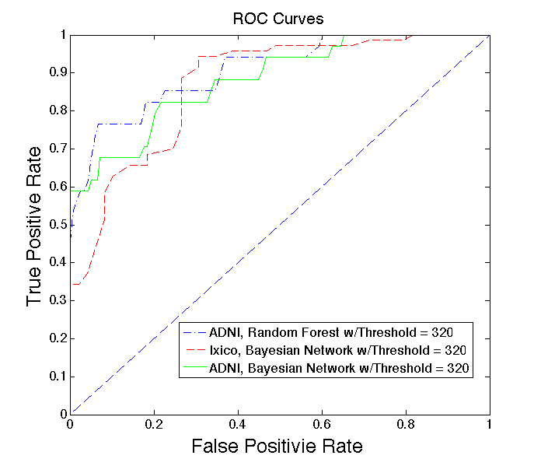
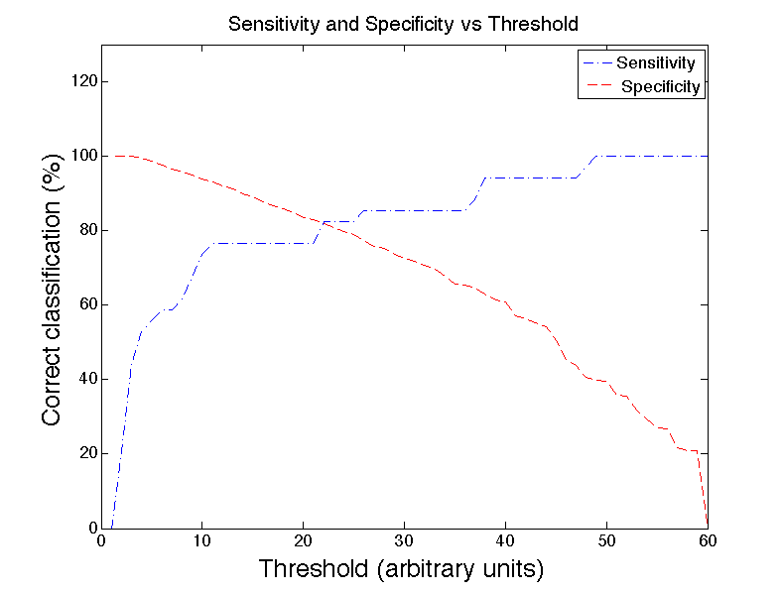
Results – Implementation 2
303 false positives
47.94% of images to manually check
Notes:
Be lax with the « fail » label but not allow any failed images to pass.
Then inspect all images labeled as « fail »

Slide 11
Results – Implementation 3
Question: How does the boosting work?
Answer: It uses a set of classifiers to simply label the images that give the previous classifier a « hard time ».
Result: 10.05% of all images require manual checking
Notes:
Very briefly explain the steps (concept isn’t particularly complicated, but a little convoluted to explain with the given time)
Break it down very simply with the question and answer.

Slide 12
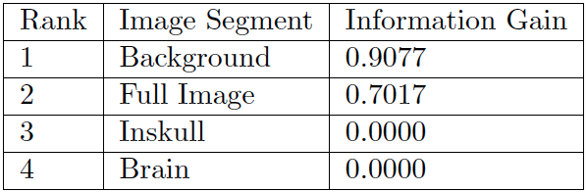
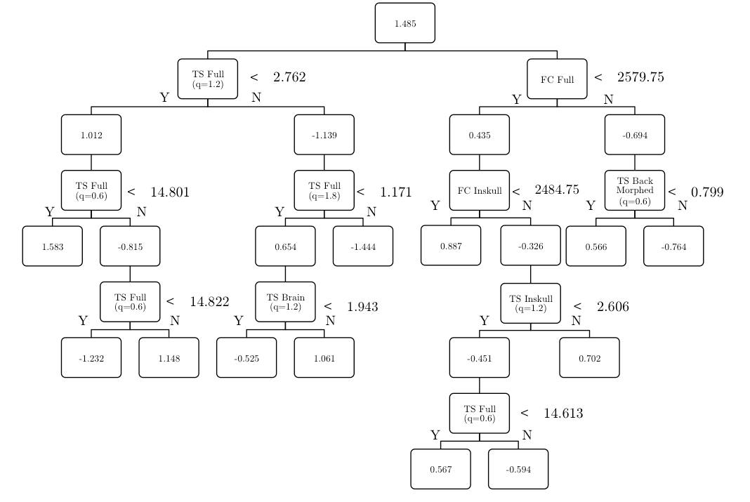
Results – Information Gain
Notes:
Classifiers seem to work… but did we use the brain images?
Info gain seems to suggest that they’re no good
But ADTree used for boosting uses it.

Slide 13
Conclusion
There is information on quality in the brain region, BUT it’s not clear whether or not entropy uses it.
Entropy is a strong contender as a quality index.
The suggested method can lead to a practical implementation. Only 10.05% of all images need to be manually checked.
Notes:
It’s most likely that the brain images can’t be used by themselves, but rather as part of a feature matrix
Entropy was already strongly suggested in the literature, this confirms those suggestions
The proposed method is a viable solution to avoid any loss of good data.

Slide 14
Q&A
Introduction
Background
Objectives
Methods
Preprocessing
Entropy criterions
Classification
Results
Preprocessing
Information gain
Classification
Implementation
Conclusion

Slide 15
Introduction
Bad Image
Good Image
Alzheimer’s Disease
Ixico’s Work
Role of automatic quality assessment
Good Quality
Measure Brain
Volume
Quality Check
MR Scan
Bad Quality
Discard
Notes:
What is AD and how is it diagnosed? Shrinkage of the brain etc.
What does Ixico have to do with AD? They have algorithms to measure brain volume. BUT image has to be good quality.
Hence automatic image QC to (1) save time and (2) automate process from A to Z

Slide 16
Background
No-reference quality measure
Existing quality measures: sharpness, flatness, natural scene statistics and intensity
Quality metrics rely on background or full image
Notes:
A lot of quality measure rely on a reference image. Explain what reference images are and why we can’t use them.
Some of the previously studied measures are… But most of these haven’t been studied from a practical standpoint with the exception of the intensity measure
Most existing quality measures rely on the background and sometimes the full image. Explain why.

Slide 17
Objectives
Study the brain region (vs. background) as a source of quality measure.
Study entropy criteria as a new quality index.
Implement a classifier that minimizes the loss of good data.
Notes:
- Enumerate objectives and clarify the points

Slide 18
Methods
Data: All images were graded as « pass » or « fail » by professional physicians.
ADNI Raw Data (NIfTI)
Data
Preprocessing
Preprocessing
Reorient
Normalize
Register
Segment
1
Thresholding
Opening and Dilation
Differential Image Calculation
Entropy Criterion Calculation
DE Entropy
Features:
Shannon entropy
Tsallis entropy
Focus criterion
2
MxN Feature Matrix
Classification
Results
Boosting
3
Results
Notes:
- Workflow can be separated into three sections. Explain very briefly each one with an emphasis on why we did 1.

Slide 19
Results – Classification
Model | Correct Classification (%) | ROC Area
Random Forest | 97.69 | 0.907
Bayesian Network | 94.83 | 0.882
Neural Network | 97.23 | 0.879
Adaptive Boosting | 97.82 | 0.877
ADTree | 97.42 | 0.861
LMT | 97.55 | 0.857
KNN | 97.42 | 0.800
SVM | 97.55 | 0.735
Decision Stump | 97.82 | 0.704
C4.5 | 97.55 | 0.696
Notes:
Briefly introduce the classifiers that were used.
The two that stuck out are the RF and BN. Not because of their success rate, but because of the ROC area.

Slide 20
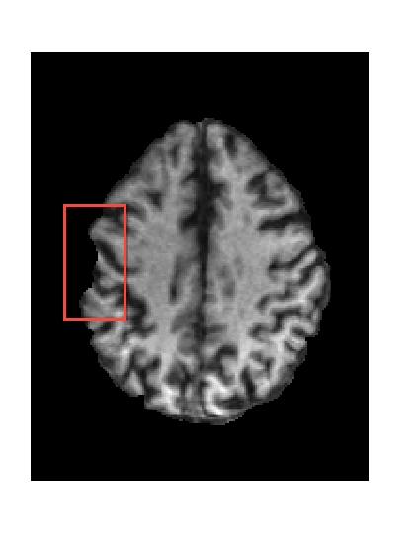
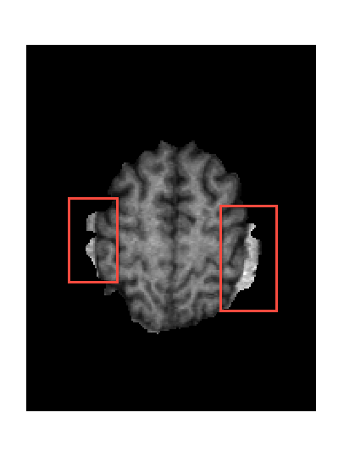
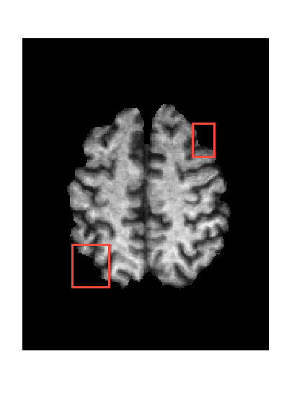
Results - Preprocessing

Slide 21
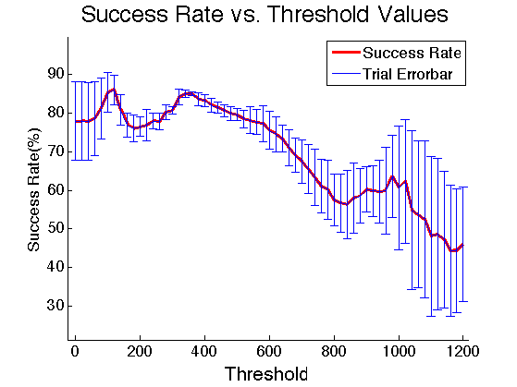
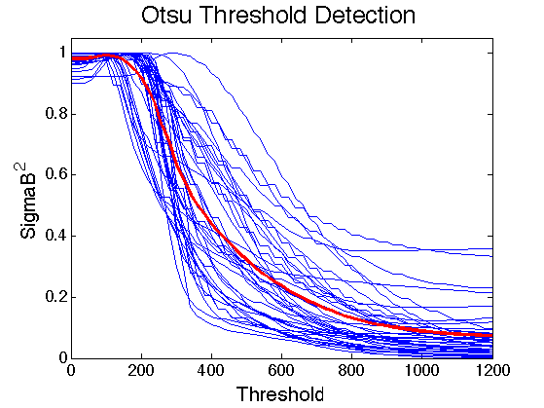
Results - Thresholding

Slide 22
Results – Implementation
There are three solutions:
Maximize the success rate
Miminize false negatives and manually check the rest
Classify images as: pass, fail, uncertain
Notes:
Classification seems good, but now needs to be implemented.
Explain each one a few different ways so that everyone can grasp the idea.

Slide 23
Results – Implementation 1
Model | Correct Classification (%)
Random Forest | 97.69
Bayesian Network | 94.83
Neural Network | 97.23
Adaptive Boosting | 97.82
ADTree | 97.42
LMT | 97.55
KNN | 97.42
SVM | 97.55
Decision Stump | 97.82
C4.5 | 97.55
Lose 1 good image
Miss 15 bad images
Notes:
First method would be OK, except that this lets 15 failed images through (almost half of the fails!)
We would have to either hope to catch those later or manually inspect all « pass » images.
This solution is no good.

Slide 24
Results – Implementation 2
303 false positives
47.94% of images to manually check
Notes:
Be lax with the « fail » label but not allow any failed images to pass.
Then inspect all images labeled as « fail »

Slide 25
Results – Implementation 3
Question: How does the boosting work?
Answer: It uses a set of classifiers to simply label the images that give the previous classifier a « hard time ».
Result: 10.05% of all images require manual checking
Notes:
Very briefly explain the steps (concept isn’t particularly complicated, but a little convoluted to explain with the given time)
Break it down very simply with the question and answer.

Slide 26
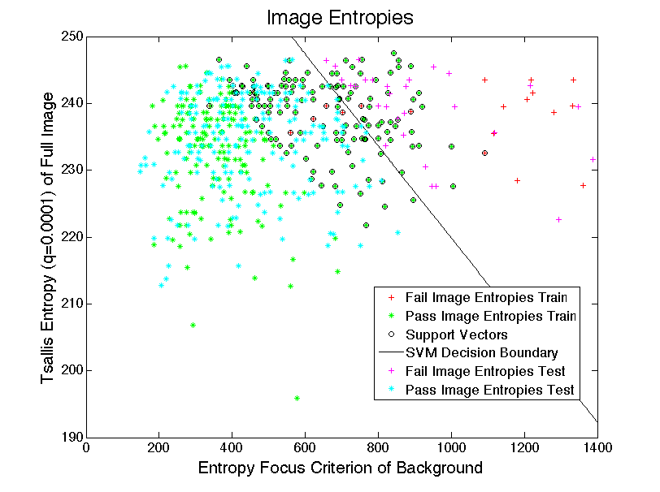
Results – Implementation 3
10.05% of all images require manual checking

Slide 27
Results – Information Gain
Notes:
Classifiers seem to work… but did we use the brain images?
Info gain seems to suggest that they’re no good
But ADTree used for boosting uses it.

Slide 28
Conclusion
There is information on quality in the brain region, BUT it’s not clear whether or not entropy uses it.
Entropy is a strong contender as a quality index.
The suggested method can lead to a practical implementation. Only 10.05% of all images need to be manually checked.
Notes:
It’s most likely that the brain images can’t be used by themselves, but rather as part of a feature matrix
Entropy was already strongly suggested in the literature, this confirms those suggestions
The proposed method is a viable solution to avoid any loss of good data.

