Slide 1
U.S.A. Passenger Airline Study Seed Scientific Candidate Assignment 1
Marc Dupuis
email: marc.f.dupuis@gmail.com
phone: (980) 319-4717

Slide 2
Introduction
This powerpoint presentation is intented as a short graphical illustration of the study of US passenger airline data.
It is meant as a complement to the PDF report which contains more details and context for each graph.

Slide 3
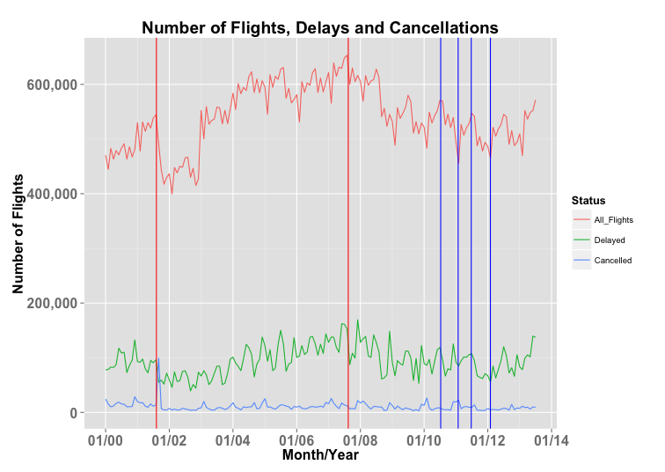
Question: How much have Americans been travelling since January 2000? And how many delays and cancellations have they experienced?
Answer:
There is a noticeable drop in flights and a spike of cancellations on September 2001
The number of flights dropped following the subprime mortgage bubble in 2008
There are yearly trends: increase in flights in the summer and decrease in winter
Delays seem to follow the same trend as all flights

Slide 4
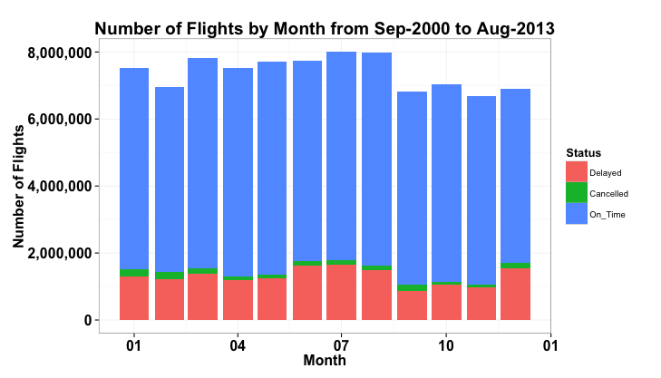
Question: Are the yearly trends noticeable? If so, when do Americans fly the most?
Answer:
As predicted from the previous plot, there is a surge in flights during the spring and summer periods and a drop in the winter
The number of delayed flights needs to be studied as a percentage of all flights (next slide)

Slide 5
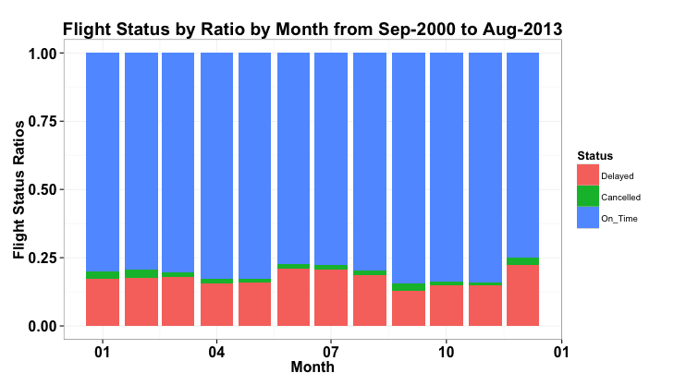
Question: Are delays correlated to the month?
Answer:
The number of delays relative to the number of flights increase in the summer and during the holidy season in December.

Slide 6
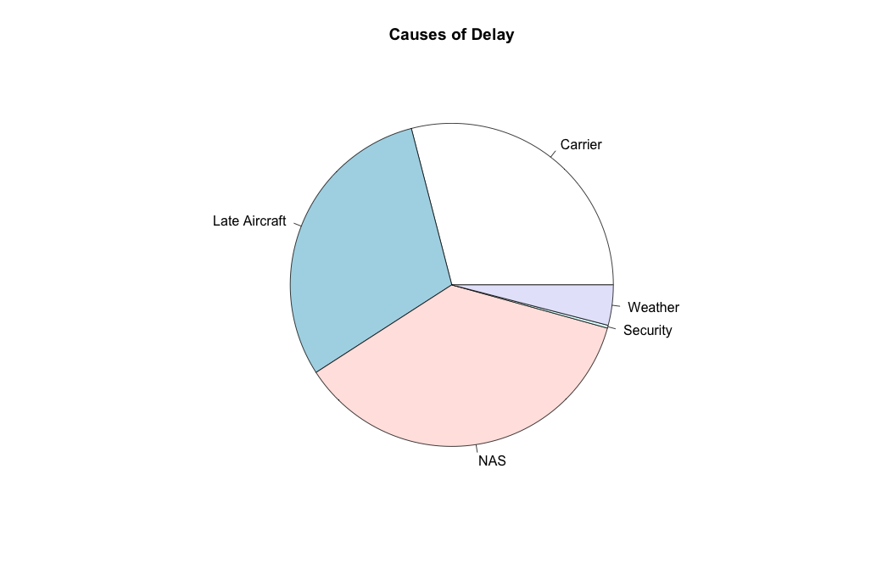
Question: What causes delays?
Answer:
Causes of dealy are equally due to late aircraft arrival, the carriers and the National Airspace System (NAS) orders
The weather plays a surprisingly low role because this only accounts for severe weather. Mild weather delays are classified under the NAS label

Slide 7
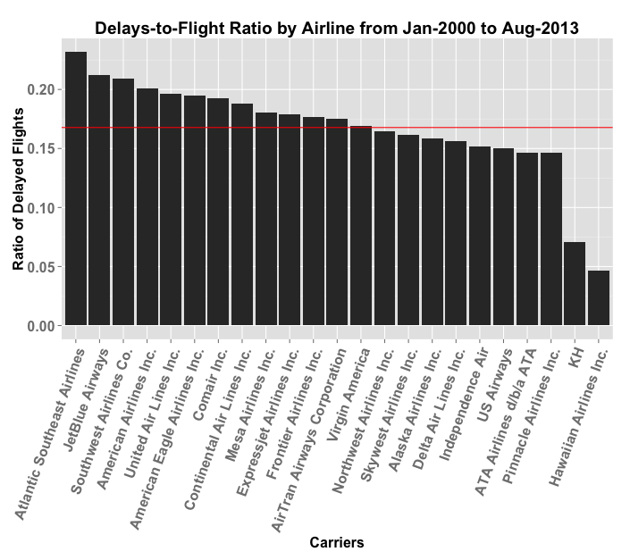
Question: Which are the best and worst performing carriers?
Answer:
The three worst airlines to travel with in terms of delay-to-flight ratios are: Atlantic Southeast Airlines, JetBlue and Southwest
The two best (by far) are Aloha Air Cargo and Hawaiian Airlines

Slide 8
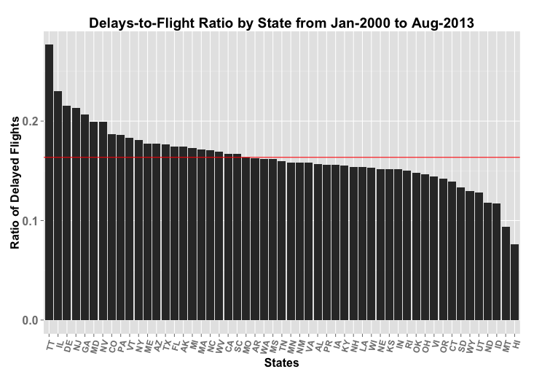
Question: Which states have the best and worst record?
Answer:
There is an even distribution of delay-to-flight ratios across all states and Puerto Rico, the Trusted Territories and the U.S. Virgin Islands
The three worst performing states are the Trusted Territories, Illinois and Delaware
The two best performing are Hawaii and Montana

Slide 9
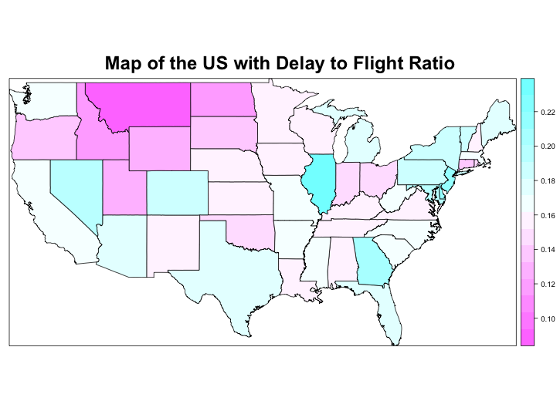
Heatmap illustrating the observed trends in the previous slide

