Slide 1
AI Analytics- Presentation for OTTONOMO’22 Challenge

Slide 2
AI Analytics
- Company is about to design and build a intelligent and innovative systems.
- I am not yet incubated with any company

Slide 3
Problem Statement:
Eye gaze detection solution for driver monitoring systems

Slide 4
How much of the proposed Solution can you achieve?
I can achieve the solution upto creating a eye gaze detection model, That model will monitor the eye gazes for a half min and if the model finds that the person is not looking in center for a while or a half of the minute. Model will display red alert message and make beep sounds for to alert the person.
And if my model finds the eyes closed for a 5 seconds with the help of Arduino board send the signal to seat and seat can vibrate to wake up the driver and make beep sounds continuously until driver wakes up.

Slide 5
Block Diagram of proposed solution
Capturing the live video
Eye gaze detection model
Detects
Drowsiness or sleeping
Not paying attention on road
Driver seat will be vibrated & Make Beep Sound
Alert with audio message & notification on the screen

Slide 6
Description of similar work done in past
Created object detection and image classification model using YOLO pretrained model
Created shape detection model, For to detect the shapes of an object
Created Facial Recognition model with antispoofing
Created Eye gaze Detection model

Slide 7
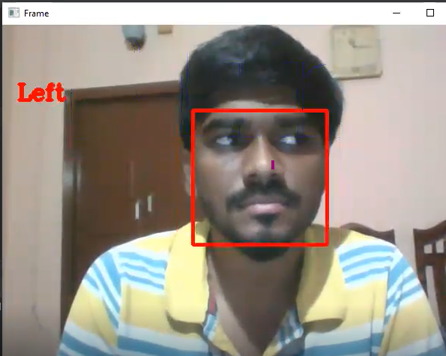
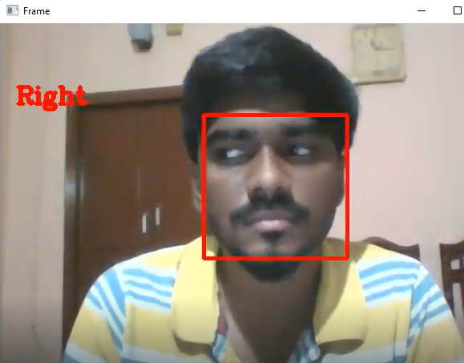
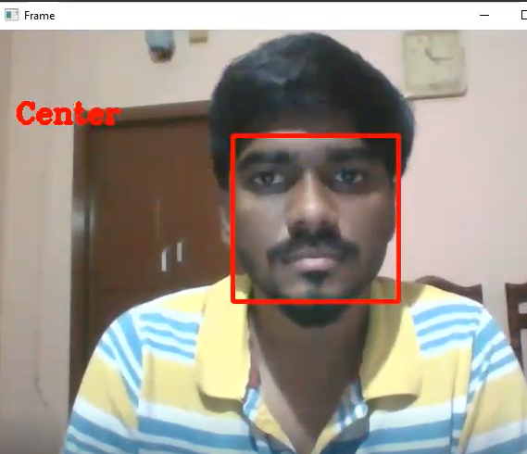
Past work - Eye Gaze Detection
Eye Gaze detection model created for to detect the direction of an eye looks
Model was created using Dlib python library and OpenCV.

Slide 8
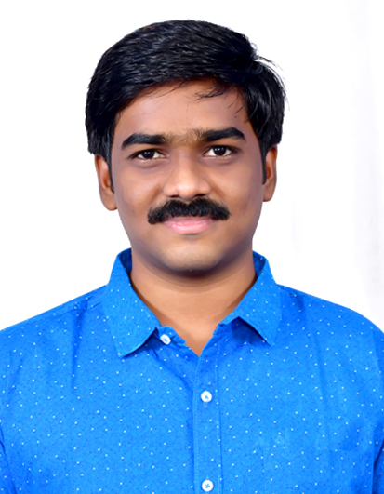
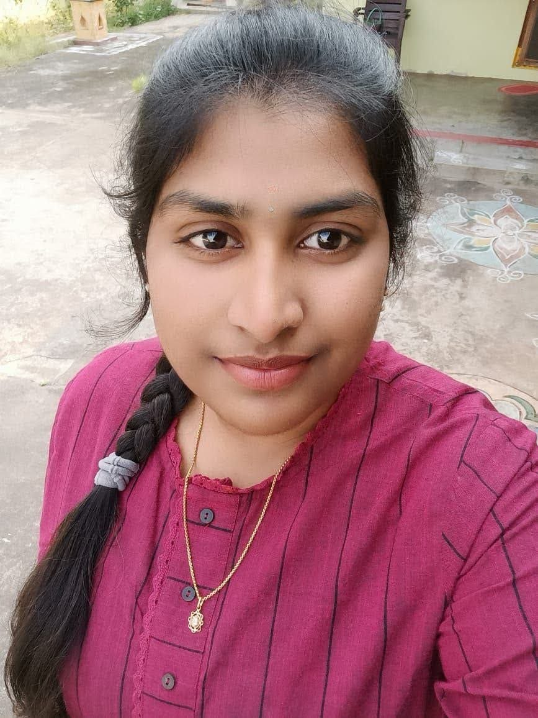
Team Members
Name: M. Durga Sai Anil
Education:
B.Tech at IIITDM Kurnool
From Aug/2018 – April/2022
CGPA:- 7.79
Branch:- Mechanical Engineering
Experience:
AI Analytics Internship at IIITDM Kurnool
From May/2021 – October/2021
Name: E.Harshitha
Education:
B.Tech at IIITDM Kurnool
From Aug/2018 – April/2022
CGPA:- 7.0
Branch:- Mechanical Engineering
Experience:
AI Analytics Internship at IIITDM Kurnool
From May/2021 – October/2021

Slide 9
Contact slide
Gmail: 118me0015@iiitk.ac.in, durgaanil7@gmail.com
Phone: 9121691928, 9440822898
Address: Tanuku - 534211, Andhra Pradesh, India
LinkedIn: www.linkedin.com/in/mutyala-durga-sai-anil
GitHub: https://github.com/mdurgasaianil

