Slide 1
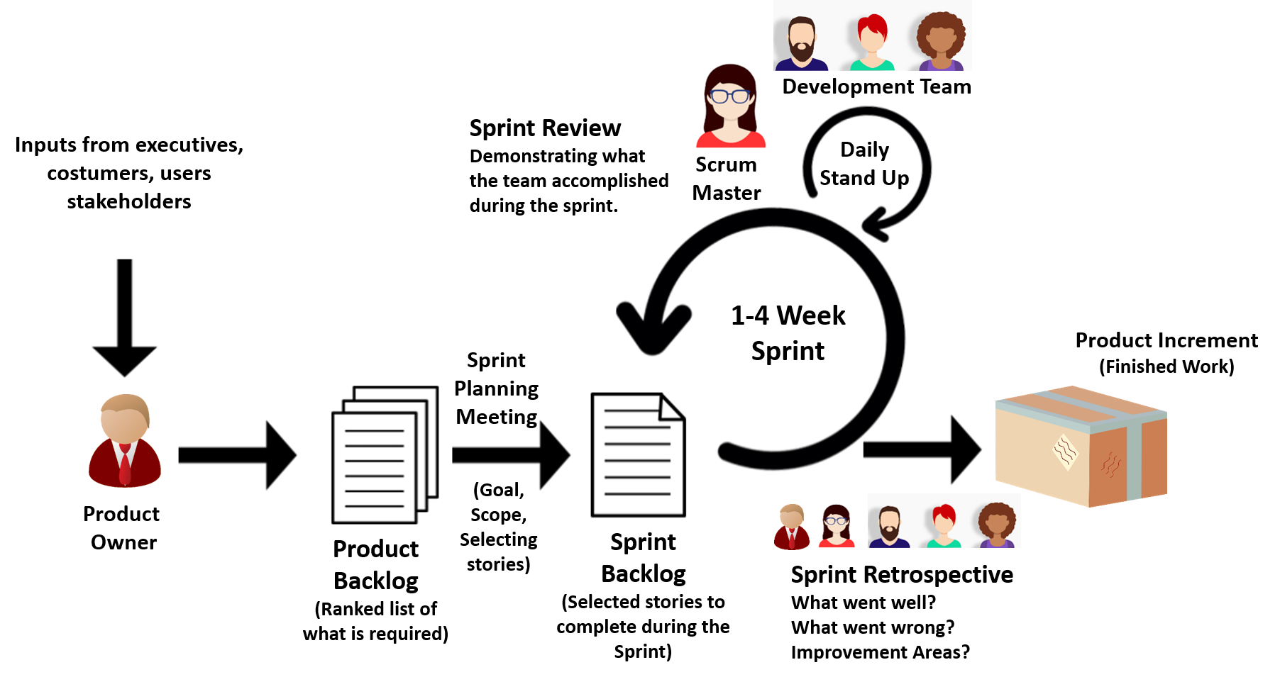
Scrum Master coaches the team, protects the team from organizational distraction, clears any obstacles encountered and helps team members focus on what they do.
Scrum Master ensures that scrum is understood well by the team members and it is working properly.
Scrum Master constantly improves the team's environment. While the product owner has a directing role, Scrum Master has an enabling role in a scrum team.
A Development team usually consists of 3-9 people and performs daily tasks.
The team is project-oriented and dedicated to the success of the project.
Each team member is very talented that is, the team members are skilled in certain subjects.
Each member can do more than one job on the project.
Discipline and integrity are the key terms for a successful team.
1-4 Week Sprint
Sprint is also called Iteration.
Product Owner (PO) is the business representative in the team and speaks for the needs of the project for maximizing the value delivered in each sprint. The product owner represents stakeholders and is the voice of the customer. Therefore, the product owner works together with stakeholders and prioritizes the product requirements.

Slide 2
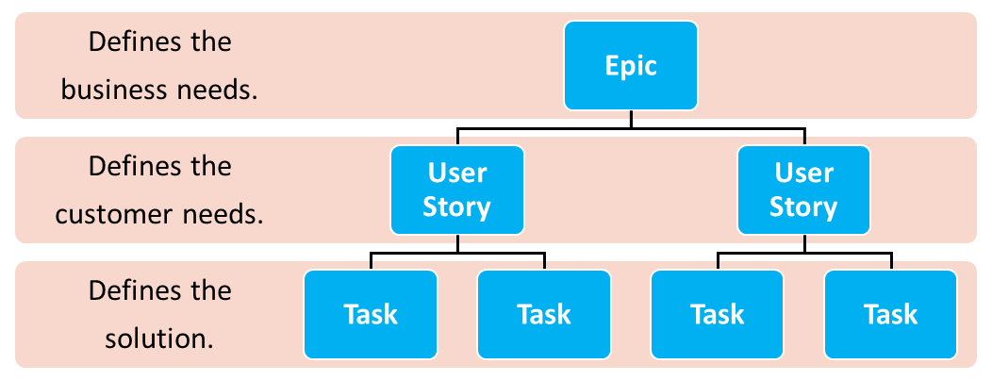
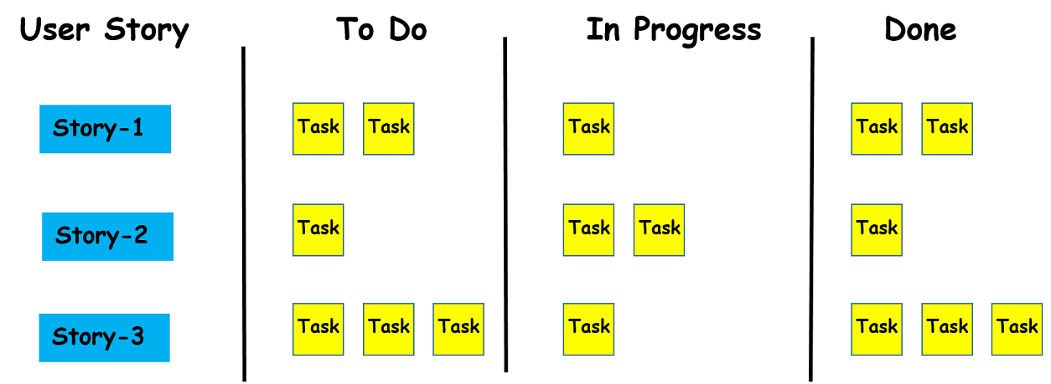
includes the type of user, what they want, and why they want it. Therefore, it answers the ‘who’, ‘what’ and ‘why’ in a simple language.
Template of a User Story:
«As a < type of user >, I want < some goal > so that < some reason>»
In scrum, artifacts serve to capture the common understanding of the team. The Scrum framework defines three major artifacts. These concepts are product backlog, sprint backlog, and product increment.
The sprint backlog can be defined as a subset of the product backlog. The sprint backlog is generated from the product backlog during the sprint planning meeting at the beginning of each sprint.
The user stories selected from the product backlog, which will be completed during the sprint constitute the sprint backlog
The product backlog refers to the list of everything that needs to be done to complete the project.
The refers to the list of everything that needs to be done to complete the project.
The user stories selected from the product backlog, which will be completed during the sprint constitute the .
The is the sum of all the product backlog items finished during the sprint.
The product increment aims to invest in small amounts in the new features of the main product.
working product is the sum of all the product backlog items finished during the sprint.
It should be a working product at the end of each sprint,

Slide 3
List of Ceremonies in Scrum
Sprint Planning Meeting,
Grooming Meeting,
Daily Stand Up Meeting or Daily Scrum,
Sprint Review Meeting,
Sprint Retrospective Meeting.
Other Artifacts in Scrum
A burn-down chart demonstrates the amount of work remained to complete a project. So, the burn-down chart is used to trace the progress of a project.
Sprint Planning Meeting
This activity takes place at the start of each sprint and all the scrum roles take part in this meeting. Normally, it lasts for one or two hours. In sprint planning meetings, the scrum team decides the scope and the goals of the sprint.
A timebox is a period of time in which a team works to achieve a goal.
The timeboxing aims to define and limit the amount of time dedicated to a certain event. Scrum framework uses timeboxing as a tool for all of the scrum activities for concretely defining ambiguous tasks.
Apart from the grooming meeting, the other four meetings are held at specific times. For example, daily stand-up meetings are held every day, and others are held at the beginning or end of each sprint. However, no specific date has been allocated for the grooming meeting. It is usually arranged in the middle of the sprint period.
It is held to review the backlog and to ensure the backlog contains the appropriate items
Estimation of user stories on the basis of man-hours is possible but not preferred. Because in that case, you won't be able to concentrate on the quality product to be delivered to the customer. In addition to that, you will concentrate on the cost and budget of the management while using man-hours. Rather than man-hours, story points are used, as it provides a complete idea about both the complexity of work and required efforts.
15 minutes. The members of the development team give three statements about - What they completed yesterday, - What they will focus on today, - What are the things impeding them?
Velocity is an indication of the average amount of items from the product backlog turned into a product increment during each sprint.
At the end of each sprint, velocity is calculated by summing up the story points for completed user stories.
In this meeting, the development team demonstrates to the whole organization what they accomplished during the sprint and receives feedback.
Like sprint review meetings this meeting is also held at the end of each sprint. The attendees of this meeting are the development team, the scrum master and the product owner. In this meeting, all the participants discuss: - What went well in the previous sprint? - What didn’t work well? - What are the improvement areas to increase team performance?

Slide 4
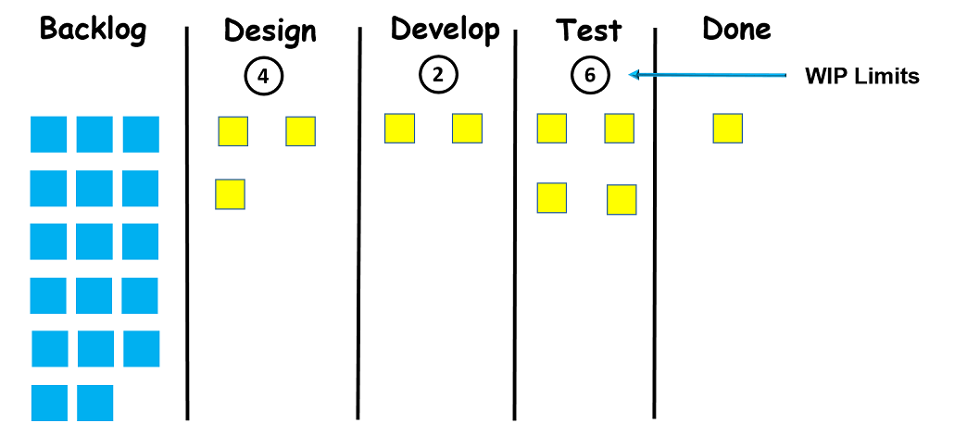
Karban is a work managment sistem.
Karban is a visual framework used to implement agile and shows what to produce, when to produce it, and how much to produce.
Karban focuses on visualizing the workflow process. The primary goal of kanban is to identify potential flaws in the process and to correct them to ensure that works progress at the desired pace.
1940-Toyota
Work-In-progress
(WIP) Limits
A Kanban is like a flash card carrying all the information about the current status of your work and the work required to be done on the product at each stage of the software development process.
There are three main components of a kanban board:
visual signals,
columns
work-in-progress limits (WIP).
FUNDAMENTAL DIFFERENCES BETWEEN THE TWO METHODS.
There are no certain time limits in kanban while sprints in scrum have a start and end dates,
While there are rigid deadlines for the tasks on the scrum board, kanban is more flexible in this regard,
In contrast to designated roles in a scrum project like product owner, scrum master, and development team, there are no certain roles in kanban,
The team rearranges the scrum board after each sprint while the same kanban board is used throughout the project.
*****Scrum is a better choice when you need a more prominent process. However, if you want improvement in running the process without much changes in the whole scenario, you should use Kanban.

Slide 5
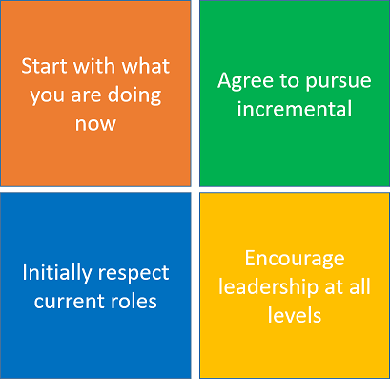
Do not make instant changes to the existing setup or process. Kanban must be directly applied to the existing workflow. Necessary changes should be made slowly and gradually, so, the team feels comfortable.
Agree to pursue incremental, evolutionary change: Make minor incremental changes rather than major changes that might lead to resistance within the team.
Initially, respect current roles, responsibilities, and job-titles: You do not need to
Initially, respect current roles, responsibilities, and job-titles: You do not need to modify your existing roles and functions that perform well. The team will coordinate and implement the necessary changes to the roles and titles. These three principles help managers overcome the expected emotional resistance and fear of change.
Encourage acts of leadership at all levels: Constant improvement at all levels of the organization is encouraged. It is desirable that all team members produce ideas, show leadership and contribute to continuous improvement.

Slide 6
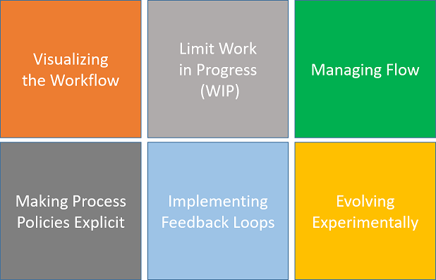
2. Limiting Work in Progress (WIP) is the second practice in the kanban. The maximum number of cards that can be in a column at any given time is called WIP limits. When you assign a limit to each column, your team doesn't work more than they can handle.
expect your team to complete the current work first before taking up a new one.
WIP limit of 1 to 1.5 times the number of people
1. Visualization is the first step to start with kanban. You need to visualize the current workflow on either a physical whiteboard or a digital Kanban board. This board can be simple or detailed depending on the complexity of the work. When you visualize the process, it can be seen what you and your team are currently doing.
3. Managing Flow
Lead time is the period between creating a task in your workflow and its final departure from the kanban board. Therefore, Kanban helps you monitor workflow, identify blockages, and make adjustments to improve the flow for reducing the lead time.
6. There are some drawbacks of the Agile method, some of them are as follows:
1- It is not easy to make an estimation of the effort required to complete a task. It becomes more complex in the case of large projects as it becomes difficult to make a prediction about the total effort required.
2- In case the desired requirements of the client are not understood properly, the final project will not meet the customer requirements. Thus, this will lead to customer dissatisfaction.
3- Only the leader who has considerable experience in the Agile model is capable to take important decisions. The team members with less or no experience are not involved in the decision-making process, thus they don’t have a chance to advance their knowledge.
4. Making process policies, basic principles and working methods explicit is the fourth practice of kanban.
“The team members who are not clear about the existing process can not improve the system.”
5. In Implementing Feedback Loops you need to get feedback from people not involved in your system. Feedback loops are also required within a system to ensure that the desired functionality is provided with the high quality. That's where different kinds of tests come out. Automated continuously running tests are preferred as they shorten feedback loops.

