Slide 1
Lecture 2 VI iMproved & Programming Languages
Dr. Brendan Kochunas
9/9/2019
NERS 590-004

Slide 2
Outline
Results of Lecture 1 Survey
VIM Tutorial https://openvim.com
Programming Languages
Motivation
What defines a programming language?
Fortran
C/C++
Comparisons of Fortran and C/C++

Slide 3
Survey Results

Slide 4
Survey Says…
2019
2018

Slide 5
Survey Says…
2019
2018

Slide 6
Survey Says…
2019
2018

Slide 7
Survey Says…
2019
2018

Slide 8
Survey Says…
2019
2018

Slide 9
Survey Says…
2019
2018

Slide 10
Survey Says...
2019
2018

Slide 11
Survey Says...
2019
2018

Slide 12
Survey Says..
2019
2018

Slide 13
Survey Says…
2019
2018

Slide 14
Survey Says...
2019
2018

Slide 15
Survey Says…
2019
2018

Slide 16
Are You already working with software in your research?

Slide 17
Survey Says...
What other topics?
Machine Learning
GPUs
Pair Programming
Portability
Working on an HPC

Slide 18
What do I want out of this course?
Work more efficiently
Efficient workflow
Write code more efficiently
Write faster code
Spend less time debugging
Improve Programming Skills
Working on large projects

Slide 19
VIM Tutorial
https://openvim.com
Bonus “Edutainment” https://vim-adventures.com

Slide 20
Beyond the Tutorial
Copy/Paste
y (yank) – Copy
d (delete) – Cut
P (paste)
Line Numbers
:set number
:set nonumber
Visual/Column Mode
Ctrl+v
Windows Ctrl+w,
v (vertical split)
s (horizontal split)
arrow keys (or h,j,k,l) to switch
Tabs :tabe [filename]
gt (or :tabn) to go to next tab
gT (or :tabp or :tabN) to go to previous tab
#gt (or :tabn #) to go to #th tab
:tabr to go to first tab
:tabl to go to last tab
:tabm to move the current tab to the last position
:tabm # to move the current tab to the #th position

Slide 21
Programming Languages

Slide 22
What defines a programming language?
Primarily: A formal standard
C/C++: C89, C99, C11 and C++98, C++03, C++11, C++14, C++17
Fortran: ISO/IEC standard 1539
Java
Python
Syntax: e.g. the “grammar”
Semantics: e.g. the “meaning” which is “vocabulary + grammar”
Programming languages should define performance of execution
Typically syntax/semantics are carefully defined, but not so for performance model.
Notes:
Primarily: A formal standard
Fortran - :1991, -1:1997, -1:2004, -1:2010
Syntax: e.g. the “grammar”
Semantics: e.g. the meaning which is “vocabulary + grammar”

Slide 23
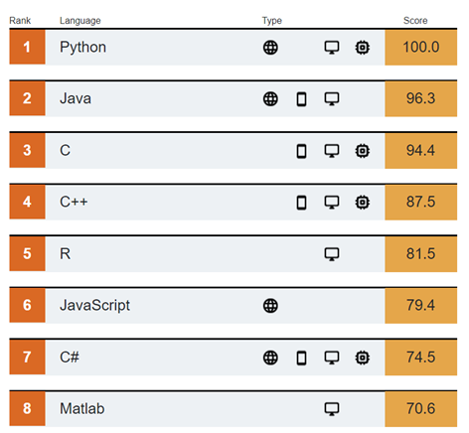
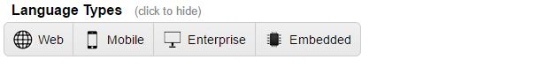
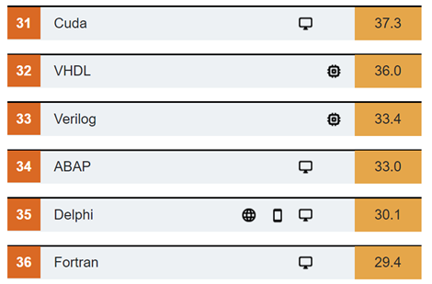
Motivation (1)
IEEE Top programming languages
http://spectrum.ieee.org/static/interactive-the-top-programming-languages-2019
Many other lists & metrics (TIOBE, PYPL ranking, etc.)
2019
Web – Languages used for developing websites and applications
Mobile – Languages used for applicatons on mobile devices
Enterprise – Languages used for enterprise, desktop, & scientific applications
Embedded – Languages used to program device controllers
Notes:
Rankings are created by weighting and combining 12 metrics from 10 sources. We offer preset weightings—the default is our IEEE Spectrum ranking—but there are presets for those interested in what's trending or most looked for by employers.
The IEEE Spectrum Top Programming Languages app synthesizes 12 metrics from 10 sources to arrive at an overall ranking of language popularity. The sources cover contexts that include social chatter, open-source code production, and job postings. Below, you’ll find information about how we choose which languages to track and the data sources we use to do it.

Slide 24
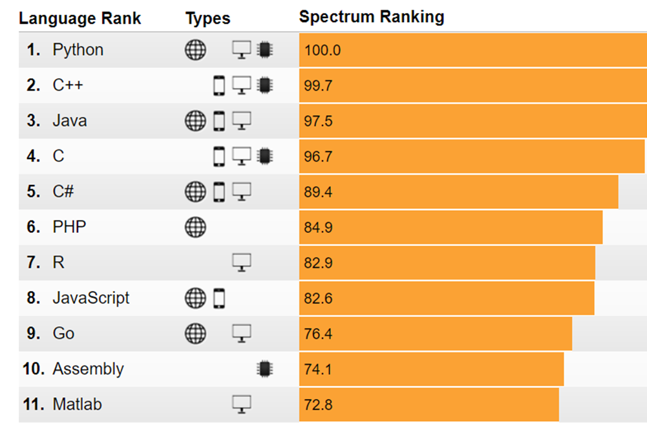
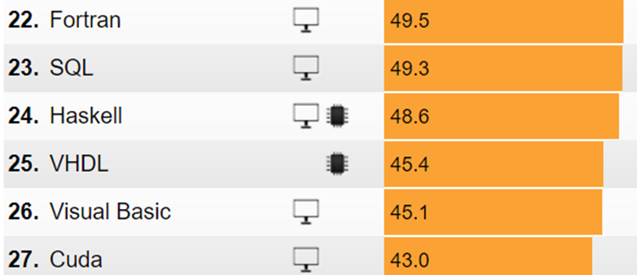
Most Popular Programming Languages 2018

Slide 25
Programming Languages in HPC
Which programming models and languages do you use for code development?
Bull, M. Guo, X. Ioannis Liabotis, I. (Feb. 2011) Applications and user requirements for Tier-0 systems, PRACE Consortium
Stitt, T. and T. Robinson (2008) A Survey on Training and Education Needs for Petascale Computing, PRACE Consortium Partners (http://www.prace-ri.eu/IMG/pdf/D7-4-1_1ip.pdf)
Slide Source: Damian Rouson, Object-Oriented Programming in Fortran 2003, workshop.

Slide 26
Programming language needs continue to evolve
“Simulation in the climate community is dominated by the nexus of the Fortran/C/C++ languages and the OpenMP/OpenACC programming models. While both Fortran and C/C++ are interoperable on almost all computing platforms available today, there is a strong desire for other productivity oriented scripting languages in a distributed environment (e.g., Python/pyMPI), as well as the desire to move away from the flat MPI model, which may be functional on the next generation of systems but will lose a factor of 10 to 50 times on GPU-accelerated systems.”
“The legacy inertia behind Fortran, coupled with perceptions that Fortran compilers deliver superior performance, ensures its continued use. Conversely, the broad computing community’s use of C++ coupled with its access to novel and emerging architectures and new language constructs has resulted in a gradual shift to C++ as the basis for simulation”
Gerber, R., et. al, ”Crosscut report: Exascale Requirements Reviews,”
U.S. DOE Office of Science, Tysons Corner, Virginia, March 9–10, (2017). doi:10.2172/1417653

Slide 27
Types of Programming Languages
Markup
Language
Scripting Language
Program Run-time system
High-Level Language
Low Level language (Assembly)
Defined by hardware (less portable)
High Level language (C/C++, Fortran, Java)
Defined by run-time system (e.g. Operating System)
Portable, depends on compilers
Scripting language (MATLAB, Python, Bash)
Defined by portable run-time system of a program
Markup language (e.g. XML, YAML, Markdown)
Used for annotation
Input to multiple types of programs/systems
Compilers
Libraries
Executables
Run-time system (OS)
Low-level Language
Hardware

Slide 28
Things a programming language should do
Variable declaration
Scalars, arrays, pointers
Intrinsic types, programmer defined types
Operators
Arithmetic: +, -, *, /
Relational: <, >, ==
Logical: and, or, not, xor
Others: e.g. exponentiation
Execution control constructs
Branching constructs
e.g. if/else, switch (or case)
Looping constructs
For or Do
While
Goto
Memory management
Automatic
Or provide programmer with intrinsics

Slide 29
Pointers
integer a[4], b[4], c[4], d[4]
pointer p, q[]
p => a(1)
p => b(2)
p => c(3)
p => d(4)
q => d(:)
Difficult to grasp if new to programming.
In high-level programming languages variable names are associated with memory.
value of variable is associated with memory location
Variables that are defined as pointers can “point” to different memory locations and often don’t have their own associated memory.
If a block of memory loses all references, this is a memory leak.
These are bad. More on these in another lecture.
a
b
c
d
p
q
1
1
1
1
2
2
2
2
3
3
3
3
4
4
4
4
NULL
1
2
3
4
5
6
7
8
9
10
11
12
13
14
15
16
17
18
p
q
Notes:
Like a library card if you ever had interaction with those...

Slide 30
Fortran

Slide 31
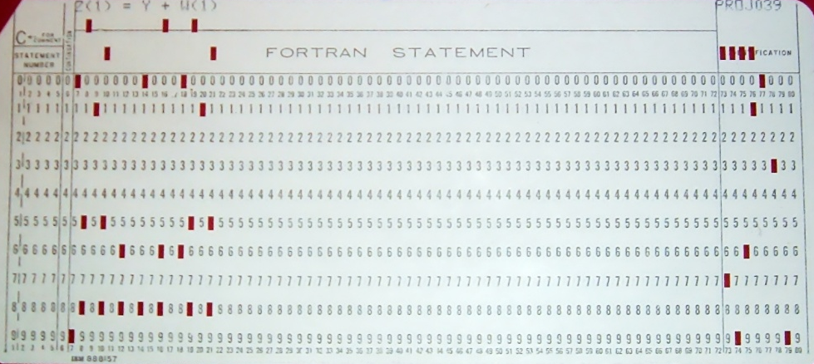
A Brief History of Fortran (1)
Originally developed in early 1950’s to facilitate programming of equations on computers at the time
FORTRAN comes from “FORmula TRANslation”
Language was founded and designed for scientific computing.
Early days: FORTRAN II (1958), FORTRAN IV (1961)
Used Punch Cards
arrange in a stack
Carry them to computer and “turn the crank”

Slide 32
A Brief History of Fortran (2)
FORTRAN 66 (1966) – First “standardized” Fortran
FORTRAN 77 (1977) – What most people think of when they here “Fortran”
Fortran 90/95 – Introduced modules, derived types, and dynamic memory allocation.
Basically caught up to features in C.
Fortran 2003/2008 – Introduced extensive object-oriented capabilities
Basically caught up to C++ (although not quite).
Still not fully supported by compilers
Fortran 2003 and later are considered “Modern Fortran”.

Slide 33
Fortran 77
c1 2 3 4
c2345678901234567890123456789012 ...
program name
implicit none
double precision a,b,c(100)
a=1.0d0
b=1.0d0
write(*,500)
+ a+b
goto 555
500 format (F10.4)
555 continue
end
Fixed Format and case insensitive
Different columns have different rules
1: Blank or comment symbol (“c” or “*”)
1-5: Statement Label
6: Continuation of previous line
7-72: Programming statements
73-80: Sequence number
Not used to today, was used by punch card sorters in case your dropped your box of cards
NO DYNAMIC MEMORY ALLOCATION
Compiler support is very good
also very good at producing very fast code
Missing modern programming language features
Detrimental to reuse
Certain things cannot be done (e.g. dynamic memory allocation)

Slide 34
Fortran 90/95
module linear_system
type :: linsys_t
real,pointer :: a(:,:),b(:),x(:)
end type
integer :: n
end module
F90 Standard: ISO/IEC standard 1539:1991
F95 Standard: ISO/IEC 1539-1:1997
Free Form
Forget all the rules about columns
Dynamic memory allocation
Intrinsic support for array operations
(e.g. a(:)=b(:))
Pointers: references to memory
Modules: reusable components of program
Derived data types: custom data types
Removed some problematic features of F77
program main
use linear_system
implicit none
real,pointer :: sol(:)
type(linsys_t) :: ls1,ls2
read(*,*) n
allocate(ls1%a(n,n))
allocate(ls1%b(n))
allocate(sol(n))
ls1%x => sol
! ...

Slide 35
Fortran 2003 & 2008
Fortran 2003: ISO/IEC 1539-1:2004
Fortran 2008: ISO/IEC 1539-1:2010
Significant addition to F90/95
F90/95 programs are F2003 compliant
Defined Object Oriented Features
Polymorphism and inheritance
Type-bound procedures (methods)
Other
Procedure pointers
Standardized C-interoperability
IEEE floating point arithmetic
Enhanced intrinsics for command line processing
Primarily added language features for enhanced parallelism
Added submodules
Entity facilitating program structure
Coarray Fortran
Simple extension for distributed parallel programming
Typically relies on underlying MPI implementation
DO CONCURRENT
Loop iterations have no interdependencies

Slide 36
Data Types
Values of data type “kinds” are not defined by standard and not available on all systems.
Therefore, these can be compiler dependent.
Careful you don’t rely on extensions.
Typically represented in “bytes” as integer
e.g. 32-bit = 4 bytes
Problem: How to guarantee portability?
Intrinsic procedures
SELECTED_REAL_KIND (F95 and later)
SELECTED_INT_KIND (F95 and later)
SELECTED_CHAR_KIND (F2003 and later)
ISO_FORTRAN_ENV intrinsic module
Module is part of Fortran 2003 standard
Kind parameters defined in 2008 standard
Inherent support for multi-dimensional arrays (up to 7-dimensions) REAL :: a(:,:,:)
Intrinsic Data Types
Keyword | kinds
CHARACTER | ASCII, ISO_10646
LOGICAL | 8-bit, 16-bit, 32-bit, 64-bit
INTEGER | 8-bit, 16-bit, 32-bit, 64-bit
REAL | 32-bit, 64-bit, 128-bit
COMPLEX | 32-bit, 64-bit, 128-bit

Slide 37
Declaration & Attributes
Lots of redundancy in syntax
So, pick the way that you like
One suggestion: pick the approach that involves the least typing.
real(kind=4),dimension(20) :: a
real(4) :: a(20) !same as above
real(8),allocatable :: b(:,:)
real(8),pointer :: c(:,:) => NULL()

Slide 38
Operators & Special Characters
Relational Operators
Fortran 77 | Fortran 90 and later | Meaning
.EQ. | == | Equal to
.NE. | /= | Not equal to
.GT. | > | Greater than
.GE. | >= | Greater than or equal to
.LT. | < | Less than
.LE. | <= | Less than or equal to
Assignment Operators
= | assignment
=> | pointer assignment
Other
Symbol(s) | Meaning
// | Concatenate strings
& | Line continuation, placed at end of line (F90 and later)
! | Comment
; | End of statement
% | Accesses component of derived type
(i) | Array index
(/1.0/) | Array literal
[i] | Coarray index
Arithmetic Operators
+ | addition
- | subtraction
* | multiplication
/ | division
** | exponentiation
Logical Operators
.AND. | and
.OR. | or
.NOT. | not
.EQV. | equivalent
.NEQV. | not equivalent

Slide 39
Program Entity Structures
Submodules
Program
module m
!declarations
interface
!submodule routines
end interface
contains
!internal procedures
end module
submodule (m) sm
!declarations
contains
!internal procedures
end submodule
Subroutine
program name
!declarations
!statements
contains
!internal procedures
end program
subroutine name(args)
!declarations
!statements
end subroutine
Module
Function
module name
!declarations
contains
!internal procedures
end module
function name(args) result(r)
!declarations
!statements
end function

Slide 40
Execution Control Constructs
DO i=1,10
END DO
DO i=10,1,-1
END DO
i=1
DO WHILE(i < 10)
i=i+1
END DO
DO WHILE(.TRUE.)
IF(i < 10) CYCLE !Skip rest of loop
BREAK !Exit loop
END DO
!Fortran 95 and later
FORALL(i=1:3, j=1:3, i < j)
a(i,j)= !stuff
END FORALL
!Fortran 2008 and later
DO CONCURRENT i=1,10 a(i)=b(i)*c(i)
END DO
Branching
Loops
!Fortran 2008 and later
SELECT TYPE(someType)
CLASS IS(baseType)
TYPE IS(extendendType)
CLASS DEFAULT
END SELECT
IF(<cond_expr>) <statement>
IF(<cond_expr1>) THEN
ELSE IF(<cond_expr1>) THEN
ELSE END IF
SELECT CASE(variable)
CASE(val1,val2)
CASE(val3)
CASE DEFAULT
END SELECT
!Fortran 95 and later
WHERE(A > 0)
B=A
ELSEWHERE(A < 0)
B=0
ELSEWHERE !A == 0
B=1
ENDWHERE

Slide 41
Fortran I/O
Fortran I/O Statement | Purpose
OPEN | Opens a file
CLOSE | Closes a file
INQUIRE | Make inquires about a file
READ | Read from a unit
WRITE | Write to a unit
FLUSH | For buffered I/O this clears the buffer
BACKSPACE | Move the position in a sequential file back one record
REWIND | Move the position in a sequential file back to the first record
I/O based on ideas of “UNITS”
Unit is an integer tied to a file or some other device (e.g. the screen)
Types of intrinsic files
READ/WRITE
 | Formatted | Unformatted
Sequential | Text file | Binary
Direct | N/A | Binary (fixed record size)
WRITE(*,*) “HELLO WORLD” !Standard Out
WRITE(ERROR_UNIT,*) “HELLO WORLD” !Standard Error
!(ERROR_UNIT from ISO_FORTRAN_ENV, typically 0)
!Formatted write to variable string
WRITE(string,’(f10.4)’) 1.0
!Write to file that was previously opened on unit 35
WRITE(35,*) “Hey unit 35!”
I/O Statements have very long “specifier lists”
For OPEN statement
UNIT, FILE, STATUS, IOSTAT, ACCESS, FORM, ACTION, RECL, POSITION, DELIM, PAD

Slide 42
Fortran 2003 & 2008 Examples
Inheritance (2003)
Coarray (2008)
type :: geom_t
integer :: dim
end type
type,extends(geom_t) :: point_t
real,allocatable :: coord(:)
end type
! Local access with ()
! Remote access with []
integer :: ca(4)[*]
ca(:)[this_image()]=this_image()
do image = 1,num_images()
write(*,*) ca(:)[image]
end do
type(geom_t) :: g
type(point_t) :: p
!...
write(*,*) g%dim
write(*,*) p%dim
write(*,*) p%coord
CA
1
1
1
1
2
2
2
2
3
3
3
3
4
4
4
4
image 1
image 2
image 3
image 4

Slide 43
Fortran Compilers
List of Compiler Vendors
Compilers on Flux
Free and Open Source
gfortran GNU
g95
EKOPath
llvm (Dragonegg)
OpenUH, Open64, Open Watcom
Commercial
Absoft
Cray
IBM XL
ifort Intel
Lahey
Numerical Algorithms Group (NAG)
pgf90 Portland Group (PGI)
Pathscale
Oracle
GNU
Intel
PGI
NAG (special license required)
Lahey (requires NAG)

Slide 44
Further Reading
Online
Books
General information (with good examples)
http://fortranwiki.org
Intel Compiler Documentation (Language Reference)
GNU Compiler Documentation
IBM Compiler Documentation (Language Reference)
“Fortran 90/95 for Scientists and Engineers,” S. J. Chapman
“Fortran 2003 Handbook,” J. Adams, W. Brainerd, R. Henderson, R. Maine, J. Martin, B. Smith
Available electronically through www.lib.umich.edu (when on campus)
“Scientific Software Design: The Object-Oriented Way", Damian Rouson, Jim Xia, and Xiaofeng Xu
“Modern Fortran Explained”, Michael Metcalf, John Reid, Malcolm Cohen

Slide 45
C and C++

Slide 46
History of C/C++
C - started in 1969 by Dennis Ritchie at Bell Labs
Concurrent with and related to the development of Unix operating system (also at Bell Labs)
Most widely used programming language – available across virtually all platforms and architectures
Informal specification “K&R” (Kernighan and Ritchie, the developers) published in 1978
ANSI standard since 1989
General purpose
Relatively fast
Current standard is C11
C++ - also developed at Bell Labs, starting in 1979
Standardized in 1998 (International Organization for Standardization)
Added features/extensions that make development and management of large software projects much simpler (mainly classes)
Newer versions have more advanced functionality (templates, namespaces, abstract classes, and more)
Widely used for scientific computing purposes because of powerful Object-Oriented programming capabilities

Slide 47
C and C++ standards
C Standards
C++ Standards
C89
original ANSI standard (also C90)
still supported by compilers
C99
new features include
function inlining,
complex type,
one-line comments with “//”,
variable-length arrays, and more
C11 (current)
atomic operations,
multi-threading,
bounds-checked functions,
static assertions
C++98
First standard, introduces object-oriented features to C
Abstraction, Encapsulation, Inheritance, Polymorphism
Multiple inheritance
C++03
Mostly fixed issues with previous standard to improve compiler consistency
C++11
Multi-threading, initializer lists for all classes, type inference (auto)
C++14
Variable templates, deprecated (for multi-threading), bug fixes, other
C++17 (planned for completion next year)

Slide 48
Data Types
Intrinsic Data Types
Keyword | Details
unsigned char | 8-bit integer 0 to 255
signed char | 8-bit integer -127 to 128
unsigned int | short (16-bit), long (32-bit or 64-bit), and long long (64-bit)
signed int
float | 32-bit
double | 64-bit
complex (C99) | complex float and complex double
bool | True or False
enum | enumeration for a set
Intrinsic – basic data types that are defined and recognized by standard C
Also available as multi-dimensional arrays
Derived – library or user-defined data type that is made up of some combination of data with intrinsic types
Standard library: vector (of any data type), string
User-defined: a struct or class that contains several variables of any combination of intrinsic and/or derived types
Definable (Derived) Data Types
Keyword | Details
union | Define several variables to share same memory space
struct | Defined in terms of intrinsic data types (or other structs)

Slide 49
C/C++ Variable Declaration
In C/C++, legal variable declarations can be made at any point within a code
Unlike Fortran, where all type declarations are made at the top of a routine or program
For C90, must be immediately after {
All variables must be declared as a certain type (and should be initialized) before being used in some expression
Variables remain defined throughout the scope in which they were declared. When a variable “falls out” of scope, its data is no longer accessible
Scope is defined in C++ by opening and closing curly braces {}
float variable;
int variable = value;

Slide 50
C Operators & Special Characters
Relational Operators
== | Equal to
!= | Not equal to
> | Greater than
>= | Greater than or equal to
< | Less than
<= | Less than or equal to
Logical Operators
&& | and
|| | or
! | not
Other
Symbol(s) | Meaning
// or /* */ | Comment and comment block
; | End of statement
{ } | Scope declaration
? : | Ternary operator (like a compacted if/else)
[ ] | Array declaration
* | Dereference variable (Unary)
& | Return memory address of variable (Unary)
-> or . | Member selection (-> is for pointers, . is for non-pointers)
Arithmetic Operators
+ | addition
- | subtraction
* | multiplication
/ | division
% | modulus
= | assignment
Augmented Assignment
++ | a=a+1
-- | a=a-1
+= | a=a+b
-= | a=a-b
*= | a=a*b
/= | a=a/b
Bitwise Operators
& | Bitwise AND
| | Bitwise OR
^ | Exclusive OR
~ | Toggle (flip) bits
>> | Left Shift
<< | Right Shift
Augmented assignment operators also available for bitwise operations

Slide 51
Program Entity Structure
/* Preprocessor commands
and include statements */
#include <stdio.h>
//Global variables and interface definitions
int n;
void sub1(int* n);
/* Functions/Subroutines
“main” is a special procedure
in C/C++ corresponding to the
“main program” */
int main()
{
sub1(&n);
return n;
}
/* ”void” means return nothing, like a Fortran
subroutine */
void sub1(int *n)
{
*n=0;
}
Preprocessor statements (Header file declarations)
Global Declarations
In C++ Class declarations go here
(will cover examples in more detail with OO programming)
Main program (only define once in program)
Functions
Other functions (optional)
C example

Slide 52
Header Files
C++ example header
namespace ners590
{
class timer {
public:
tic();
toc();
private:
double startTime_;
double totalTime_;
}
Header files are used to define variables and interfaces
Generally each source file has a corresponding header file, especially in C++
The header data is appended to the top of the source code files by the compiler when an #include “header.h” statement is present.
Header files allow compilers to “resolve dependencies” in your program.
In C++ header files:
Variables are declared not only as a specific type but also public or private
Public: any function has access to read, use, and change this data
Private: only the object that owns the data can manipulate it
Methods of a class are defined by name, type of returned data, and types of all of the input data
GOOD practice: “namespace” entitites in your header files.
Usage
#include “ners590_timer.hpp”
//Declare variable “t” as a ners590 //timer, other headers might define //classes named timer
ners590::timer t;

Slide 53
Execution Control Constructs
IF/ELSE
Followed by curly braces { }, executes code within braces depending on result of conditional checks
if (condition) { }
Switch
A logical branch, achieves the same logical result as IF/ELSE with much simpler syntax in some cases, and a different sequence of logical checks
switch(variable):
case(value1)
case(value2)
for(initialization, condition, step) {}
Repeat code and execute step (usually increment/decrement) after each loop until the condition is no longer met

Slide 54
C and C++ I/O
C
C++
Routines are defined in “standard library”, accessible through header files.
Primary library: <stdio.h>
Some useful routines:
printf, fprintf
fopen, fclose, fget, fscanf
C++ I/O libraries: <fstream>, <iostream>
cout << “Hello, world!” << endl;
Hello, world!
cout outputs to screen, is in standard namespace (e.g. equivalent to std::cout, “std::” is implied)
cin << waits for input from the keyboard

Slide 55
Standard Library
Angled brackets imply header is supplied by system or compiler
Different for C and C++
A HUGE advantage over Fortran
Contains many useful types and functions
Example: Vector
a dynamic data container class with many methods for accessing more effectively than a standard array
.push_back(), .pop_back(), .at(), .size()
Dynamic memory management (malloc, dmalloc, free)
Random number generator (rand, srand, RAND_MAX)
abs() – absolute value
Many other useful C libraries
cstring, cmath, cstdio
#include <vector>
#include “ners590_timer.hpp”
Quotes imply header file is source file
defined by programmer

Slide 56
Further Reading
C
C++
The Language
Standard Library
The Language
Standard Library

Slide 57
Reference Counted Pointers (RCP)
Also known as a smart pointer.
Automates “garbage cleanup” e.g. frees unused memory
Keeps track of (e.g. counts) how many pointers are referencing a particular block of memory
When no more pointers are referencing the block of memory, it can be automatically freed.
Useful machinery for helping to prevent memory leaks in C++
Part of C++11 Standard: std::shared_ptr
Other implementations available from third party libraries: boost, Trilinos

Slide 58
Templating (C++)
template <class A_t> class calc
{
public:
A_t multiply(A_t x, A_t y);
A_t add(A_t x, A_t y);
};
template <class A_t> A_Type calc<A_t>::multiply(A_t x,A_t y) {
return x*y;
}
template <class A_t> A_t calc<A_t>::add(A_t x, A_t y)
{
return x+y;
}
Very powerful feature in C++
Idea is like meta-programming.
Write a program for a “template” type.
Compiler generates machine code for all data types matching the template.
class calc
{
public:
int multiply(int x, int y);
int add(int x, int y);
};
int calc::multiply(int x, int y) { return x*y; } int calc::add(int x, int y) { return x+y; }
Creating a Template means you have written this routine
once for integers, floats, doubles, bools, and any classes
of the templated type!
Example from: http://www.cprogramming.com/tutorial/templates.html

Slide 59
Working with Fortran and C/C++ together

Slide 60
Interoperable Intrinsic Datatypes (Fortran 2003 and later)
Description | Fortran type declaration | C type declaration
Character | CHARACTER(LEN=1,KIND=C_CHAR) | char
True/False | LOGICAL(C_BOOL) | _Bool
default integer | INTEGER(C_INT) | int
floating point (32-bit) | REAL(C_FLOAT) | float
double precision (64-bit) | REAL(C_DOUBLE) | double
Integer 8-bit | INTEGER(C_INT8_T) | int8_t
Integer 16-bit | INTEGER(C_INT16_T) | int16_t
Integer 32-bit | INTEGER(C_INT32_T) | int32_t
Integer 64-bit | INTEGER(C_INT64_T) | int64_t
Long integer | INTEGER(C_LONG) | long int
Long long integer | INTEGER(C_LONG) | long long int
See documentation for ISO_FORTRAN_ENV module for complete listing.

Slide 61
Modules and Headers
program main
use module1
use module2
include ‘file1.h’
!Rest of program
end program
Fortran modules are like compiler generated header files
Makes Fortran a little bit more tricky to compile because modules must be compiled in the correct order to resolve dependencies.
Makes C/C++ a little more cumbersome because you are always having to create header files.
Header files are portable.
Compiled module files are not.
Fortran can also include “header files”, but the INCLUDE keyword in Fortran implies a direct insertion (e.g. copy-paste) of the contents of an INCLUDEd file.
Contents must be valid Fortran code
Typically used for defining types or global variables, sort of deprecated as a bad programming practice.
Modules “module1” and “module2” must
have been compiled prior to compiling
the program.

Slide 62
Other Things to keep in mind
Item | Fortran | C | C++
Case Sensitive variable names | No | Yes | Yes
Statements end with “;” | Optional | Required | Required
Assumed Starting Index | 1 | 0 | 0
Multi-dimensional array ordering in memory | In-out | Out-in | Out-in
Strings | Fixed length | End with null character
Memory layout of multi-dimensional arrays
i
i
Fortran
j
a(i,j) | 1 | 2
1 | 1 | 2
2 | 3 | 4
C/C++
j
a[i][j] | 0 | 1
0 | 1 | 3
1 | 2 | 4

Slide 63
Other things you’ll encounter
Programming Language Extensions
Directives and Preprocessor
Includes things like
Syntax or Semantics not defined in the standard
An example is Co-array Fortran
Until Fortran 2008 standard
Additional functions
Interfaces to OS
BEWARE
Extensions are usually not portable between compilers
Primarily applicable to high level languages with compilers
Preprocessor
Happens before compilation
Can control what source code is compiled
Mechanism for portability
Directives
can appear as comments or preprocessor commands
Allows for safe compilation when feature is not available.

