Slide 1
Lecture 4 Elements of Development
Prof. Brendan Kochunas
9/16/2019
NERS 590-004

Slide 2
Outline
(?) Linear Regression Analysis
(?) Python
(?) LaTeX
Elements of Development
Configuring
Compiling
Linking
Program Design, Infrastructure, Testing, Debugging will be covered in other lectures ☺

Slide 3
LaTeX

Slide 4
A little bit about LaTeX
LaTeX (Lamport TeX) is document preparation software with automated typesetting
Widely used for the publication of scientific documents
It allows the writer to follow a template with minimal effort
Very straightforward expression of mathematical expressions and equations
Easy management of citations and cross-references
Portable across many platforms
Many packages available for specific symbols or layouts
Algorithms
Graphics
Hyper-references
Extensions for basic packages like math, tables, etc.
User can define useful shortcuts for commands that are used frequently
Basically a programming language all its own.

Slide 5
Downsides of LaTeX
Installation of LaTeX compilers and packages required
Working on different machines may make it difficult to keep packages/documents consistent
Not a WYSIWYG (what you see is what you get) language
Need to “compile” a “code” just to generate a document
It can sometimes be REALLY annoying to do something that you think is trivial
Usually not an issue unless you want some sort of very special/unique formatting
A lot of commands/packages are black boxes that can be difficult to understand/modify
e.g., trying get figures to sit exactly where you want them may require many trials and an absurd amount of Googling

Slide 6
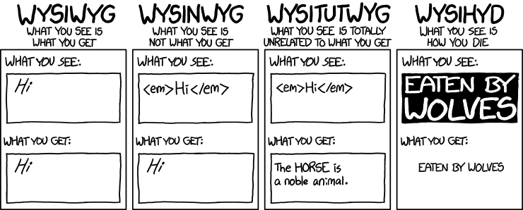
Types of Editors: https://xkcd.com/1341/

Slide 7
Compiling and Editing in LaTeX
A LaTeX PDF can be generated from a .tex file via the command line:
pdflatex <filename>.tex
running the command twice may be necessary to resolve/updated references
Editors for LaTeX allow users to avoid compiling via the command line
Options exist for every platform
e.g.: Texmaker, TeXstudio, Sublime Text (via a plugin), TeXShop, TeXworks
LyX is a WYSIWYG LaTeX editor that allows users to avoid writing actual LaTeX code
We highly recommend https://v2.overleaf.com/ (formerly www.sharelatex.com)
Online-based editor (kind of like Google Docs for LaTeX)
Free to use unless you want to collaborate with others
No need to download any packages or figure out how to install/compile LaTeX
Cross-platform in the sense that your work is saved on the cloud and your output will be independent of the computer you use

Slide 8
Creating Your First LaTeX Document
Very easy to generate a document, even if you’ve never used LaTeX before
Most commands are intuitively named and can be found via a simple Google search
Examples: \gamma produces the Greek letter gamma, \int produces an integral sign
\documentclass{article}
\usepackage[utf8]{inputenc}
begin{document}
your content here…
\end{document}
Example LaTeX document: https://www.sharelatex.com/project/57d858d53414e8de018b3643

Slide 9
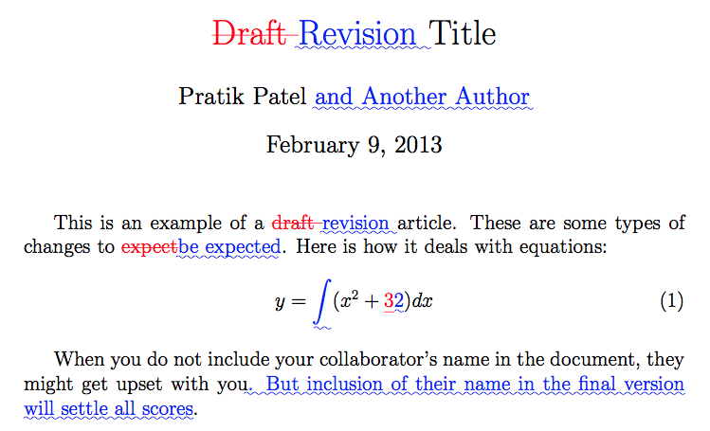
latexdiff
latexdiff is a great tool for comparing the contents of two similar latex files
Similar to “track changes” on Microsoft Word
latexdiff file1.tex file2.tex produces a .tex file which, when compiled, yields a PDF with markups showing all the changes from file1.tex to file2.tex
See https://www.sharelatex.com/blog/2013/02/16/using-latexdiff-for-marking-changes-to-tex-documents.html for more information

Slide 10
Introduction to Python
Based on 2016 Introduction to Python Workshop https://goo.gl/uYrc0e

Slide 11
Outline for Intro to python
What is Python and where does it fit?
Syntax and arithmetic
If, elif, and else
Sequences and for loops
Data processing (numpy)
Plotting
Workflow options
Further reading

Slide 12
Common Programming Languages
Compiled
Interpreted
Fortran
C
C++
Java
bash
C shell
Perl
make
Python
Matlab
R
SPSS
Scripting
Scientific Calculation

Slide 13
Interpreted Languages for Scientific Calculations
MATLAB
Python
Based somewhat on Fortran
syntax is very much like C.
Costs
Free for students
$2150 for regular people
+$1000 for each add on package
Simulink
statistical toolbox
parallel computing, etc.
Based on C/C++
$0!
Comes with most linux distributions and Mac.
Some distributions offer add ons and support for $$$
Python v3 not compatible with Python v2 :(
__future__ package to help transition

Slide 14
Executing python
Interactively
Start a python “shell”: $ python
Run a script
$ python myscript.py
Run a script interactively
$ python –i myscript.py

Slide 15
Basic Syntax and Operators
Arithmetic Operators
Boolean Operators
print(‘Hello world’)
x = 10.
print(x + 5.)
print(x - 4.)
print(x * 2.)
print(x / 3.)
print(x ** 2.)
# (x^2 in MATLAB)
x = 10.
# comparison
print(x == 15.)
print(x <= 12.)
print(x != 5.)
# boolean logic
print(not True)
print(True and False)
print(True or False)

Slide 16
Intrinsic types
Python uses “dynamic typing”
No need to explicitly declare int, float, bool, etc.
Types are implied
Declare variables anywhere!
x = 10. #implied float
i = 1 #implied int
l = True #implied bool
c = “Hello World” #implied string
#Python 2
2/3 == 0
2./3. == 0.66667
#Python 3
2/3 == 2./3. == 0.66667
2//3 == 0

Slide 17
Execution Control Constructs
If-Else
Looping
# indentation required:
if condition1:
statements
elif condition2:
other statements
elif condition3:
other statements
else:
alt statements
# i = 0, 1, ..., n-1
for i in range(n):
print(i)
# iterate through a
# sequence
x_list = [1, 2, 4, 8]
for x in x_list:
print(x)

Slide 18
Python Lists
Effectively the implementation of arrays
Can be mixed “types”
But these arrays are fancy
Can function like the classical data structure definitions of stacks, queues, or decks
Operations on lists are very easy compared to other languages.
Not very fast...
For speed you want numpy.
VY0 = [2., 3., 4.]
print(VY0)
print(VY0[0],VY0[-1])
print(len(VY0))
VY0.append(5.)
VY0[2] = "cat"
print(VY0)
VY0.pop(0)
print(VY0)

Slide 19
Python For Scientific Calculations
Python is designed for general computing, but it has modules to facilitate scientific computing.
The numpy and scipy modules are designed for
large N-dimensional numeric arrays
efficient loop operations using compiled code (BLAS and LAPACK)
transcendental functions, optimization, signal processing, ...
Trilinos also offers python interfaces in pyTrilinos
In fact, it is fairly easy to generate python interfaces to compiled code using SWIG.
Basically anything that can provide a C interface can be called from another programming language.

Slide 20
A little more about packages...
Similar to how C has the C standard library, python has packages
Except they are not “standard”
You have to install them in addition to python
Some distributions for python include a bunch of packages
e.g. anaconda, canopy, etc.
Common packages for scientific computing
matplotlib – plotting tools
numpy - operations on bulk data
Compiled C libraries (fast)
scipy – statistics, analysis, curve fitting
h5py – HDF5 interface for python
mpi4py – MPI interface for python
Importing packages
# import specific items
from math import sin, pi
print(sin(pi))
# import and rename items
from random import choice as c
print(c([1, 5, 7]))
# import (& rename) package
import numpy as np
print(np.pi)
# import a subpackage
import matplotlib.pyplot as plt

Slide 21
A race! (or why you want numpy...)
This demonstrates problems of overhead with interpreted languages.
e.g. having another run time system on top of the operating system.
Native Python
Numpy
N = int(1e7)
x1 = N * [1.]
x2 = N * [0.]
for i in range(N):
x2[i] = x1[i] **2
print('done with x2')
import numpy as np
x3 = np.ones(N)
x4 = x3 ** 2
print('done with x4')

Slide 22
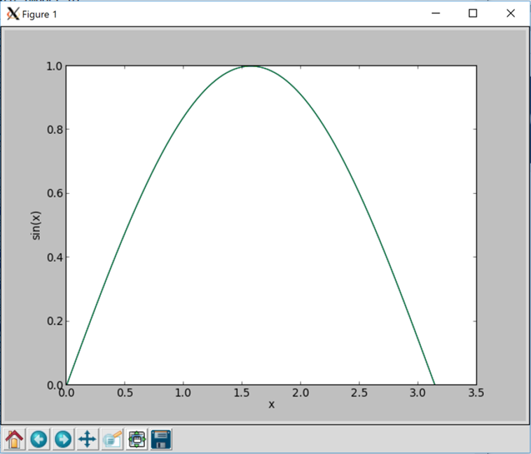
Plotting Example
import matplotlib.pyplot as plt
import numpy as np
x = np.linspace(0,np.pi,100)
y = np.sin(x)
# Commands are very
# similar to MATLAB
# Basic idea:
plt.plot(x, y)
plt.xlabel(‘x’)
plt.ylabel(‘sin(x)’)
plt.show()

Slide 23
Further Reading
Numpy and Scipy
https://docs.scipy.org/doc/
Gorelick and Ozsvald, “High Performance Python,” O’Reilly Media, 2014.
https://search.lib.umich.edu/articles/record/FETCH-LOGICAL-a20226-f73b8557ff448d247627a886c1ffc2c90a965f101c963ddd998713efc6af39573
MOOC: https://www.sololearn.com/Course/Python/
A great new tool for productivity is the Jupyter Notebook
https://jupyter-notebook-beginner-guide.readthedocs.io
Scientific computing distributions of Python
Anaconda and miniconda
Canopy/Enthought

Slide 24
Motivation
Learn skill to solve your own problems
not fully dependent on “tech support”
Helps you be more adept at using software distributed by others
Automate developer workflow

Slide 25
Teaching Objective
Understand the difference between configuring, compiling, and linking
Understand the subtleties in these steps which you will need to know to complete homework 1.
Really understand how a compiler works
e.g. We are “going to learn how the sausage is made”
Should give you everything you need to know for homework 1

Slide 26
Elements to Development
Program Design, Testing, and Debugging are all integral parts of development.
They each will get their own lecture later in the semester.
This lecture is focused on the tools and steps needed to build software:
Configure
Compile
Link
Test
Debugging
Software Design and Program Construction (e.g. writing source code)
Install

Slide 27
The “Toolchain”
Configure
Compile
Link
Test
Install
Definitions
Examples
The tools (e.g. programs and their libraries) typically used by the developer that are needed to take your source files (as input) and produce executables.
Frequently the definition of a tool chain will also include:
a program for “configuring”
a “make” script and program
a distribution of MPI
Third Party Libraries (TPLs) are typically not considered part of the “toolchain”
MPI is sort of the exception to this
Toolchains represent part of the “Minimum Requirements” for a software package.
Software packages can also support multiple toolchains
In the CASL project
CMake 2.8.11
autoconf-2.69 (auto tools)
gnu-4.8.3 compilers
mpich-3.1.3 (MPI library)
Assumes GNU Make or Make is available on the system
Almost always available on linux since it may be needed to install (parts of) the OS
Other examples
Trilinos – supports many
PETSc – supports many
xSDK – being defined for future computational science and engineering applications

Slide 28
Some Terminology about “Time”
configure-time – when you are configuring
compile-time/build-time – when you are compiling
link-time – when you are linking (very last step in “compiling”)
run-time – when you are running the executable
Important for communicating “when things went wrong”

Slide 29
What is Configuring?
For Scientific Software Development
Imperfect Cooking Analogy
Purpose is to probe the system for to determine
the computer architecture (e.g. x86, AIX, etc.)
what compilers are installed, and where they are installed
what additional system software is installed
what third party libraries are available
Basically creates “Makefiles” for a specific computer and environment for use in compiling (the next step)
Specialized programs exist to perform the “configure” step.
autotools (autoconf/automake) → configure
CMake → cmake
Most difficult part to establishing complex software systems.
Considered part software infrastructure
AUTOMATE as much as possible
Look around and find all the necessary ingredients and cookware (pots, pans, knives) to make dinner
Your stomach
Appliances
Spatula, spoon and knives
Salt, Pepper, Spices and Sauces
Detailed instructions to cook in your kitchen
Cookbooks
Writing your own cookbook for others
It’s a part of life
Use pre-packaged frozen meals

Slide 30
Things that Configuring Can Control
Where the libraries and executables produced from compilation are installed
Compiler options:
e.g. whether the libraries and executables are “debug” (slow) or “release” (fast)
e.g. whether the compilation produces “dynamic” or “static” binaries
What features of the library are enabled
e.g. with HDF5 you can specify whether you want the compiled library to include Fortran interfaces or just C interfaces.
e.g. what third party libraries to include (often provide additional capability in the software package
In HDF5 the “Z” library can be included to provide data compression.
Various other options that would be specific to the software package.

Slide 31
Configuration Options
The Cliff’s Notes
“Common” Usage and Options
Depends on the tool!
You will always have to read documentation
Usually files are named INSTALL or README
Hopefully libraries and programs you work with are well documented
Make sure you document your configuration steps well (or make them “robust”) in software you produce
People won’t use your software if it is difficult to install or build.
Autotools (autoconf/automake)
./configure [options]
--prefix=<path_to_install>
CC=<c_compiler>
FC=<fortran_compiler>
CMake
cmake [options] <path_source_dir>
-DCMAKE_BUILD_TYPE=“Release”
-DCMAKE_C_COMPILER
-DCMAKE_CXX_COMPILER
-DCMAKE_Fortran_COMPILER

Slide 32
Troubleshooting the Configure Step
For Scientific Software Development
For Cooking
My configure failed! What do I do?
Uh oh... Usually difficult to resolve
At best, problem is solved by modifying your environment.
At worst, may require some other software be installed
And you may not have privileges to do so!
In this case you’re likely
…unless you’re willing to put in way more time than is appropriate
I can’t find everything I need to cook dinner!
I’m hungry now, but I need to grill this steak!
Ask your neighbor for a cup of sugar and some eggs or a melon baller
You mean I need an grill!?
But I live in an apartment!
Guess you’ll go hungry
…unless I can make friends with someone who has a grill

Slide 33
Examples of Configuration Scripts
CMake (CMakeLists.txt) for METIS
Autoconf (configure.in) for PAPI
cmake_minimum_required(VERSION 2.8)
project(METIS)
set(GKLIB_PATH "GKlib" CACHE PATH "path to GKlib")
set(SHARED FALSE CACHE BOOL "build a shared library")
if(MSVC)
set(METIS_INSTALL FALSE)
else()
set(METIS_INSTALL TRUE)
endif()
# Configure libmetis library.
if(SHARED)
set(METIS_LIBRARY_TYPE SHARED)
else()
set(METIS_LIBRARY_TYPE STATIC)
endif(SHARED)
include(${GKLIB_PATH}/GKlibSystem.cmake)
# Add include directories.
include_directories(${GKLIB_PATH})
# Recursively look for CMakeLists.txt in subdirs.
add_subdirectory("include")
add_subdirectory("libmetis")
add_subdirectory("programs")
AC_PREREQ(2.59)
AC_INIT(PAPI, 5.5.0.0, ptools-perfapi@eecs.utk.edu)
AC_CONFIG_SRCDIR([papi.c])
AC_CONFIG_HEADER([config.h])
AC_MSG_CHECKING(for architecture)
AC_ARG_WITH(arch,
[ --with-arch=<arch> Specify architecture (uname -m)],
[arch=$withval],
[arch=`uname -m`])
AC_MSG_RESULT($arch)
AC_ARG_WITH(bitmode,
[ --with-bitmode=<32,64> Specify bit mode of library],
[bitmode=$withval])
AC_MSG_CHECKING(for OS)

Slide 34
Autotools Configure Example Cont.
#!/bin/sh
# Guess values for system-dependent variables and create Makefiles.
# Generated by GNU Autoconf 2.59 for PAPI 5.5.0.0.
# Identity of this package.
PACKAGE_NAME='PAPI'
PACKAGE_TARNAME='papi'
PACKAGE_VERSION='5.5.0.0'
PACKAGE_STRING='PAPI 5.5.0.0'
PACKAGE_BUGREPORT='ptools-perfapi@eecs.utk.edu'
ac_unique_file="papi.c"
# Factoring default headers for most tests.
ac_includes_default="\
#...
#if STDC_HEADERS
# include <stdlib.h>
# include <stddef.h>
#else
# if HAVE_STDLIB_H
# include <stdlib.h>
# endif
#endif
As a user you typically will not run autoconf
But as a developer you might
As a user you will run configure shell script produced by autoconf.
Conventional wisdom for developers
CMake >> Autohell Autotools
If starting new, start with CMake.

Slide 35
What is a Compiler?
It’s a program written by people
so it has bugs
And different versions and the behavior between versions can vary significantly.
Translates a high-level programming language (suitable for humans) into a low level machine language required by the computer.
Typically have several common features
Checking for syntax and programming errors
Supply debugging information
Perform optimizations

Slide 36
Modern Compiler Program Architectures
Compiler
Source Code
Libraries and/or
Executables
Front End
Middle
Part
Back End
Lexical Analysis
Read and parse text in source files into tokens
Syntax Analysis
Arrange tokens in syntax tree to reflect program structure
Type checking
Checks syntax tree for mistakes (e.g. undefined variables)
Intermediate coded generation
Translation to simple machine independent language
Typically will vary between compilers
Optimization
Apply algorithms for optimization to intermediate language
Register allocation
Translate variables to machine registers (memory locations)
Machine code generation
Translate intermediate language to machine code (assembly)
Assembly and linking
Convert assembly to binary and resolve addresses for variables and functions

Slide 37
Other things a compiler does (sort of)
source.c
Preprocess (separate program executed by compiler during compilation, “cpp”)
Modifies source files
A part of C, but can be used in the compilation of C++ & Fortran
In Fortran file extensions control default behavior:
*.F, *.F90 are automatically preprocessed, and *.f, *.f90 are not
Based on “directives”, start with “#” in first column.
Include files, macro expansion, conditional compilation
Compilers will predefine some symbols for you
Link (separate program executed by compiler during compilation, “ld”)
We’ll discuss linking in a few slides…
cpp
<preprocessed file>

Slide 38
Some Preprocessor Examples
C
Fortran
#include <stdio.h>
//Define macros
#define PI 3.14159
#define RADTODEG(x) ((x) * 57.29578)
int main()
{
float x;
x=RADTODEG(PI*0.5);
printf("PI/2 radians in degrees is %.6f\n",x);
return 0;
}
PROGRAM main
#ifdef __GFORTRAN__
WRITE(0,'(a,i2,a)') 'File: "'//__FILE__//'", line ',__LINE__, &
" was compiled with gfortran!"
#else
WRITE(0,'(a,i2,a)') 'File: "'//__FILE__//'", line ',__LINE__, &
" was NOT compiled with gfortran!"
#endif
ENDPROGRAM
PROGRAM main
WRITE(0,'(a,i2,a)') 'File: "'//"hello.F90"//'", line ',4, &
" was compiled with gfortran!"
ENDPROGRAM
int main()
{
float x;
x=((3.14159*0.5) * 57.29578);
printf("PI/2 radians in degrees is %.6f\n",x);
return 0;
}

Slide 39
Compiler options for debugging
GCC compiler option | Meaning
-g | Produce debugging information in the operating system's native format (stabs, COFF, XCOFF, or DWARF). GDB can work with this debugging information.
-fsanitize=<opt> | Enable AddressSanitizer, a fast memory error detector.
-fbounds-check | Generate additional code to check that indices used to access arrays are within the declared range during run time.
-fcheck-pointer-bounds | Each memory reference is instrumented with checks of the pointer used for memory access against bounds associated with that pointer.
-fstack-check | Generate code to verify that you do not go beyond the boundary of the stack.
Pretty much only –g is important.
For the other run-time checks, significant overhead in run time may be observed.

Slide 40
Other compiler options
GCC compiler option | Meaning
-c | Compile without linking
-o | Name of output file.
-I | Search path for included header files (there are predefined system paths)
-L | Search path for libraries
-l | Library name to link in
-D <symbol> | Define preprocessor symbol <symbol> during compilation
-E | Output preprocessed source file
-S | Output assembly from compilation
-fPIC | Compile Position Independent Code (necessary for shared objects)
-fopenmp | Process OpenMP directives
-p | Generate profiling information during run time for profiling analysis tools (e.g. gprof)
-ftest-coverage | Generate coverage information during run time for coverage analysis tools (e.g. gcov)

Slide 41
Object code & Binary output
Snippet of object file from program on slide 15 in vi
^?ELF^B^A^A^@^@^@^@^@^@^@^@^@^A^@>^@^A^@^@^@^@^@^@^@^@^@^@^@^@^@^@^@^@^@^@^@¸^B^@^@^@^@^@^@^@^@^@^@@^@^@^@^@^@@^@^M^@
^@UH<89>åH<81>ìà^A^@^@HÇ<85>(þÿÿ^@^@^@^@Ç<85>0þÿÿ^E^@^@^@HÇ<85>hþÿÿ^@^@^@^@Ç<85>pþÿÿ^H^@^@^@Ç<85> þÿÿ^@^P^@^@Ç<85>$þÿÿ^@^@^@^@H<8d><85> þÿÿH<89>Çè^@^@^@^@H<8d><85> þÿÿº^X^@^@^@¾^@^@^@^@H<89>Çè^@^@^@^@H<8d><85> þÿÿº^D^@^@^@¾^@^@^@^@H<89>Çè^@^@^@^@H<8d><85> þÿÿº^\^@^@^@¾^@^@^@^@H<89>Çè^@^@^@^@H<8d><85> þÿÿH<89>Çè^@^@^@^@ÉÃUH<89>åH<83>ì^P<89>}üH<89>uðH<8b>Uð<8b>EüH<89>Ö<89>Çè^@^@^@^@¾^@^@^@^@¿^H^@^@^@è^@^@^@^@è^Xÿÿÿ¸^@^@^@^@ÉÃ^@^@^@^@^@^@^@^@^@^@^@^@^@^@^@^@^@hello.F90^@(a,i2,a)File: "hello.F90", line ^@^@^D^@^@^@ was compiled with gfortran!^@^@^@^@^@^@^@^@^@^@^@^@^@^@^@^@^@^@^@^@D^@^@^@ÿ^A^@^@^@^@^@^@^@^@^@^@^@^@^@^@^A^@^@^@^@^@^@^@^A^@^@^@^@GCC: (Ubuntu/Linaro 4.6.4-1ubuntu1~12.04) 4.6.4^@^@^@^@^@^@^@^@^T^@^@^@^@^@^@^@^AzR^@^Ax^P^A^[^L^G^H<90>^A^@^@^\^@^@^@^\^@^@^@^@^@^@^@´^@^@^@^@A^N^P<86>^BC^M^F^B¯^L^G^H^@^@^\^@^@^@<^@^@^@^@^@^@^@;^@^@^@^@A^N^P<86>^BC^M^Fv^L^G^H^@^@^@^@.symtab^@.strtab^@.shstrtab^@.rela.text^@.data^@.bss^@.rodata^@.comment^@.note.
Compiling a source file source.F90 (e.g. –c) produces an object file source.o
Object files are relocatable machine code.
Typical object file format for linux is ELF.
Cannot view object files in text editors
ELF files contain
Program header table describing 0 or more segments
Contains run-time information
Section header table describing 0 or more sections
Contains link-time information
Data referred to by segments and sections
How can you inspect ELF files/object code/object files?

Slide 42
Inspecting Object Files
readelf –a source.o
nm source.o
Symbol table '.symtab' contains 18 entries:
Num: Value Size Type Bind Vis Ndx Name
0: 0000000000000000 0 NOTYPE LOCAL DEFAULT UND
1: 0000000000000000 0 FILE LOCAL DEFAULT ABS hello.F90
2: 0000000000000000 0 SECTION LOCAL DEFAULT 1
3: 0000000000000000 0 SECTION LOCAL DEFAULT 3
4: 0000000000000000 0 SECTION LOCAL DEFAULT 4
5: 0000000000000000 0 SECTION LOCAL DEFAULT 5
6: 0000000000000000 180 FUNC LOCAL DEFAULT 1 MAIN__
7: 0000000000000060 32 OBJECT LOCAL DEFAULT 5 options.1.1538
8: 0000000000000000 0 SECTION LOCAL DEFAULT 7
9: 0000000000000000 0 SECTION LOCAL DEFAULT 8
10: 0000000000000000 0 SECTION LOCAL DEFAULT 6
11: 0000000000000000 0 NOTYPE GLOBAL DEFAULT UND _gfortran_st_write
12: 0000000000000000 0 NOTYPE GLOBAL DEFAULT UND _gfortran_transfer_charac
13: 0000000000000000 0 NOTYPE GLOBAL DEFAULT UND _gfortran_transfer_intege
14: 0000000000000000 0 NOTYPE GLOBAL DEFAULT UND _gfortran_st_write_done
15: 00000000000000b4 59 FUNC GLOBAL DEFAULT 1 main
16: 0000000000000000 0 NOTYPE GLOBAL DEFAULT UND _gfortran_set_args
17: 0000000000000000 0 NOTYPE GLOBAL DEFAULT UND _gfortran_set_options
0000000000000000 t MAIN__
U _gfortran_set_args
U _gfortran_set_options
U _gfortran_st_write
U _gfortran_st_write_done
U _gfortran_transfer_character_write
U _gfortran_transfer_integer_write
00000000000000b4 T main
0000000000000060 r options.1.1538
Wait… Why do I need to know what’s in my object files?
97% of the time you don’t need to know. However, this can be useful in resolving link errors and multi-language programs

Slide 43
Name Mangling (Fortran)
Fortran
SUBROUTINE Sub1(n)
...
ENDSUBROUTINE
Source File
Binary symbol name is different from high level programming language name
Variants:
Lower, Lower_, Lower__
Upper, Upper_, Upper__
Used to be critical for calling Fortran from C.
Now the Fortran standard provides features that give programmer more control over name mangling.
Compile
Object File
0000000000000000 T sub1_
SUBROUTINE Sub1(n) BIND(C,NAME=“Sub1”)
...
ENDSUBROUTINE
0000000000000000 T Sub1
This example is “Lower_”

Slide 44
Name Mangling (C++)
#include <iostream>
#include <string>
using namespace std;
template <typename T>
inline T const& Max (T const& a, T const& b)
{ return a < b ? b:a;
}
int main ()
{ int i = 39; int j = 20; cout << "Max(i, j): " << Max(i, j) << endl;
double f1 = 13.5; double f2 = 20.7; cout << "Max(f1, f2): " << Max(f1, f2) << endl;
string s1 = "Hello"; string s2 = "World";
cout << "Max(s1, s2): " << Max(s1, s2) << endl;
return 0;
}
Shows up with templating
Have to produce different binary code for each templated type
Necessary for linking
00000000000001c6 t _Z41__static_initialization_and_destruction_0ii
U _ZNKSs7compareERKSs
U _ZNSaIcEC1Ev
U _ZNSaIcED1Ev
U _ZNSolsEPFRSoS_E
U _ZNSolsEd
U _ZNSolsEi
U _ZNSsC1EPKcRKSaIcE
U _ZNSt8ios_base4InitC1Ev
U _ZNSt8ios_base4InitD1Ev
U _ZSt4cout
U _ZSt4endlIcSt11char_traitsIcEERSt13basic_ostreamIT_T0_ES6_
0000000000000000 b _ZStL8__ioinit
U _ZStlsISt11char_traitsIcEERSt13basic_ostreamIcT_ES5_PKc
0000000000000000 W _ZStltIcSt11char_traitsIcESaIcEEbRKSbIT_T0_T1_ES8_
Example from: https://www.tutorialspoint.com/cplusplus/cpp_templates.htm

Slide 45
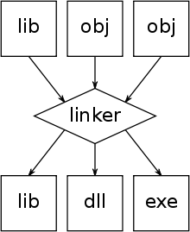
What is Linking?
Linking is the process of combining the various objects and libraries output from compilation into a single executable (or library or object).
May also include binaries (e.g. libraries) already installed on the system
Sometimes performed by external program called by compiler (e.g. ld)
Sometimes part of compiler (depends on the vendor)
Key steps in linking are
Resolving external symbols that the linker uses to figure out how to piece together the executable
Relocating load addresses of various program parts (e.g. function addresses and variable addresses) to reflect the assigned addresses in the whole program.
Linking can produce targets thatare statically linked or dynamically linked

Slide 46
Dynamic Linking vs. Static Linking
Static Linking
Dynamic Linking
Probably what you think of when you think “linking”
Copy all binary code from all libraries and objects then package into a single executable image
Usually results in larger executable file sizes
A little more portable since all the binary code is packaged together
Requires all libraries that are linked to be static libraries (e.g. lib<name>.a)
Sometimes a requirement on large clusters
Compute nodes and login nodes are different
Symbol resolution is delayed until executable is run
Executable code has undefined symbols
Requires all libraries that are linked to be dynamic libraries (e.g. lib<name>.so)
Some advantages
For system libraries used by every program, no need to copy into every executable (e.g. libc)
If there is a bug in a library, and a new version of the library that fixes the bug is installed, all programs benefit.
Statically linked executables need to be re-linked
Some disadvantages
Libraries that are updated that break backwards compatibility, might break your executable.
Need to have the correct environment.
Not necessarily portable, OS and environment need to consistent.

Slide 47
What link errors look like
Static Link Error
Dynamic Link Error
PROGRAM hello_main
WRITE(*,*) "Hello World!"
CALL some_undefined_routine()
ENDPROGRAM
$ ./some_mpi_program.exe
./mpi_program.exe: error while loading shared libraries: libmpi.so: cannot open shared object file: No such file or directory
When you attempted to run the executable,
The OS could not find the library using the
information in your current environment
$ gfortran -c hello.F90
$ gfortran hello.o -o hello.exe
hello.o: In function `MAIN__':
hello.F90:(.text+0x71): undefined reference to `some_undefined_routine_'
collect2: ld returned 1 exit status
The command given to the linker did not include the library or object (or the correct path to the library or object) that defines the named symbol.

Slide 48
How to trouble shoot link errors
Static Link Error
Dynamic Link Error
Most likely you are missing the correct entries on the following options passed to the linker:
-l<library_name_with_symbol>
-L<path_to_library>
Could also be a typo in your source code
Generally easy to resolve
If you know where the missing library is located.
Can be difficult if you have no idea why the symbol is trying to be linked (where is it used, where is it defined
More likely to happen when you are linking third party libraries
Most likely your environment is not the same as when you compiled
Check your environment
Environment variable is LD_LIBRARY_PATH
Useful command: ldd
Shows you exactly what libraries are dynamically linked to your executable
$ ldd ./some_mpi_program.exe
linux-vdso.so.1 => (0x00007ffcf2be8000)
libmpi.so => not found
libc.so.6 => /lib/x86_64-linux-gnu/libc.so.6 (0x00007f4d12878000)
/lib64/ld-linux-x86-64.so.2 (0x00007f4d12c38000)

Slide 49
Dynamic Loading: Linking in code at run time
Start your executable then load a library into memory.
Use case is “plugins”. An example might be linking proprietary correlations for material properties.
Can be done interactively. User could specify library name and function name as an input.
Challenging to list “available symbols” in library, although this can be done. But basically need to know what routine you want to call
In Linux requires “dl” library.
#include <dlfcn.h>
void* sdl_library = dlopen("libSDL.so", RTLD_LAZY);
if (sdl_library == NULL) {
// report error ...
} else {
void* initializer = dlsym(sdl_library,"SDL_Init"); //extract library contents
if (initializer == NULL) {
// report error ...
} else {
// cast initializer to its proper type and use
typedef void (*sdl_init_function_type)(void);
sdl_init_function_type init_func = (sdl_init_function_type) initializer;
}
}
https://en.wikipedia.org/wiki/Dynamic_loading

Slide 50
Multi-language Programs
The key is linking!
Linker does not care what high-level language produced your object code. It could have been generated from Fortran or C or C++.
Linker just has to resolve symbols in object code.
Well one subtlety, you must have a compatible application binary interface (ABI)
Usually not an issue unless you are compiling on one machine and linking on another.
If a programming language or environment (e.g. Python) supports linking of C interfaces than you can link any code that provides a C interface
Most languages support C interfaces (because they were probably implemented in C or the compiler was)
Therefore, C is the de-factor language of interoperability.
By “C interface” I mean a binary symbol that is producible from the C high-level language and a C compiler.

Slide 51
Summary: Using the Toolchain
Autotools
make
make <test_target>
make install
./configure
Configure
Compile
Link
Test
Install
cmake <options> <source_dir>
make
ctest
make install
CMake

