Slide 1
Lecture 8 Software Engineering (managing the chaos that is developing software)
Prof. Brendan Kochunas
9/30/2019
NERS 590-004

Slide 2
Outline
Overview of Software Engineering
Components in the Development process
Development Cycle Workflows
Ross’s Taxonomy of Testing
What every software project has... a Lifecycle

Slide 3
Today’s Learning Objectives
Understand the techniques that will make you a “better programmer”
If you take away one thing from this class remember these lessons and really study the further reading. https://www.safaribooksonline.com/library/view/code-complete-second/0735619670/?ar&orpq
Understand better the subtle lessons of the assignments so far.

Slide 4
Overview of Software Engineering

Slide 5
Software Engineering Practices
Software Engineering Practices relate to the question: “How do you write your software?”
Includes topics such as
Version control
Testing
Lifecycle
Release schedule
Development process (software construction)
Coding standards
Its all about your PROCESS!

Slide 6
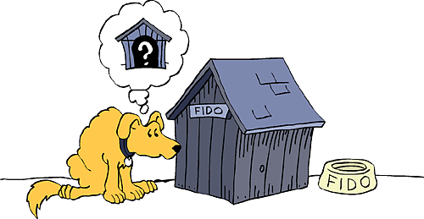
Metaphors in Writing Software
Various metaphors
Learning from the Metaphor
Historically writing software has been called:
“a science”
“an art”
“a process”
“a game”
“farming, hunting werewolves, or drowning with dinosaurs in a tar pit”
Presently:
Writing software is like “construction” (e.g. building a house)
implies planning, preparation, and execution
Things needed for simple structures may not work for large structures
“Building a 4’ tower requires a steady hand, a level surface, and about 10 undamaged beer cans”
Building a tower that’s 400’ can’t use 400 beer cans. You’ll need something else...
Simple projects may not need a lot of planning
Don’t build things you don’t have to
You’re not going to build a dishwasher from scratch for your house
Plan appropriately: e.g. how much complexity is there?
Source material: Steve McConnell, Code Complete 2nd Edition, Microsoft Press, 2004.

Slide 7
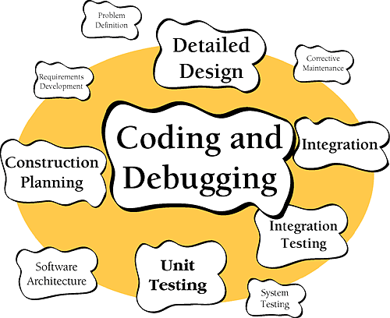
Software “Construction”
What is Software Construction
Why is it important?
Software construction is software development. It includes:
Construction is the central part of any software project.
The point is you write code.
It is the only guaranteed activity in software development
Like actual construction it can be done well or poorly.
As computational scientists we want to do it well.
Good software construction leads to users and leads to a career.
Source material: Steve McConnell, Code Complete 2nd Edition, Microsoft Press, 2004.

Slide 8
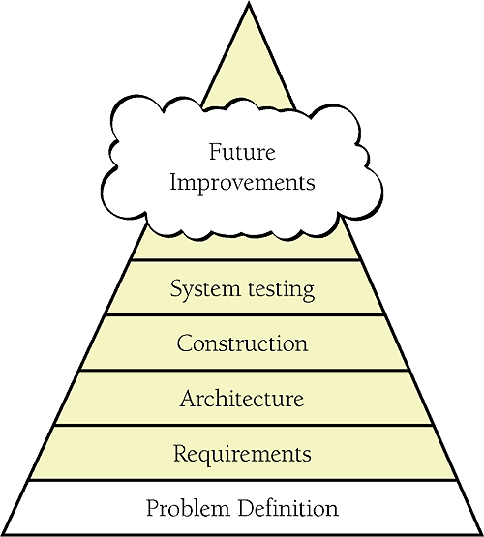
Parts of Software Construction: Problem-Definition
The problem definition defines the problem to be solved WITHOUT any reference to possible solutions.
Kind of like a vision statement or mission statement.
Should be in terms of the “user” not the “developer”
Example:
“We need to make sure a nuclear reactor will shutdown safely in the event of an accident.”
The problem statement is the foundation of everything that follows in software construction.
The penalty for failing to get the right problem definition is you can waste a lot of time solving the wrong problem.
Source material: Steve McConnell, Code Complete 2nd Edition, Microsoft Press, 2004.

Slide 9
Parts of Software Construction: Requirements (1)
Requirements describe in detail what a software system is supposed to do.
It is the “contract” between the customer/user and the developer.
Useful to define for each individual part of the program or feature
Usually describe functional requirements
In CSE this is usually solving a mathematical equation
Define inputs (coefficients)
Define outputs (solution) and output format
Should define error handling behavior
May define performance goals
May define solution algorithm
Requirements always change
“Requirements are like water. They’re easier to build on when they’re frozen”
Requirements always change
REQUIREMENTS ALWAYS CHANGE
Changing requirements when desigining ~3x overhead
Changing requirements during construction 5x-10x overhead
Changing requirements after release 10x-100x overhead
Example: Lab 2
Source material: Steve McConnell, Code Complete 2nd Edition, Microsoft Press, 2004.

Slide 10
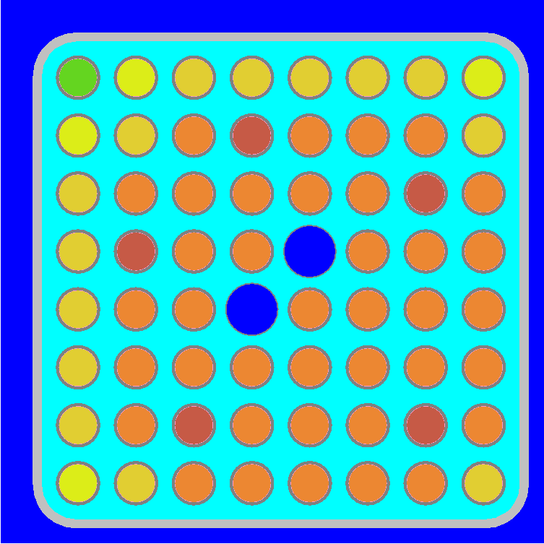
Parts of Software Construction: Requirements (2)
More Analogies
Example
Importance of planning:
You don’t just start hammering boards together with nails when you want to build a house
You figure out what a house needs to do by familiarizing yourself with building codes.
Affect of changing requirements
After the construction crew has put the dry-wall up and installed the windows the homeowner decides they want to move some windows.
When the homeowner is meeting with the architect they decide to move some windows.
Obtain a solution to the following equation
For the following model
Pitfalls:
Requirements need not state the solution methodology (e.g. algorithm), although they may
Requirements should not be given in terms of the program entitites (variables, classes, libraries, interfaces)
Boiling Water Reactor
Fuel Lattice

Slide 11
Parts of Software Construction: Architecture
Examples:
Software Architecture is the highest level of software design.
The frame that holds the detailed parts.
Should be easily understandable
Work here generally overlaps with the “high-level” design.
Key practice: Consider multiple designs.
In doing architecture design force yourself to develop more than one solution and compare them.
Pitfall:
Architecture should be agnostic of programming language.

Slide 12
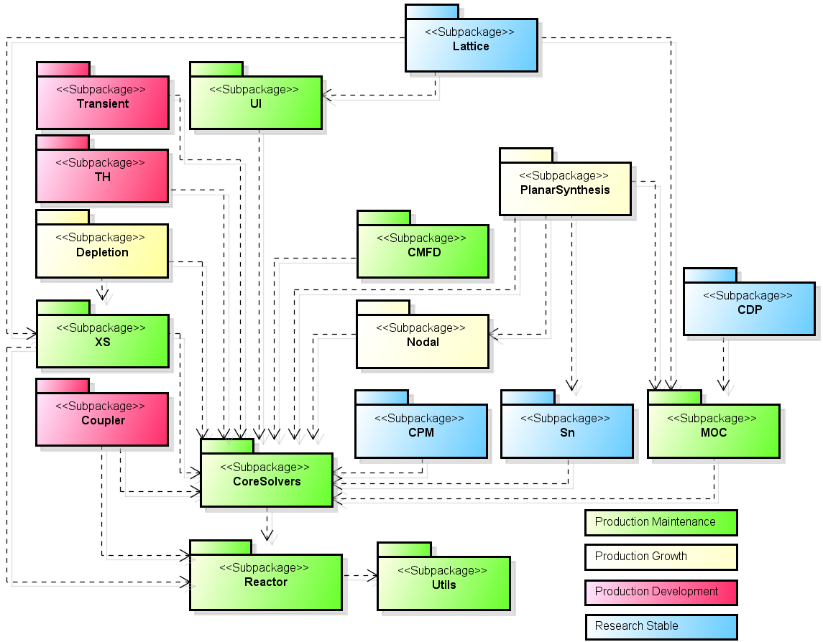
Parts of Software Construction: Another Architecture Example

Slide 13
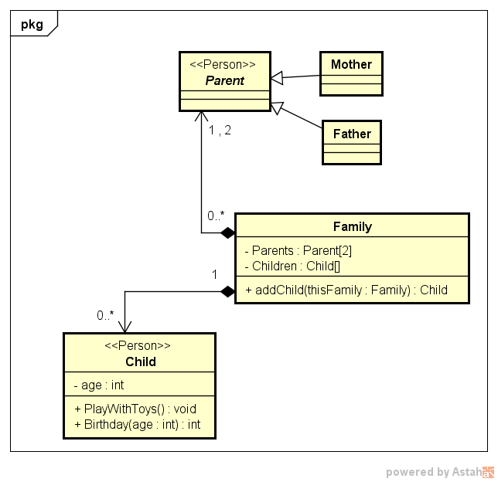
Parts of Software Construction: High Level Design
The high level design includes detailed design documentation that would describe
An Application Program Interface (API)
Class definitions
methods, attributes, inheritance
Dependencies within different parts of the program
State diagrams, sequence diagrams, activity diagrams (flow-charts)
Key practices:
Consider multiple designs. force yourself to develop more than one solution and compare them.
The unified modeling language (UML) is an excellent tool for doing HLD.
Pitfalls:
Difficult to keep up to date.
Creating unnecessary dependencies.
UML Example
High Level Design Defines Relationships (between parts of program)
Notes:
Parent and child are types of people.
Parent can be either a mother or father. These are “specific instances”
Family is composed of 2 parents and zero or more children
1 family has 0 or more children
1 or 2 parents a part of 0 or more families

Slide 14
Parts of Software Construction: Low Level Design
Example: Homework 1
Low level design is the design that takes place “behind” an interface
e.g. “under the hood”
Often some choice of algorithm as well.
e.g. sort a data set
Key Practice
Get very detailed requirements when you can.
Defensive programming / Design by Contract
Pitfalls:
Poor performance
Memory leaks
Unnecessary dependencies
Bugs
Computation of the Z-curve index
Code I provided
Extra-credit using bit manipulation

Slide 15
Ok, I understand everything that’s a part of Software Development
But, how do I use these parts effectively?

Slide 16
Development Workflows

Slide 17
Development Workflows
Workflows are based on a particular philosophy or approach to software development.
Waterfall: Once through and your done
Incremental: Perform the same tasks in cycles
Spiral: Focused on risk management
Iterative:
Agile: Work in a way that lets you adapt quickly
Scrum, Extreme programming
Lean: Don’t do more than you need to. Minimize “waste”.
Kanban
...and many more
There is no right or wrong workflow, but for certain projects in certain situations some workflows will be more productive than others.
Often times you need to tailor something specific for your project & team.
Further Reading: https://en.wikipedia.org/wiki/Software_development_process

Slide 18
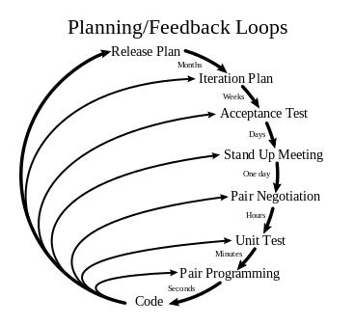
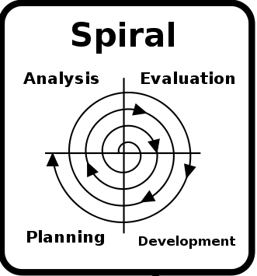
Workflow Illustrations
Agile Iterative
Waterfall
Requirements
Requirements
Extreme Programming
Architecture
Architecture
High-Level Design
High-Level Design
Low-Level Design
Low-Level Design
Construction
Construction
Testing
Testing

Slide 19
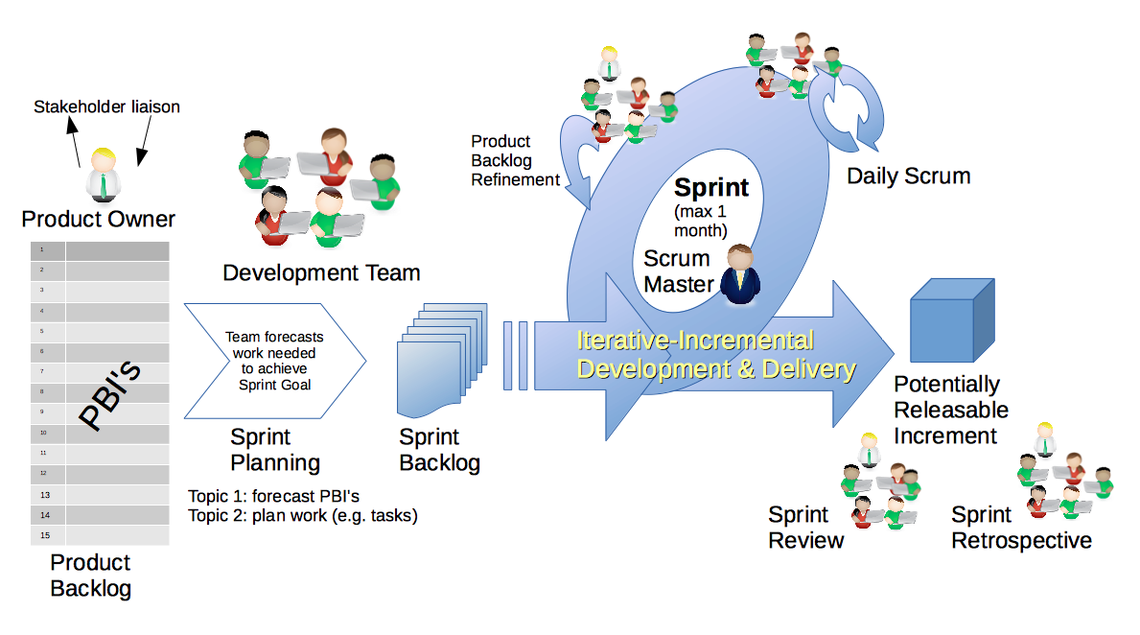
Other Workflow Concepts: Scrum
Concepts
Project roles
Timeboxing
Backlog
Stand-ups
Review and Retrospective
https://upload.wikimedia.org/wikipedia/commons/thumb/d/df/Scrum_Framework.png/220px-Scrum_Framework.png

Slide 20
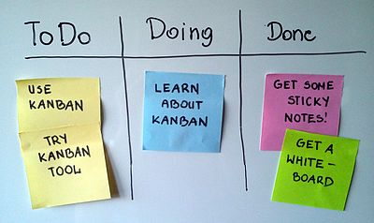
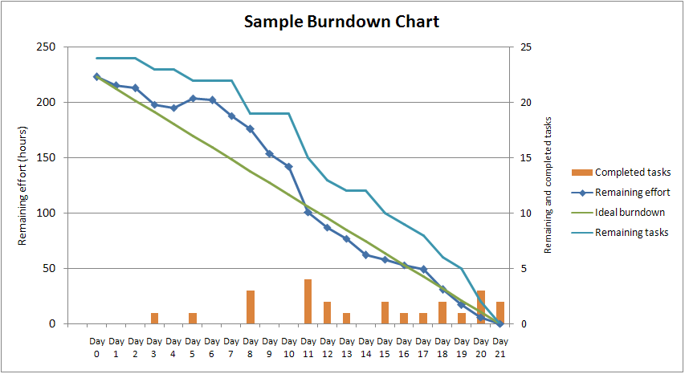
Other Workflow Concepts: Kanban & Burndown
Concepts
Kanban Board
Visualize Workflow.
Limit work in progress.
Evolve policies.
Burndown Charts.
https://upload.wikimedia.org/wikipedia/commons/0/05/SampleBurndownChart.png
https://upload.wikimedia.org/wikipedia/commons/thumb/d/d3/Simple-kanban-board-.jpg/1280px-Simple-kanban-board-.jpg

Slide 21
Test Driven Development
Agile Iterative Development
Test Driven Development
Requirements
Requirements
Architecture
Architecture
High-Level Design
High-Level Design
Low-Level Design
Unit Testing
Construction
Low-Level Design
Testing
Construction

Slide 22
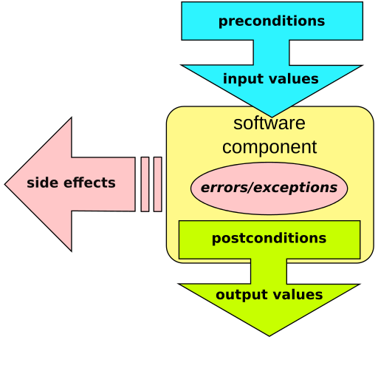
Design by Contract
SUBROUTINE MatVec(A,x,y)
REQUIRE(SIZE(A,DIM=2) == SIZE(x))
REQUIRE(SIZE(A,DIM=1) == SIZE(y))
!Perform y <- A*x
ENSURE(.NOT.(y /= y)) !test for NaN
ENDSUBROUTINE
Articulated from “business contracts” for a client and supplier
A form of “defensive programming” where overhead can be eliminated
Check assumptions made by code
Not natively supported in most languages
Available as a 3RD party feature
For C/C++ use C preprocessor or GNU Nana
For Fortran use C-preprocessor
Python has PyContracts or PyDBC
Debug
SUBROUTINE MatVec(A,x,y)
IF(.NOT.(SIZE(A,DIM=2) == SIZE(x))) &
WRITE(0,*) “DBC REQUIRE FAIL!”, & __FILE__,__LINE__
IF(.NOT.(SIZE(A,DIM=1) == SIZE(y)) &
WRITE(0,*) “DBC REQUIRE FAIL!”, & __FILE__,__LINE__
!Perform y <- A*x
IF(.NOT.(.NOT.ANY((y /= y))) &
WRITE(0,*) “DBC ENSURE FAIL!”, & __FILE__,__LINE__ ENDSUBROUTINE
Release
SUBROUTINE MatVec(A,x,y)
!Perform y <- A*x
ENDSUBROUTINE
https://en.wikipedia.org/wiki/Design_by_contract#/media/File:Design_by_contract.svg

Slide 23
Final Disclaimer on Workflows
Using workflows effectively is like using version control (or a lab notebook) effectively.
Workflows require self-discipline.
They do not help you if you do not adhere to their rules.
Typically requires active effort on the part of someone to “enforce” workflow practices
They can be a lot of overhead at times.

Slide 24

Ross’s Taxonomy of Testing

Slide 25
A Taxonomy of Testing
Testing is the backbone of software quality assurance (SQA).
Types of testing
Unit Testing – Test individual units of program in isolation
Should run very fast: < 1 second (a couple seconds is ok)
Integral Testing – Testing program components together
Should run fast: < 1 minute (a couple minutes is ok)
Regression Testing – Test whole program for changes in program output
Should run fast: < 1 minute (a couple minutes is ok)
Verification Testing – Test that you are “doing things right”
Can happen at unit or integral or regression level. Comparison analytic solutions or manufactured solutions.
Validation Testing – Whole program testing “doing the right thing”; simulating reality, comparison to experiment.
May be long running: minutes to hours
Memory Testing – Expensive testing that does detailed memory simulations to detect errors (valgrind)
Coverage Testing – Figure out how much of your source code is actually covered by testing
Portability Testing – test on different platforms and with different compilers
Other types of testing exist

Slide 26
Testing Layers
Nightly Testing
Secondary Tested (ST)
CATEGORIES [BASIC CONTINUOUS NIGHTLY]
(includes all testing*)
Post-Push CI Testing
Secondary Tested (ST)
CATEGORIES [BASIC CONTINUOUS]
(includes more regression testing)
Correctness Testing
Pre-Push CI Testing
Primary Tested (PT)
CATEGORIES [BASIC]
(unit tests & some regression tests)
*Additional Categories: Heavy or Weekly
Coverage Testing
Memory (Valgrind) Testing

Slide 27
AUTOMATE TESTING AS MUCH AS YOU CAN!

Slide 28
Software Lifecycles

Slide 29
Software Lifecycle Model
What is it?
What should a Lifecycle model do?
The model used to decide when to perform particular development activities
Implicit to all software projects
Not necessarily formally defined.
Much better to have a formally defined lifecycle model.
Will define “maturity levels”
Also defines what activities to perform at each level
Allow exploratory research to remain productive
Don’t require more work than necessary in early phases of basic research
Enable reproducible research
Required for credible peer reviewed research
Improve overall development productivity
Focus on right software engineering practices at the right time. Minimize overhead
Improve production software quality
Focus on foundational issues first. Build on quality with quality
Communicate maturity levels more clearly to customers
Manage user expectations
Notes:
Description summarizes TriBITS Software Lifecycle Model
https://doi.org/10.2172/1038225

Slide 30
Example of “Validation-Centric” Lifecycle Model (What you may be familiar with)
Validation is “doing the right thing”
Software product is viewed as “black box” that is supposed to do the right thing.
Not generally concerned with the internal structure of the program
Can be very efficient because it has little overhead initially.
Usually more difficult to maintain long term
Software is poorly designed
Difficult to detect changes (no automated testing)
Little to no planning
Elicit Requirements (e.g. solve Ax=b)
Write the software
(usually design as you go) (debug as you go) (manually test as you go)
Maintain (It works. It’s done) (Don’t need to add any new features)
As much as 75% or more of total cost in a software project can be maintenance!
Notes:
Ultimately Costs much more.
In many cases leads to early abandonment.

Slide 31
TriBITS Lifecycle Model: Maturity Levels
Exploratory/Experimental (EX)
Primary purpose is to explore alternative approaches and prototypes
Little to no testing or documentation
Not to be included in a release
Very likely code will end up in recycle bin
Research Stable (RS)
Strong unit and verification tests
Very good line coverage in testing
Has a clean design
May not be optimized
May lack “robustness” and complete documentation
Production Growth (PG)
Includes all good qualities of RS code
Improved checking for bad inputs
More graceful error handling
Good documentation
Integral and regression testing
Production Maintenance (PM)
Includes all good qualities of PG code
Primary development activities are bug fixes, performance tweaks, and portability.
Unspecified (UM)
Provides no official indication of maturity

Slide 32
Maturity of Software Quality Metrics (Ideal)
Figure 1. “Typical levels of various production quality metrics in the different phase of the proposed Lean/Agile-consistent TriBITS lifecycle model”
From R. Bartlett, et al., “TriBITS Lifecycle Model” Version 1.0,” SAND2012-0561, (2012)

Slide 33
Maturity of Software Quality Metrics (Unfortunate Reality)
This is what will happen if your team is not disciplined!
Figure 6. “Example of the more typical variability in key quality metrics in a typical CSE software development process.”
From R. Bartlett, et al., “TriBITS Lifecycle Model” Version 1.0,” SAND2012-0561, (2012)

Slide 34
Summary
Development Processes:
Software Development consists of:
Add overhead, but will frequently save you time in the long term
Require discipline
provide software quality assurance
may need to be tailored to your situation.
Problem Definition
Requirements
Architecture
High-level design
Low-level design
Testing

Slide 35
Software Processes on GitHub

