Slide 1
Lecture 10 Computer Architecture and Basic Performance
Dr. Brendan Kochunas
10/07/2018
NERS 590-004

Slide 2
Outline
Motivating example:
Lab 4 Matrix-matrix Multiply
Basic notions of serial performance
Computer Architecture
How do we understand it?
Memory Hierarchy
How to characterize the “micro-architecture”
Things that happen in parallel and parallel architectures

Slide 3
Learning Objectives
Insights into Lab 4
Understand the definition of performance.
Understand what parts of computer hardware affect performance.
Understand detailed practical models for architecture of processors and supercomputers

Slide 4
Motivation

Slide 5
Matrix-matrix Multiply
Lab 4
Write your own matrix-matrix multiply
Compare to dgemm from BLAS
For system BLAS library and OpenBLAS
Compare to NumPy

Slide 6
Results for Lab 4
Matrix Size | My Implementations |  |  | System BLAS | OpenBLAS | NumPy | MKL
100 | 0.001 | 0.001 | 0.003 | 0.001 | 0.064 | 0.002 | 0.002
500 | 0.062 | 0.068 | 0.465 | 0.071 | 0.069 | 0.007 | 0.007
1000 | 0.505 | 0.559 | 4.109 | 0.575 | 0.291 | 0.034 | 0.034
2000 | 5.516 | 6.160 | 39.028 | 5.787 | 0.749 | 0.231 | 0.231
4000 | 47.922 | 50.341 | >100 | 46.229 | 2.822 | 1.690 | 1.682
Results obtained on Great Lakes
Clearly something is going on here...
Notes:
$ python >>> import numpy >>> numpy.__config__.show()

Slide 7
Matrix-matrix Multiply
do i=1,n
do j=1,n
do k=1,n
c(i,j)=c(i,j)+a(i,k)*b(k,j)
enddo
enddo
enddo
Lab 4
Write your own matrix-matrix multiply
Compare to dgemm from BLAS
For system BLAS library and OpenBLAS
Compare to NumPy
do k=1,n
do j=1,n
do i=1,n
c(i,j)=c(i,j)+a(i,k)*b(k,j)
enddo
enddo
enddo
c=MATMUL(A,B)
Fortran one-liner

Slide 8
NumPy uses MKL!
$ python >>> import numpy >>> numpy.__config__.show()
lapack_opt_info:
libraries = ['mkl_intel_lp64', 'mkl_intel_thread', 'mkl_core', 'iomp5', 'pthread']
library_dirs = ['/sw/lsa/centos7/python-anaconda2/created-20170424/lib']
define_macros = [('SCIPY_MKL_H', None), ('HAVE_CBLAS', None)]
include_dirs = ['/sw/lsa/centos7/python-anaconda2/created-20170424/include']
blas_opt_info:
libraries = ['mkl_intel_lp64', 'mkl_intel_thread', 'mkl_core', 'iomp5', 'pthread']
library_dirs = ['/sw/lsa/centos7/python-anaconda2/created-20170424/lib']
define_macros = [('SCIPY_MKL_H', None), ('HAVE_CBLAS', None)]
include_dirs = ['/sw/lsa/centos7/python-anaconda2/created-20170424/include']
openblas_lapack_info:
NOT AVAILABLE
lapack_mkl_info:
libraries = ['mkl_intel_lp64', 'mkl_intel_thread', 'mkl_core', 'iomp5', 'pthread']
library_dirs = ['/sw/lsa/centos7/python-anaconda2/created-20170424/lib']
define_macros = [('SCIPY_MKL_H', None), ('HAVE_CBLAS', None)]
include_dirs = ['/sw/lsa/centos7/python-anaconda2/created-20170424/include']
blas_mkl_info:
libraries = ['mkl_intel_lp64', 'mkl_intel_thread', 'mkl_core', 'iomp5', 'pthread']
library_dirs = ['/sw/lsa/centos7/python-anaconda2/created-20170424/lib']
define_macros = [('SCIPY_MKL_H', None), ('HAVE_CBLAS', None)]
include_dirs = ['/sw/lsa/centos7/python-anaconda2/created-20170424/include']
Turns out...
NumPy uses Intel MKL!
Anaconda (and probably Canopy) distributions of NumPy also include Intel MKL libraries!
MKL has a free community edition library.

Slide 9
Performance Basics
To understand the performance you observe, you first have to understand what performance to expect
To have an expectation of performance, we all have to be on the same page about what performance is

Slide 10
What is performance?
What does it mean for a code to be fast?
How do you get fast code?
The real metric: Time
Derived metrics
FLOPS = FLoating Point OPerations per Second
Bandwidth = data per unit time (sort of like a flow rate)
Latency = Minimum time for data to travel from point A to point B
Theoretical Peak Performance
Very difficult to achieve in practice
Can be computed from hardware specs
Do things efficiently in time
First: Choose the right algorithm
Second: Understand how to express that algorithm in the programming language
Third: Understand how the source code will get mapped to the hardware
Fourth: Tune the code to the hardware
A lot of this can be done with pen and paper

Slide 11
Computer Architecture

Slide 12
Idealized Processor Model
Processor
Memory
Integer Math
Processor names bytes, words, etc. in its address space
These represent integers, floats, pointers, arrays, etc.
Operations include
Read and write into very fast memory called registers
Arithmetic and other logical operations on register
Order specified by program
Read and returns the most recently written data
Compiler and architecture translate high level expressions into “obvious” Lower level instructions
Hardware executes instructions in order specified by compiler
Idealized Cost
Each operation has roughly the same cost (read, write, add, multiply, etc.)
Floating Point Math
Registers
Read address(A) into R1
Read address(B) into R2
R3 = R1 + R2
Write R3 to address(C)
A+B=C

Slide 13
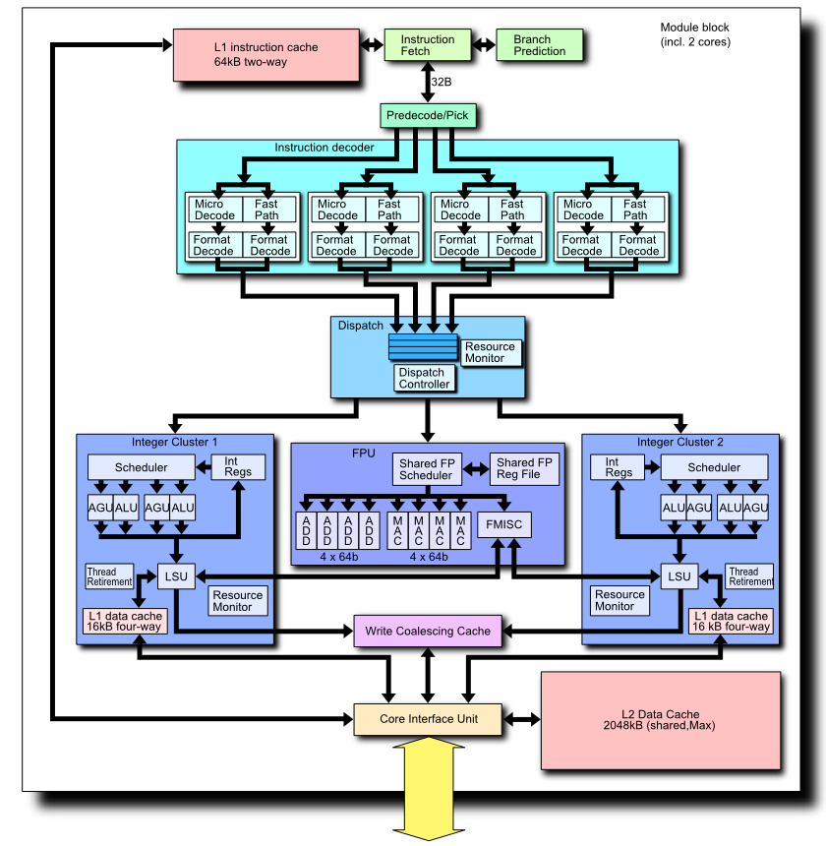
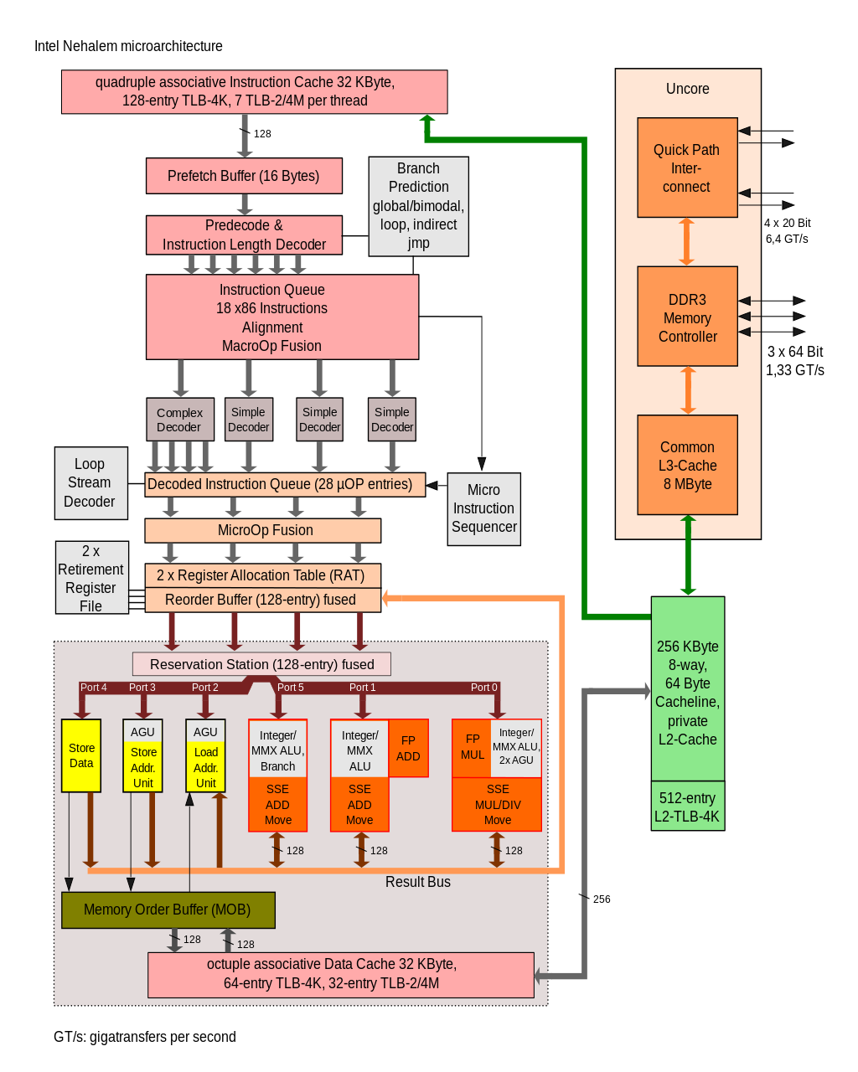
Real World Processors
Intel “Nehalem”
AMD “Bulldozer”
Notes:
Intel Figure: By I, Appaloosa, CC BY-SA 3.0, https://commons.wikimedia.org/w/index.php?curid=2541872
AMD Figure: By Shigeru23 - Made by uploader (ref:[1], [2], [3]), CC BY 3.0, https://commons.wikimedia.org/w/index.php?curid=17130259

Slide 14
“Single” Processor Concept
Real world processors have
Registers and caches
Small amounts of fast memory
Stores values of recently used data nearby
Different memory operations can have very different costs
Parallelism
Multiple “functional units” that can run in parallel
Pipelining
A form of parallelism like assembly line
Why is this your problem?
In theory, compilers and hardware “understand” all this complexity
and can optimize our programs; in practice they do not often do this well
Compilers do not know about different algorithms that might be better
We want to know the details to use processors effectively
Don’t want to know all the details
Don’t want to have an incomplete model.
Processor
ALU
FPU
Registers
Data Cache
Instr. Cache
L2 Cache
Main Memory
… levels of cache

Slide 15
Cache Basics
Cache is fast (expensive) memory which keeps copy of data in main memory;
Typically it is hidden from software (e.g. no standard way of programming directly)
Simplest example: data at memory address xxxxx1101 is stored at cache location 1101
Cache hit: in-cache memory access—cheap
Cache miss: non-cached memory access—expensive
Need to access next, slower level of cache
Cache line length: # of bytes loaded together in one entry
Ex: If either xxxxx1100 or xxxxx1101 is loaded, both are
Associativity
direct-mapped: only 1 address (line) in a given range in cache
Data stored at address xxxxx1101 stored at cache location 1101, in 16 word cache
n-way: n ≥ 2 lines with different addresses can be stored
Up to n ≤ 16 words with addresses xxxxx1101 can be stored at cache location 1101 (so cache can store 16n words)

Slide 16
Why have multiple levels of cache/memory?
Most programs have a high degree of locality in their memory access patterns
Spatial locatility: accessing data nearby previously accessed data
Temporal Locality: access data and reuse that data a lot
A memory hierarchy attempts to exploit locality to improve overall average access time.
Cache is small and fast (speed = $$$)
A large cache always has delays: time to check addresses is longer
There are other parts to memory hierarchy (TLB, pages, swap, etc.)
Attempts to reconcile Processor/Memory Gap

Slide 17
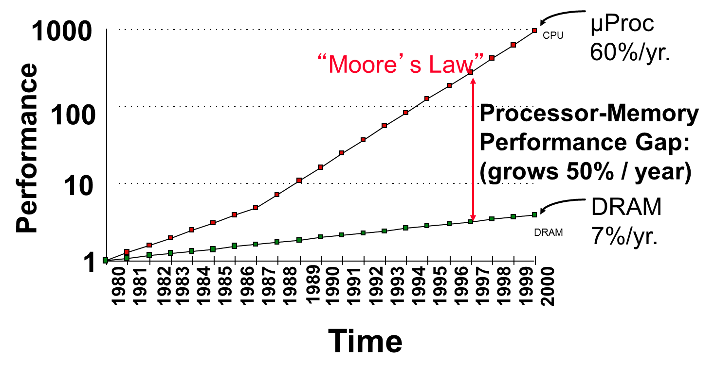
Processor-DRAM Gap (latency)
Main delay is mostly communication time
Memory is getting bigger (increases access times)
Slide Source: Jim Demmel
Notes:
Y-axis is performance
X-axis is time
Latency
Cliché:
Not e that x86 didn’t have cache on chip until 1989

Slide 18
Memory Hierarchy
Tape Archival Storage
Disk
L2 and L3 cache
(SRAM)
Main Memory
(DRAM)
L1 cache
On chip
 | Register | L1 | L2 | L3 | DRAM | Disk | Tape
Size | < 1 KB | ~1KB | 1 MB | 10’s MB | 1-100’s GB | TB | PB
Speed | < 1ns | <1 ns | ~1 ns | ~1-10 ns | 10-100 ns | 10 ms | ~10s

Slide 19
Techniques for exposing details of Memory
Determine memory access times experimentally using “micro”-benchmarks
Membench (Saavedra-Barrera), STREAM, others…
s
for array A of length L from 4KB to 8MB by 2x
for stride s from 4 Bytes (1 word) to L/2 by 2x
time the following loop
(repeat many times and average)
for i from 0 to L by s
load A[i] from memory (4 Bytes)
time the following loop
(repeat many times and average)
for i from 0 to L
load A[i] from memory (4 Bytes)
1 experiment

Slide 20
Membench: What to Expect
average cost per access
memory
time
size > L1
cache hit time
total size < L1
Consider the average cost per load
Plot one line for each array length: time vs. stride
If array is smaller than a given cache all accesses will hit (after first run)
Small stride is best: e.g. if cache line holds 4 words, expect ¼ miss
Picture assumes one-level cache
More difficult to measure on modern processors due to more complex memory systems
s = stride

Slide 21
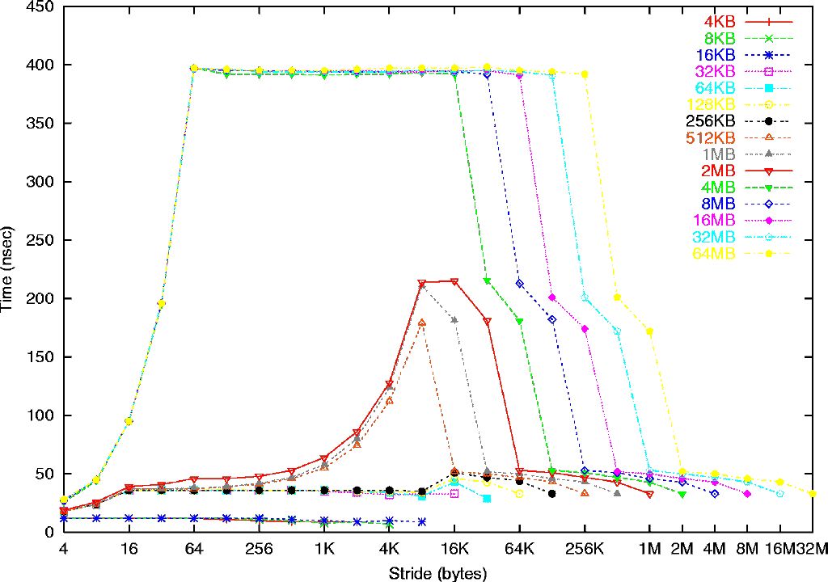
Array length
Mem: 396 ns
(132 cycles)
Example Membench Results
for
Sun Ultra-2i, 333 MHz
L2: 2 MB,
12 cycles (36 ns)
L1:
16 KB
2 cycles (6ns)
L1: 16 B line
L2: 64 byte line
8 K pages, 32 TLB entries
See www.cs.berkeley.edu/~yelick/arvindk/t3d-isca95.ps for details
Notes:
Each symbol is an experiment, vertical axis is time/load
Experiments with same length array share symbol, color, joined by line
Such experiments differ only in stride in bytes (horizontal axis)
note that minimum stride = 4 bytes = 1 word
4) Main Observation 1: complicated, depending on array length and stride
5) Main Observation 2: time/load ranges from 6 ns to 396 ns, 66x difference – important!
6) Detail 1: bottom 3 lines (4KB to 16KB) take 6 ns = 2 cycles, but 32KB and larger take longer
deduce that L1 cache is 16 KB, takes 2 cycles/word (yes, according to hardware manual)
7) Detail 2: next 6 lines (32 KB to 1MB) take 36ns = 12 cycles for small stride (2MB a little more)
but 4MB takes much longer:
deduce that L2 cache is 2MB, takes 12 cycles/word (yes)
8) Detail 3: remaining lines take 396 ns = 132 cycles for medium stride,
deduce that main memory takes 132 cycles/word
9) Detail 4: look at 32KB to 1MB lines, speed halves from stride 4 to 8 to 16, then constant
deduce that L1 line size is 16 bytes
10) Detail 5: look at 4MB to 64MB lines, speed halves from stride 4 to 8 to … to 64, then constant
deduce that L2 line size is 64 bytes
11) Detail 6: look at lines 32KB-256KB, vs 512 KB-2MB, increase up to 8KB stride of latter
deduce that page size is 8 KB, and TLB has 256KB/8KB = 32 entries

Slide 22
STREAM Benchmark
STREAM: Sustainable Memory Bandwidth in High Performance Computers
Measures sustainable memory bandwidth (in MB/s) based on simple vector kernels
Developed & maintained by Dr. John D. McCalpin at University of Virginia
Developing “second-generation” STREAM benchmark (STREAM2)
Emphasis is on measuring
Bandwidth of memory hierarchy, latency, other access patterns, locality (e.g. bandwidth and latency between distributed shared memory systems)
https://www.cs.virginia.edu/stream/ref.html
------------------------------------------------------------------
name kernel bytes/iter FLOPS/iter
------------------------------------------------------------------
COPY: a(i) = b(i) 16 0
SCALE: a(i) = q*b(i) 16 1
SUM: a(i) = b(i) + c(i) 24 1
TRIAD: a(i) = b(i) + q*c(i) 24 2
------------------------------------------------------------------

Slide 23
Single Core Parallelism
Pipelining
Like an assembly line, have different parts of processor doing things in parallel
Just know that this happens, you don’t have much ability to control this, other than perhaps some compiler options
Vector Instructions (SIMD)
SIMD = Single Instruction Multiple Data
As a programmer, you have some control over this…
Use of compiler options
Also have to write your code in a way that lets compiler recognize SIMD
Easily expressible in Fortran with intrinsic array operators and functions

Slide 24
Pipelining
In this example:
Sequential execution takes 4 * 90min = 6 hours
Pipelined execution takes 30+4*40+20 = 3.5 hours
Bandwidth = loads/hour
BW = 4/6 l/h w/o pipelining
BW = 4/3.5 l/h w pipelining
BW <= 1.5 l/h w pipelining, more total loads
Pipelining helps bandwidth but not latency (90 min)
Bandwidth limited by slowest pipeline stage
Potential speedup = Number pipe stages
Dave Patterson’s Laundry example: 4 people doing laundry
wash (30 min) + dry (40 min) + fold (20 min) = 90 min
Latency
6 PM
7
8
9
Time
T
a
s
k
O
r
d
e
r
30
40
40
40
40
20
A
B
C
D

Slide 25
Single Instruction Multiple Data
x0
x1
x2
x3
One operation produces multiple results
Implemented as SSE assembly instructions by compiler
SSE = Streaming SIMD Instructions
Several standards SSE (128-bit), SSE2, … SSE4, AVX (256-bit), AVX2 (512-bit)
Operate on anything that fits into x bytes (e.g. 16 bytes)
Operations include add, multiply, etc.
Challenges
Need to be contiguous in memory and aligned
Some instructions are needed to move data around from one register to another
+
y0
y1
y2
y3
=
x0+y0
x1+y1
x2+y2
x3+y3
256-bit wide vector
64-bit
128-bit
256-bit

Slide 26
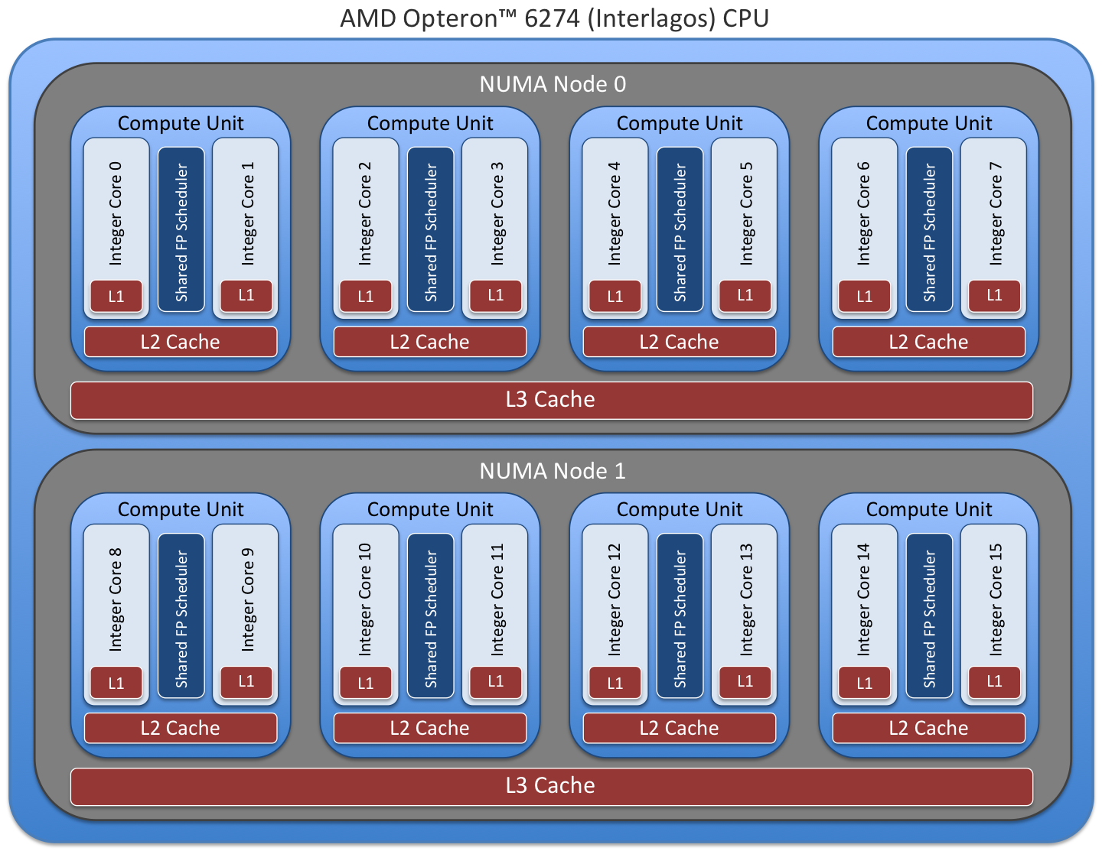
Cores, Processors, and Nodes OH MY!
We have been narrowly focused on a “single core”.
Many processors are “multi-core”
Common for motherboards to have multiple “sockets” or processors
A node has one motherboard, with multiple processors, and each processor has multiple cores
Other terminology
Symmetric Multi-processor (SMP)
Non-Uniform Memory Access (NUMA)
Illustration of Titan Compute Node [1]
[1] - https://www.olcf.ornl.gov/support/system-user-guides/titan-user-guide/

Slide 27
Flux node (generated by lstopo)

Slide 28
Contemporary HPC Platforms
Metadata Servers
Job Server
Scratch Space
(Lustre File system)
Login1
…
Compute Nodes
Login2
…
Home
Project
Archival
Storage
I/O Server
Data Transfer Nodes
Users

Slide 29
Memory Hierarchy for Distributed Machines
Tape Archival Storage
Disk
Node
L2 and L3 cache
(SRAM)
Main Memory
(DRAM)
L1 cache
On chip
 | Register | L1 | L2 | L3 | DRAM | Cluster | Disk | Tape
Size | < 1 KB | ~1KB | 1 MB | 10’s MB | 1-100’s GB | TB | TB | PB
Speed | < 1ns | <1 ns | ~1 ns | 1-10 ns | 20-100ns | 1-100 μs | 10 ms | ~10s

