Slide 1
Lecture 11 Serial Performance and Optimization
Prof. Brendan Kochunas
10/09/2019
NERS 590-004

Slide 2
Outline
Motivation
Defining Performance
Performance Analysis of Matrix-Vector Multiply
Common techniques for serial optimization
More advanced optimizations

Slide 3
Learning Objectives
Understand what computational intensity is
Understand how to construct and utilize a performance model
Understand tricks for optimizing code

Slide 4
Motivation and Defining Performance

Slide 5
Motivation for Performance
We can run more simulations in less time, and therefore get results quicker, learn quicker, publish quicker, graduate quicker, etc.
While some common algorithms have been optimized, not every algorithm has, and perhaps for your problem/algorithm this is an area of research.
However, many of the same techniques can be employed for various algorithms.
Matrix Size | myDGEMM | OpenBLAS | MKL
100 | 0.001 | 0.064 | 0.002
500 | 0.068 | 0.069 | 0.007
1000 | 0.559 | 0.291 | 0.034
2000 | 6.160 | 0.749 | 0.231
4000 | 50.341 | 2.822 | 1.682
30x!

Slide 6
What is performance?
What does it mean for a code to be fast?
How do you get fast code?
The real metric: Time
Do things efficiently in time
Derived metrics
FLOPS = FLoating Point OPerations per Second
Bandwidth = data per unit time (sort of like a flow rate)
Latency = Minimum time for data to travel from point A to point B
Theoretical Peak Performance
Very difficult to achieve in practice
Can be computed from hardware specs
Good serial metric: % of theoretical peak
...maybe
First: Choose the right algorithm
Second: Understand how to express that algorithm optimally in the programming language
Third: Understand how the source code will get mapped to the hardware
Fourth: Tune the code to the hardware
A lot of this can be done with pen and paper

Slide 7
Things to keep in mind about architecture
Processor
Registers
ALU
FPU
“Typical” Memory Hierarchy Access Times (circa 2015)
 | Register | L1 | L2 | L3 | DRAM | Cluster | Disk | Tape
Size | < 1 KB | ~1KB | 1 MB | 10’s MB | 1-100’s GB | TB | TB | PB
Speed | < 1ns | <1 ns | ~1 ns | 1-10 ns | 20-100ns | 1-100 μs | 10 ms | ~10s
L1 Cache
Data Cache
Instr. Cache
L2 Cache
… levels of cache
Main Memory

Slide 8
Peak Performance
Two Lessons from this:
This should be an easy calculation
Finding the right information can get quite complicated
Best to provide references e.g. document or presentation from the manufacturer
Example: Intel Haswell
What is the maximum FLOPs per cycle?
Need to look at SIMD information on processor
If we have AVX it supports a 256-bit vector so it can operate on 4 doubles
Does it support a fused multiply add (FMA instruction)?
Yes, so the chip can execute 4 FMA instructions (8 FLOPs) at once
How many vector units does it have?
Apparently it has 2 vector units… so now we’re at 16 FLOPs at once
How many cycles to execute an FMA instruction (which is two operations)?
Not always easy to find… common to assume 1 cycle.
However there may be other limiting factors such as latency (5 cycles in this case)
What is the clock speed (cycles per second)? 2.50 GHz
Well with AVX it appears to be 2.1 GHz
How many cores does it have? 12
16 FLOPs/cycle × 2.5e9 cycles/second × 12 cores = 480 GFLOPS
16 FLOPs ÷ 5 cycle × 2.1e9 cycles/second × 12 cores = 80 GFLOPS
Another derived metric is fraction of theoretical peak

Slide 9
Algorithm Performance
Not all algorithms are created equally
e.g. Big-O notation O(n²) vs O(n log n)
Not all implementations (algorithms really) are created equally
Can have “same” implementations with vastly different performance
Very few algorithms allow you to achieve sustained performance at a significant fraction of the theoretical peak
Let’s go through an example

Slide 10
Simple Performance Model
Assume just 2 levels of memory in hierarchy: fast memory and slow memory
Consider a model to predict execution time for some set of operations
Minimum possible time is Ft_{F} when all data is in fast memory
Can also rewrite as
F= # of FLOPs
L=# of loads
t_{F} = time for flop
t_{M}= time for memory load/store
T = execution time
t_{M}/t_{F} is machine balance → key to machine efficiency
Generally t_{F} << t_{M}
F/L=q is computational efficiency → key to algorithm efficiency
Larger q means time is closer to minimum.
q ≥ t_{M} / t_{F} to get at least half of the peak speed!

Slide 11
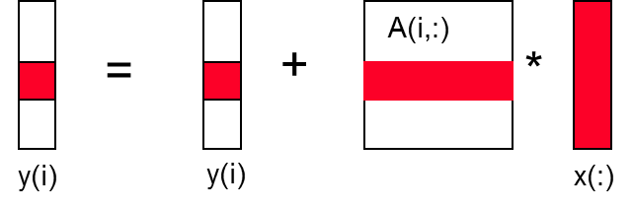
Matrix-Vector Multiply
{implements y = y + A*x}
for i = 1:n
for j = 1:n
y(i) = y(i) + A(i,j)*x(j)

Slide 12
Analysis of Matrix-Vector Multiply
{read x(1:n) into fast memory}
{read y(1:n) into fast memory}
for i = 1:n
{read row i of A into fast memory}
for j = 1:n
y(i) = y(i) + A(i,j)*x(j)
{write y(1:n) back to slow memory}
Assume all data for variables starts in slow memory
L = number of slow memory loads & stores
F = number of arithmetic operations
q =
Notes:
L = n^2 + 3n
F = 2n^2
q = 2

Slide 13
Plug-n-Chug
Some real data
From Flux t_{M} =8 ns (assuming L3 access time) and assume t_{F} = 0.3 ns (1 cycle)
machine balance
(q must be at least
this for ½ peak speed)
Table B.1 and B.2 from R. Vuduc Dissertation: http://bebop.cs.berkeley.edu/pubs/vuduc2003-dissertation.pdf

Slide 14
Simplifying Assumptions
Lets make sure we’re aware of the simplifying assumptions in this model and analysis
Ignored parallelism in processor between memory and arithmetic within the processor
Sometimes drop arithmetic term in this type of analysis
Assumed fast memory was large enough to hold three vectors
Reasonable if we are talking about any level of cache
Not if we are talking about registers (~32 words)
Assumed the cost of a fast memory access is 0
Reasonable if we are talking about registers
Not necessarily if we are talking about cache (e.g. 1 or 2 cycles for L1)
Memory latency is constant
So this analysis still assumes a “best case” scenario

Slide 15
Other Performance Models
Latency based execution time model for “Single Processor”
Most generally when dealing with complex kernels
F= # of FLOPs
L=# of loads
α = cache access latency
M = cache misses
T = execution time
N_{i} = Number of operations of type i
t_{i} = time to execute operation of type i

Slide 16
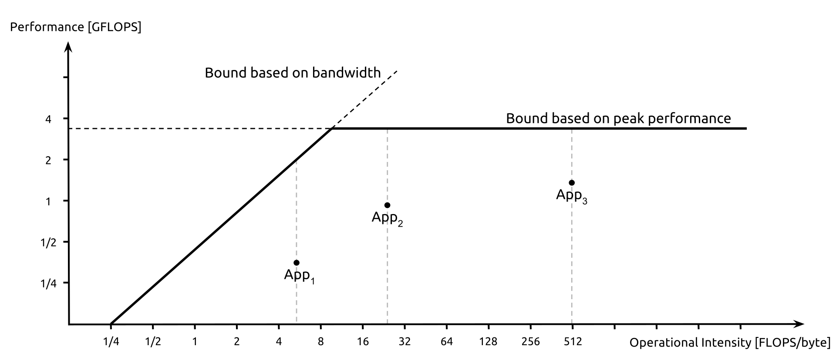

Roofline Models
Visual representation of performance relating arithmetic intensity (q) and hardware performance limits
$$q=\frac{F}{L}$$

Slide 17
Optimization

Slide 18
Things people say about Optimization
"We should forget about small efficiencies, say about 97% of the time: premature optimization is the root of all evil. Yet we should not pass up our opportunities in that critical 3%. A good programmer will not be lulled into complacency by such reasoning, he will be wise to look carefully at the critical code; but only after that code has been identified"
Donald Knuth
“You’re bound to be unhappy if you optimize everything”
Donald Knuth
“The best optimization you will ever have is to have your program go from not working to working”
paraphrasing

Slide 19
How Optimization Should Look (Profiling)
Kernel or Solver (~10%)
Rest of code (~10%)
Rest of code (~90%)
Kernel or Solver (~90%)
Lines of Code
Contribution to Execution Time

Slide 20
Common Optimization Techniques
Before you program
Choose the best algorithm
e.g. choose known fastest converging algorithms or algorithms with asymptotically small operation counts
Choose the best way to express this algorithm in a programming language
Perform algebra to minimize operations or minimize memory traffic and communication
Design data structures around computational kernels & maximize cache locality
As you are programming
compiler optimization flags
choose best operators (remove unnecessary FLOPs)
loop unrolling (pipelining & vectorization)
remove conditionals (lets compiler optimize loops better)
function tabulation (remove unnecessary FLOPs)

Slide 21
Compiler flags
GCC compiler option | Meaning
-O0 | Reduce compilation time and make debugging produce the expected results. This is the default.
-O1 | compiler tries to reduce code size and execution time, without performing any optimizations that take a great deal of compilation time. (favors size of executable)
-O2 | Performs nearly all supported optimizations that do not involve a space-speed tradeoff. Includes all -O1 optimizations
-O3 | Highest level of optimization. Includes all -O2 optimizations
-Ofast | Disregard strict standards compliance. -Ofast enables all -O3 optimizations. It also enables optimizations that are not valid for all standard-compliant programs.
-Og | Optimizations safe for debugging
-fipa-pta | Perform interprocedural pointer analysis and interprocedural modification and reference analysis. This option can cause excessive memory and compile-time usage on large compilation units. It is not enabled by default at any optimization level.
-funsafe-math-optimizations | Allow optimizations for floating-point arithmetic that (a) assume that arguments and results are valid and (b) may violate IEEE or ANSI standards.

Slide 22
Operator Choice
Avoid exponentiation
Polynomial evaluation
e.g. Correlations for material properties, Semi-empirical models for coefficients
Division is allegedly more expensive than multiplication
t2=t**2.0 !slowest
t2=t**2 !slow
t2=t*t !fastest
When its unavoidable
c=a**b
c=EXP(b*LOG(x)) !may be faster
rc=1.0d0/c
DO i=1,n
a(i)=b(i)*c
ENDDO
DO i=1,n
a(i)=b(i)/c
ENDDO

Slide 23
Expose Independent Operations
Hide instruction latency
Use local variables to expose independent operations that can execute in parallel or in a pipelined fashion
Balance the instruction mix (e.g. what functional units are available?)
f1 = f5 * f9;
f2 = f6 + f10;
f3 = f7 * f11;
f4 = f8 + f12;

Slide 24
Exploit Multiple Registers
Reduce demands on memory bandwidth by pre-loading into local variables
also: register float f0 = …;
float f0 = filter[0];
float f1 = filter[1];
float f2 = filter[2];
while( … ) {
*res++ = f0*signal[0]
+ f1*signal[1]
+ f2*signal[2];
signal++;
}
while( … ) {
*res++ = filter[0]*signal[0]
+ filter[1]*signal[1]
+ filter[2]*signal[2];
signal++;
}

Slide 25
Loop Unrolling
Compilers are not necessarily very good (or not as good as we’d like sometimes) at interpreting how to optimize loops
So compilers will do this if right flags are provided and loops are “clear” enough to compiler
!works correctly only if the array size is a multiple of 4
subroutine lngth4(n,a,s)
integer :: n
real(8) :: s,a(n)
integer :: i
real(8) :: t1,t2,t3,t4
t1=0.d0; t2=0.d0; t3=0.d0; t4=0.d0
do i=1,n-3,4
t1=t1+a(i)*a(i)
t2=t2+a(i+1)*a(i+1)
t3=t3+a(i+2)*a(i+2)
t4=t4+a(i+3)*a(i+3)
enddo
s=t1+t2+t3+t4
endsubroutine
subroutine lngth1(n,a,s)
integer :: n
real(8) :: s,a(n)
integer :: i
s=0.d0
do i=1,n
s=s+a(i)*a(i)
enddo
endsubroutine
Unrolled to a depth of 4

Slide 26
Loop Unrolling (2)
Exploits vector instructions and pipelining
Cannot be done to arbitrary size
Registers will get overloaded
Size should be “register-blocked” or “cache-blocked”.
subroutine lngth4(n,a,s)
integer :: n
real(8) :: s,a(n)
integer :: i
real(8) :: t1,t2,t3,t4,tr
t1=0.d0; t2=0.d0; t3=0.d0; t4=0.d0; tr=0.d0
do i=1,n-3,4
t1=t1+a(i)*a(i)
t2=t2+a(i+1)*a(i+1)
t3=t3+a(i+2)*a(i+2)
t4=t4+a(i+3)*a(i+3)
enddo
do j=n-MOD(n,4)+1,n
tr=tr+a(j)*a(j) !in practice need “remainder”
enddo
s=t1+t2+t3+t4+tr
endsubroutine

Slide 27
Remove conditionals from loops
Loops that have branching constructs are usually not optimized by compiler
Set all even indices to 0 and all odd indices to 1
DO i=1,SIZE(a)
IF(MOD(i,2 == 1)) THEN
a(i)=1
ELSE
a(i)=0
ENDIF
ENDDO
DO i=1,SIZE(a),2
a(i)=1
ENDDO
DO i=2,SIZE(a),2
a(i)=0
ENDDO
DO i=1,SIZE(a)-1,2
a(i)=1
a(i+1)=0
ENDDO
IF(MOD(SIZE(a),2) == 1) &
a(SIZE(a))=1

Slide 28
Removing False Dependencies
Using local variables, reorder operations to remove false dependencies
With some compilers, you can declare a and b unaliased.
Done via “restrict pointers”, compiler flag, or pragma.
a[i] = b[i] + c;
a[i+1] = b[i+1] * d;
false read-after-write hazard
between a[i] and b[i+1]
float f1 = b[i];
float f2 = b[i+1];
a[i] = f1 + c;
a[i+1] = f2 * d;

Slide 29
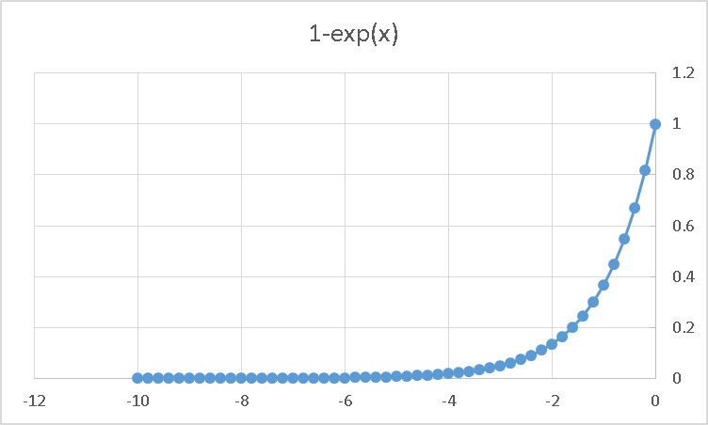
Function tabulation
Some special functions (exponential, logarithm, gamma function, error function, etc.)
Require many FLOPs to evaluate to double precision.
Tabulate function and linearly interpolate result
Introduces interpolation error.
Error is generally proportional to of table size
If evaluating the table A LOT, want table to be small enough to fit into cache
In some cases, we can accept interpolation error because we do not know physical value to double precision (e.g. 15 digits) accuracy.

Slide 30
More advanced techniques
Algorithm has 2*n³ = O(n³) Flops and operates on 3*n² words of memory
q potentially as large as 2*n³ / 3*n² = O(n)
Memory blocking
Cache oblivious ordering
Communication Avoiding Algorithms (State of the Art)
Naïve Matrix Multiply
{implements C = C + A*B}
for i = 1 to n
{read row i of A into fast memory}
for j = 1 to n
{read C(i,j) into fast memory}
{read column j of B into fast memory}
for k = 1 to n
C(i,j) = C(i,j) + A(i,k) * B(k,j)
{write C(i,j) back to slow memory}
C(i,j)
C(i,j)
A(i,:)
=
+
*
B(:,j)

Slide 31
Memory Blocking (Tiling)
Idea: improve computational intensity and temporal locality of data.
Consider A,B,C to be N-by-N matrices of b-by-b subblocks where b=n / N is called the block size
for i = 1 to N
for j = 1 to N
{read block C(i,j) into fast memory}
for k = 1 to N
{read block A(i,k) into fast memory}
{read block B(k,j) into fast memory}
C(i,j) = C(i,j) + A(i,k) * B(k,j) {do a matrix multiply on blocks}
{write block C(i,j) back to slow memory}
C(i,j)
C(i,j)
A(i,k)
=
+
*
B(k,j)

Slide 32
Analysis of Blocked Matrix Multiply
Recall:
m is amount memory traffic between slow and fast memory
matrix has nxn elements, and NxN blocks each of size bxb
f is number of floating point operations, 2n³ for this problem
q = f / m is our measure of algorithm efficiency in the memory system
So
m = N*n² read each block of B N³ times (N³ * b² = N³ * (n/N)² ⁼ N*n²)
+ N*n² read each block of A N³ times
+ 2n² read and write each block of C once
= (2N + 2) * n²
So computational intensity q = f / m = 2n³ / ((2N + 2) * n²)
≈ n / N = b for large n
So we can improve performance by increasing the blocksize b
Can be much faster than matrix-vector multiply (q=2)
Larger block size = more efficient
Limit: All three blocks from A,B,C must fit into fast memory
Assume fast memory size M_{fast}
3b² ≤ M_{fast}, so q ≈ b ≤ (M_{fast}/3)^{1/2}

Slide 33
Cache Oblivious Algorithms
Typically implemented as recursive algorithms and recursive data structures
Tiled algorithm requires finding good block size (will depend on hardware)
Cache Oblivious Algorithms offer an alternative
Idea is to order things in memory to minimize latency with multiple levels of memory hierarchy.
Make use of Space Filling Curves
Advantages:
the recursive layout works well for any cache size
Disadvantages:
The index calculations to find A[i,j] are expensive
Implementations switch to column-major for small sizes
Z-Order Space Filling Curve

Slide 34
Summary of Serial Optimizations
Details of machine are important for performance
Processor and memory system (not just parallelism)
What to expect? Use understanding of hardware limits
Machines have memory hierarchies
100s of cycles to read from DRAM (main memory)
Caches are fast (small) memory that optimize average case
There is parallelism hidden within processors
Pipelining, SIMD, etc
Data locality is at least as important as computation
Temporal: re-use of data recently used
Spatial: using data nearby that recently used
Can rearrange code/data to improve locality
Goal: minimize communication = data movement
Performance intensive code should be written clearly for compiler (not for humans)

