Slide 1
Lecture 13 Parallel Algorithms & Performance
Prof. Brendan Kochunas
10/21/2019
NERS 590-004

Slide 2
Outline
Motivation and Big Picture
Quick Review of Parallel Architectures
Types of parallelism and their algorithms/programming models
Ingredients of parallel algorithms
Common problems with debugging parallel code
Parallel Performance Metrics
Algorithm Performance Example:
Neutron transport

Slide 3
Motivation
We may understand the mathematical formulations of our problems.
We may understand “simple” ways to implement these on a computer.
We’re interested in advancing our algorithms to perform simulations (and conduct science) at a faster pace.
This requires knowledge of how to take our algorithms and devise parallel models for use on today’s supercomputers
(and tomorrow’s desktops)

Slide 4
Today’s Learning Objectives
Knowledge of what techniques are used to develop parallel algorithms
And the types of problems this creates
How do parallel algorithms map to hardware?
What are the problems I should expect to encounter in parallel programming?
What metrics are useful for evaluating the quality of a parallel algorithm?
Performance models can be developed for complex serial and parallel algorithms,
and analysis of these models can give us insight into our algorithms.

Slide 5
Flux node
Architecture

Slide 6
Contemporary HPC Platforms
Metadata Servers
Job Server
Scratch Space
(Lustre File system)
Login1
…
Compute Nodes
Login2
…
Home
Project
Archival
Storage
I/O Server
Data Transfer Nodes

Slide 7
Types of Parallel Algorithms

Slide 8
Distributed Memory Parallelism
Each process has its own memory.
Data between processes must be explicitly communicated.
Usually more difficult to convert serial programs to distributed memory execution models
Generally much easier to design software from ground up to run with distributed memory
Common programming models
MPI
Unified Parallel C (UPC), Fortran Co-arrays

Slide 9
Typical Algorithms for Distributed Memory Parallelism
Master/Worker
Bulk Synchronous
Master usually does more variety of work (e.g. I/O)
Master controls execution of workers. Sends workload to workers
Periodic synchronization
Large workloads on processors between synchronization.
Master
Worker
Worker
Worker
Worker
Figure from: D. Keyes, “Algorithmic Adaptations to Extreme Scale Computing”, ATPESC Workshop Presentation, (2013).
Notes:
CITE FIGURE

Slide 10
Shared Memory Parallelism
All processes “see” the same memory.
Changes by one process to main memory are visible to all processes
Usually low overhead to implement with current programming models
Not always easy to get good performance
Common programming models
pthreads (POSIX)
OpenMP
Kokkos

Slide 11
Typical Algorithms in Shared Memory Parallelism
Fork/Join
Pool of Tasks
Simple loop parallelization
Tasks and work assignment are usually dynamic.
!Serial Section
DO PARALLEL i=1,n !implied fork
!some operations for i
END DO PARALLEL !implied join
Worker
Worker
Worker
Worker
Scheduler
Tasks
Worker
Worker
Fork
Join

Slide 12
Hybrid Parallelism
You guessed it, combines distributed and shared memory.
This is representative of most modern compute clusters.
But remember these machines are configured to be able to run flexibly as either purely distributed, hybrid, or (if the programming model exists) purely shared memory.
Cluster of multi-core machines.
Distributed memory
Shared memory

Slide 13
A few closing points
Distributed memory algorithms and shared memory algorithms are not necessarily mutually exclusive
e.g. your code may make use of some combination of these
There are other types of algorithms, but these are the “most common”
Generally, parallel algorithms typically require some definition of how the memory is treated between the parallel processes
This can be abstracted away from the hardware.

Slide 14
Parallel Algorithm “Ingredients”

Slide 15
Parallel Algorithm Ingredients
What is the programming model? (distributed, shared, both)
If distributed, what is the communication model?
What should the granularity of the parallelism be?
How are you going to decompose the problem in parallel?
How are you going partition the problem to obtain a balanced decomposition?
Can all this be done once for a single simulation?
What synchronizations are required?

Slide 16
Coarse Grained vs. Fine Grained
Coarse Grained
Fine Grained
Divide work into large tasks
Example: executing several functions
Coarse grained parallelism usually has better strong scaling than fine-grained parallelism.
Although smaller limits to the maximum parallelism
More susceptible to load imbalance.
Divide work into many small tasks
Example: iterations of a loop
Usually has good load balance
Difficult to hide overhead from parallelism
Works well for things like SIMD & vector computing
Algorithm & Hardware will ultimately determine which is better. However, coarse-grained will usually be better

Slide 17
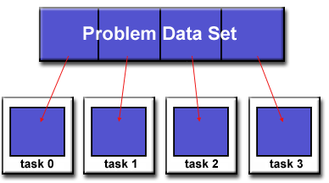
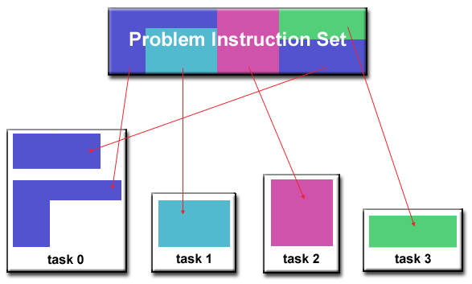
Decomposition
What is being divided into parallel work?
Most typical is domain decomposition
Divide up part of your equation “phase space”
Phase space = dependent variables of unknown (e.g. Cartesian space)
Slightly different is data decomposition
e.g. decompose a matrix in parallel
Matrix is usually a discretization of the phase space(s)
Also have functional decomposition
Decompose by computation or operation
e.g. fluid on one process, solid on another for convective/conductive heat transfer
Figures from: https://computing.llnl.gov/tutorials/parallel_comp/

Slide 18
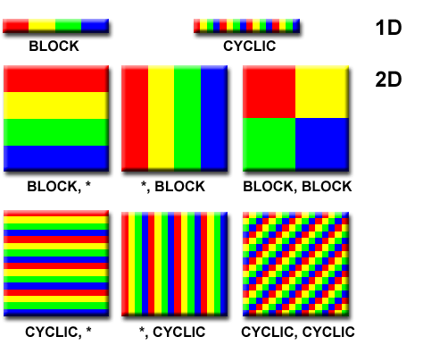
Partitioning
How do you decompose the problem in parallel?
Example: Matrix partitioning
In general this is a much harder problem.
Especially for the general case.
Involves a lot of graph theory
Libraries exist to do this for us: METIS & ParMETIS
Figures from: R. Vuduc, “Graph Partitioning,” Lecture in CSE/CS 8803, Georgia Institute of Technology, April 2008
Figure from: https://computing.llnl.gov/tutorials/parallel_comp/

Slide 19
Dynamic vs. Static
Static
Dynamic
Determine decomposition and partitioning once up-front prior to execution.
Execute without changing number of processors or decomposition or partitioning
Fork/Join is not considered dynamic if the number of threads always the same
More likely you will encounter this case
Necessary to achieve better performance if computation load changes during run time.
Change number of processors during run time.
Change partitioning during run time.

Slide 20
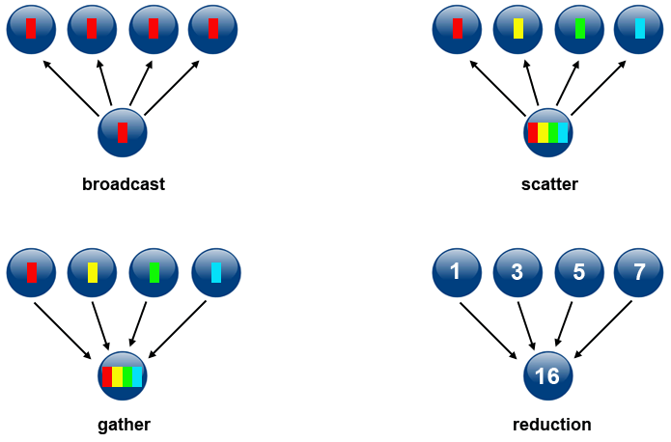
Synchronization
Illustrations of collective operations
Generally, best to avoid as much as possible
In practice, never completely avoidable.
In shared memory parallelism this includes the fork and join operations.
Synchronization usually occurs whenever you encounter an integral.
More generally it occurs with “reduction” operations.
In a reduction operation you reduce parallel data to a single process
E.g. computing a sum, finding a max, computing a product, logical operators
In distributed memory parallelism (more specifically MPI), it is any collective operation (not just reduce)
Critically important to be aware of collective operations
Figure from: https://computing.llnl.gov/tutorials/parallel_comp/

Slide 21
Parallel Programming Pitfalls

Slide 22
Parallel Programming Sounds Easy… but
But it is much harder than programming in serial
There is a whole new world of bugs that you can encounter
Deadlocks and Race conditions
Efficiency is more difficult to achieve
Generally have to be more aware of what’s going on…

Slide 23
Deadlock
Problem
Solution
Symptoms
Code will run for a while
Then code will “hang”.
Code just sits... and sits... and sits.
Investigate where your calls to communication are made.
Usually will happen around branching constructs.
Think about how it would execute with 2 processors.
IF(MOD(myRank,2) == 0) THEN
CALL MPI_Send(sbuffer, n, MPI_DOUBLE_PRECISION, &
myRank+1, 0, MPI_COMM_WORLD, mpierr)
CALL MPI_Recv(rbuffer, n, MPI_DOUBLE_PRECISION, &
myRank+1, 0, MPI_COMM_WORLD, MPI_STATUS_NULL, mpierr)
ELSE
CALL MPI_Send(sbuffer, n, MPI_DOUBLE_PRECISION, &
myRank-1, 0, MPI_COMM_WORLD, mpierr)
CALL MPI_Recv(rbuffer, n, MPI_DOUBLE_PRECISION, &
myRank-1, 0, MPI_COMM_WORLD, MPI_STATUS_NULL, mpierr)
ENDIF
IF(MOD(myRank,2) == 0) &
CALL MPI_Reduce(sbuf,rbuf,n,MPI_DOUBLE_PRECISION, MPI_SUM, &
0, MPI_COMM_WORLD, mpierr)
IF(MOD(myRank,2) == 0) THEN
CALL MPI_Send(sbuffer, n, MPI_DOUBLE_PRECISION, &
myRank+1, 0, MPI_COMM_WORLD, mpierr)
CALL MPI_Recv(rbuffer, n, MPI_DOUBLE_PRECISION, &
myRank+1, 0, MPI_COMM_WORLD, MPI_STATUS_NULL, mpierr)
ELSE
CALL MPI_Recv(rbuffer, n, MPI_DOUBLE_PRECISION, &
myRank-1, 0, MPI_COMM_WORLD, MPI_STATUS_NULL, mpierr)
CALL MPI_Send(sbuffer, n, MPI_DOUBLE_PRECISION, &
myRank-1, 0, MPI_COMM_WORLD, mpierr)
ENDIF

Slide 24
Race Conditions
Problem
Solution
Symptoms
Indeterminate behavior.
Seemingly random values are produced
Shared memory parallelism
Create separate storage for each thread
Reduce values among threads at end of parallel execution
Introduce a serialization/lock/critical section on variable
s=0.0
PARALLEL DO i=1,n
s(t)=s(t)+a(i)*a(i)
END PARALLEL DO
sum=SUM(s(1:nthreads))
sum=0.0
PARALLEL DO i=1,n
sum=sum+a(i)*a(i)
END PARALLEL DO
Thread 1
Thread 2
sum=0.0
PARALLEL DO i=1,n
!Critical
sum=sum+a(i)*a(i) !One thread at a time
END PARALLEL DO
sum
0.0
i=1
i=2
0.0+a(1)*a(1)
0.0+a(2)*a(2)
sum
???
Notes:
Callback to fine grained

Slide 25
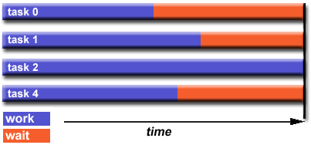
Load Balance & Idle Time
Problem
Solution
Poor strong scaling
Poor parallel efficiency
Increase cores by factor of 2x, do not observe 2x speedup.
Determine what the load balance/imbalance is
Need to assign a value of “work” to each subdomain.
What is the maximum to minimum workload for all domains.
Change partitioning to improve load balancing
Change parallel algorithm

Slide 26
State of the Art Techniques in Load Balancing and Scheduling
Utilize Directed Acyclic Graphs (DAGs)
Decompose your algorithm into a DAG
Use algorithms for dynamic or optimal scheduling on the DAG
Improves performance on multicore/hybrid architectures
Figures from: J. Dongarra, “Adaptive Linear Solvers and Eigensolvers”,ATPESC Workshop Presentation, (2013).

Slide 27
Summary of Programming Pitfalls
If you think debugging serial programs is difficult, debugging parallel programs is often exponentially harder.
Before you get a bruise from banging your head against the wall
Take a step back and ask yourself what’s the behavior you are observing
Then think like a (medical) doctor, and try to diagnose the problem based on the symptoms.
Race conditions and deadlocks are really easy to implement accidentally.
Resolving load imbalance often requires a lot of effort.

Slide 28
Parallel Performance

Slide 29
Parallel Performance Metrics
Strong Scaling: fixes problem size and increases number of processors.
Provides insight into how finely grained an algorithm can be parallelized and how much parallel overhead there is relative to useful computation
Weak Scaling: fixes problem size per process and increases number of processors.
Provides insight into whether the parallel overhead varies faster or slower than the amount of work as the problem size is increased.
Speedup and Efficiency:
Good efficiency does not necessarily mean you have fast code
It could mean you have terrible serial performance

Slide 30
Parallel Execution Time Models
Moving from serial to parallel
Canonical Execution Time Models
Serial Latency based model
Parallel Model
Difficult to develop exact expressions,
Alternatively measure realistic average values based on microbenchmarks.
Distributed Memory Computing
Point-to-Point Communication Time
Collective operations have their own (depends on algorithm implemented in library)
Latency
Bandwidth
Amount of data
Time to perform reduce operation (e.g. sum, max, multiply, etc.)

Slide 31
Fundamentals of getting good parallel performance
Maximize amount of work that can be parallelized.
Minimize overhead.
Usually this means
Balance work loads among processors
Avoid synchronization
Especially for shared memory
use non-blocking communication
Primarily in distributed memory models
Make sure the serial code is optimized.
Assumes perfect load balance
Minimize
Minimize

Slide 32
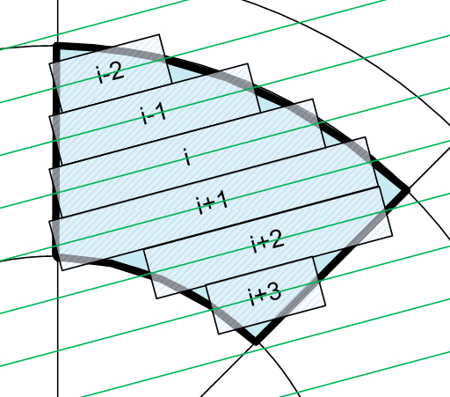
Example of More Complex Performance Models: Neutron Transport
k
k
k
k
Segment average angular flux
k
k
Region average angular flux
Propagation of flux along a characteristic segment

Slide 33
Parallel Decomposition
Spatial
decomposition
Angular decomposition
angle 1
angle 2
Ray Decomposition
Thread 1
Thread 2

Slide 34
Summary of Parallel Kernel
build
exp
MOC
scal
BCUp
flux

Slide 35
Serial Performance Model
The time to perform a sweep is represented by the different components of the algorithm.
Number of FLOPs and Loads as function of the problem size
Component | FLOPs | Loads | Computational Intensity (FLOPs/Loads)
build
exp |  |  | 0.5
MOC |  |  | 0.75
BC | 0 |  | 0
BCUp | 0 |  | 0
scal |  |  | ~1.0
flux |  |  | 1.0
Sweep (Total)

Slide 36
Validation of Serial Performance Model
Relative Difference Between Performance Model
and Experimentally Measured Performance
Case | FLOPs | Loads | Exec. Time
Default | 0.0002% | -5.54% | -7.41%
Fine Angles | 0.0002% | -6.89% | -7.38%
Fine Rays | 0.00007% | -12.19% | 4.45%
Fine Space | 0.0001% | 0.70% | -1.89%
Performance Model Prediction
Measured

Slide 37
Parallel Performance Model
Serial
Parallel
Spatial Decomposition
Angular Decomposition
Ray Decomposition

Slide 38
Comparison of Measured and Predicted Parallel Efficiency for Strong Scaling
N_{p} | Ray Decomposition |  |  | Angle Decomposition |  |  | Space Decomposition
 | by FPU | by core | Model | by FPU | by core | Model | by FPU | by core | Model
2 | 104.9% | 53.5% | 99.40% | 101.8% | 80.00% | 99.03% | N/A | N/A | N/A
4 | 100.5% | 67.04% | 97.89% | 98.18% | 78.88% | 97.15% | N/A | N/A | N/A
8 | 87.49% | 67.33% | 94.22% | 96.05% | 71.03% | 93.60% | 98.91% | 76.32% | 99.52%
16 | N/A | 62.17% | 86.78% | 89.30% | 63.85% | 87.22% | N/A | N/A | N/A
64 | N/A | N/A | N/A | N/A | N/A | N/A | 93.14% | 71.66% | 98.69%
AMD Opteron 6200 Series
“Interlagos” Processor Micro-architecture

Slide 39
Parallel Efficiency of Spatial Weak Scaling
Comparison of Predicted and Measured Weak Scaling Efficiency for Spatial Decomposition
Weak Scaling Efficiency for Spatial Decomposition with Different Reference Cases

Slide 40
Serial Performance Model Hardware Sensitivities

Slide 41
Parallel Performance Model Network Hardware Sensitivity

Slide 42
Parallel Performance Model Sensitivity to Number of Domains

