Slide 1
Lecture 18 Heterogeneous Architectures
Prof. Brendan Kochunas
11/06/2019
NERS 590-004

Slide 2
Outline
Introduction
GPU Architecture
Programming GPUs
CUDA
Others
Kokkos

Slide 3
Motivation
Hardware limits of serial performance
Moore’s law no longer holds
Performance gain is now often gained through parallelism
GPUs offer massive parallelism
Required to use GPUs on some modern HPC clusters!

Slide 4
Learning Objectives
Basic knowledge of GPU architecture
Knowledge of how to program for GPUs
CUDA, Kokkos
What is important for efficiency?
Memory Layout
Thread Scheduling
Portability

Slide 5
What is a GPU? Why do we care?
Graphics Processing Unit
As the name suggests, historically used for processing graphics
Card in computer (PCI/PCIe)
Unified shader pipeline – different “shaders” used in graphics processing
All shaders require: texturing (data loads), math operations (FLOPs)
Unified pipeline allows for better GPU utilization
Data loads + math operations? Sounds a lot like normal computing?
GPGPU – General Purpose GPU
GPUs unified shader pipeline allows for us to use them in general computing!

Slide 6
Why use a GPU?
GPUs have a lot of small cores
Opportunity for massive parallelism
But… threads are executed in SIMD within warps! (Data parallelism)
CPU is “low latency, low throughput”
Serial and moderate parallel calculations
GPU is “high latency, high throughput” → streaming processor
i.e. good for most highly parallel applications (think simulations)

Slide 7
GPU Architecture
Notes:
- Make diagram using lstopo – add GPU (slide 1)

Slide 8
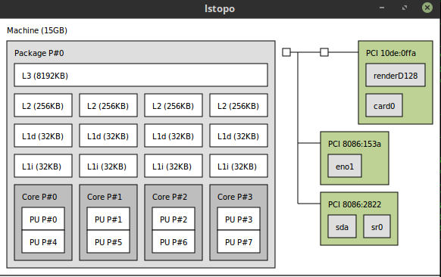
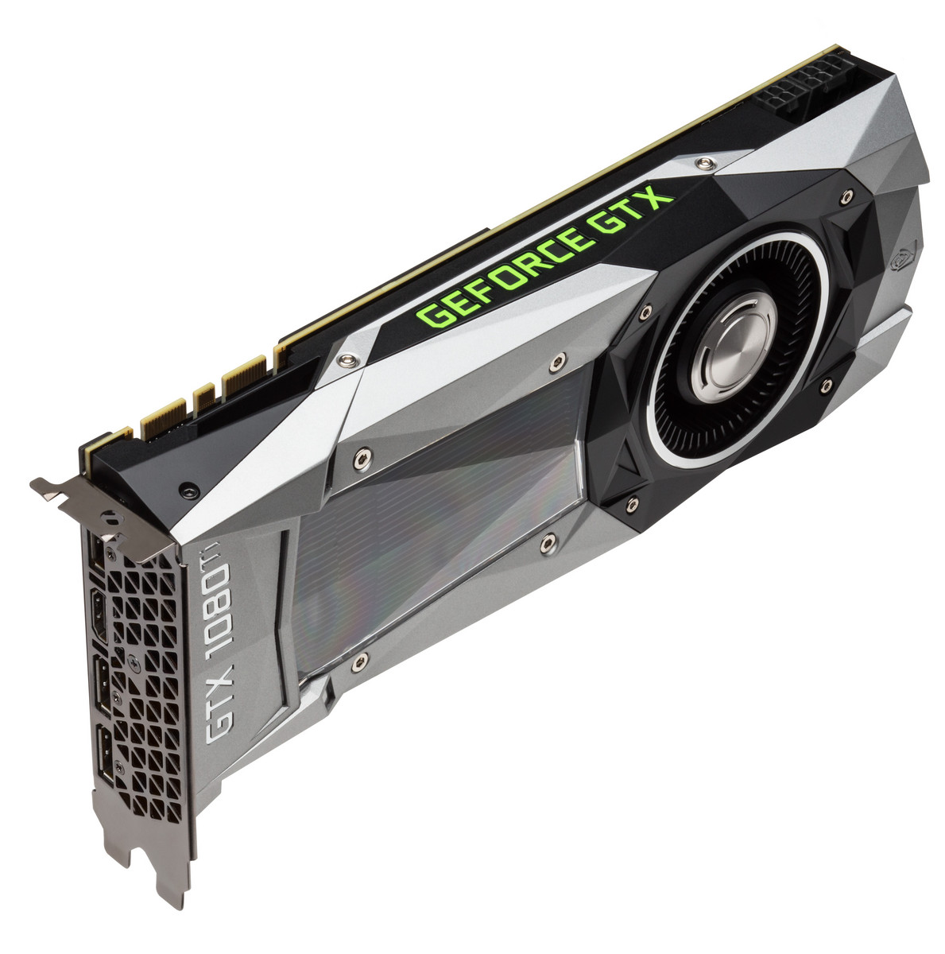
lstopo
CPU shown on the left (NUMA node)
See each core, cache-level
GPU is shown as a PCI device (right)
https://www.google.com/search?q=image+of+gpu&source=lnms&tbm=isch&sa=X&ved=0ahUKEwixsvnYnMDeAhUE0oMKHSXXC7IQ_AUIEygB&biw=1368&bih=722#imgrc=J4rnsk1P30xTOM:

Slide 9
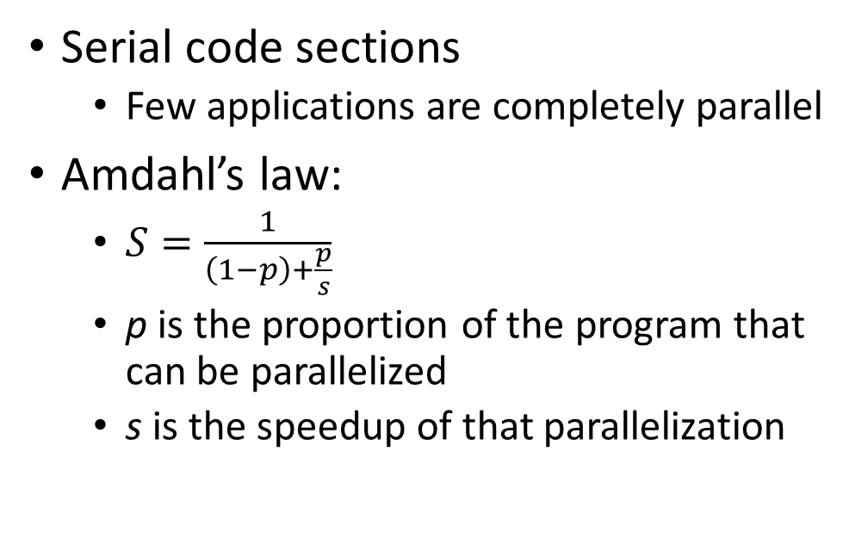
Heterogeneous System Architectures
Serial code sections
Few applications are completely parallel
Amdahl’s law:
$S=\frac{1}{\left(1−p\right)+\frac{p}{s}}$
p is the proportion of the program that can be parallelized
s is the speedup of that parallelization
Read Input
Setup
Parallel Computation
Serial Computation
Output
CPU
Visualization
GPU

Slide 10
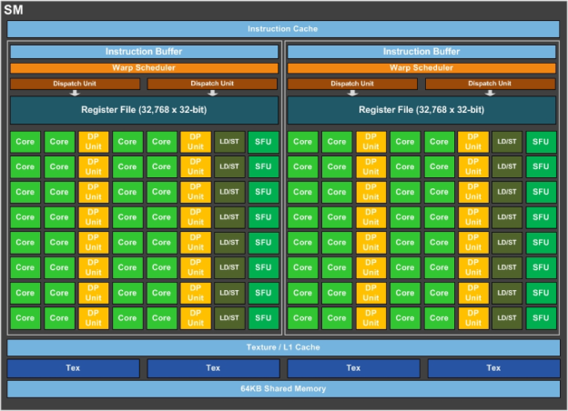
GPU Architecture
A modern GPU has several Streaming Multiprocessors (SMs)
Pascal SM - 64 CUDA cores
Tesla GP100 – 56 SMs
Totally: 3584 CUDA cores
Each SM has “warps” (2)
Each warp performs operations in SIMT fashion
Single Instruction Multiple Thread
https://devblogs.nvidia.com/inside-pascal/

Slide 11
CPU vs GPU
CPUs
GPUs
Designed for Task Parallelism:
Each thread executes a task
Tasks have different instructions
Relatively low number of threads
Within core/thread SIMD (4)
Large cache to hide latency
Only option for serial applications
Data Parallelism:
SIMT model (SIMD)
Same instruction on different data
Large number of threads (10,000+)
Stream Processing:
Large set of data (stream)
Run same series of operations on all the data
Series of operations is called a kernel

Slide 12
CUDA

Slide 13
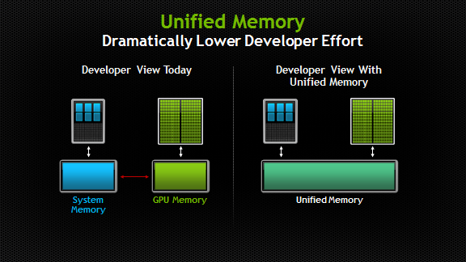
CUDA
CUDA is a platform and API for utilizing GPUs
C/C++ and Fortran
Only works for Nvidia GPUs!
Host = CPU
Device = GPU
Memory management
Host vs device memory
Explicit data passing
Unified memory (CUDA 6+)
https://devblogs.nvidia.com/unified-memory-in-cuda-6/
Notes:
Models for controlling what hardware your data is on
Connection to MPI

Slide 14
Basics – Kernels
Kernel
Essentially a function to be performed on the device (GPU)
Use __global__ keyword to indicate device code
Call with
__global__ void mykernel(…);
<<<gridDim, blockDim>>>mykernel(...);

Slide 15
Basics – Threads, Blocks, Grids
Threads are organized into a grid of blocks
A grid is a collection of blocks – Executed on a single GPU
A block is a collection of threads – Executed on a single SM
A thread is the smallest unit – Executed on a single scalar core
A thread represents a single scalar core performing work
Threads are grouped into “warps” (32 threads) – SIMT
Indexing can be multidimensional
<<<gridDim, blockDim>>>mykernel(...);

Slide 16
Basics – Indexing/Parallelism
Within a kernel
the grid and block sizes are available: gridDim.x, blockDim.x
the block and thread indices are available: blockIdx.x, threadIdx.x
Calculate global index from these
Multidimensional indexing → replace x with y,z!
What is the point of having blocks and threads?
Threads can communicate/synchronize!
Shared memory

Slide 17
Let’s do an example…
Matrix-matrix multiplication
C = AB
Naïve approach
Each element in C is given by
Dot product of corresponding row and column in A and B, respectively
A
C
B

Slide 18
Matrix-matrix multiplication (1)
To make memory access patterns more obvious – flatten arrays
0
1
2
Why are memory access patterns important?
Threads (cores) are grouped in warps
Warps operate in SIMT fashion (lock-step)
If 1 has a cache-miss all have a cache-miss (effectively)
Linear memory accesses
A, C should be row-major
B should be column-major
3
4
5
6
7
8

Slide 19
Matrix-matrix Multiplication (2)
On CPU – Naïve matmul
Loop through elements in C
Loop over corresponding row/column in A/B
Matrices have been flattened
A, C = Row-Major
B = Column-Major
void matmul(unsigned n, unsigned m, unsigned p, double* A, double* B, double* C){
unsigned A_idx = 0; unsigned B_idx = 0; unsigned C_idx = 0;
for(unsigned row = 0; row < n; ++row){
for(unsigned col = 0; col < p; ++col) {
// Compute element of C at (row, col)
A_idx = row * m; B_idx = col * m;
// Initialize to zero
C[C_idx] = 0.0f;
// Loop over row/col of A/B (respectively)
for(unsigned idx = 0; idx < m; ++idx){
// Summation for the element
C[C_idx] += A[A_idx] * B[B_idx];
// Increment indices in A, B
++A_idx; ++B_idx;
}
// Increment the global C index
++C_idx;
}
}
}

Slide 20
Matrix-matrix Multiplication (3) - Threads
On GPU
Parallelize w/ threads
Hardware limits number of threads
Not general
Not fast
__global__ void matmul(unsigned n, unsigned m, unsigned p, double* A, double* B, double* C){
// Each thread gets an INDEPENDENT element of C
// From the index...we compute row and column
unsigned C_idx = threadIdx.x;
unsigned row = C_idx / p;
unsigned col = C_idx - p * row;
// Then compute A, B indices (starting)
unsigned A_idx = m * row;
unsigned B_idx = m * col;
// Initialize to zero
C[C_idx] = 0.0f;
// Loop over row/col of A/B (respectively)
for(unsigned idx = 0; idx < m; ++idx){
// Summation for the element
C[C_idx] += A[A_idx] * B[B_idx];
// Increment indices in A, B
++A_idx; ++B_idx;
}
}

Slide 21
Matrix-matrix Multiplication (4) - Blocks
On GPU
Parallelize w/ blocks of threads
General
Not very fast though
Memory accesses
Each thread has a single element of C
Each thread accesses contiguous chunks of A, B
Very small cache
Reloading A, B values!
__global__ void matmul(unsigned n, unsigned m, unsigned p, double* A, double* B, double* C){
// Each thread gets an INDEPENDENT element of C
// From the index...we compute row and column
unsigned C_idx = blockDim.x * blockIdx.x + threadIdx.x;
unsigned row = C_idx / p; unsigned col = C_idx - p * row;
// Then compute A, B indices (starting)
unsigned A_idx = m * row; unsigned B_idx = m * col;
// Initialize to zero
C[C_idx] = 0.0f;
// Loop over row/col of A/B (respectively)
for(unsigned idx = 0; idx < m; ++idx){
// Summation for the element
C[C_idx] += A[A_idx] * B[B_idx];
// Increment indices in A, B
++A_idx; ++B_idx;
}
}

Slide 22
Matrix-matrix Multiplication (5) - Tiling
On CPU
Tiling increases cache locality → fewer misses
On GPU
Tiling increases cache locality → fewer misses
A, B tiles (submatrices) can be loaded into shared memory (cache)
Fewer loads, fewer misses
Relatively small tiles → fits in cache!
Significantly better performance!

Slide 23
Summary of Cuda
Control
Over where data is stored
Over where functions are executed
Kernels are executed on GPU
Kernel functions marked by keyword __global__
Parallelism is hierarchical
Grid of Blocks of Threads
A block of threads should work on contiguous memory
A single thread should move through memory with stride-1 access

Slide 24
Other Approaches for GPGPUs

Slide 25

OpenCL
What is OpenCL?
Programming framework for heterogeneous systems
Includes CPUs, GPUs, DSPs, FPGAs, etc
Maintained by Khronos Group
Portability
…at what cost?
https://en.wikipedia.org/wiki/OpenCL

Slide 26
OpenCL – Execution Model
Abstract Execution Model
Work Item – Basic unit of work on compute device (GPU)
Kernel – Code that runs on a work item
Program – Collection of kernels and other functions
Context – Environment where work items execute
Command Queue – Queue used by host to submit work to the device(s)
Work size
Global work size, work-group size
Effectively same as grids, blocks in CUDA

Slide 27
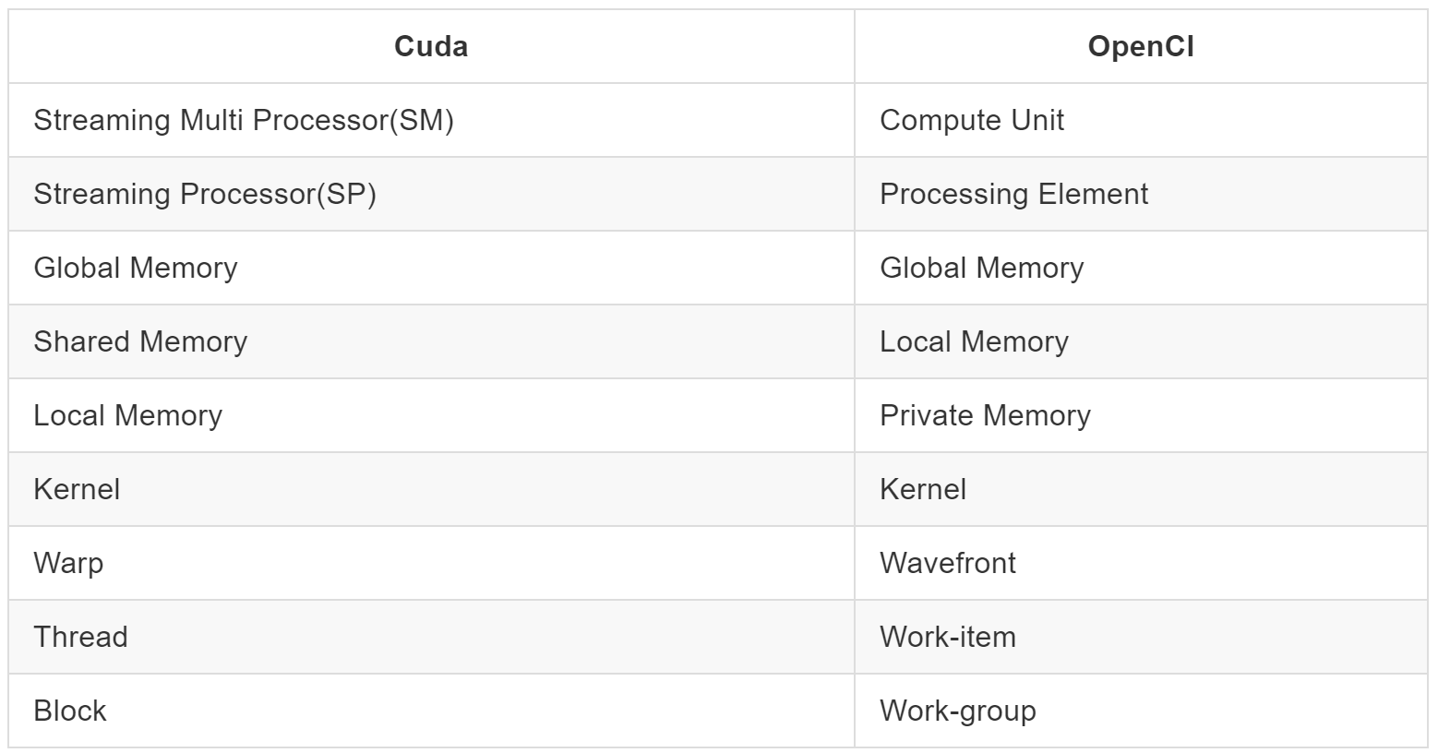
CUDA and OpenCL
https://leonardoaraujosantos.gitbooks.io/opencl/chapter1.html

Slide 28
OpenMP(4+) and OpenACC
OpenMP and OpenACC
Offer directive based approach for writing GPU code
Typically simpler than writing CUDA/OpenCL codes
Typically worse performance
...Compilers are making progress
Portability
At what cost?
Notes:
OpenACC absorption
Compiler optimization is improving

Slide 29
Portability?
Is portability a good thing?
Code may be portable…but not efficient!
CPU
0
1
2
3
4
5
6
7
8
9
10
11
12
13
14
15
0
1
2
3
GPU
0
1
2
3
4
5
6
7
8
9
10
11
12
13
14
15

Slide 30
“You cannot make a solution independent of the actual platform or finite set of platforms. Reality is not a hack you’re forced to deal with to solve your abstract, theoretical problem. Reality is the actual problem.”
– Mike Acton, CppCon 2014 “Data-Oriented Design and C++” https://www.youtube.com/watch?v=rX0ItVEVjHc

Slide 31
Another look
CPU
0
1
2
3
0
1
2
3
0
1
2
3
0
1
2
3
0
1
2
3
GPU
0
0
0
0
1
1
1
1
2
2
2
2
3
3
3
3
CPU w/ SIMD
0
0
0
0
0
0
0
0
0
0
0
0
0
0
0
0
0
1
2
3

Slide 32
CPU and GPU Programming
Threads on GPUs are (somewhat) analogous to Instruction Level Parallelism (ILP) on CPU
Blocks on GPUs are (somewhat) similar to threads on CPUs
No communication though
Portability may be possible, but we must be aware of architecture differences!

Slide 33
Kokkos
Open Source – Developed by Sandia National Laboratories
https://github.com/kokkos
Detailed training slides at https://github.com/kokkos/kokkos-tutorials
Kokkos offers performant portable code
Aims for simplicity
Shouldn’t be more difficult than OpenMP!
(You need some modern C++ knowledge though)
It’s a library
A lot to cover. We will see examples on Friday!

Slide 34
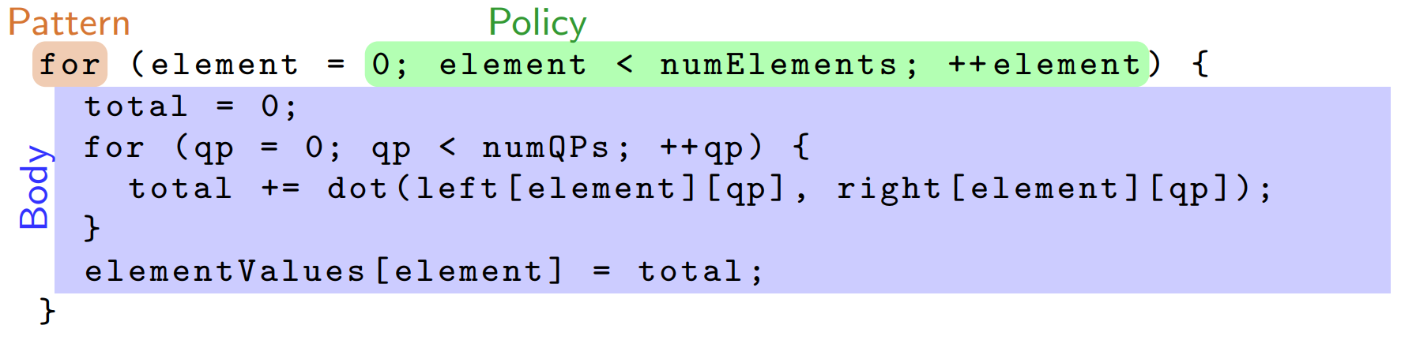
Kokkos – Introduction (1)
Pattern – structure for computations
Policy – Range, schedule, thread teams, etc.
Body – Work to be done (kernel)
https://github.com/kokkos/kokkos-tutorials/blob/master/Intro-Full/Slides/KokkosTutorial_ORNL18.pdf

Slide 35
Kokkos – Introduction (2)
For performance, memory access patterns must be architecture dependent!
The Kokkos library maps work to cores
Provide Kokkos with range and body
Kokkos will map indices to cores (may be on GPU!)
If Kokkos is a library…how do we provide a body?
Functors! (function with data)

Slide 36
Kokkos – Functors
Parallel functor must have access to the data it needs through the functor’s data members
Functors are simply structs
with void operator()(const size_t index) {…};
Or, lambdas (C++11)
Lambdas auto-generate a functor
Tends to be less tedious (more productivity)
Notes:
Functors are function objects—operation with some data
Lambdas are anonymous functions—e.g. they’re not declared with a symbol name
Lambdas are like really really lightweight functions.
[capture](parameters) -> return_type { function_body }

Slide 37
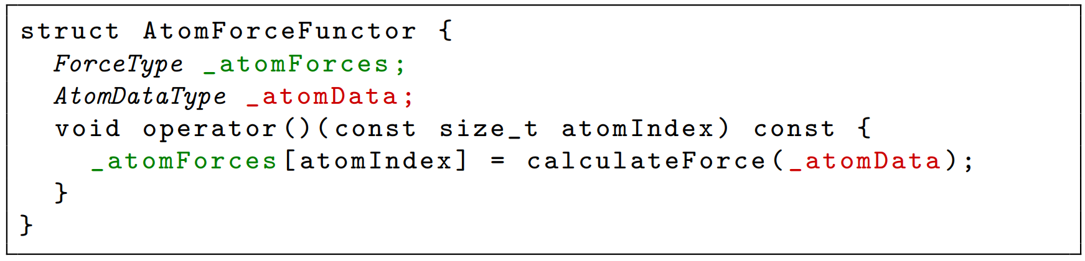
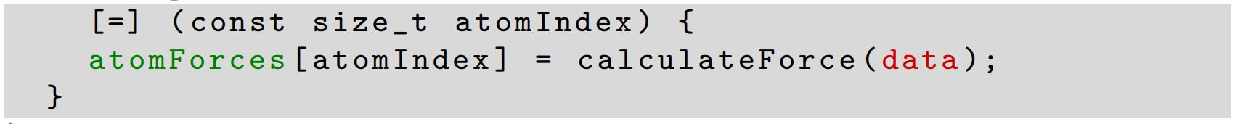
Functor vs Lambda Example
Functor
Lambda

Slide 38
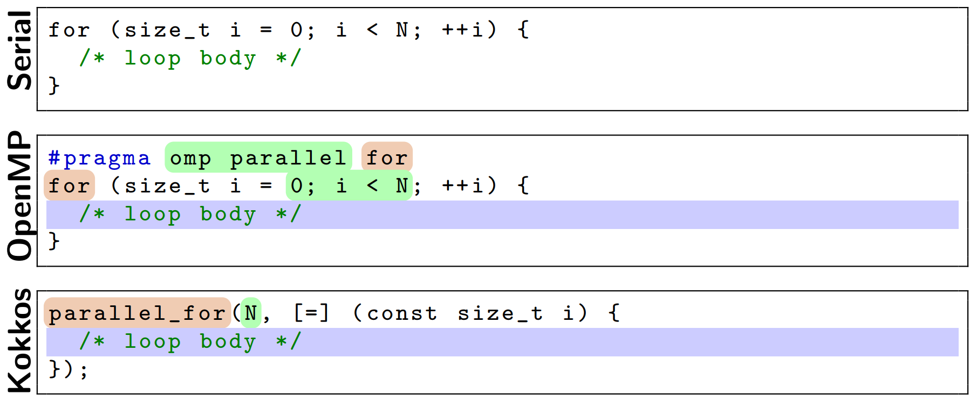
Kokkos – Comparison
Not more difficult than OpenMP, in concept

Slide 39
Kokkos – Views
Views allow us to store/communicate data between host and device
They are like pointers (you should copy, not reference)
Templated – on data type
And others!
Memory Space, Layout, Memory Traits, etc. (more details to come)
Multidimensional
Ease of use
Rectangular (not jagged)
No hidden allocations! (important for performance)

Slide 40
Kokkos – Execution Space
Execution Space tells us where the code will run
Serial, Threads, OpenMP, Cuda, etc.
Can control via default Execution Space – Compile Time
Can specify Execution Space in the policy
A template parameter
Need to mark non-CPU space lambda/functors with macro
#define KOKKOS_INLINE_FUNCTION inline __device__ __host__

Slide 41
Kokkos – Memory Space
Memory Space tells us where the data is stored
Template parameter on Views
HostSpace, CudaSpace, CudaUVMSpace, etc.
Each Execution Space has a default memory space
If in CudaSpace
Data is stored on GPU
Metadata is also stored on CPU
Mirror/deep_copy

Slide 42
Kokkos – Layouts
Multidimensional arrays in C/Fortran have different “Layouts”
Row-major is good in some places
Column-major is good in some places
Kokkos gives a simple approach to multidimensional array layout:
Layout is a templated parameter on a View
LayoutLeft → Left-most index is stride 1
LayoutRight → Right-most index is stride 1
More, and you can create your own

Slide 43
Kokkos – Scheduling
On the CPU we wanted each thread to work over a contiguous chunk of memory
On the GPU we wanted each thread block to work over a contiguous chunk of memory (thread indexing strided)
Kokkos maps indices to cores in contiguous chunks on CPU and strided for GPU
Using this knowledge in addition to Layouts
We can achieve performant portable code
…if we choose the right layout for the architecture

Slide 44
Kokkos – Subviews and Multiloop Parallelism
Subview
Like a “slice” of a View
Uses colon notation from Fortran, Matlab, Python, etc.
No allocation occurs in construction! – but not free!
Avoid usage if not accessing a lot
MDRangePolicy
MultiDimensional Range Policy
Parallelism over multiple loop levels
Similar to collapse in OpenMP
Notes:
Check openMP keyword for MDRangePolicies

Slide 45
Kokkos – Hierarchical Parallelism
Hierarchical Parallelism allows for nested parallelism
League of Teams of Threads vs Grid of Blocks of Threads
Thread teams – Threads that work concurrently and can synchronize
Think block in Cuda
Functor/lambda operations get a team member
teamMember.league_rank();
teamMember.team_rank();
blockIdx, threadIdx in Cuda
Vector level parallelism
Vectorizable loops on CPU
(Sub-)warp level parallelism on GPUs

Slide 46
Matrix-matrix multiplication
Parallel implementation of naïve matrix-matrix multiplication
mat_l, mat_r are aliases for Kokkos::View<double**>
LayoutLeft, LayoutRight
void matmul(unsigned n, unsigned m, unsigned p, mat_r A, mat_l B, mat_r C)
{
typedef Kokkos::MDRangePolicy< Kokkos::Rank<2> > mdrange_policy;
Kokkos::parallel_for("matmul", mdrange_policy({0, 0} , {n, p}),
KOKKOS_LAMBDA (unsigned row, unsigned col) {
for(unsigned idx = 0; idx < m; ++idx){
C(row, col) += ( A(row, idx) * B(idx, col) );
}
}
);
}

Slide 47
Kokkos – Atomics/MemoryTraits
Atomics – Atomic Operations
Solution to multiple threads trying to write to same location
Locks are not scalable to 10,000+ threads
Data replication is not scalable to 10,000+ threads
Example: Kokkos::atomic_add(…);
Memory Traits
Template parameter on Views
Atomic, Read, Write, ReadWrite, ReadOnce, Contiguous, RandomAccess
Tells compiler/Kokkos what you will do with the memory

Slide 48
Kokkos – Scratch Space
Scratch space offers (roughly) a programmer managed cache
GPUs have small dedicated scratch space
Kokkos lets you use these much more easily than Cuda
CPUs don’t have special hardware for this
But, memory access patterns are cache-aware
Accessing data in this scratch space is much faster than in main memory
Level 0 fastest
Level 1 fast

Slide 49
Kokkos – Summary
Offers Portability
without compromising performance
Simple things are just as simple as in OpenMP
Advanced tuning is simpler than native implementations
For GPUs
Not so much for CPUs

Slide 50
Useful resources
https://devblogs.nvidia.com
https://devblogs.nvidia.com/even-easier-introduction-cuda/
https://devblogs.nvidia.com/unified-memory-cuda-beginners/
https://devblogs.nvidia.com/inside-pascal/
http://www.cs.cmu.edu/afs/cs/academic/class/15668-s11/www/cuda-doc/CUDA_C_Programming_Guide.pdf
https://github.com/kokkos/kokkos-tutorials

