Slide 1
Lecture 22 Testing, Verification, Validation
Prof. Brendan Kochunas
11/20/2019
NERS 590-004

Slide 2
Outline
Motivation
Review of Testing
Definitions
Code Verification
Solution Verification
Validation & Prediction

Slide 3
Why should I care about V&V?
How do you know someone else’s code is correct?
How does someone else know your code is correct?
Correct in what sense?
Does it do what its supposed to?
Does it represent reality?
How can we develop tests that are meaningfully providing evidence of verification and validation?

Slide 4
Today’s Learning Objectives
Understand difference of Verification and Validation
Understand testing strategies for verification and validation testing

Slide 5
Further Reading
Oberkampf, W., & Roy, C. (2010). Verification and Validation in Scientific Computing. Cambridge: Cambridge University Press. doi:10.1017/CBO9780511760396
This book is 665 pages!
https://doi.org/10.1017/CBO9780511760396
https://search.lib.umich.edu/catalog/record/015554090
Specifically, chapters: 2, 5, 6, 7, 12

Slide 6

Ross’s Taxonomy of Testing

Slide 7
A Taxonomy of Testing
Testing is the backbone of software quality assurance (SQA).
Types of testing
Unit Testing – Test individual units of program in isolation
Should run very fast: < 1 second (a couple seconds is ok)
Integral Testing – Testing program components together
Should run fast: < 1 minute (a couple minutes is ok)
Regression Testing – Test whole program for changes in program output
Should run fast: < 1 minute (a couple minutes is ok)
Verification Testing – Test that you are “doing things right”
Can happen at unit or integral or regression level. Comparison analytic solutions or manufactured solutions.
Validation Testing – Whole program testing “doing the right thing”; simulating reality, comparison to experiment.
May be long running: minutes to hours
Memory Testing – Expensive testing that does detailed memory simulations to detect errors (valgrind)
Coverage Testing – Figure out how much of your source code is actually covered by testing
Portability Testing – test on different platforms and with different compilers
Other types of testing exist

Slide 8
Testing Layers
Nightly Testing
Secondary Tested (ST)
CATEGORIES [BASIC CONTINUOUS NIGHTLY]
(includes all testing*)
Post-Push CI Testing
Secondary Tested (ST)
CATEGORIES [BASIC CONTINUOUS]
(includes more regression testing)
Correctness Testing
Pre-Push CI Testing
Primary Tested (PT)
CATEGORIES [BASIC]
(unit tests & some regression tests)
*Additional Categories: Heavy or Weekly
Coverage Testing
Memory (Valgrind) Testing

Slide 9
Terminology
What is V&V?

Slide 10
Early Definitions of Verification and Validation
Model verification: substantiation that a computerized model represents a conceptual model within specified limits of accuracy.
Model validation: substantiation that a computerized model within its domain of applicability possesses a satisfactory range of accuracy consistent with the intended application of the model.

Slide 11
Other Definitions
IEEE
Department of Defense
Verification: the process of evaluating the products of a software development phase to provide assurance that they meet the requirements defined for them by the previous phase.
Validation: the process of testing a computer program and evaluating the results to ensure compliance with specific requirements.
Verification: the process of determining that a model implementation accurately represents the developer’s conceptual description of the model.
Validation: the process of determining the degree to which a model is an accurate representation of the real world from the perspective of the intended uses of the model.
Notes:
IEEE has less of a focus on physical or physics applications

Slide 12
American Institute of Aeronautics & Astronautrics
Verification
Validation
Notes:
Verification: the process of determining that a model implementation accurately represents the developer’s conceptual description of the model and the solution to the model.
Validation is same as DoD.

Slide 13
ASME
Code verification: the process of determining that the numerical algorithms are correctly implemented in the computer code and of identifying errors in the software.
Solution verification: the process of determining the correctness of the input data, the numerical accuracy of the solution obtained, and the correctness of the output data for a particular simulation.
Notes:
Used DoD Validation definition

Slide 14
Aspects of Validation
Quantification of the accuracy of the computational model results by comparing the computed system response quantities (SRQs) of interest with experimentally measured SRQs
Use of the computational model to make predictions, in the sense of interpolation or extrapolation of the model, for conditions corresponding to the model’s domain of intended use.
Determination of whether the estimated accuracy of the computational model results satisfies the accuracy requirements specified for the SRQs of interest.

Slide 15
Code Verification
How do you prove that your program is a faithful representation of the original mathematical model?

Slide 16
Selection of Criteria/Metrics
Choosing the solution is a natural, but has practical issues.
Need a good reference solution or exact solution
Mapping of the numerical solution to the reference can be burdensome
Considering the full solution may be overwhelming w.r.t the amount data
Solution: Norms!
L1 norms are good for problems where discontinuities or singularities might exist. Typically applied for discretization errors.
L2 norms also commonly used for discretization errors.
L-infinity will be the most sensitive
Additionally consider, quantities of interest for the application

Slide 17
Types of Code Verification Tests
Simple Tests
Code-to-Code Verification
Discretization Error Quantification
Convergence Tests
Order-of-Accuracy Tests

Slide 18







Simple Test Example
Symmetry
Define a problem with geometry and boundary conditions symmetric about a plane
Can also look at periodic problems
Rotational Invariance
Similar to the above except change coordinates
Conservation (perform global integration)
of energy in heat transfer
of mass or momentum in fluid flow
$${\dot{m}}_{in}$$
$${\dot{m}}_{out}$$
$$y$$
$$x$$
$$x$$
$$y$$
$${\dot{m}}_{in}={\dot{m}}_{out}$$

Slide 19




Discretization Error Tests
Compare the numerical solution to an exact solution
Quantitative assessment of code output using a single mesh
Example: beam attenuation
$${I\left(x\right)=I}_{0}\exp\left(−τx\right)$$
$$τ$$
$$I_{0}$$
$$x$$
Notes:
The main drawback to this test is that once the discretization error has been evaluated, it requires
a subjective judgment of whether or not the error is sufficiently small.

Slide 20
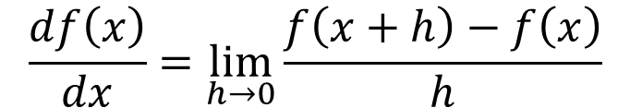
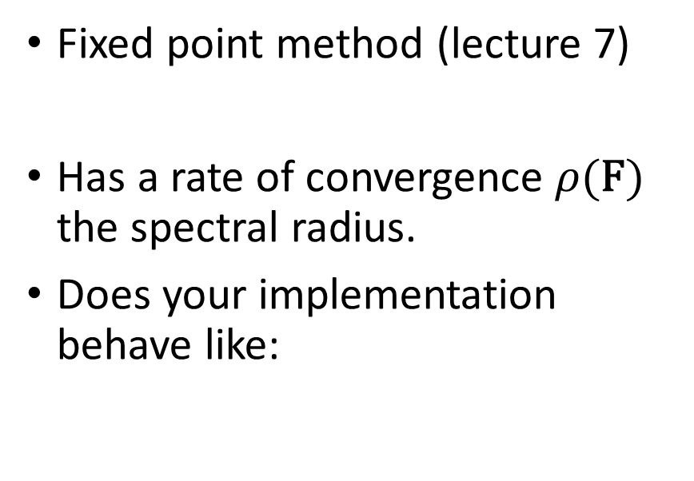
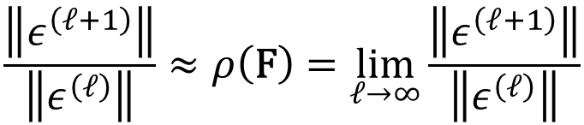
Convergence Tests
Mesh Refinement
Iterative Methods
Essentially testing the fundamental theorem of calculus
As you refine your discretization does the error reduce towards zero?
Fixed point method (lecture 7)
Has a rate of convergence $ρ(\text{F})$ the spectral radius.
Does your implementation behave like:
$$x^{\left(ℓ+1\right)}=\text{F}x^{(ℓ)}+\text{c}$$
$$\frac{df\left(x\right)}{dx}=\lim_{h→0}{\frac{f\left(x+h\right)−f\left(x\right)}{h}}$$
$$\frac{\left\|ε^{\left(ℓ+1\right)}\right\|}{\left\|ε^{\left(ℓ\right)}\right\|}≈ρ\left(\text{F}\right)=\lim_{ℓ→∞}{\frac{\left\|ε^{\left(ℓ+1\right)}\right\|}{\left\|ε^{\left(ℓ\right)}\right\|}}$$

Slide 21
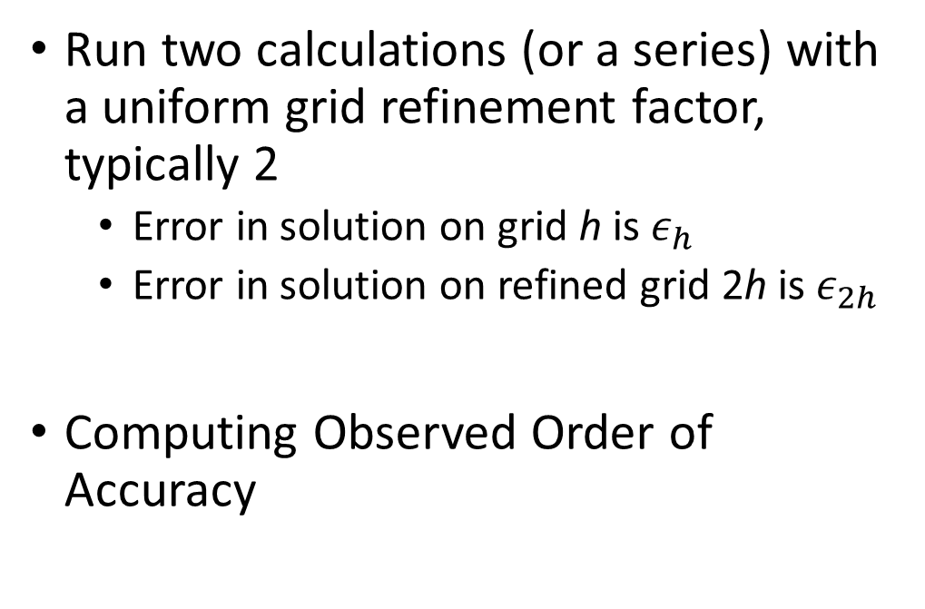
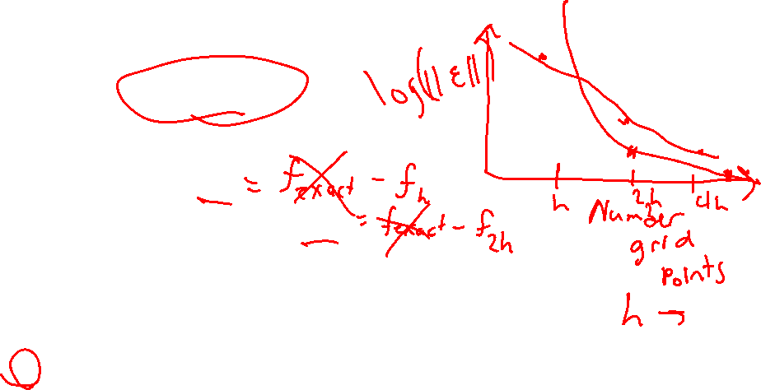

Order-of-Accuracy Tests
Run two calculations (or a series) with a uniform grid refinement factor, typically 2
Error in solution on grid h is $ε_{h}$
Error in solution on refined grid 2h is $ε_{2h}$
Computing Observed Order of Accuracy
$$\hat{p}=\frac{\ln\left(\frac{ε_{2h}}{ε_{h}}\right)}{\ln\left(2\right)}$$
Notes:
Trick is to identify and find the “asymptotic” range.
Systematic mesh refinement can also be tricky.
Numerical precision can pose a problem as well.

Slide 22


Formal Order of Accuracy
Establish formal order of accuracy
Example: Finite Difference
Does your observed order of accuracy agree with theory?
$$f\left(x_{i}+Δx\right)=f\left(x_{i}\right)+\frac{df\left(x_{i}\right)}{dx}\frac{Δx}{1!}+\frac{df\left(x_{i}\right)}{dx}\frac{Δx^{2}}{2!}+…$$
$$\frac{df\left(x_{i}\right)}{dx}≈\frac{f\left(x_{i}+Δx\right)−f\left(x_{i}\right)}{Δx}+O\left(Δx^{2}\right)$$

Slide 23
Solution Verification
Is the given numerical approximation of a mathematical model sufficiently accurate for its intended use?

Slide 24
Elements of Solution Verification
Verification of Input Data
Examples: boundary conditions, coefficients, geometry approximations
Verification of Post-Processing Tools
Examples: Excel Charts—how do you show pointwise data?
Numerical error estimation
Examples: round-off, statistical sampling, iterative error, discretization error

Slide 25
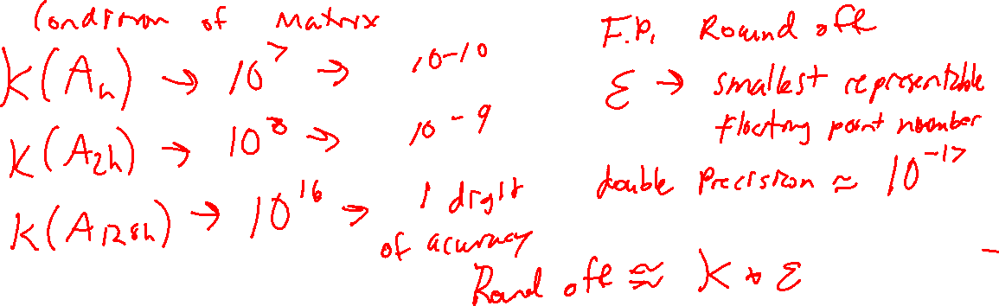
How to estimate numerical errors

Slide 26
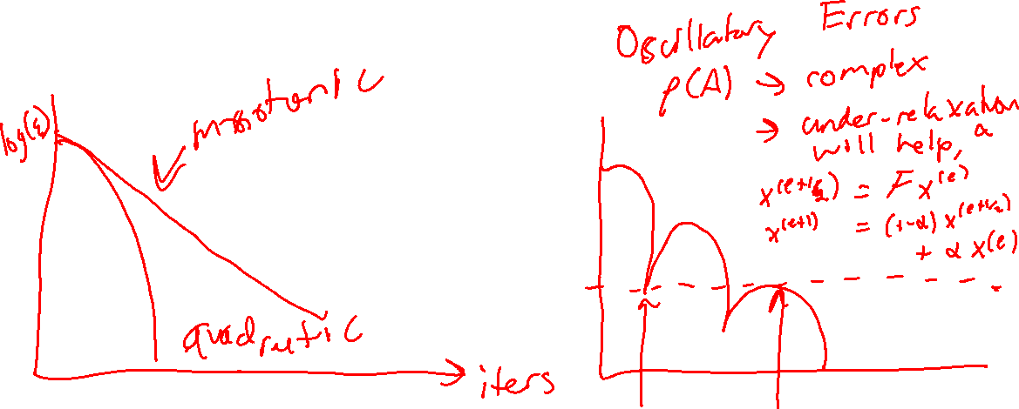
How to show iterative errors?

Slide 27
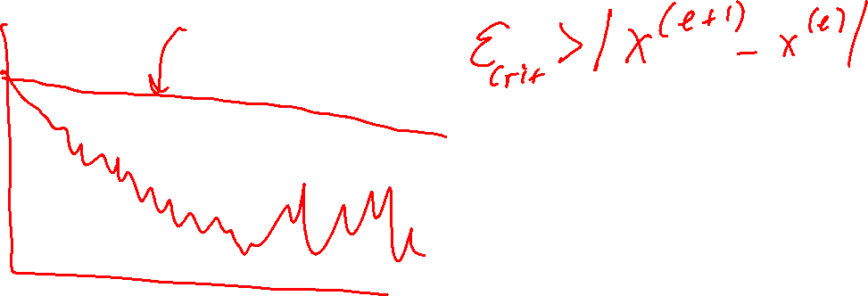
How to show iterative errors?

