Slide 1
Lecture 23 Unit Testing
Prof. Brendan Kochunas
11/25/2019
NERS 590-004

Slide 2
Outline
Motivation
Review of Testing
Definitions
Code Verification
Solution Verification
Validation & Prediction

Slide 3
If unit testing is new to you it might seem abstract?
What do I test?
How do I test it?
How do I define a unit test?
What are some of the challenges of writing a unit test?

Slide 4
Today’s Learning Objectives
Understand how to approach writing a unit test
Work through a concrete example
Become aware of unit testing frameworks

Slide 5
Further Reading
McConnell, Steve. Code Complete. Second edition., Microsoft Press, 2004.
https://search.lib.umich.edu/catalog/record/012121444
Specifically, chapter: 22

Slide 6
Preliminaries
Requirements
Architecture
High-Level Design
Low-Level Design
Construction
Testing

Slide 7
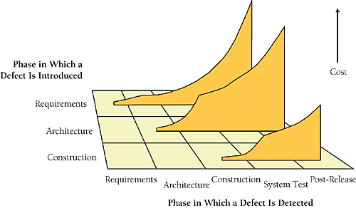
Cost of Fixing Defects
Time Introduced | Requirements | Architecture | Construction | System Test | Post-Release
Requirements | 1x | 3x | 5-10x | 10x | 10-100x
Architecture | -- | 1x | 10x | 15x | 25-100x
Construction | -- | -- | 1x | 10x | 10-25x

Slide 8
The Role of Testing
The goal of testing is counter to normal development activities
Trying to “break” the code—not add features
Have to assume you’ll find errors in your code (otherwise you won’t)
Unit Testing is the execution of a complete class, routine, or a small program that has been written by a single programmer or team of programmers, that is tested in isolation from the more complete system.
Goal of unit testing: make sure code is doing what it is supposed to
Testing can never completely prove the absence of errors.
Testing by itself does not improve software quality

Slide 9
Approaches to Testing

Slide 10
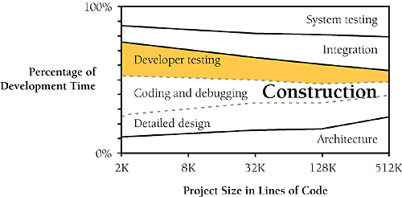
Time in relation testing
How much time developing tests?
When to develop tests?
“Rule of thumb” is ~50%
But this is misleading as it often includes debugging
Real number is around ~25%
As early as possible!
Writing test now or later takes the same amount of time
Having test cases first allows you to detect defects earlier, and more easily
Writing tests first, gets you thinking more deeply about requirements and design
Identifies problematic/incomplete requirements
During construction and before integration
If you develop 3 routines and integrate them, and there’s a problem—where is it?

Slide 11
Recommended Approaches
Plan tests at requirements stage—or as early as possible
Test for each relevant requirement
Test for design concerns (then plan at design stage)
Use “basis testing” and “data-flow” testing
Keep a checklist of the kinds of errors that are made on the project
For next level projects

Slide 12
Limitations
Developer tests tend to be “clean tests”
Recommendation is 5 “dirty tests” for every clean test
Tend to have an optimistic view of our testing
Your code is not as well tested as you think
Tend to skip more complex testing
“Corner” cases are hard to think, but can be equally problematic
Testing is not a magic bullet. It takes time.

Slide 13
Basis Testing
Case | Test Description | Test Data
1 | Nominal case | All boolean conditions are true
2 | The initial for condition is false | numEmployees < 1
3 | The first if is false | m_employee[ id ].governmentRetirementWith-held >=MAX_GOVT_RETIREMENT
4 | The second if is false because the first part of the and is false | not m_employee[ id ].WantsRetirement
5 | The second if is false because the second part of the and is false | not EligibleForRetirement( m_employee[id] )
6 | The third if is false | not EligibleForPersonalRetirement( m_employee[ id ] )
Make sure your tests cover all execution paths with the minimal set of cases
Test cases are designed around program control flow

Slide 14
Data Flow Testing
Idea based on assumption that data usage is at least as error prone as control flow
Three states
Defined – Data has been initialized, but not yet used
Used – data has been used as an argument or right of assignment operator
Killed – In an undefined state
Combine with control flow enter and exited
Develop test cases around data state combinations e.g.
Defined-defined, defined-exited, killed-used, etc.

Slide 15
Unit Testing Frameworks

Slide 16
Evaluating a Unit Test Framework
Minimal amount of work needed to add new tests
Easy to modify existing tests
Supports setup & teardown (e.g. Fixtures)
Handles exceptions and crashes well
Good assert functionality
Timing information (catch performance errors, rather than correctness)
Output and integration with other tools

Slide 17
Fortran
FUnit
https://github.com/Goddard-Fortran-Ecosystem/pFUnit
Futiliy
https://github.com/CASL/Futility/blob/master/src/Futility_DBC.h
https://github.com/CASL/Futility/blob/master/src/Futility_DBC.f90
https://github.com/CASL/Futility/blob/master/src/UnitTest.h
https://github.com/CASL/Futility/blob/master/src/UnitTest.f90

Slide 18
C++
CppUnit
C++ port of JUnit
Boost.Test
https://www.boost.org/doc/libs/1_45_0/libs/test/doc/html/utf.html
CxxTest
Catch
Google Test
https://github.com/google/googletest

Slide 19
Python
Unittest Library
Python Standard library
https://docs.python.org/3/library/unittest.html
Full taxonomy
https://wiki.python.org/moin/PythonTestingToolsTaxonomy

Slide 20
Java
JUnit
There’s just one

Slide 21
Examples

