Slide 1
Lecture 25 HPC + Jupyter Notebooks + Workflows
Prof. Brendan Kochunas
12/4/2019
NERS 590-004

Slide 2
Outline
Introduction to Jupyter Notebooks
Running Jupyter on Great Lakes
Tips & Tricks in Jupyter
Hands on Demos

Slide 3
Today’s Learning Objectives
Know how to run a jupyter notebook on Great Lakes
Know how to get other code into Jupyter
Know how to interact with Great Lakes from inside Jupyter

Slide 4
Why should I care about Jupyter Notebooks and HPC?
As we’ve learned throughout the semester HPC is challenging to use
This is somewhat inherent in the design
But—does it have to be difficult?
Other languages (e.g. Python or MATLAB) are much better for productivity
From Lecture 2
“Simulation in the climate community is dominated by the nexus of the Fortran/C/C++ languages and the OpenMP/OpenACC programming models. While both Fortran and C/C++ are interoperable on almost all computing platforms available today, there is a strong desire for other productivity oriented scripting languages in a distributed environment (e.g., Python/pyMPI), as well as the desire to move away from the flat MPI model, which may be functional on the next generation of systems but will lose a factor of 10 to 50 times on GPU-accelerated systems.”
Gerber, R., et. al, ”Crosscut report: Exascale Requirements Reviews,”
U.S. DOE Office of Science, Tysons Corner, Virginia, March 9–10, (2017). doi:10.2172/1417653

Slide 5
Typical Modeling and Analysis Workflows
Model Development
Meshing
Run Calculation
Analyze Results
Publish
What is the distribution of effort for these tasks?

Slide 6
Typical Modeling and Analysis Workflows
Notebooks can be used to integrate and automate these workflows.
Analyze Results
Model Development
Publish
Meshing
Run Calculation

Slide 7

Jupyter Notebooks

Slide 8
Background
Jupyter – JULia, PYThon, and R
Open Source and developed by Project Jupyter—a nonprofit
Grew out of the IPython (Interactive Python)
Evolved and replaced the IPython notebook
IPython was designed to utilize parallel computing
e.g. task and data parallelism, SIMD, and MIMD
Key concept is the Notebook Interface

Slide 9
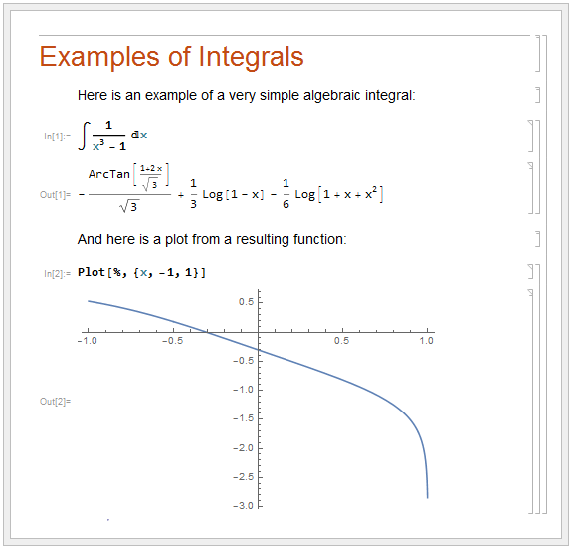
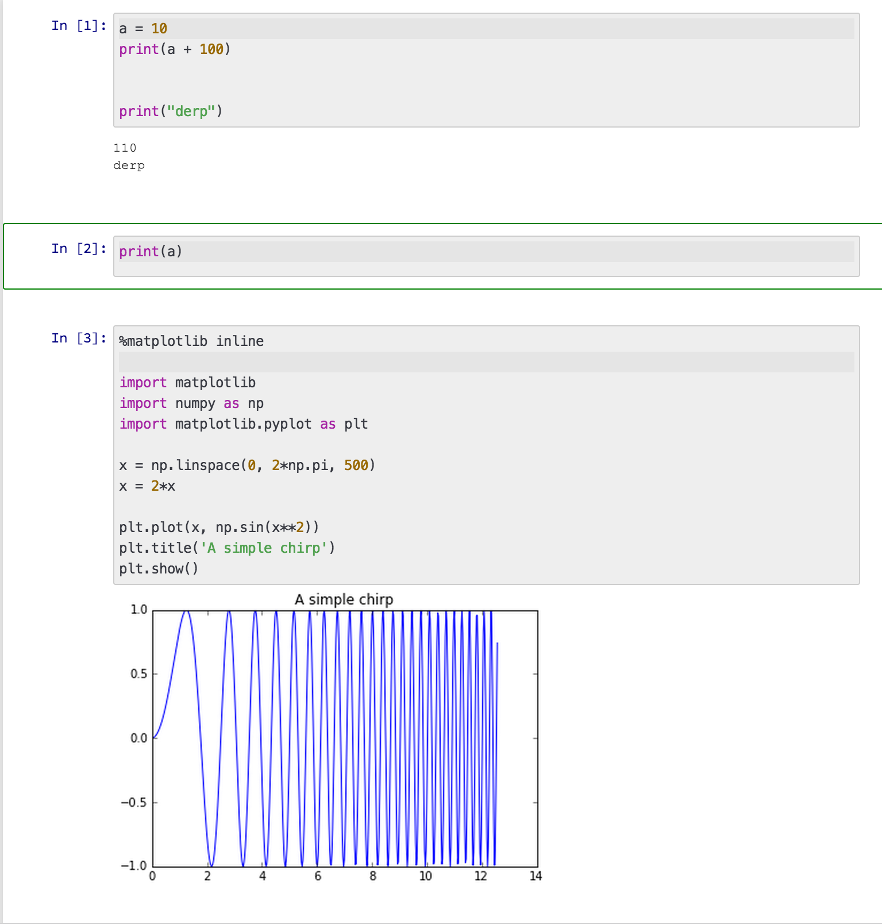
Concept of a notebook
Mathematica
Jupyter Notebook
Notebook is composed of cells
Cells can be of different types
Functional/Evaluatable
Text or Documentation (with nice formatting)
Can be exported to other formats
HTML, PDF, etc.
Not a new concept
Existed in Mathematica long before Python
Excellent for expositions that involve computations
Notes:
https://reference.wolfram.com/language/tutorial/Files/UsingANotebookInterface.en/1.gif
https://www.google.com/url?sa=i&source=images&cd=&cad=rja&uact=8&ved=2ahUKEwi9yKuN6JzmAhWX4J4KHW4TDgwQjRx6BAgBEAQ&url=https%3A%2F%2Fatom.io%2Fpackages%2Fjupyter-notebook&psig=AOvVaw3uPXwUEsXRaQs1kAX9Q7XO&ust=1575577037580615
http://i.imgur.com/100MtXR.png

Slide 10
Under the hood
...
"metadata": {
"kernelspec": {
"display_name": "Python 3",
"language": "python",
"name": "python3"
},
"language_info": {
"codemirror_mode": {
"name": "ipython",
"version": 3
},
"file_extension": ".py",
"mimetype": "text/x-python",
"name": "python",
"nbconvert_exporter": "python",
"pygments_lexer": "ipython3",
"version": "3.7.3"
}
},
"nbformat": 4,
"nbformat_minor": 2
}
The IPython Notebook (ipynb) is just a JSON text file
Suitable for version control with git
Enhances interoperability with Web applications
e.g. Github

Slide 11
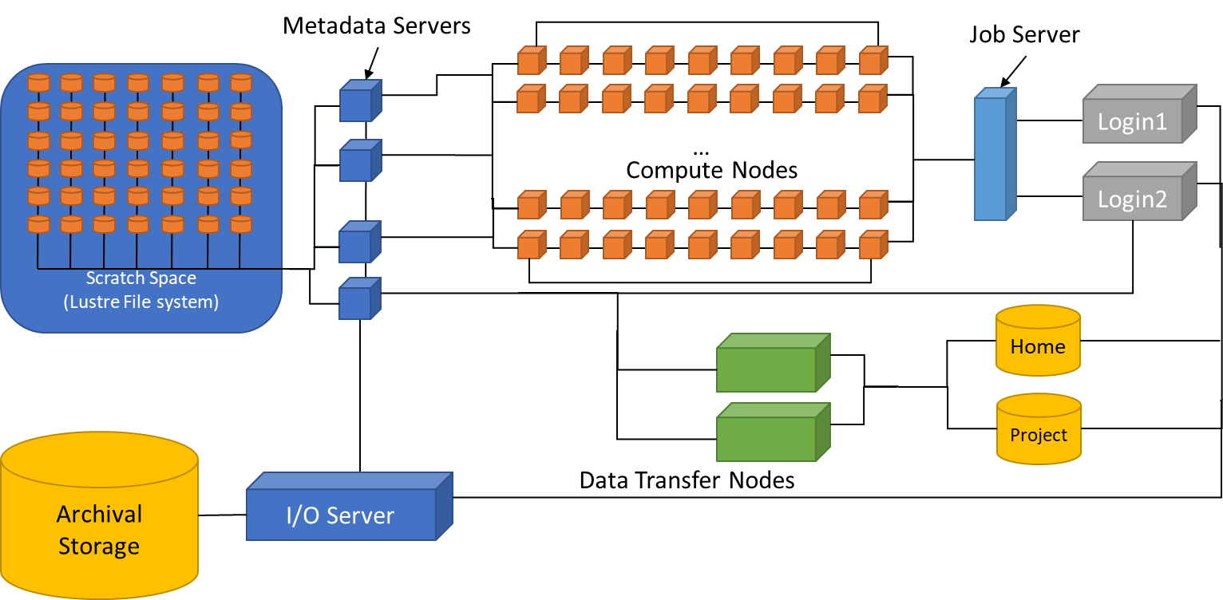


How it Works
Internet
Python
Web browser
on any computer
Users

Slide 12
Normal HPC Interface
Metadata Servers
Job Server
Scratch Space
(Lustre File system)
Login1
…
Compute Nodes
Login2
…
Home
Project
Archival
Storage
I/O Server
Data Transfer Nodes
Users

Slide 13
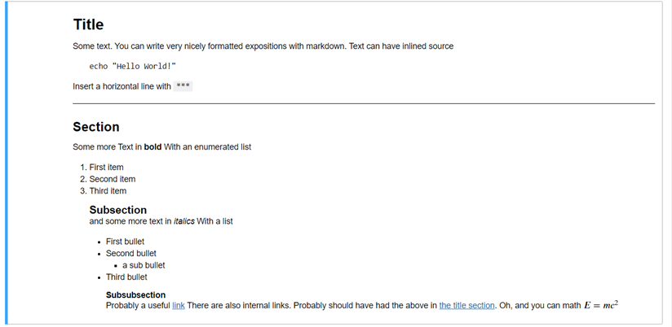
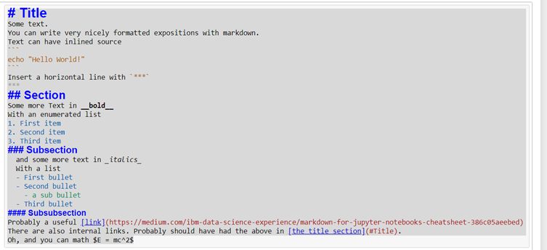
In-line Documentation with Markdown
Toggle cell type to markdown with m
Toggle cell back to evaluatable with y
https://markdown-it.github.io/

Slide 14
Tips and Tricks

Slide 15
Keyboard Shortcuts
Command mode and insert mode
Just like VIM!
Adding/removing cells
a – insert above
b – insert below
dd – delete cell (just like VIM!)
Merging/Splitting Cells
Shift + m to merge cells
Ctrl + Shift + - to split cell at cursor
Toggle Output: Esc + o
Evaluate Current Cell: Ctrl + Enter
Ctrl+Shift+p for Command Prompt

Slide 16
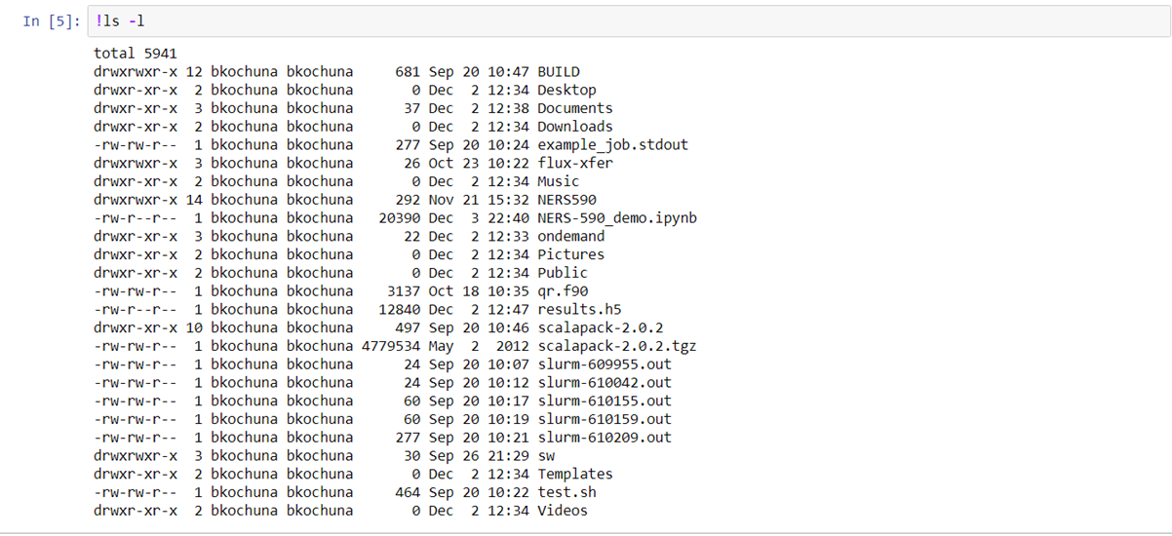
Interacting with the Shell
Shell commands are simply preceded by a “!”

Slide 17

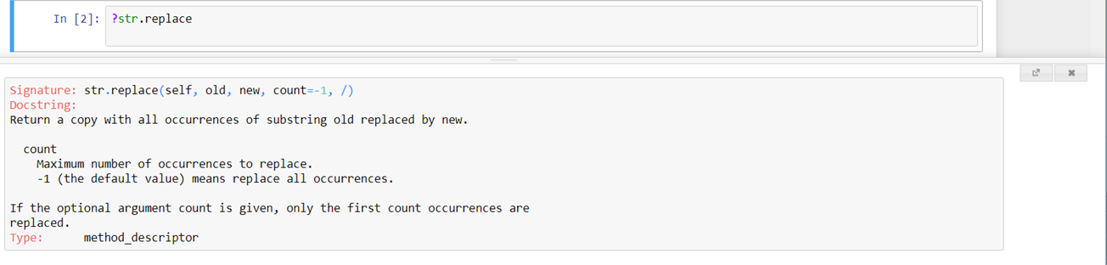
In-line Help
Preced command with a “?”
Keyboard shortcut for showing doc string of previous word: Shift+Tab

Slide 18
Python Magic!
%load – Load a python file
%timeit – Time the following command
%%writefile <filename> – Write cell contents to a file
%pycat – cat’s a file’s contents to a popup

Slide 19
Column Selection
Similar to Sublime Text
Hold down Alt key and select with mouse

Slide 20
Hands On Demos
Detailed ARC-TS Instructions: https://arc-ts.umich.edu/greatlakes/user-guide/#document-3
Basically open a browser to: https://greatlakes.arc-ts.umich.edu/

Slide 21
Detailed ARC-TS Instructions
https://arc-ts.umich.edu/greatlakes/user-guide/#document-3
Basically open a browser to: https://greatlakes.arc-ts.umich.edu/

