Slide 1
Chapter-12
File Handling

Slide 2
HIERARCHY OF DATA
BIT: Binary Digit (0,1; Y,N; On, Off)
BYTE: Combination of BITS which represents a character
FIELD: Collection of BYTES which represents a DATUM or Fact
RECORD: Collection of FIELDS which reflects a TRANSACTION
FILE: A collection of similar RECORDS
DATABASE: An Organization’s Electronic Library of FILES organized to serve Library of FILES organized to serve business applications

Slide 3
What is Record?
Collection of information items(Fields) about particular entity.
File
Record
Record
Record
Field
Field

Slide 4
What is File?
A named collection of bits, usually stored on a disk, with some properties.
Files are managed by the file system.
A file’s type can be encoded in the file’s name or contents like .com, .exe, .bat, .dll, .jpg, .mov, .mp3,

Slide 5
Operations on File
Create
Write
Read
Reposition within file
Delete
Truncate

Slide 6
Access methods
Some file systems provide different access methods that specify ways the application will access data.
Four Access modes :
Sequential
Relative
Indexed
Direct

Slide 7
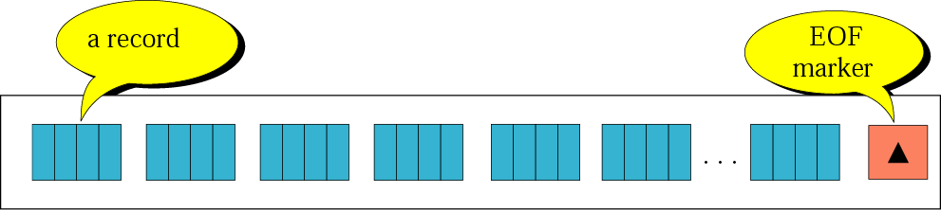
Sequential Access Mode
A sequential file contains records organized by the order in which they were entered. The order of the records is fixed.
Records in sequential files can be read or written only sequentially.
After you place a record into a sequential file, you cannot shorten, lengthen, or delete the record. However, you can update (REWRITE) a record if the length does not change. New records are added at the end of the file.

Slide 8
Performance of Sequential file
Advantages
  The major advantage is the ability to access the next record quickly.
  Access time is very good if the access pattern matches the ordering of records in the file.
  Simple
Disadvantages
  If ordering of the records doesn’t match the accessing pattern, then the performance can be terrible.

Slide 9
Indexed Access Mode
An indexed file contains records ordered by a record key. A record key uniquely identifies a record and determines the sequence in which it is accessed with respect to other records.
Each record contains a field that contains the record key. A record key for a record might be, for example, an employee number or an invoice number.
An indexed file can also use alternate indexes, that is, record keys that let you access the file using a different logical arrangement of the records.

Slide 10
Relative Access Mode
A relative record file contains records ordered by their relative key, that is, a record number that represents the location of the record relative to where the file begins.
For example, the first record in a file has a relative record number of 1, the tenth record has a relative record number of 10, and so forth. The records can have fixed length or variable length.

Slide 11
Direct Access Mode
Random file access refers to the ability to read or modify information directly at any given position in a file.
You do this by getting and setting a file position indicator, which represents the current access position in the file associated with a given stream.

Slide 12
Commonly Used C File-System Functions
Name Function
fopen( ) Opens a file
fclose( ) Closes a file
putc( ) or fputc( ) Writes a character to a file
getc( ) or fgetc( ) Reads a character from a file
fgets( ) Reads a string from a file
fputs( ) Writes a string to a file
fseek( ) Seeks to a specified byte in a file
ftell( ) Returns the current file position
fprintf( ) Is to a file what printf( ) is to the console
fscanf( ) Is to a file what scanf( ) is to the console
feof( ) Returns true if end-of-file is reached
ferror( ) Returns true if an error has occurred
remove( ) Erases a file
fflush( ) Flushes a file

Slide 13
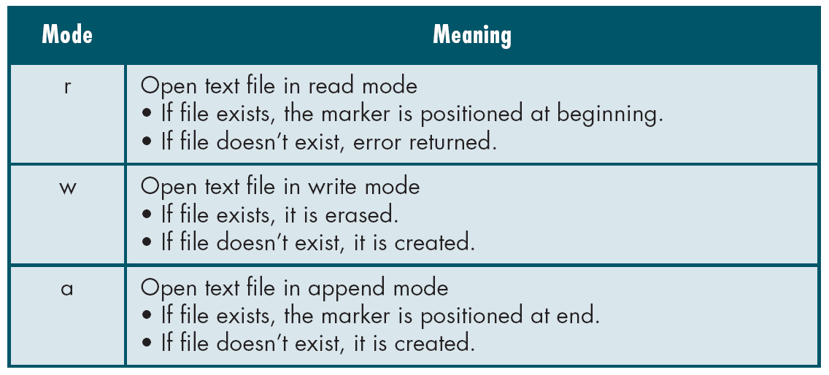
fopen() function
  Description : Creates a new file for use.
  Syntax : fopen(“filename”, “mode”);
  Example :
  FILE *fp; fp=fopen(“data.txt”, “r”)

Slide 14
fclose()
Description : Closes a file which has been opened for use.
Syntax : fclose(file_pointer);
Example : fclose(fp);

Slide 15
Input/output operations on file
getc()
  Description :reads a character from file.
  Syntax : getc(file_pointer);
  Example: char c;
  c=getc(fp);
putc()
  Description :writes a character to a file.
  Syntax : putc(charcter_to_write,file_pointer);
  Example: char c;
  putc(c,fp);

Slide 16
Input/output operations on file
getw()
  Description :reads an integer from file.
  Syntax : getw(file_pointer);
  Example: int word;
  word=getw(fp);
putw()
  Description :writes an integer into a file.
  Syntax : putw(integer_to_write,file_pointer);
  Example: int i;
  putw(i,fp);

Slide 17
Input/output operations on file
fprintf()
  Description : writes a set of data values to a file.
  Syntax : fprintf(fp, “conversion spacification”,list_of_var);
  Example : fprintf (fp, “%d %s %f”, roll_no, name, percentage);
fscanf()
  Description : reads a set of data values from a file.
  Syntax : fscanf(fp, “conversion spacification”,list_of_var);
  Example : fscanf (fp, “%d %s %f”, &roll_no, name, &percentage);

Slide 18
Random access to file
fseek()
  Description : sets the position to a desired point in the file.
  Syntax : fseek(file_ptr,offset,position);
  offset specifies the number of positions to be moved from the location specified by position.
  Position can take one of the following three values.
  Value meaning
  0 beginning of the file
  1 current position
  2 end of file

Slide 19
Random access to file
Statement | Meaning
fseek(fp,0,0) | Go to beginning
fseek(fp,0,1) | Stay at current position
fseek(fp,0,2) | Go to end of file
fseek(fp,m,0) | Move to (m+1)th byte in the file.
fseek(fp,m,1) | Go forward m bytes)
fseek(fp,-m,1) | Go backward by m bytes from the current position
fseek(fp,-m,2) | Go backward by m bytes from end
ftell()
  Description : gives current position in the file.
  Syntax : ftell(file_pointer);
  Example : ftell(fp);

Slide 20
Random access to file
Rewind()
  Description : Sets position to the beginning of the file.
  Syntax : rewind(file_pointer);
  Example : rewind(fp);

Slide 21
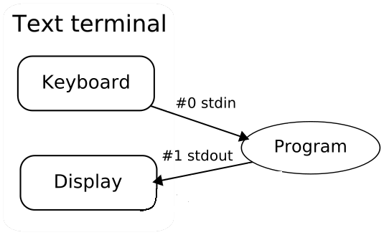
Stream File
a stream is a source of data,
usually individual bytes
or characters.
Streams are an abstraction used when reading or writing files.
C performs all file operations into operations on streams of bytes, which may be "input streams" or "output streams".
A file is opened using fopen, which returns an I/O stream attached to the specified file from which reading and writing can be done. If the function fails, it returns a null pointer.

Slide 22
Text file
A text file is a kind of computer file that is structured as a sequence of lines.
A text file exists within a computer file system. The end of a text file is often denoted by placing one or more special characters, known as an end-of-file marker, after the last line in a text file.
"Text file" refers to a type of container, while plain text refers to a type of content. Text files can contain plain text, but they are not limited to such.
Because of their simplicity text files are commonly used for storage of information.
Advantage:
  When data corruption occurs in a text file, it is often easier to recover and continue processing the remaining contents.

Slide 23
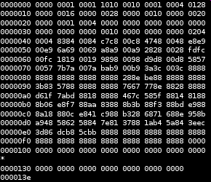
Binary file
A binary file is a computer file which
may contain any type of data, encoded
in binary form for computer storage and processing purposes.
for example, computer document files containing formatted text. Many binary file formats contain parts that can be interpreted as text; binary files that contain only textual data without any formatting information are called plain text files.
In many cases, plain text files are considered to be different from binary files because binary files are made up of more than just plain text.
If a binary file is opened in a text editor, each group of eight bits will typically be translated as a single character

