Slide 1
Chapter-5
Operators And Expressions

Slide 2
Operators
It is a symbol that tells the computer to perform certain mathematical or logical manipulations.
Depending upon number of operands C operators are classified into three main categories.
  Unary operators
  Binary operators
  Ternary operators

Slide 3
Type of Operators in C
C operators are classified into following categories.
  Arithmetic Operators
  Relational Operators
  Logical Operators
  Assignment Operators
  Increment And Decrement Operators
  Conditional Operators
  Bitwise Operators
  Special Operators

Slide 4
IF..ELSE statement
Syntax : if ( test expression )
    {
    true block statement (s);
    }
    else
    {
    statement-x;
  Expression is evaluated first.
  Depending upon value of the expression is true (non-zero) or false (zero) control transfers to a particular statement.

Slide 5
Arithmetic Operators
Operator | Meaning
+ | Addition or Unary plus
- | Subtraction or Unary minus
* | Multiplication
/ | Division
% | Modulo division

Slide 6
Relational Operators
Operator | Meaning
< | Is less than
<= | Is less than or equal to
> | Is greater than
>= | Is greater than or equal to
== | Is equal to
!= | Is not equal to

Slide 7
Logical Operators
Operator | Meaning
&& | Logical AND
|| | Logical OR
! | Logical NOT

Slide 8
Assignment Operators
“Shorthand” Assignment operator.
  var = var op exp;
  is equal to
  var op= exp;
Simple assignment | Shorthand assignment
a=a+1 | a+=1
a=a-1 | a-=1
a=a*1 | a*=1
a=a/1 | a/=1
a=a%b | a%=b

Slide 9
Increment and decrement Operators
Operator | Meaning
++ | Increment by 1
-- | Decrement by 1
Rules for ++ and – operators
  They are unary operators and they require variable as their operands.
  Postfix ++ (or --) : assignment then increment.
  Prefix ++ (or --) : increment then assignment

Slide 10
Conditional Operator
Also called ternary operator. (? : )
variable=expr1 ? expr2 : expr3
If expr1 is true then expr2 is evaluated.
if it is false then expr3 is evaluated.

Slide 11
Bitwise Operator
Operator | Meaning
& | Bitwise AND
| | Bitwise OR
^ | Bitwise exclusive OR
<< | Shift Left
>> | Shift Right

Slide 12
Special Operators
Comma Operator:
  It is used to link related expressions to gather.
  Ex: value = (x=10, y=5, x+y);
  for(i=0,j=10;i<=n;i++,j++);
address of (&)operator:
  Used to display address of any variable.
  “%u” is used for conversion specification in printf() statement.
sizeof() operator:
  It returns the number of bytes the operand occupies.
  The operand may be a variable, a constants or a data type qualifier.
  Ex: s1=sizeof(sum);
  s2=sizeof(double);
  s3=sizeof(23);

Slide 13
Evaluation of expression
Example :
9 – 12 / (3 + 3) * (2 – 1)
  Step1: 9 – 12 / 6 * (2 – 1)
  Step2: 9 – 12 / 6 * 1
  Step3: 9 – 2 * 1
  Step4: 9 – 2
  Step5 : 7
9 – (12 / (3 + 3) * 2) – 1
9- ( (12 / 3) + 3 * 2 ) - 1

Slide 14
Rules for evaluation of expression
Parenthesized sub expression evaluated from left to right.
If parentheses are nested, the evaluation begins with the innermost sub-expression.
The precedence rule is applied in determining the order of operators in evaluating sub-expressions.
The associativity rule is applied when two or more operators of the same precedence level appear in sub expression.
When parentheses are used, the expressions within parenthesis assume highest priority.

Slide 15
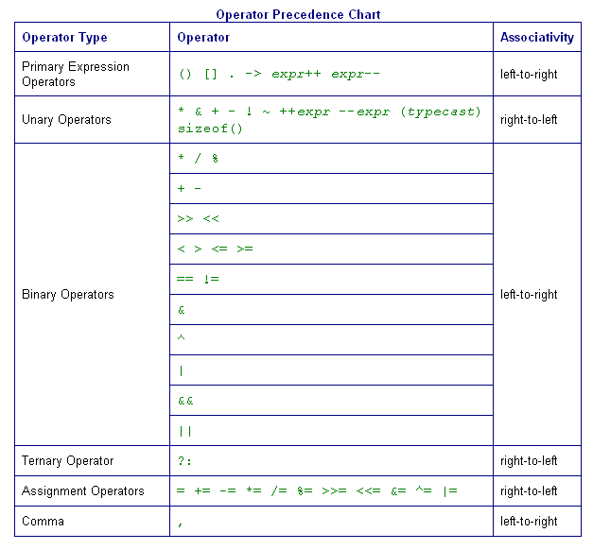
1
2
3
4
5
6

Slide 16
Type Conversion
C permits mixing of constants and variables of different types in an expression.
During the evaluation, If the operand are of different types then the lower type is automatically converted to the higher type before the operation proceeds.
Implicit Type Conversion:
C automatically converts any intermediate values to the proper type so that expression can be evaluated without loosing any significance. This automatic conversion is known as implicit type conversion.

Slide 17
Conversion Hierarchy
Long double
double
float
Unsigned long int
Long int
Unsigned int
int
Short | char

Slide 18
Explicit Type Conversion
When we want to force a type conversion in a way that is different from automatic conversion.
The process of a local conversion is known as explicit conversion or casting a value.
  Syntax: (type-name) expression
  Ex: int n1=30, n2=20;
  float ratio;
  ratio= (float)n1/n2;

Slide 19
Rules for Type Conversion
The final result of an expression is converted to the type of the variable on the left of the assignment sign before assigning the value to it.
The following changes occurs during the final stage.
  float to int causes truncation of the fractional part.
  double to float causes rounding of digits.
  long int to int causes dropping of the higher bits.

