Slide 1
CHAPTER 2
ROLE OF TESTING

Slide 2
Role of testing in SDLC
Testing activities play an equally important role in development and programming.
when srs document is given by the client test lead prepares test plan. and test engineer prepares test cases. and they will be having a meeting in middle .when the build is released we start executing test case and if we found any defect .we will be reporting to developer and he fixes it as bug and we perform regression testing and we release the build to maintenance
In SDLC tester comes in to play in the testing phase of SDLC .The main role of tester is to test the application by giving both positive and negative input to the application and then based on the test he prepares - Test Plan Test log Test case / Test script and finally the report writing.

Slide 3
The Role of a Tester in SDLC
1. Tester prepares the Test cases Test Scenarios from the SRS
2. Using the script the tester performs different kinds of testing (Regression Function)
3. Tester Notes the results (pass/Fail)
4. If Result Fail then the scenario is raised in the Test director
5. Once its fixed by the developer the tester performs a regression testing.

Slide 4
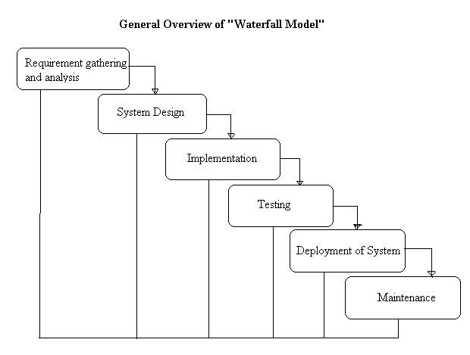

Slide 5
Waterfall Model is one type of SDLC (Software Development Lifecycle) model.
This is also referred to as a linear-sequential life cycle model. It is very simple to understand and use.
In a waterfall model, each phase must be completed in its entirety before the next phase can begin.
At the end of each phase, a review takes place to determine if the project is on the right path and whether or not to continue or discard the project.
1. Requirements analysis
2. High level system design
3. Low level system design
4. Coding
5. Unit and integration testing
6. System testing
7. Acceptance testing
8. Operation and maintenance

Slide 6
V-MODEL

Slide 7
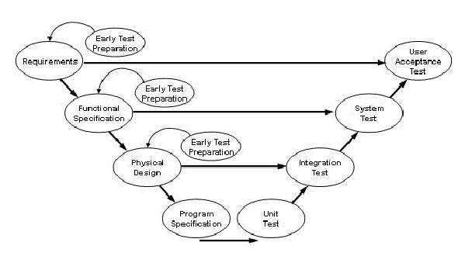

Slide 8
V-MODEL
Main idea behind the general V-model is that development tasks and testing task.
The V-model is a software development process which can be presumed to be the extension of the waterfall model.
Two branches of the letter ”V” in which left branch represent Development process.
During development system is gradually being designed and then programming is final step.
represent integration and testing process, and where their functionality is tested.
Integration and testing end upon completion of acceptance test of entire system developed according to this process.

Slide 9
left branch are the activities we know from waterfall model
  Requirement specification: needs and requirement of customer user are gathered.
  Functional system design: requirement are mapped onto function and dialogue of new system
  Technical system design: interface of system environment and decomposition of system into smaller subsystem.
  Component specification: each subsystem ,its task,behavior,innerstructure and interface to other subsystem.
  Programming: specified component is implemented in program language.

Slide 10
Right branch of V-model define a corresponding test level of each construction level.
  Component test: each s/w component perform correctly.
  Integration test: check group of component collaborate in the way its specified.
  System test: system meets the specified requirement.
  Acceptance test: system meets requirement as specified, from customer point of view.

Slide 11
Validation and verification
Process of checking the development result according to their original requirement is called validation.
During validation tester judges whether product solve its task ,and therefore if this product is suitable for its use.
Verification refer to only one single phase of development process.
Outcome of a particular development phase has been achieved correctly and completely according to its specification..
This means it is examined as to whether specification are correctly implemented and whether the product meets its specification.

Slide 12
V-Model advantages
It is also called as verification and validation Model.
This means the verification and validation will be done side by side.
It emphasis the strict process flow to develop a quality product.
The errors occurred in any phase will be corrected in that phase itself.
Improved quality and reliability.
Allows testers to be active in the project early in the project’s lifecycle. They develop critical knowledge about the system.

Slide 13
V-Model disadvantages
It needs lot of resources and money.
It needs an established process to implement.
It can be implemented by only some big companies.

Slide 14
When to use the V-Shaped Model
•Excellent choice for systems requiring
high reliability – hospital patient control
applications
•All requirements are known up-front
•When it can be modified to handle changing requirements beyond analysis
phase
•Solution and technology are known

Slide 15
W-model

Slide 16
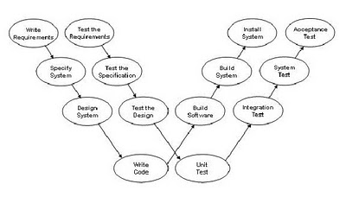
W-model

Slide 17
W-model
Paul Heraldic introduced the W-Model approach in 1993.
The W-Model focuses on the development products themselves. Essentially, every development activity that produces a work product is “shadowed” by a test activity.
The purpose of the test activity specifically is to determine whether the objectives of a development activity have been met and the deliverable meets its requirements.
In its most generic form, the W-Model presents a standard development lifecycle with every development stage mirrored by a test activity

Slide 18
On the left hand side, typically, the deliverables of a development activity (for example, write requirements) is accompanied by a test activity “test the requirements” and so on.
If your organization has a different set of development stages, then the W-Model is easily adjusted to your situation.
The important thing is this: the W-Model of testing focuses specifically on the product risks of concern at the point where testing can be most effective.
The Test activities first start after the implementation. The connection between the various test stages and the basis for the test is not clear.
The tight link between test, debug and change tasks during the test phase is not clear.
In the models presented above, there usually appears an unattractive task to be carried out after coding. In order to place testing on an equal footing, a second 'V' dedicated to testing is integrated into the model. Both 'V's put together give the 'W' of the 'W-Model'.

Slide 19
The W-Model and static test techniques.
The W-Model and static test techniques.
The W-Model and static test techniques.

Slide 20
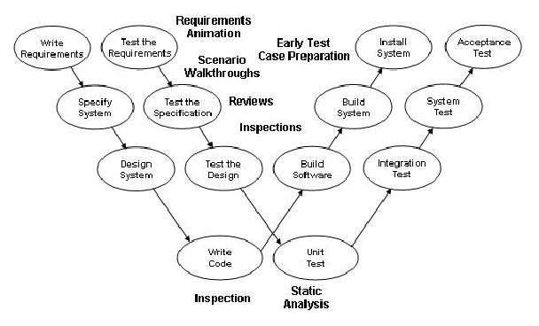
The W-Model and static test techniques

Slide 21
If we focus on the static test techniques, you can see that there is a wide range of techniques available for evaluating the products of the left hand side.
Inspections, reviews, walkthroughs, static analysis, requirements animation as well as early test case preparation can all be used.

Slide 22
The W-Model and dynamic test techniques.

Slide 23
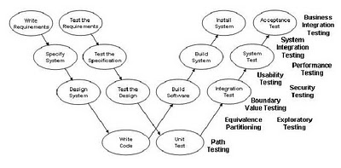
The W-Model and dynamic test techniques

Slide 24
If we consider the dynamic test techniques you can see that there is also a wide range of techniques available for evaluating executable software and systems.
The traditional unit, integration, system and acceptance tests can make use of the functional test design and measurement techniques as well as the non-functional test techniques that are all available for use to address specific test objectives.
If there are five development stages concerned with the definition, design and construction of code in your project, it might be sensible to have only three stages of dynamic testing only.
Component, system and acceptance testing might fit your normal way of working. The test objectives for the whole project would be distributed across three stages, not five. There may be practical reasons for doing this and the decision is based on an evaluation of product risks and how best to address them.

Slide 25
We use the W-Model in test strategy as follows. Having identified the specific risks of concern, we specify the products that need to be tested; we then select test techniques (static reviews or dynamic test stages) to be used on those products to address the risks; we then schedule test activities as close as practicable to the development activity that generated the products to be tested.
The W-model does not impose any rule that later dynamic tests must be based on documents created in specific stages (although earlier documentation products are nearly always used as baselines for dynamic testing).

Slide 26
Advantages of the W-Model
In the W-model the importance of the tests and the ordering of the individual activities for testing are clear.
The strict division between constructive tasks on the left-hand side and the more destructive tasks on the right-hand side that exists in the V-model is done away with.
In the W-model it is clear that such a division between tasks is not sensible and that a closer co-operation between development and testing activities must exist.
From the project outset onwards the testers and the developers are entrusted with tasks and are seen as an equal-rights partnership
. During the test phase, the developer is responsible for the removal of defects and the correction of the implementation.

Slide 27
Disadvantages of the W-Model
The models of software development presented do not clarify the expenditure needed for resources that need to be assigned to the individual activities.
In the W-model it appears that the different activities have an equal requirement for resources (time, personnel, etc.) .
For highly critical applications the test activities certainly have higher weighting or at least equal weighting with other activities

Slide 28
Agile Development Methodology
Agile means "Moving Quickly"
To understand the Testing Process in an Agile Development Methodology, it is important to understand the Agile development paradigm.
Agile Development paradigm is not very new. Although the Agile Software Development program came into existence in February 2001, the concepts existed long before that and were expressed in different ways. (Spiral and incremental Development Methodology is such example.

Slide 29
Understanding Agile Software Development:
The Agile Software Development primarily focuses on an iterative method of development and delivery.
The developers and end users communicate closely and the software is built.
A working piece of software is delivered in a short span of time and based on the feedback more features and capabilities are added.
In Agile Testing, testers are no longer a form of Quality Police. Testing moves the project forward leading to new strategy called Test Driven Development. Testers provide information, feedback and suggestions rather than being last phase of defense.
The focus is on satisfying the customer by delivering working software quickly with minimum features and then improvising on it based on the feedback.
The customer is thus closely involved in the Software Design and Development Process.

Slide 30
How is Testing approach different in an
Agile Development Scenario?
The Testing Strategy and Approach in Agile Development could be very different from traditional methods.
In fact it could vary with project needs and the project team.
In many scenarios, it may make sense to not have a separate testing team.
In fact testing can done more effectively in short turn around times, by people who know the system and its objectives very well.
For example: In certain teams Business Analysts could be doing a few rounds of testing each time the software version is released. Business Analysts understand the Business Requirements of the Software and test it to verify if it meets the requirements.
Developers may test the software. They tend to understand the system better and can verify the test results in a better way. Testing for AGILE Software Development requires innovative thinking and the right mix of people should be chosen for doing the testing.

Slide 31
What to test?
Given the relatively short turn around times in this methodology it is important that the team is clear on what needs to be tested.
Even though close interaction and innovation is advocated rather than processes, sufficient stress is given to the testing effort.
While each team may have its own group dynamics based on the context, each code has to be unit tested.
The developers do the unit testing to ensure that the software unit is functioning correctly.
Since the development itself is iterative it is possible that the next release of code was built by modifying the previous one. Hence Regression Testing gains significant importance in these situations.
The team tests if the newly added functionality works correctly and that the previously released functionality still works as expected.

Slide 32
Agile testers
• Use reusable checklists to suggest tests
• Focus on the real meaning of the test rather than the minor details
• Use lightweight documentation styles/tools
• Capturing test ideas in charters for investigate Testing.
• Leverage documents for multiple purpose

Slide 33
Test levels
Unit testing
Component testing
Module testing
Integration testing
System testing
Acceptance testing
Generic testing

Slide 34
Component testing
It is first level test.
The testing of a single software component is therefore is therefore called component testing.
Test object: The main attribute of the testing is:- the software components are tested individually and isolated from all other software component of the system. isolation is necessary to prevent external influence on component. if testing detect a problem, it is definitely a problem originating from the component under test itself.
Test environment: Testing is performed in close cooperation with development. tester must know the programming language and suitable programming tools must be at hand. this is why developer perform the component testing.

Slide 35
Test objective:
  Important task is to guarantee that the particular test object execute its entire functionality ( input/output behavior) correctly and completed, as required by specification. when whole system is integrated ,each software component must cooperate with many neighboring component and must have the ability to exchange data with them.
  cause the whole system to crash. rather, it should be able to handle the error situation in a reasonable and robust way.
  robustness is another very important aspect of the component test. the way to do this resemble the functional test .
  test data are used that are either known to be wrong or at least are special cases not mentioned in the specification. Such test cases are called negative tests.
  This may refer to nonfunctional characteristics like efficiency and maintainability.

Slide 36
Test strategy:
  The tester can design test cases using their knowledge about the component program structure, its function and variable.
  This helps in checking for correct or incorrect behavior of the component.
  A modern approach in component testing, is to prepare and automate test cases before coding.

Slide 37
Difference between Driver and Stub
A Stub is a piece of code emulating a called function OR A piece of code that simulates the activity of missing component. Stubs are created during integration testing like Top-down approach.
A Driver is a piece of code emulating a calling function OR A piece of code that passes test case to another piece of code. Drivers are created integration testing like bottom-up approach.

Slide 38
Unit
The smallest compliable component. A unit typically is the work of one programmer (At least in principle). As defined, it does not include any called sub-components (for procedural languages) or communicating components in general.

Slide 39
Unit Testing
A unit is smallest testable piece of software
  can be compiled, linked, loaded
  e.g functions/procedures, classes, interfaces
  normally done by programmer
  Test cases written after coding
Disadvantage
  –Test cases -written to suit programmer’s implementation (not necessarily specification)
  Better to use “Buddy Testing”

Slide 40
Unit Testing
Unit testing is a software verification and validation method in which a programmer tests if individual units of source code are fit for use.
A unit is the smallest testable part of an application. In procedural programming a unit may be an individual function or procedure.

Slide 41
Component
A unit is a component. The integration of one or more components is a component.

Slide 42
Component Testing
The same as unit testing except that all stubs and simulators are replaced with the real thing.
Two components (actually one or more) are said to be integrated when:
  They have been compiled, linked, and loaded together.
  They have successfully passed the integration tests at the interface between them.
  Thus, components A and B are integrated to create a new, larger, component (A,B). Note that this does not conflict with the idea of incremental integration -- it just means that A is a big component and B, the component added, is a small one.

Slide 43
Conclusion
Component testing should check :
  functionality
  Robustness
  Component’s characteristics that have a crucial influence on its quality . This may include some non functional characteristics like efficiency and maintainability.
    Efficiency – how efficiently the component uses computer resource
    Maintainability – all characteristics of a program that have an influence on how easy or how difficult it is to change the program or to continue developing it.

Slide 44
Module Testing
Also known as unit or component testing phase, module testing is concerned with the testing of the smallest piece of software for which a separate specification exists.

Slide 45
Integration
Groups of components are supposed to form larger structural units and subsystems. This connecting of components are called integration.
It is done by developer, testers, or special integration teams.

Slide 46
Integration test
It is second level test.
Group of these component are composed to form larger structural unit and subsystem. this connecting of component is called integration.
It is done by developer, tester or special integration team.
Goal of integration is to expose fault in the interface and in the interaction between integrated component.
Test objects: In integration the single component are assembled step by step and will result in larger unit. ideally there should be an integration test after each of these step.
  Every subsystem generated in this manner can later be the basis for the integration of even larger unit.

Slide 47
Test environment:
  With component testing, test driver are also needed.
  Test driver send data to test object and they receive and log the result because the test object are assembled component that have no interface to the outside.
  component test was well organized then one or more test driver should be available.
  In this case the tester can reuse these test driver without much effort.
  During testing additional tools called monitor are required.
  Monitor (std protocol) are program that read and log data traffic between component.

Slide 48
  Test objective:
    The test objective is to reveal interface and cooperation problem, as well as conflict between integrated parts.
    Problem arises when 2 single component integrate and together might not work because of interface format may not be compatible to each other (for ex. Files are missing).
    Fault in the data exchange or in the communication between the component.
    It is possible to omit component test after integration?
      Failure occurs in test and difficult to locate its origin.
      Failure occur in test designed like functional fault with in individual component.

Slide 49
Integration strategies:
  Component are completed at different times so the project manager cannot allow the tester to do nothing while waiting until the development of all the component is finished and they are ready to be integrated.
  Basic integration strategies can follow when it depends on delivery dates as follows:
    Top down integration: start with top level component of system that call other component but is not called itself. it tested a main part of test environment. So drivers are not needed.
    Bottom up integration: start with elementary system component that do not call further component, except for function of operating system
    Ad hoc integration: component are being integrated in the order in which they are finished.
    Backbone integration: skeleton is built into which component are gradually integrated.

Slide 50
System test
After integration next test level is system test.
System testing checks if the integrated product meet the specified requirement
The system test, though, looks at the system from the perspective of the customer and the future user. tester validate the requirement are completely and appropriate met.

Slide 51
Test object and test environment:
  System test look at the system as a whole. this is done in an environment as similar as possible to the intended operational environment.
  In this test the hardware and software products that are used later should be installed on test platform (h/w, system s/w, device driver s/w, network, external system etc).
  In attempt to save costs and effort, instead of testing the system in separate environment the system test is run in customer operational environment. but this not beneficial because failure will occur and damage to customer operational environment can result.
  System test effort is often underestimated, especially because of the complex testing environment.

Slide 52
Test objective:
  It is goal of the system test to validate whether the complete system meets the specified functional and nonfunctional requirement.
  Problem in system test:
  unclear system requirement
  Missed decision (tester identify original requirement)
  Project may fail (requirement are not specified)

Slide 53
Acceptance test
Before installing and using the software in real life, another test level must be executed the so called acceptance test.
Here focus is on customer perspective and judgment.
Acceptance test might be only test the customer is actually involved in or which they can understand.
Customer may even be responsible for the Acceptance test.

Slide 54
Typically forms of Acceptance testing include the following:
  Testing to determine if contract has been met.
  User Acceptance testing
  Operational (Acceptance )test
  Field test (alpha and beta testing)

Slide 55
Testing to determine if contract has been meet.
The test criteria are the acceptance criteria determined in the development contract.
In contrast to system testing which take place in the environment of the producer acceptance testing is run in the customer actual operational environment.

Slide 56
User Acceptance testing
Last phase of validation is the test for user acceptance.
Every user group should be included in the acceptance.
The customer usually organizes these test, selecting test cases based on business processes and typically use scenario.

Slide 57
Operational (Acceptance )test
  Operational (Acceptance )testing assures the acceptance of the system by the system administrators.
  Field test (alpha and beta testing)
  Testing done by representative customer.
  Testing of preliminary version by representative customer is called alpha testing or beta testing.
  Alpha test are carried out at the producers location.
  Beta test are carried out at the customers site.

Slide 58
Generic testing
Following types of testing can be distinguished in generic :
  Functional testing
  nonfunctional testing
  Testing of s/w structure
  Testing related to changes

Slide 59
Functional testing:
  Functional testing includes all kind of test which verify a system input-output behavior.
  To design functional test cases the black box testing method are used.
  Functional requirement specify the behavior of the system they describe “what” the system must be able to do.
  In requirement based testing, the released requirement are used as the basis for testing. for each requirement at least one test case is designed and documented in the test specification.

Slide 60
Nonfunctional testing
Nonfunctional requirement do not describe the function, but the attributes of the functional behavior or the attribute of the system as a whole, i.e “how well” or with what quality the system should carry out its function.
The following non functional system characteristic should be:
  Load test: measuring system behavior for increasing system load (e.g. no. of users that work simultaneously ,no. of transaction)
  Performance test: measuring processing speed and response time for particular use cases, usually dependent on increasing load
  Volume test: observation of the system behavior dependant on the amount of data (eg. Processing of very large file.)

Slide 61
  Stress test: observation of system behavior when it is overloaded.
Testing of security: against unauthorized access.
Stability or reliability test during permanent operation.
Robustness test: measuring the system response to operating error or wrong programming or h/w failure etc
Testing of compatibility
Testing of different configuration of the system
Usability test: examination of ease of learning the system, efficiency of operation, understandability of the system o/p.
Checking of the documentation
Checking of maintainability

Slide 62
Testing of software structure
Structural technique use information about the test object internal code structure or architecture.
The objective is to design and run enough test cases to, if possible completely cover all structural items.

Slide 63
Testing related to change
When existing s/w is changed ,defect are repaired or new part are added the change parts must be retested. in order to address them existing test case are repeated these tests are called regression tests.
Rerunning of all the test that have detected fault which have been fixed in new software release.
Complete regression testing.
Selection of regression testing: high priority test according to test plan are repeated.

