Slide 1
Unit 5
Test Management

Slide 2
Test management
Describe how to organize test teams
Team members qualification are important.
Task of a test manager and which supporting process must be present for efficient testing.

Slide 3
Test organization
It consist of :
  Test team
  Task
  Qualification

Slide 4
Test teams
Testing activities must executed during entire s/w life cycle.
Testing related task should be coordinate and planned in close cooperation with development activities.
Benefits of independent testing:
  Independent tester are unbiased and see different defects than developer
  This tester can verify assumption made by developer during specification and implementation of the system.

Slide 5
Drawback of independent testing:
  There might be lack of communication due to too much isolation from development team.
  Independent Testing become a bottleneck if the tester are not prepared with necessary resources.
  Developer think “tester will find trouble anyway”
Models or options for independence are possible:
  1. Developer test the program of a colleague.
  2. There are Tester with in the development team; these tester do all test work on their team.
  3. One or more dedicated testing team exist within the project team. (team not responsible for development task). such independent tester belong to business organization or IT operation group.

Slide 6
  4. Independent test specialist for specific testing task (such as performance test , usability test, security test or compatibility test)
  5. Separate organization (testing dept, external testing facility) is responsible for testing (on specific test level e.g. system test)
  Above mentioned model is appropriate depend among other thing on actual test level
Component testing:
  Testing should perform in close combination with development activities.
  It is worst choice to allow developers to test their own program.
  Independent testing of model 1 would certainly improve testing quality.
  Testing like model 2 is useful, if a sufficient no. of testing staff relative to no. of developer staff can be made available for testing.

Slide 7
Integration testing:
  When the same team developed the component also perform integration and integration testing, this testing can be organized parallel to component testing (models 1,2)
  If component originating from several team are integrated then mixed integration team with representative from involved development group or should be responsible.
  Depending on size of development project and no. of component model 3 to 5 consider here.
System testing
  Final product shall be consider from point of view of the customer and end user.
  This leaves only models 3,4 and 5 as professionally acceptable choice.

Slide 8
Tasks and qualification
Following roles should be assigned as:
  Test manager (Test leader):
    Test planning and test control expert, possessing knowledge and experience in the field of software testing, quality management, project management and personnel management. typical task may include:
    Writing or reviewing the test policy for the organization
    Writing the test strategy and test plan

Slide 9
    Representing the testing view in the object
    procure testing resource
    Selecting suitable test strategies and methods and introducing or improving testing related processes.
    Initiate and monitor the test work (spec,impl,exec ).
    Selecting and introducing suitable test tools
    Introducing suitable metrics for measuring test progress and evaluate quality of testing and product.
    Writing-> test report and communicating them.

Slide 10
Test designer (test analyst):
  Expert in test method and test specification having knowledge and experience in the field of software testing. typical task may include:
      Analyzing, reviewing and assessing user requirement specification, design and models.
      Creating test specification
      Preparing and acquire test data.
Test administrator:
  Expert for installing and operating the test environment( system administrator knowledge)

Slide 11
    Tester :
      Expert in executing tests and incident reporting.
      Typical tester task may include:
        Reviewing test plan and test cases
        Using test tools and test monitoring tools
        Executing and sorting tests, evaluating the result and documenting the result and difference.
        Certified tester can manually perform test and document them.
        Tester also need social skill: ability to work in a team
        Multi disciplinary team (additional IT specialist)
        Specialized software test service provider: Resources are not available within the company.

Slide 12
Test planning
Testing should not be the only measure for quality assurance (QA)
It should be used in combination with other quality assurance measure.
Therefore an overall plan for quality assurance measure is needed that will be documented in QA plan are as follows:

Slide 14
Quality assurance plan according to IEEE
  Purpose
  Mention document
  Management
  Documentation
  Standards ,perform, convention and metrics
  Software reviews
  Test
  Problem reporting and corrective action

Slide 15
  Tools, techniques and methodologies
  Supplier control
  Record collection, maintenance
  Training
  Risk management
  Glossary
  SQAP change procedure and history

Slide 16
2. Test plan
A task as testing requires careful planning.
The test managers planning activities may include:
  Defining overall approach to and strategy for testing
  Deciding about the test situation
  Definition of test level as well as their cooperation and integrating and coordinating the testing activities with other project activities

Slide 17
  Deciding how to evaluate the test result.
  Selecting metrics for monitoring and controlling test work as well as defining test exit criteria
  Determining how much test documentation shall be prepared
  Writing the test plan and deciding on what,who,when and how much testing
  Estimate test effort and test costs
  The result are documented in the test plan

Slide 18
Purpose of test plan
To prescribe the scope, approach, resources, and schedule of the testing activities.
To identify the items being tested, the features to be tested, the testing tasks to be performed, the personnel responsible for each task, and the risks associated with this plan.

Slide 19
3. Prioritizing tests
With Good planning and control it is possible that time and budget for the total test or in a certain test level are not sufficient to execute all planned test cases
In this case it is necessary to select test cases in a sensible way
Even with a reduced test, it must be assured that as many critical fault are found as possible. this means test cases must be prioritized.

Slide 20
Advantage :The most important test cases are executed first.
Criteria for prioritization of test cases may be:
  Usage frequency of a function or the probability of failure in software use.
  Risk of failure (severity+ probability of failure )
  Visibility of a failure for the end user is a further criterion for prioritization of test cases.
  Test case can be chosen depending on the priority of the requirement.
  Beside the functional requirement the quality characteristic may have differing importance for the customer.

Slide 21
  Prioritization can also be done from the viewpoint of the developer of the system architecture.
  The complexity of the individual component : complex program part should be tested
  Failure having a high project risk should be found early.

Slide 22
4. Test exit criteria
It is important part of test planning.
The purpose of text exit criteria is to define when testing can be stopped .
As test execution is generally at the end of a project.
Typical test criteria are:
  Test coverage: How many test case have been run (successfully), how many requirement are covered and how much code is covered.
  Product quality: no. of fault found, critically of failure, failure rates, reliability etc

Slide 23
  Residual risk: not executed tests, not repaired defects, incomplete coverage of requirement or code etc
  Economic constraint: allowed cost, project risks, delivery dates and market chances.
    The test manager define the project specific test exit criteria in the test strategy.

Slide 24
Cost and economy aspect
Testing can be very costly and can constitute a significant cost factor in software development.
Question arises how much effort is sufficient for testing a specific software product and when
To answer this question we should know the possible costs due to lack of testing:

Slide 25
  Costs of defect:
    if verification and testing activities are reduced or cut out completely the consequence is a higher no. of unrevealed fault and deficiencies in the product may lead the following costs are:
    Direct defect costs:
      Due to calculation mistake (data loss, wrong orders, damage of hardware or part of technical installation)
    Indirect defect cost:
      . Some ex. bad publicity, even legal cost such as loss of license.
    Costs for defect correction.
      Ex :time needed for failure analysis,
      correction, test and regression test,
      redistribution and reinstallation,

Slide 26
Risk analysis:
  To determine which type of costs will occur, how likely this, how expensive i.e. how high the defect risk is for project.
  Risk depend on the kind and size of the software product, type of customer
  Depend on the type and no. of failure ,no. of product installation as well as no. of user

Slide 27
2. Costs of testing:
  To reduce or limit risk to plan verification and test activities
  Following list shows most important factor that a test manager take into account when estimate the cost of testing:
      Maturity of the development process
        Stability of organization
        Developers error speed
        Frequency of changes in the software
        Time pressure from unrealistic plans
        Validity ,level of detail and consistency of plan

Slide 28
  Quality and testability of the software:
    Number, severity and distribution of defect in the system being tested
    Quality, fluency and importance of the documentation and other information used as test basis
    Size and type of the software and its system environment
    Complexity of the problem (cyclomatic number)
  Test infrastructure:
    Availability of testing tools
    Availability of test platform, test environment and infrastructure
    Availability of and experience with testing process standard and procedure

Slide 29
Qualification of employees:
  Testing experience and knowledge of tester
  Test tool and test environment experience of the tester
  Application (test object) experience and knowledge of the tester.
  Collaboration of tester- developer -management -customer

Slide 30
Quality requirement:
  planned test coverage
  max no. of remaining defect after testing
  Requirement for security and safety
  Requirement for test documentation
Test strategy:
  The testing objective (test level )
  Selection of the test technique (black or white)
  Schedule of the tests (start and execution of the test work in the project)

Slide 31
3. Test effort estimation
Before defining a schedule and assigning resources the testing effort and amount of resources needed must be estimated.
For small project estimation in one step. for large project separate estimate per test level and per test cycle is necessary.
In general two approaches for estimation of test effort are possible:
  Listing all testing task, then either task owner or experts who have estimation experience estimate each task.
  Estimating testing effort based on effort data of former project or based on typical values. (e.g.. Average no. of test cases run per hour)

Slide 32
Test strategies
Test strategy define the project testing objective and means to achieve them.
Test strategy determine testing effort and costs.
Selecting an appropriate Test strategy is one of the most important planning task decision the test manger has.
The goal is to choose a test approach that optimize the relation between cost of testing and cost of defect.

Slide 33
To classify test approaches or strategies is based on the point in time at which the bulk of the test design work is begun:
  Preventative approaches Vs Reactive approaches.
  Analytical approaches Vs heuristic approach:

Slide 34
Preventative Vs reactive approach
Are those in which tester are involved from the beginning: test planning and design start as early as possible
Test manager actually optimize testing and reduce testing costs.
Are those in which tester are involved too late.
Test manager must react correctly.
One very successfully strategy in such a situation is called “exploratory testing”

Slide 35
Reactive approaches, where test design comes after the software or system has been produced.
Early test specification and preparation, as well as application of review and static analysis contribute to early defect finding.
Preventative approaches, where tests are designed as early as possible.

Slide 36
Analytical Vs heuristic approach:
Test planning is founded on data and analysis of these data.
Test planning is found on experience of expert (from inside or outside the project)

Slide 37
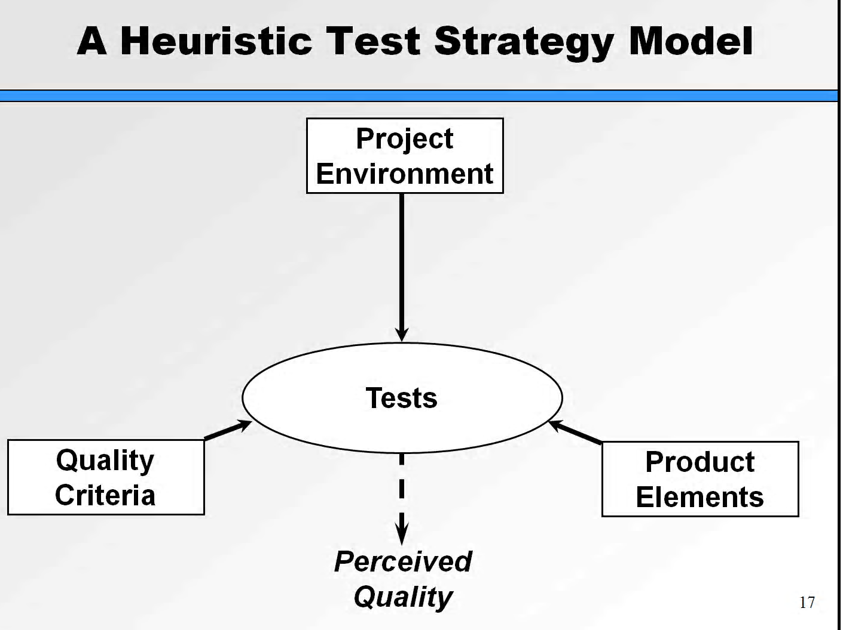

Slide 38
The Approaches used in practice are often between these extremes and use both analytical and heuristic element:
  Model based testing: abstract functional model of software under test
  Statistical or stochastic( model based testing): used about fault distribution in test object
  Risk based testing: uses information on project and product risk.
  Process or standard compliant approach: e.g.. V-model
  Reuse oriented approaches: goal is to set up testing quickly by maximum reuse
  Checklist based approaches: use failure and defect list from earlier test cycle
  Expert oriented approaches: use the expertise and “gut feeling”

Slide 39
Test Activity management
Every cycle through the test process commonly generates change request or fault correction request to the developer.
If fault are corrected or changes are implemented a new version of software emerge and it must be tested again.
Every test level the test process is executed repeatedly
Test manager is responsible for initiating, supervising and controlling these test cycle.
Activity are:
  Test cycle planning
  Test cycle monitoring
  Test cycle control

Slide 40
Test cycle planning
  The general planning must be supplemented by detailed planning for each upcoming actual test cycle.
    Consider the following aspects:
      Development status:
        Software actually available at the beginning of a test cycle which altered functionally. it require to adjust test cases.
      Test results:
        Problem exposed by previous test cycle may require a change in test priorities. Corrected fault require additional retest which also need to be planned. additional test may needed when problem cannot be completely analyzed.

Slide 41
      Resources:
        Planning current test cycle must be reliable with current project plan, current availability of test environment and of special test tools etc.
Taking these item into consideration test manager estimates :
    effort and time for test activity and
    what test cases should performed at what time by which tester in which order.

Slide 42
Test cycle monitoring
To measure and monitor the result of the ongoing tests, objective→ test metrics should be used.
Following approaches can be distinguished:
  Fault based and failure based metrics:
    No. of encounter faults respectively generated→ incident report in particular release.
  Test case based metrics:
    No. of test cases specified or planned,
    no. of test case still->blocked
    Test object based metrics:
      Coverage of code
    Cost based metrics
      Already incurred test cost (prevented failure cost)

Slide 43
Test status report:
  Each test cycle a test status report is written:
    Test object, test level, test cycle date from__ to__
    Test progress: test planned /run/blocked
    Incident status: new/open/corrected
    Risk: new/changed/known
    Outlook: planning of next test cycle
  Test exit criteria:
    Priority meaning
    1 test case must be executed
    2 test case should be executed
    3 test case must be executed
    Product will be released

Slide 44
Test cycle control
If testing is delayed with respect to project and test planning, the test manager must take suitable countermeasure this is called test control.
This action relate to test or any other development activity.
To request or arrange additional test resources in order to make up for the delay and catch up on the schedule in remaining cycle.
If additional resources are not available, the test plan itself must be adapted i,e Test cases with low priority will be omitted

Slide 45
Depend on Severity of fault and problem found, the test duration may be extended this happen additional test cycle become necessary as corrected software must be retested after each correction cycle this could mean that product release must be postponed.
Changes to test plan must be communicate clearly

Slide 46
Configuration management
The purpose of configuration management is to establish and maintain the integrity of the products (components, data and documentation) of the software or system through the project and product life cycle.
several developer and tester take part in process simultaneously it is far from easy to keep an overview of current related component.
If configuration management is not done properly in a project the following typical symptoms may be observed:
  Developer mutually overwrite each other modification in source code.
  Integration activities are slow down

Slide 47
Problem analysis, fault correction and regression test are complicated
Tests and->test evaluation are impeded because it is unclear:
  Which test case belong to which version of test object
Following requirement should be met:
  Version management
  Configuration identification
  Incident status and change status accounting
  Configuration review: audit offer the possibility to check whether all software component were documented by configuration management.

Slide 48
Why can be tester dependent on configuration management?
a) Because configuration management assures that we know the exact version of the test ware and the test object
b) Because test execution is not allowed to proceed without the permission of the change control board
c) Because changes in the test object are always subject to configuration management
d) Because configuration management assures the right configuration of the test tools

Slide 49
What test items should be put under configuration management
a) The test object, the test material and the test environment
b) The problem reports and the test material
c) Only the test objects. The test cases need to be adapted during agile testing

Slide 50
Incident management
Since one of the objectives of testing is to find defects, the discrepancies between actual and expected outcomes need to be logged as incidents.
In order to manage all incident to completion, an organization should establish a process and rules for classification.
Incidents may be raised during development, review, testing or use of a software product.
It start during test execution ,or upon test run completion by evaluate test log.
Documenting incident done for every unexpected behavior or observed difference outcome documented in the test log.

Slide 51
Incident reports have the following objectives:
Provide developers and other parties with feedback about the problem to enable identification, isolation and correction as necessary.
Provide test leaders a means of track the quality of the system under test and the progress of the testing.
Provide ideas for test process improvement.

Slide 52
Incident classification: failure severity
Class
Fatal
2 Very serious
3 Serious
4 Moderate
5 Mild
Description
System breakdown, possibly with loss of data
Requirement not stick to or incorrectly implemented
Functional deviation or restriction (normal failure) requirement incorrect or partially implement
Minor difference
Spelling error

Slide 53
INCIDENT STATUS REPORT
NEW
TESTER
DEVELOPER
OBSERVATION
TEST MANAGER
OPEN
REJECTED
DEVELOPER
ANALYSIS
PROJECT MANAGER
CORRECTION
TESTER
DEVELOPER
FAILED
TEST
CLOSED
TESTER

Slide 54
Test progress monitoring and control
Test progress monitoring
1. The purpose of test monitoring is to give feedback and visibility about test activities.
2 Information to be monitored may be collected manually or automatically and may be used to measure exit criteria, such as coverage.
3 Metrics may also be used to assess progress against the planned schedule and budget.

Slide 55
Common test metrics include:
Percentage of work done in test case preparation (or percentage of planned test cases prepared).
Percentage of work done in test environment preparation.
Test case execution (e.g. number of test cases run/not run, and test cases passed/failed).
Defect information (e.g. defect density, defects found and fixed, failure rate, and retest results).
Test coverage of requirements, risks or code.
Subjective confidence of testers in the product..
Testing costs, including the cost compared to the benefit of finding the next defect or to run the next test.

Slide 56
Test control
Test control describes any guiding or corrective actions taken as a result of information and metrics gathered and reported. Actions may cover any test activity and may affect any other software life cycle activity or task.
Examples of test control actions are:
Making decisions based on information from test monitoring.
Re-prioritize tests when an identified risk occurs (e.g. software delivered late).
Change the test schedule due to availability of a test environment.
Set an entry criterion requiring fixes to have been retested (confirmation tested) by a developer before accepting them into a build.

Slide 57
Performance Test
  Evaluate the fulfillment of a system or component with specified performance requirements.
  In the current era, when you hardly have any stand alone desktop application Performance, Load and stress Testing becomes key to the success of your application. Performance testing comes under non functional testing.
  Performance testing is executed to determine how fast a system or sub-system performs under a particular workload. It can also serve to validate and verify other quality attributes of the system, such as scalability, reliability and resource usage.

Slide 58
Security testing
Security Testing is very important in today's world, because of the way computer and internet has affected the individual and organization.
Today, it is very difficult to imagine world without Internet and latest communication system. All these communication systems increases efficiency of individual and organization by multifold.
Since every one from individual to organization, uses Internet or communication system to pass information, to do business, to transfer money it becomes very critical for the service provider to make sure that information and network are secured from the interloper.

Slide 59
Stress / Load Test
Evaluates a system or component at or beyond
the limits of its specified requirements.
Testing under unusually heavy loads, heavy repetition of certain actions or inputs, input of large numerical values, large complex queries to a database etc.
Term often used interchangeably with ‘load’ and ‘performance’ testing.
Determines the load under which it fails and how.
  Testing an application under heavy loads.
  Eg. Testing of a web site under a range of loads to determine, when the system response time degraded or fails.

Slide 60
Volume testing is a way to test functionality. Stress testing is a way to test reliability. Load testing is a way to test performance. There is little agreement on what the specific goals of load testing are. The terms load testing, performance testing, reliability testing, and volume testing, are often used interchangeably.

