Slide 1
Testing object oriented software

Slide 2
DIFFERENT OO TESTING
Unit Testing
Integration Testing
System Testing
Regression Testing
Tools for Testing OO System

Slide 3
UNIT TESTING
Smallest unit is class
Classes should be tested thoroughly because
    It is a combination of data & method
    It is heavily reuse
    It provide many feature
Conventional method can be applied directly

Slide 4
Unit Testing
Object must be tested via message passing
To achieve this objective Alpha-Omega method is used

Slide 5
Alpha-Omega method (Working)
Test the object through its lifecycle from
“Birth to Death”.
Test the simple methods first & then the more complex methods.
Test the methods from private through public methods.
Send a message to everyone at least once.

Slide 6
INTEGRATION TESTING
Testing whether classes and object work together or not
Different traditional integration method can be used

Slide 7
System Testing
Ensuring that system matches specification
layed out in the requirements.
Importance of System Testing in OO
Different classes may be combined together by client and this combination may lead to new defect that are uncovered.
Instantiated object may not free all its allocated resource, thus causing memory leak and such related problem, which will show up only in system testing phase.

Slide 8
Regression Testing
  Ensuring that changes made to one component does not have any side effect on other component

Slide 9
Tools for Testing of OO systems
There are several tools that help in testing oo system.
Use cases
Class diagrams
Sequence diagrams
State diagrams
2

Slide 10
Use cases
Use cases represent the various tasks that a user will perform when interacting with the system.
Use cases go into the details of the specific steps that the user will go through in accomplishing each task & the responses for each steps.
This fits in place for the object oriented paradigm, as the tasks and responses are similar to message passed to the various objects.

Slide 11
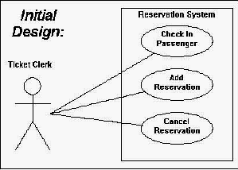
USE CASES
Use case perform various task that a user will perform when interacting with system

Slide 12
Class diagrams
Class diagrams represents the different entities and relationship that exist among the entities.
A class diagram has the following elements:
Box: represents a class.
Association : represents a relationship between two classes by line.
Class Name

Slide 13
Continue….
Customer may have any number of
orders
Association
Association may be 1-1, 1-many, many-1and so on.
Generalization: represents child classes that are derived from parent classes.
Order
Customer
*
Places
1

Slide 14
Continue….
Generalization
Customer
Corporate customer
Personal customer

Slide 15
Sequence diagram
We saw that an oo system works by communicating messages across the various objects.
A sequence diagram represents a sequence of message passed among objects to accomplish a given application scenario or use case.

Slide 16
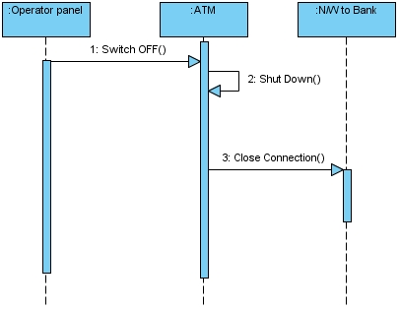
Continues….

Slide 17
State diagrams
State diagrams are used to give an abstract description of the behavior of a system
When an object can be modeled as state machine, then the techniques of state-based testing.
Sate-based testing is black box testing method.

Slide 18
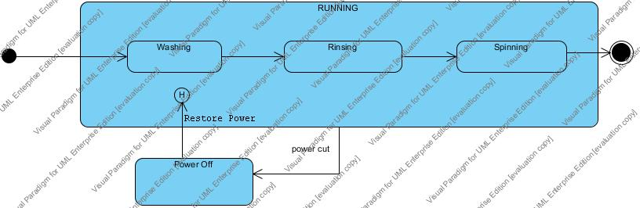
State Diagram
A state-transition model describes the different states and transitions of a class

