Slide 1
JOINS
Notes:
http://docs.oracle.com/cd/B28359_01/server.111/b28286/queries006.htm#sthref3277

Slide 2
Data
Assume we have the following two tables. Table A is on the left, and Table B is on the right. We'll populate them with four records each.
TableA |  | TableB
Id | name | Id | name
1 | pirate | 1 | rutabaga
2 | monkey | 2 | pirate
3 | ninja | 3 | darth vader
4 | spaghetti | 4 | ninja

Slide 3
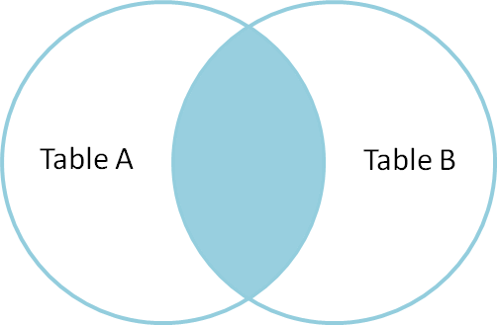
INNER JOIN
SELECT * FROM TableA
INNER JOIN TableB
ON TableA.name=TableB.name
Id | name | Id | name
1 | pirate | 2 | pirate
3 | ninja | 4 | ninja
Inner join produces only the set of records that match in both Table A and Table B.

Slide 4
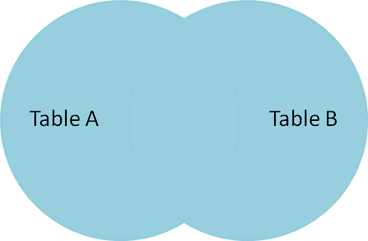
FULL OUTER JOIN
Id | name | Id | name
1 | pirate | 2 | pirate
3 | ninja | 4 | ninja
4 | spaghetti | - | -
2 | monkey | - | -
- | - | 3 | darth vader
- | - | 1 | rutabaga
SELECT * FROM TableA
FULL OUTER JOIN TableB
ON TableA.name=TableB.name
Full outer join produces the set of all records in Table A and Table B, with matching records from both sides where available. If there is no match, the missing side will contain null.

Slide 5
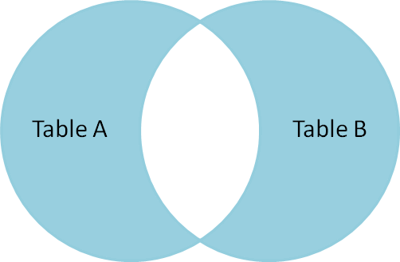
SELECT * FROM TableA
FULL OUTER JOIN TableB
ON TableA.name=TableB.name
WHERE TableA.id IS NULL
OR TableB.id IS NULL
Id | name | Id | name
2 | monkey | - | -
4 | spaghetti | - | -
- | - | 1 | rutabaga
- | - | 3 | darth vader
To produce the set of records unique to Table A and Table B, we perform the same full outer join, then exclude the records we don't want from both sides via a where clause.

Slide 6
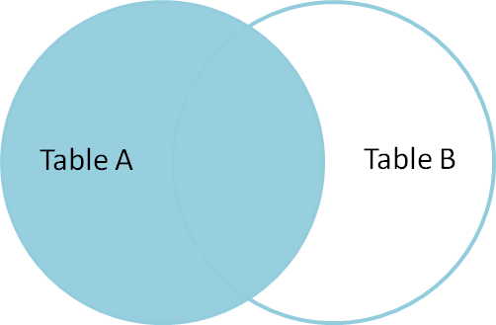
LEFT OUTER JOIN
SELECT * FROM TableA
LEFT OUTER JOIN TableB
ON TableA.name=TableB.name
Id | name | Id | name
1 | pirate | 2 | pirate
2 | monkey | - | -
3 | ninja | 4 | ninja
4 | spaghetti | - | -
Left outer join produces a complete set of records from Table A, with the matching records (where available) in Table B. If there is no match, the right side will contain null.

Slide 7
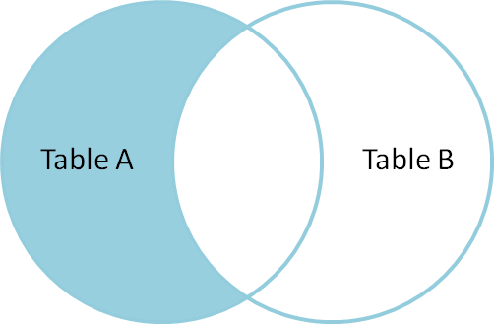
SELECT * FROM TableA
LEFT OUTER JOIN TableB
ON TableA.name=TableB.name
WHERE TableB.id IS NULL
Id | name | Id | name
2 | monkey | - | -
4 | spaghetti | - | -
To produce the set of records only in Table A, but not in Table B, we perform the same left outer join, then exclude the records we don't want from the right side via a where clause.

Slide 8
CROSS JOIN
SELECT * FROM TableA
CROSS JOIN TableB
This joins "everything to everything", resulting in 4 x 4 = 16 rows, far more than we had in the original sets.

Slide 9


