Slide 1
Chapter 7
Subqueries

Slide 2
Chapter Objectives
Determine when it is appropriate to use a subquery
Identify which clauses can contain subqueries
Distinguish between an outer query and a subquery
Use a single-row subquery in a WHERE clause
Use a single-row subquery in a HAVING clause
Use a single-row subquery in a SELECT clause

Slide 3
Chapter Objectives
Distinguish between single-row and multiple-row comparison operators
Use a multiple-row subquery in a WHERE clause
Use a multiple-row subquery in a HAVING clause
Use a multiple-column subquery in a WHERE clause

Slide 4
Chapter Objectives
Create an inline view using a multiple-column subquery in a FROM clause
Compensate for NULL values in subqueries
Distinguish between correlated and uncorrelated subqueries
Nest a subquery inside another subquery

Slide 5
Subquery
Used when query is based on unknown value
A query nested inside another query
Requires SELECT and FROM clauses
Must be enclosed in parentheses
Place on right side of comparison operator

Slide 6
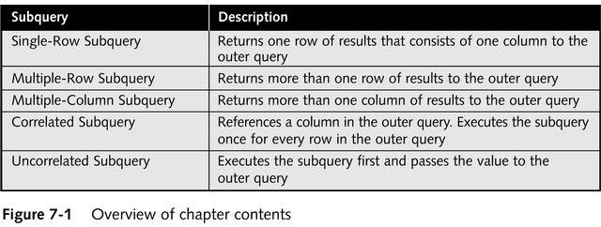
Types of Subqueries

Slide 7
Single-Row Subquery Operators
Can only return one result to outer query
Operators include =, >, <, >=, <=, < >

Slide 8
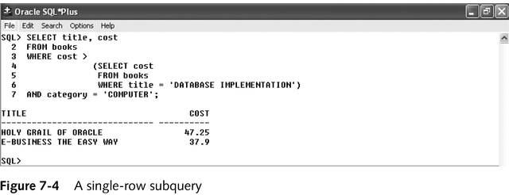
Single-Row Subquery –
In WHERE Clause
Used for comparison against individual data

Slide 9
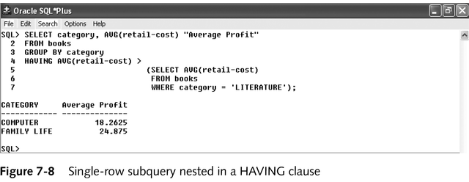
Single-Row Subquery –
In HAVING Clause
Required when returned value is compared to grouped data

Slide 10
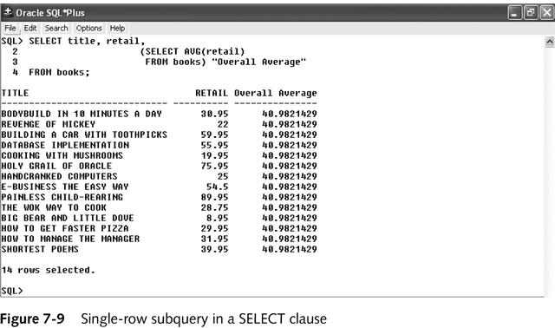
Single-Row Subquery –
In SELECT Clause
Replicates subquery value for each row displayed

Slide 11
Multiple-Row Subqueries
Return more than one row of results
Require use of IN, ANY, ALL, or EXISTS operators

Slide 12
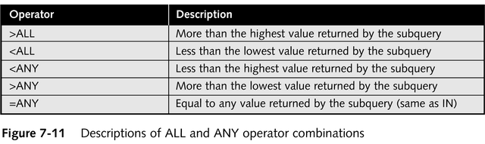
ANY and ALL Operators
Combine with arithmetic operators

Slide 13
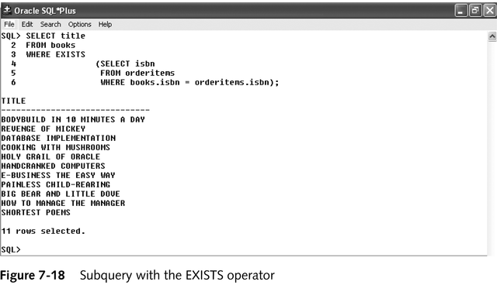
EXISTS Operator
Determines whether condition exists in subquery

Slide 14
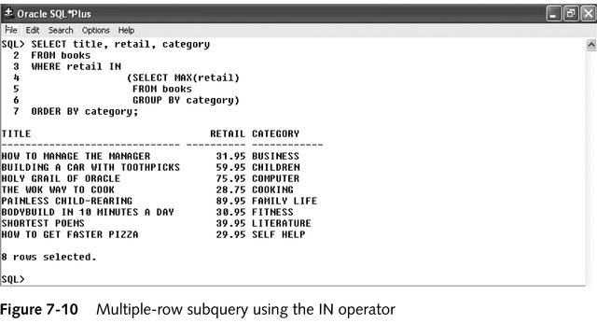
Multiple-Row Subquery –
In WHERE Clause

Slide 15
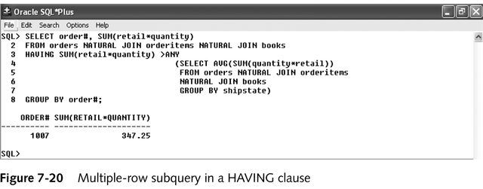
Multiple-Row Subquery –
In HAVING Clause

Slide 16
Multiple-Column Subquery
Returns more than one column in results
Can return more than one row
Column list on left side of operator must be in parentheses
Uses IN operator for WHERE and HAVING clauses

Slide 17
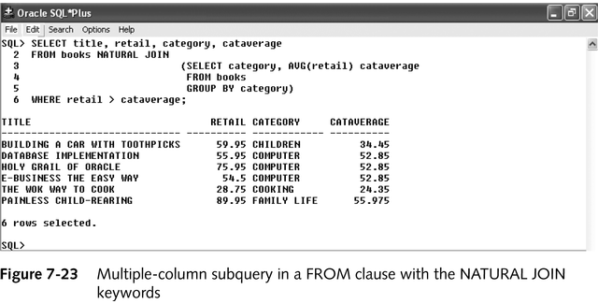
Multiple-Column Subquery –
In FROM Clause
Creates temporary table

Slide 18
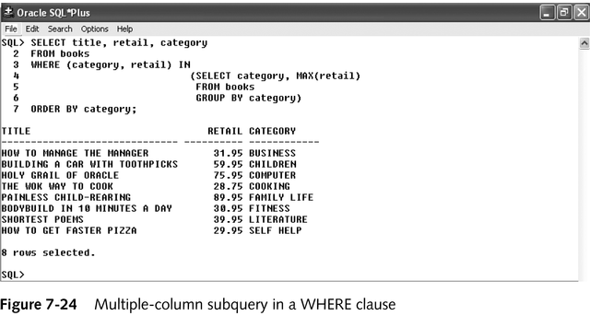
Multiple-Column Subquery –
In WHERE Clause
Returns multiple columns for evaluation

Slide 19
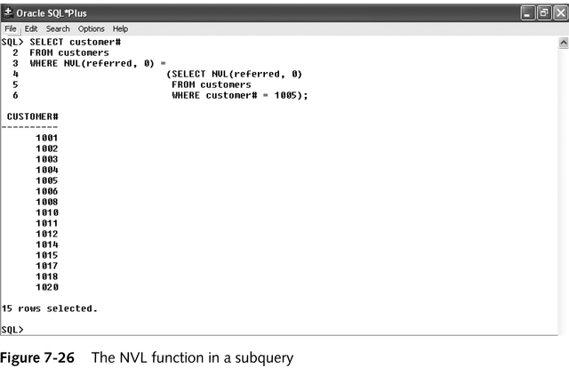
NULL Values
When subquery might return NULL values, use NVL function

Slide 20
Uncorrelated Subqueries
Processing sequence:
  Inner query executed first
  Result passed to outer query
  Outer query executed

Slide 21
Correlated Subqueries
Inner query executed once for each row processed by outer query
Inner query references row contained in outer query

Slide 22
Nested Subqueries
Maximum 255 subqueries if nested in WHERE clause
No limit if nested in FROM clause
Innermost subquery resolved first, then next level, etc.

Slide 23
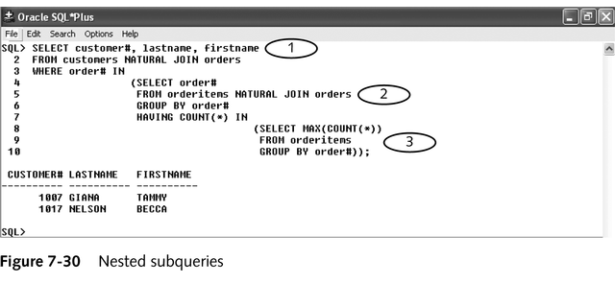
Nested Subquery Example
Innermost resolved first (3), then second level (2), then outer query (1)

