Slide 1
MemoryStream Class

Slide 2
A memory stream is created from an array of unsigned bytes rather than from a file or other stream. Memory streams are used as temporary, in-memory storage (temporary buffers) in lieu of creating temporary files. This stream is highly optimized for speed since the data is stored in memory and the processor can easily access it. Memory streams should be used to store frequently accessed data.

Slide 3
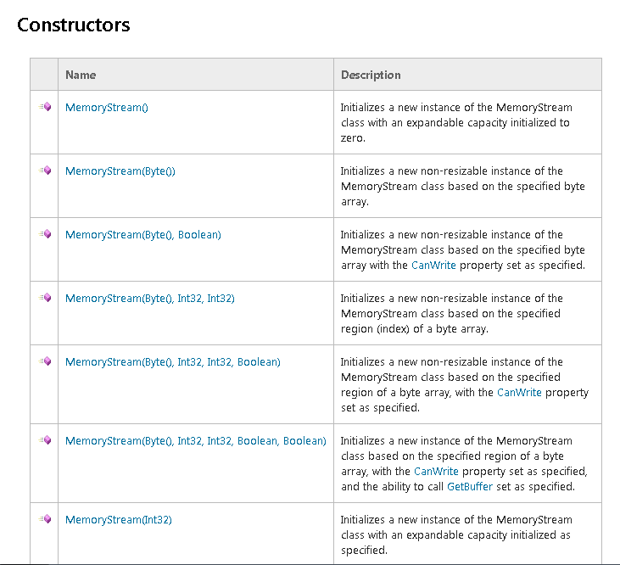

Slide 4
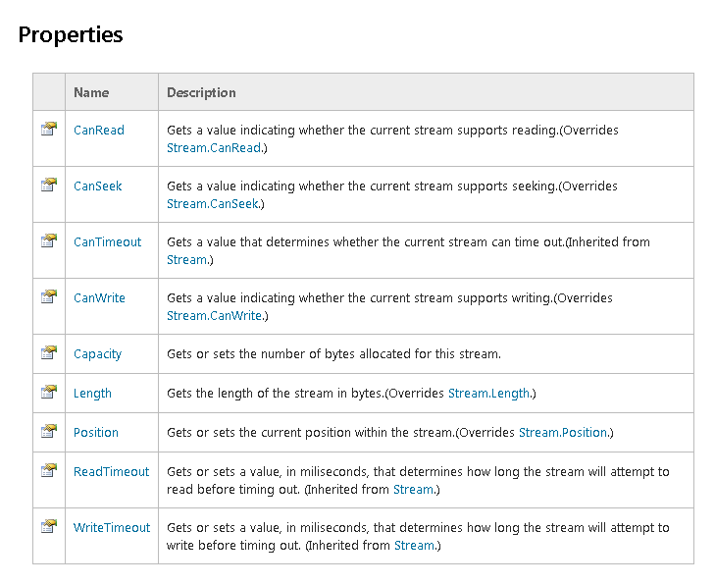

Slide 5
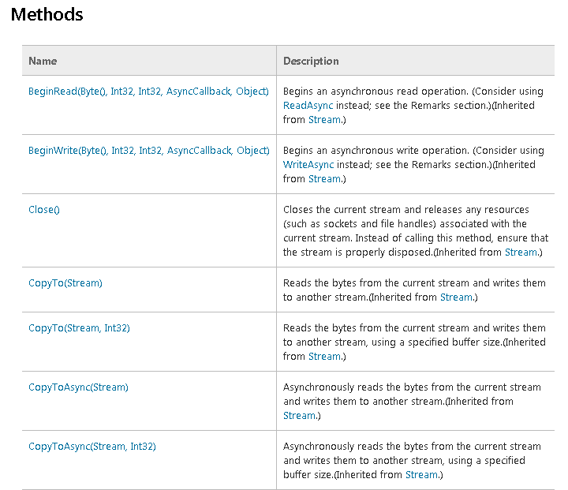

Slide 6
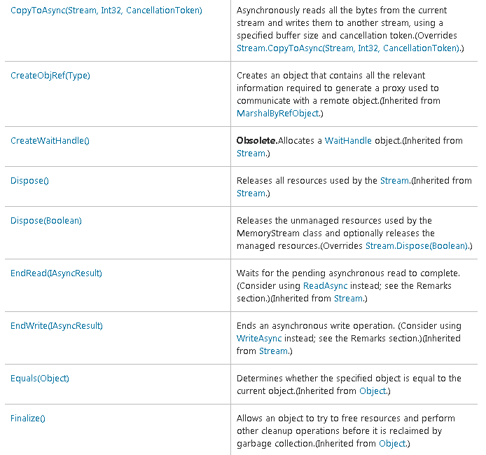

Slide 7
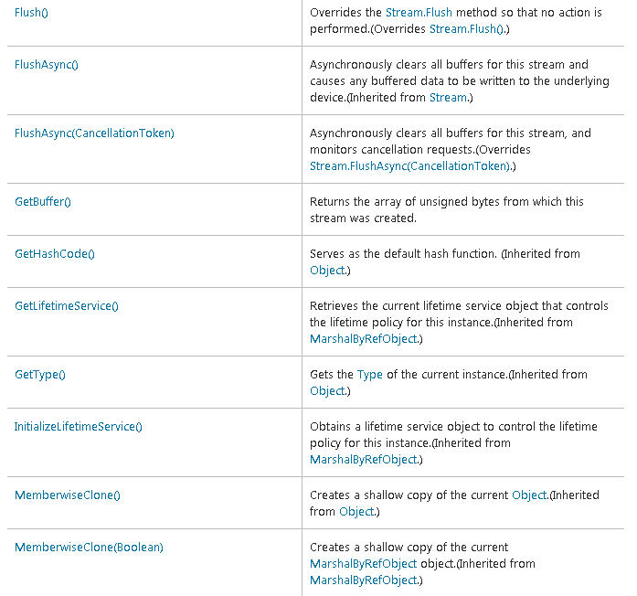

Slide 8
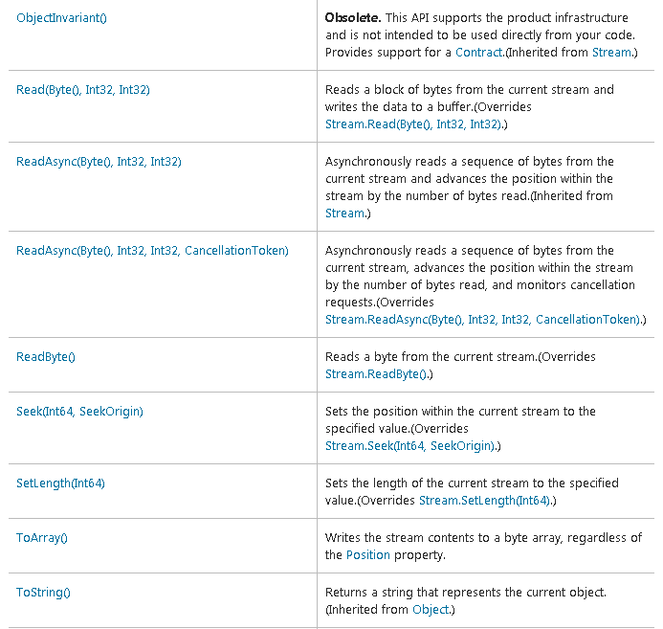

Slide 9
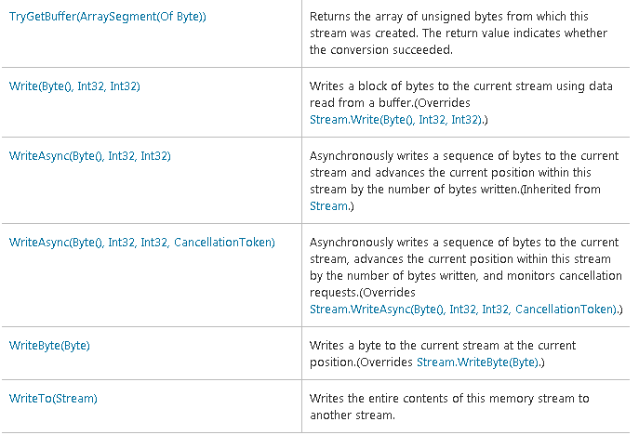

Slide 10
The Read and Write methods of the MemoryStream class read and write from an internal buffer that is created when the memory stream is created. The example shown in the following listing uses the MemoryStream class to add a custom signature at the end of the specified file.

Slide 11
MemoryStream Reading and Writing Example
Imports System
Imports System.IO
Imports System.Text
Public Class MemStream
Public Shared Sub Main(ByVal args As String()) 'Check the number or arguments If args.Length < 1 Then Console.WriteLine("Usage: MemStream <sourcefile>")
Console.ReadKey()
Return End If
Try 'Get the current date Dim dt As DateTime = DateTime.Now Dim tag As String = "This file was signed on " + dt.ToShortDateString()

Slide 12
'Get a byte array from the string Dim tagarray As Byte() = System.Text.Encoding.ASCII.GetBytes(tag.ToCharArray())
'Construct a memory stream with the byte array as a parameter Dim mstream As New MemoryStream(tagarray)
'Open a FileStream on the source file
Dim fout As New FileStream(args(0), FileMode.Open, FileAccess.Write)
'Seek to the end of the file fout.Seek(0, SeekOrigin.[End]) Dim buffer As [Byte]() = New [Byte](tagarray.Length) {} Console.WriteLine("Starting to write signature")
'Read the contents of the MemoryStream into a buffer Dim n As Integer = mstream.Read(buffer, 0, buffer.Length)

Slide 13
'Write the buffer to the file fout.Write(buffer, 0, n)
'Close the streams mstream.Close() fout.Close() Console.WriteLine("Signature Written") Catch e As IOException Console.WriteLine("An IO Exception Occurred :", e) Catch oe As Exception Console.WriteLine("An Exception Occurred :", oe) End Try Console.ReadLine()
End Sub
End Class

Slide 14
