Slide 1
HTML/CSS Tutorial

Slide 2
Definitions
WWW -- a software infrastructure layered on top of the Internet
HTTP -- HyperText Transport Protocol, layered on top of TCP
HTTPS -- secure HTTP using encryption
HTML -- HyperText Markup Language, version 4.01 is current

Slide 3
HTML Page Format
<HTML>
<HEAD>
<TITLE> Qi’s web! </TITLE>
</HEAD>
<BODY>
<H1> Hello World </H1>
<! Rest of page goes here. This is a comment. >
</BODY>
</HTML>

Slide 4
BODY Element
<BODY attributename="attributevalue">
Deprecated attributes (but still used)
  BACKGROUND=“Sunset.jpg” (can be tiled)
  BGCOLOR=color
  TEXT=color
  LINK=color (unvisited links)
  VLINK=color (visited links)
  ALINK=color (when selected)

Slide 5
Headings
  <H1 ...> text </H1> -- largest of the six
  <H2 ...> text </H2>
  <H3 ...> text </H3>
  <H4 ...> text </H4>
  <H5 ...> text </H5>
  <H6 ...> text </H6> -- smallest of the six
ALIGN="position" --left (default), center or right

Slide 6
Headings
<HTML>
<HEAD>
<TITLE>Document Headings</TITLE>
</HEAD>
<BODY>
Samples of the six heading types:
<H1>Level-1 (H1)</H1>
<H2 ALIGN="center">Level-2 (H2)</H2>
<H3><U>Level-3 (H3)</U></H3>
<H4 ALIGN="right">Level-4 (H4)</H4>
<H5>Level-5 (H5)</H5>
<H6>Level-6 (H6)</H6>
</BODY>
</HTML>

Slide 7
<P> Paragraph
<P> defines a paragraph
Add ALIGN="position" (left, center, right)
Multiple <P>'s do not create blank lines
Use <BR> for blank line
Fully-specified text uses <P> and </P>
But </P> is optional

Slide 8
<BODY>
<P>Here is some text </P>
<P ALIGN="center"> Centered text </P>
<P><P><P>
<P ALIGN="right"> Right-justified text
<! Note: no closing /P tag is not a problem>
</BODY>

Slide 9
<PRE> Preformatted Text
<PRE>
if (a < b) {
a++;
b = c * d;
}
else {
a--;
b = (b-1)/2;
}
</PRE>

Slide 10
Special Characters
Character | Use
< | &lt;
> | &gt;
& | &amp;
" | &quot;
Space | &nbsp;

Slide 11
Colors
Values for BGCOLOR and COLOR
  many are predefined (red, blue, green, ...)
  all colors can be specified as a six character hexadecimal value: RRGGBB
  FF0000 – red
  888888 – gray
  004400 – dark green
  FFFF00 – yellow

Slide 12
Fonts
<FONT COLOR="red" SIZE="2" FACE="Times Roman">
This is the text of line one </FONT>
<FONT COLOR="green" SIZE="4" FACE="Arial">
Line two contains this text </FONT>
<FONT COLOR="blue" SIZE="6" FACE="Courier"
The third line has this additional text </FONT>
Note: <FONT> is now deprecated in favor of CSS.

Slide 13
Ordered (Numbered) Lists
<OL TYPE="1">
<LI> Item one </LI>
<LI> Item two </LI>
<OL TYPE="I" >
<LI> Sublist item one </LI>
<LI> Sublist item two </LI>
<OL TYPE="i">
<LI> Sub-sublist item one </LI>
<LI> Sub-sublist item two </LI>
</OL>
</OL>
</OL>

Slide 14
Unordered (Bulleted) Lists
<UL TYPE="disc">
<LI> One </LI>
<LI> Two </LI>
<UL TYPE="circle">
<LI> Three </LI>
<LI> Four </LI>
<UL TYPE="square">
<LI> Five </LI>
<LI> Six </LI>
</UL>
</UL>
</UL>

Slide 15
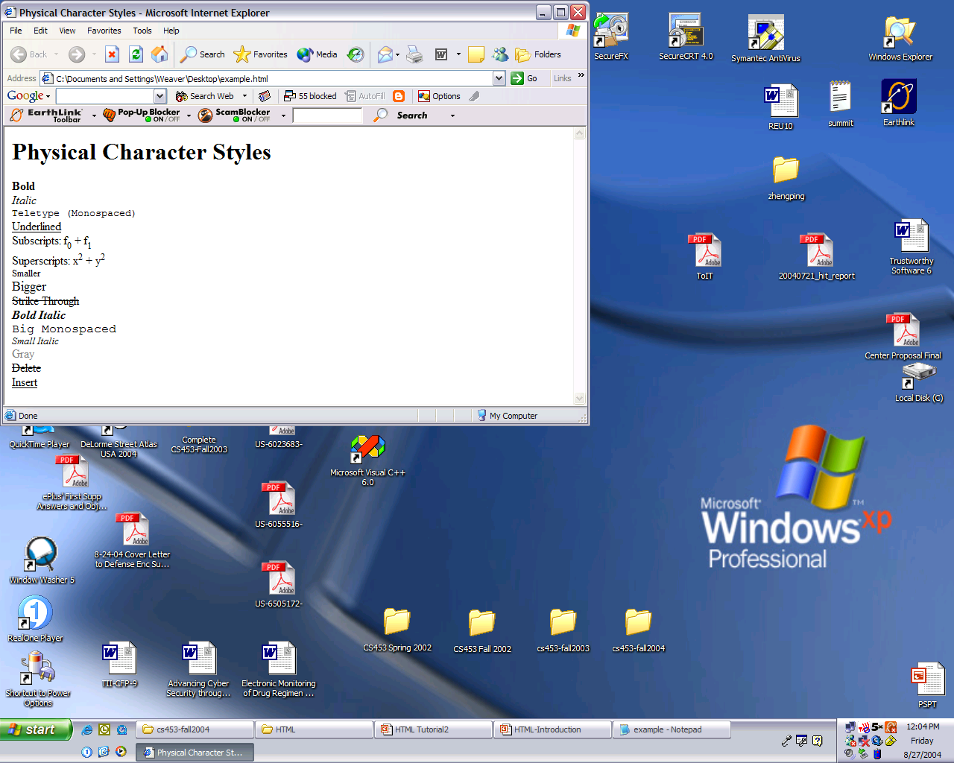
Physical Character Styles
<H1>Physical Character Styles</H1>
<B>Bold</B><BR>
<I>Italic</I><BR>
<TT>Teletype (Monospaced)</TT><BR>
<U>Underlined</U><BR>
Subscripts: f<SUB>0</SUB> + f<SUB>1</SUB><BR>
Superscripts: x<SUP>2</SUP> + y<SUP>2</SUP><BR>
<SMALL>Smaller</SMALL><BR>
<BIG>Bigger</BIG><BR>
<STRIKE>Strike Through</STRIKE><BR>
<B><I>Bold Italic</I></B><BR>
<BIG><TT>Big Monospaced</TT></BIG><BR>
<SMALL><I>Small Italic</I></SMALL><BR>
<FONT COLOR="GRAY">Gray</FONT><BR>
<DEL>Delete</DEL><BR>
<INS>Insert</INS><BR>

Slide 16
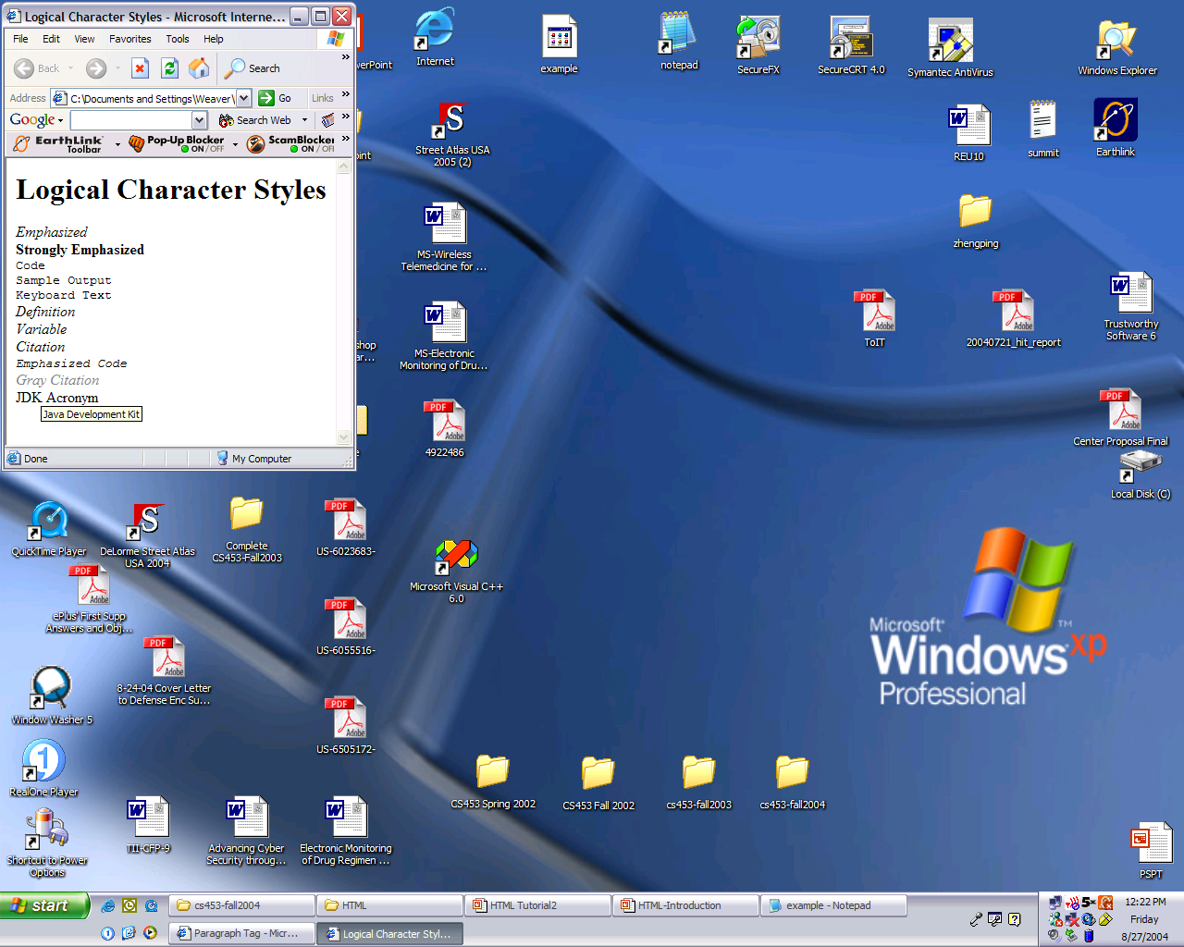
Logical
Character
Styles
<H1>Logical Character Styles</H1>
<EM>Emphasized</EM><BR>
<STRONG>Strongly Emphasized</STRONG><BR>
<CODE>Code</CODE><BR>
<SAMP>Sample Output</SAMP><BR>
<KBD>Keyboard Text</KBD><BR>
<DFN>Definition</DFN><BR>
<VAR>Variable</VAR><BR>
<CITE>Citation</CITE><BR>
<EM><CODE>Emphasized Code</CODE></EM><BR>
<FONT COLOR="GRAY"><CITE>Gray Citation</CITE></FONT><BR>
<ACRONYM TITLE="Java Development Kit">JDK Acronym</ACRONYM>

Slide 17
<A> Anchors (HyperLinks)
Link to an absolute URL:
If you get spam, contact <A HREF="htttp:www.microsoft.com">
Microsoft </A> to report the problem.
Link to a relative URL:
See these <A HREF="#references"> references </A>
concerning our fine products.
Link to a section within a URL:
Amazon provided a <A HREF="www.amazon.com/#reference">
reference for our company. </A>

Slide 18
Naming a Section
<H2> <A NAME="#references"> Our References </A> </H2>
Example

Slide 19
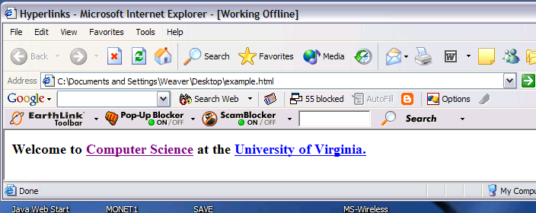
Hyperlinks
<BODY>
<H3>Welcome to <A HREF="http://www.cs.virginia.edu">
<STRONG>Computer Science</STRONG></A>
at the <A HREF="www.virginia.edu">University of Virginia.</A>
</H3>
</BODY>

Slide 20
Images
SRC is required
WIDTH, HEIGHT may be in units of pixels or percentage of page or frame
  WIDTH="357"
  HEIGHT="50%"
Images scale to fit the space allowed

Slide 21
Images
Align=position | Image/Text Placement
Left | Image on left edge; text flows to right of image
Right | Image on right edge; text flows to left
Top | Image is left; words align with top of image
Bottom | Image is left; words align with bottom of image
Middle | Words align with middle of image

Slide 22
Images
<BODY>
<img src="dolphin.jpg" align="left" width="150" height="150" alt="dolphin jump!">
This is a very cute dolphin on the left!<br>
This is a very cute dolphin on the left!<br>
This is a very cute dolphin on the left!<br>
This is a very cute dolphin on the left!<br>
This is a very cute dolphin on the left!<br>
This is a very cute dolphin on the left!<br>
This is a very cute dolphin on the left!<br>
This is a very cute dolphin on the left!<br>
This is a very cute dolphin on the left!<br>
This is a very cute dolphin on the left!<br>
You can see text wrap around it<br>
</BODY>
</HTML>

Slide 23
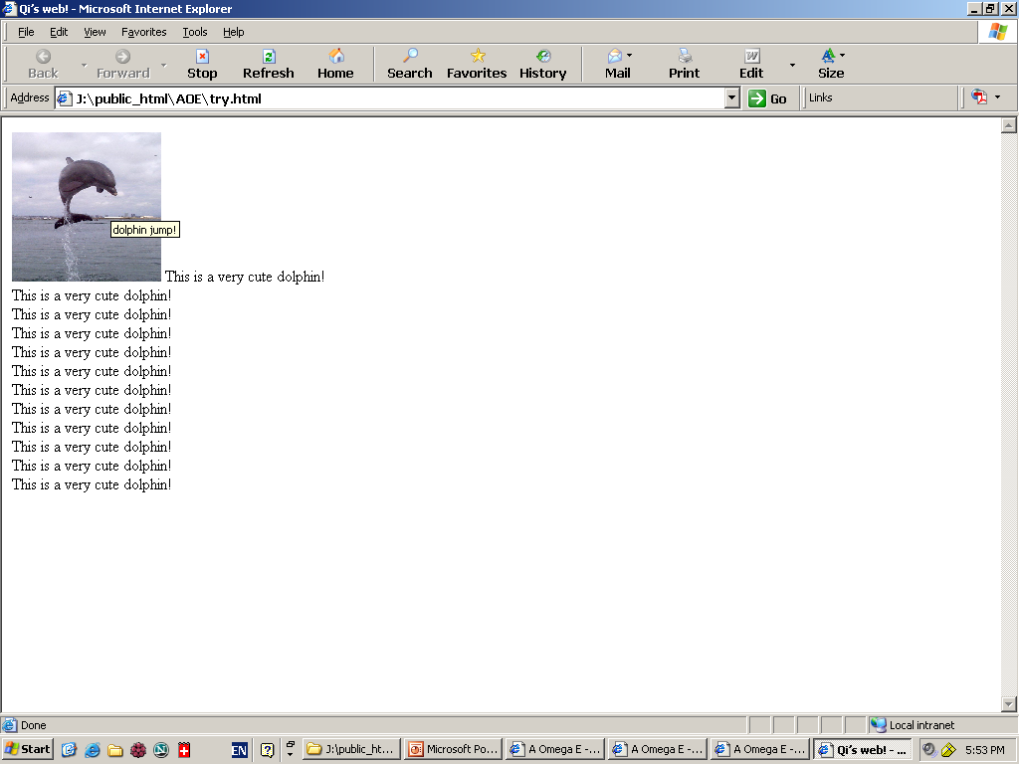
ALIGN="left"

Slide 24
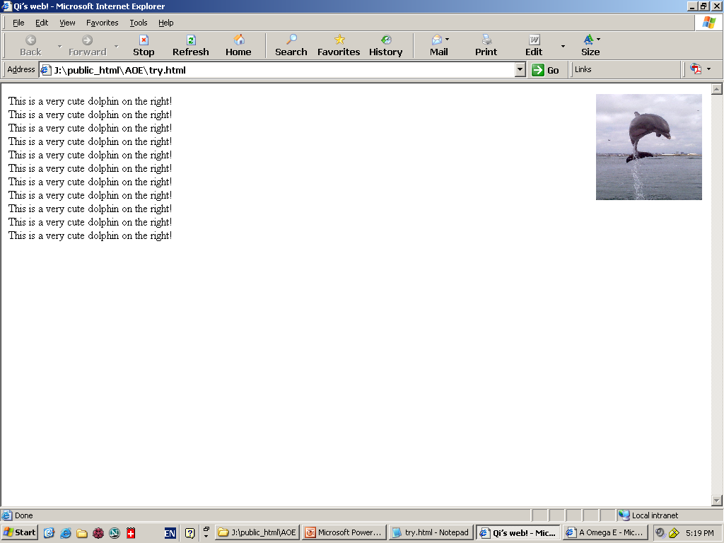
ALIGN="right"

Slide 25
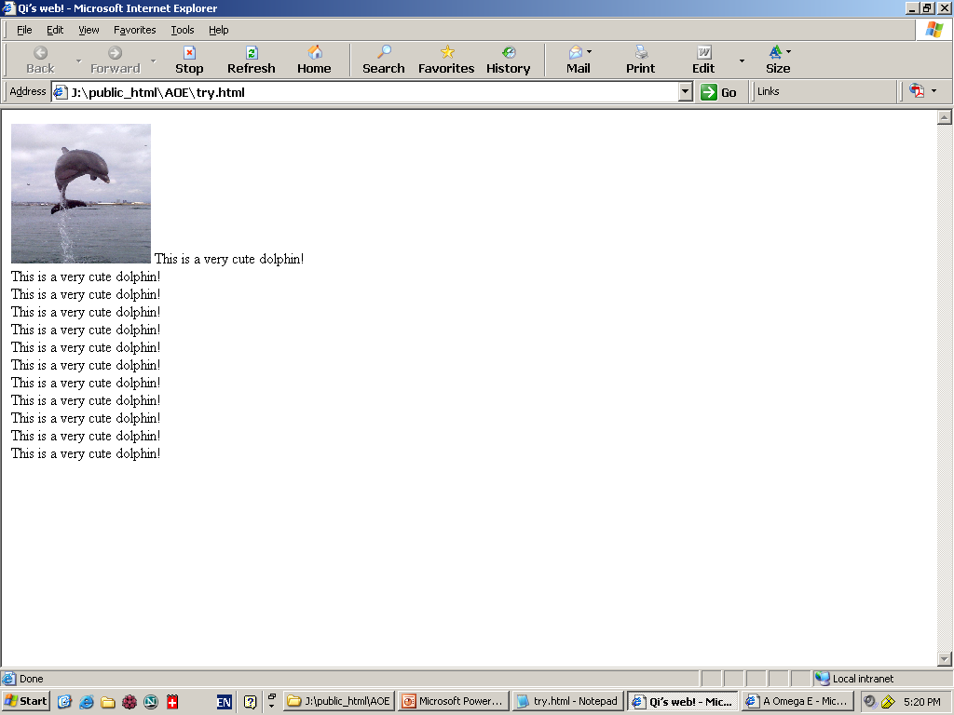
ALIGN=“bottom"

Slide 26
Tables
<TABLE> table tag
<CAPTION> optional table title
<TR> table row
<TH> table column header
<TD> table data element

Slide 27
Tables
  <TABLE BORDER=1>
  <CAPTION>Table Caption</CAPTION>
  <TR><TH>Heading1</TH> <TH>Heading2</TH></TR>
  <TR><TD>Row1 Col1 Data</TD><TD>Row1 Col2 Data</TD></TR>
  <TR><TD>Row2 Col1 Data</TD><TD>Row2 Col2 Data</TD></TR>
  <TR><TD>Row3 Col1 Data</TD><TD>Row3 Col2 Data</TD></TR>
  </TABLE>

Slide 28
<TABLE> Element Attributes
ALIGN=position -- left, center, right for table
BORDER=number -- width in pixels of border (including any cell spacing, default 0)
CELLSPACING=number -- spacing in pixels between cells, default about 3
CELLPADDING=number -- space in pixels between cell border and table element, default about 1
WIDTH=number[%]-- width in pixels or percentage of page/frame width

Slide 29
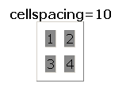
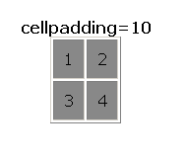
cellspacing=10
cellpadding=10

Slide 30
<TABLE> Element Attributes
BGCOLOR=color -- background color of table, also valid
for <TR>, <TH>, and <TD>
RULES=value -- which internal lines are shown; values are
none, rows, cols, and all (default)
EX: <TABLE COLS=“40%, *,*”>
<TABLE ROWS=“*,*”>

Slide 31
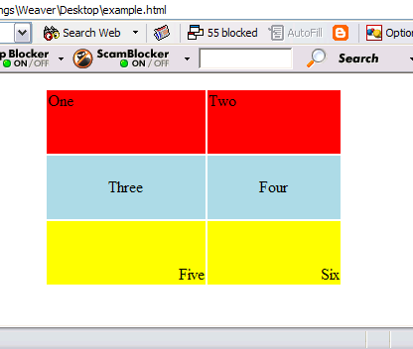
<TR> Table Row Attributes
Valid for the table row:
ALIGN -- left, center, right
VALIGN -- top, middle, bottom
BGCOLOR -- background color
<TABLE ALIGN="center" WIDTH="300" HEIGHT="200">
<TR ALIGN="left" VALIGN="top" BGCOLOR="red"><TD>One</TD><TD>Two</TD>
<TR ALIGN="center" VALIGN="middle" BGCOLOR="lightblue"><TD>Three</TD><TD>Four</TD>
<TR ALIGN="right" VALIGN="bottom" BGCOLOR="yellow"><TD>Five</TD><TD>Six</TD>
</TABLE>

Slide 32
<TD> Table Cell Attributes
Valid for the table cell:
colspan -- how many columns this cell occupies
rowspan – how many rows this cell occupies
<TABLE ALIGN="center" WIDTH="300" HEIGHT="200" border="1">
<TR>
<TD colspan="1" rowspan="2">a</TD>
<TD colspan="1" rowspan="1">b</TD>
</TR>
<TR>
<TD colspan="1" rowspan="1">c</TD>
</TR>
</TABLE>

Slide 33
Frames
Frames help control navigation and display
<FRAME> attributes include
  FRAMEBORDER – yes or 1 for borders
  FRAMESPACING – width of border
  BORDERCOLOR – color
  SRC – location of HTML to display in frame
  NAME – destination for TARGET attribute

Slide 34
Frames
  MARGINWIDTH – left/right margins
  MARGINHEIGHT – top/bottom margins
  SCROLLING – yes or 1 adds scroll bar
  NORESIZE – yes or 1 disables resizing

Slide 35
Frames
<FRAMESET ROWS="75%,25%">
<FRAMESET COLS="*,*,*">
<FRAME SRC="http://www.virginia.edu">
<FRAME SRC="http://www.virginia.edu">
<FRAME SRC="http://www.virginia.edu">
</FRAMESET>
<FRAMESET COLS="*,*">
<FRAME SRC="http://www.virginia.edu">
<FRAME SRC="http://www.virginia.edu">
</FRAMESET>
</FRAMESET>

Slide 36
Frames
<FRAMESET ROWS="25%,75%"
<FRAMESET COLS="*,*,*">
<FRAME SRC="http://www.virginia.edu">
<FRAME SRC="http://www.virginia.edu">
<FRAME SRC="http://www.virginia.edu">
</FRAMESET>
<FRAMESET COLS="*,*">
<FRAME SRC="http://www.virginia.edu">
<FRAME SRC="http://www.virginia.edu">
</FRAMESET>
</FRAMESET>

Slide 37
Frames
<FRAMESET ROWS="*,*">
<FRAMESET COLS="15%, 2*, *">
<FRAME SRC="http://www.cs.virginia.edu/">
<FRAME SRC="http://www.cs.virginia.edu/">
<FRAME SRC="http://www.cs.virginia.edu/">
</FRAMESET>
<FRAMESET COLS="40%, *">
<FRAME SRC="http://www.cs.virginia.edu/">
<FRAME SRC="http://www.cs.virginia.edu/">
</FRAMESET>
</FRAMESET>

Slide 38
Cascading Style Sheets
A powerful way to specify styles and formatting across all documents in a web site
Style sheets can be specified inline or as a separate document
Helps to keep a common look and feel

Slide 39
CSS
General form:
  selector {property: value} or
  selector {property1: value1;
  property2: value2;
  ...
  propertyn: valuen }

Slide 40
CSS
H1 {text-align: center;
color: blue;
font: Arial, Times New Roman}
P {text-align: left;
color: red;
font-family: Tahoma, Arial Narrow;
font-style: italics}

Slide 41
Fizzics1 (no style sheet)
<HTML>
<HEAD>
<TITLE>New Advances in Physics</TITLE>
</HEAD>
<BODY>
<H1>New Advances in Physics</H1>
<H2>Turning Gold into Lead</H2>
In a startling breakthrough, scientist B.O. "Gus" Fizzics
has invented a <STRONG>practical</STRONG> technique for
transmutation! For more details, please see
<A HREF="give-us-your-gold.html">our transmutation thesis</A>.
...
</BODY>
</HTML>
From: Core Web Programming, Marty Hall and Larry Brown, © 2002

