Slide 1
DOM

Slide 2
What is the Document Object Model?
The Document Object Model is a platform- and language-neutral interface that will allow programs and scripts to dynamically access and update the content, structure and style of documents. The document can be further processed and the results of that processing can be incorporated back into the presented page.

Slide 3
The Document Object Model
The Document Object Model (DOM) is a way of representing the document independent of browser type. It allows a user to access the document via a common set of objects, properties, methods, and events, and to alter the contents of the web page dynamically using scripts.

Slide 4
The DOM Standard
It’s not the easiest standard to follow. Supporting a generic set of properties and methods has proved to be a very complex task, and the DOM standard has been broken down into separate levels and sections to deal with the different areas. The different levels of the standard are all at differing stages of completion.

Slide 5
Level 0
There was no Level 0. This term in fact refers to the “old way” of doing things—the methods implemented by the browser vendors before the DOM standard. Someone mentioning level 0 properties is referring to a more linear notation of accessing properties and methods. For example, typically you’d reference items on a form with the following code:
document.forms[0].elements[1].value = “button1”;

Slide 6
Level 1
Level 1 is the first version of the standard. It is split into two sections:
one is defined as core (objects, properties, and methods that can apply to both XML and HTML) and
the other as HTML (HTML-specific objects, properties, and methods).
The first section deals with how to go about navigating and manipulating the structure of the document. The objects, properties, and methods in this section are very abstract.
The second section deals with HTML only and offers a set of objects corresponding to all the HTML elements. In 2000, level 1 was revamped and corrected, though it only made it to a working draft and not to a full W3C recommendation.

Slide 7
Level 2
Level 2 is complete and many of the properties, methods, and events have been implemented by modern browsers. It has sections that add specifications for events and style sheets to the specifications for core and HTML-specific properties and events.
Notes:
(It also provides sections on views and traversal ranges, neither of which will be covered in this book; you can find more information at www.w3.org/TR/2000/R-DOM-Level-2-Views-20000927/ and www.w3.org/TR/2000/PR-DOM-Level-2-Traversal-Range-20000927/.)

Slide 8
Level 3
Level 3 is still under development. It is intended to resolve a lot of the complications that still exist in the event model in level 2 of the standard, and adds support for XML features, such as contents models and being able to save the DOM as an XML document.

Slide 9
Browser Compliance with the Standards
Almost no browser has 100 percent compliance with any standard, although some, such as Firefox and Opera, come pretty close with the DOM.

Slide 10
Representing the HTML Document as a Tree Structure
Because HTML is standardized so that web pages can contain only the standard features supported in the language, such as forms, tables, images, and the like, a common method of accessing these features is needed.
This is where the DOM comes in. It provides a uniform representation of the HTML document, and it does this by representing the entire HTML document/web page as a tree structure.

Slide 11
What Is a Tree Structure?
The rules for creating trees are simple. You start at the top of the tree with the document and the element that contains all other elements in the page. The document is the root node. A node is just a point on the tree representing a particular element or attribute of an element, or even the text that an element contains.
The root node contains all other nodes, such as the DTD declaration, the XML declaration, and the root element (the HTML or XML element that contains all other elements). The root element should always be the <html> element in an HTML document.
Underneath the root element are the HTML elements that the root element contains. Typically an HTML page will have <head> and <body> elements inside the <html> element. These elements are represented as nodes underneath the root element’s node, which itself is underneath the root node at the top of the tree

Slide 12

The two nodes representing the <head> and <body/> elements are examples of child nodes, and the <html/> element’s node above them is a parent node.
Since the <head/> and <body/> elements are both child nodes of the <html/> element, they both go on the same level underneath the parent node <html/> element.
The <head/> and <body/> elements in turn contain other child nodes/HTML elements, which will appear at a level underneath their nodes. So child nodes can also be parent nodes. Each time you encounter a set of HTML elements within another element, they each form a separate node at the same level on the tree.

Slide 13
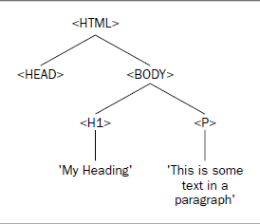
An Example HTML Page
Let’s consider a basic HTML page such as this:
<!DOCTYPE html PUBLIC “-//W3C//DTD XHTML 1.0 Transitional//EN”
“http://www.w3.org/TR/xhtml1/DTD/xhtml1-transitional.dtd”>
<html xmlns=”http://www.w3.org/1999/xhtml” ><head></head>
<body>
<h1>My Heading</h1>
<p>This is some text in a paragraph</p>
</body>
</html>

Slide 14
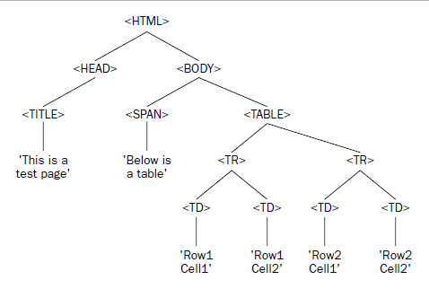
One more example
<!DOCTYPE html PUBLIC “-//W3C//DTD XHTML 1.0 Transitional//EN”
“http://www.w3.org/TR/xhtml1/DTD/xhtml1-transitional.dtd”>
<html xmlns=”http://www.w3.org/1999/xhtml” >
<head>
<title>This is a test page</title>
</head>
<body>
<span>Below is a table...</span>
<table border=”1”>
<tr>
<td>Row 1 Cell 1</td>
<td>Row 1 Cell 2</td>
</tr>
<tr>
<td>Row 2 Cell 1</td>
<td>Row 2 Cell 2</td>
</tr>
</table>
</body>
</html>

