Slide 1
Genetic Algorithm (GA)
By: Tasneem Halim
Mahendra Duwal Shrestha

Slide 2
Introduction
An Evolutionary Algorithm is a generic population-based metaheuristic optimization algorithm which uses mechanisms inspired by biological evolution, such as reproduction, mutation, recombination, and selection.
Genetic Algorithms (GA) are adaptive heuristic search algorithm based on the evolutionary ideas of natural selection and genetics to solve the optimization problems.
GA does not provide the "Best Solution" but definitely provides more robust and better solutions.

Slide 3
Natural Selection
Charles Darwin coined the term “Natural Selection”
The origin of species: “Preservation of favorable variations and rejection of unfavorable variations.”
Continuous struggle for life
Survival of the fittest
Notes:
Continuous struggle for life – More individuals are born than can survive.
Survival of the fittest - Individuals with an advantage have a greater chance to survive.

Slide 4
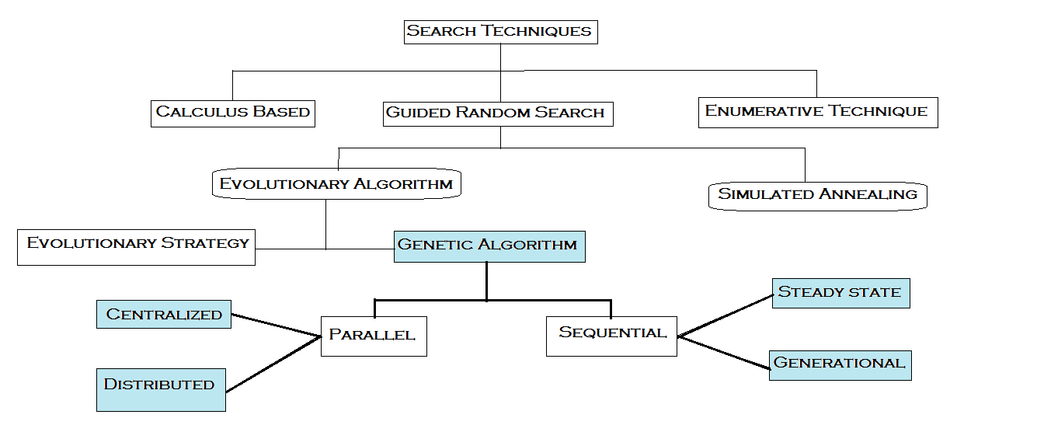
Classification of Searching Techniques

Slide 5
History
In the 1960s, Rechenberg introduced "evolution strategies"
Became popular in early 1970s through work of John Holland
Holland and his students work on adaptive systems to create foundations for later developments
By 1975, publication of book Adaptation in Natural and Artificial Systems, by Holland and his students at University of Michigan
Notes:
=> Genetic algorithms (GAs) were invented by John Holland in the 1960s and were developed by Holland and his students and colleagues at the University of Michigan in the 1960s and the 1970s

Slide 6
History
Rechenberg's evolution strategies started with a "population" of two individuals, one parent and one offspring
Holland's updated Schema Theorem - a formalized framework for prediction of quality of next generation
In 1980s, genetic algorithms were being applied to a broad range of subjects in industries
In 1992 John Koza used GA to evolve programs to perform certain tasks. He called his method "genetic programming" (GP)

Slide 7
Terms
Individual - Any possible solution
Population - Group of all individuals
Chromosome - Blueprint for an individual
Trait - Possible aspect or feature of an individual
Fitness - Target function that we are optimizing

Slide 8
GA Overview
simulates survival of the fittest among individuals for problem solving
each individual represented by array of characters
each generation consists of population of individuals
individuals in population -> process of evolution
Notes:
GA simulates survival of the fittest among individuals over consecutive generation to solve a problem.
Individuals in population are made to go through process of evolution

Slide 9
GA Overview
Individuals in population compete for resources and mates
Most successful individuals produce more offsprings
Genes from good parents propagate
Two good parents sometimes produce better offsprings
Each successive generation becomes more suited to environment
Notes:
Individuals most successful in each competition produce more offsprings than individuals who perform poorly. In this way, genes from good parents propagate throughout the population and sometimes two good parents will produce better offsprings. Thus, each successive generation becomes more suited to environment.

Slide 10
When GA is used
Alternate solutions are too slow or complicated
The objective function is not derivable
Problem is similar to those which were solved by GA before

Slide 11
How is GA works
Start with a large “population” of randomly generated “attempted solutions” to a problem
Repeatedly for each generation:
Evaluation of fitness from the attempted solutions
Selection (probabilistically) of a subset of the best solutions
Use these solutions to generate a new population (crossover and mutation)
Quit (Termination) when obtained satisfactory solution (or after certain number of generations)

Slide 12
Flow Chart
Start
Generate initial population
Evaluate individual fitness
Is stop criteria matched?
Yes
Stop
No
Selection of parents
Crossover and Mutation

Slide 13
Components of GA
Representation
1.1. Binary strings (110110)
1.2. Arrays of integers (1 2 6 3 5 7)
1.3. Array of letters (ABCDEF)
Selection
Roulette-wheel or fitness proportionate
Cut off selection
Elitist selection
Notes:
Methods of Representation
Each individual solution can be represented as chromosome with genes as:
Binary strings: 101110
Arrays of integers or floating points: 1 2 4 3 7 6
Arrays of letters: ABCDEF
Methods of Selection:
Many different strategies to select the individuals to be copied over into the next generation.
Roulette-wheel selection.
Elitist selection.
Cutoff selection.
Roulette Wheel Selection:
Conceptually, this can be represented as a game of roulette - each individual gets a slice
of the wheel, but more fit ones get larger slices than less fit ones. So that a more fit individual has more chance to progress into next generation than others.
Elitist selection:
Chose only the most fit members of each generation.
Cutoff selection:
Select only those that are above a certain cutoff for the target function.

Slide 14
Components of GA
3. Reproduction
3.1. Crossover
3.1.1. Single point crossover
3.1.2. Multi point crossover
3.1.3. Uniform crossover
3.2. Mutation

Slide 15
Selection
Equates to survival of the fittest
A proportion of existing population is selected
Fitness is evaluated
Based on fitness, individual chromosomes are chosen for later breeding
Notes:
A proportion of existing population is selected for breeding new generation based on fitness of individuals.

Slide 16
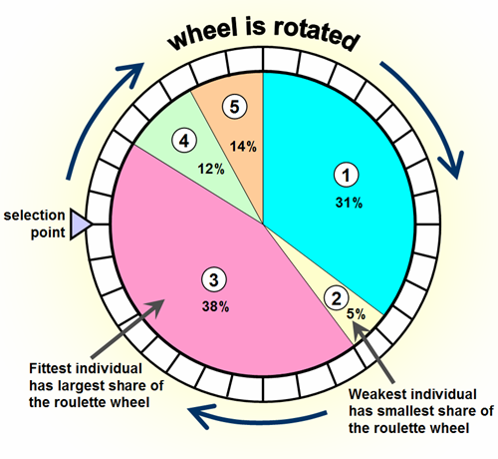
Selection
Roulette wheel selection:
can be represented as a game of roulette
each individual gets a slice of the wheel
more fit ones get larger slices than less fit ones
Notes:
One of the most popular selection methods is roulette wheel selection. Conceptually, it can be represented as a game of roulette. Each individual gets a slice of the wheel but more fit ones get larger slices than less fit ones so that chance of getting selected for more fit ones is higher.

Slide 17
Selection
Elitist selection:
Choose only the most fit members of each generation.
Cutoff selection:
Select only those that are above a certain cutoff for the target function.

Slide 18
Crossover
Represents mating between individuals
Randomly chooses a crossover point(s) and exchange the subsequences
Two chromosomes from two parents are randomly recombined or crossed over to form new offsprings

Slide 19
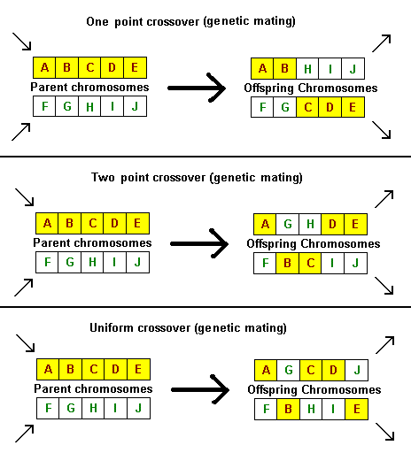
Different types of Crossover
Single point crossover
Two point crossover
Uniform crossover
Notes:
Single point crossover
A point is randomly selected. Each segment in new offspring is copied from two different parents.
Two point crossover
In this case two points are selected to crossover.
Uniform crossover
Each bit or gene in new offspring chromosome is randomly selected from one out of two parents.

Slide 20
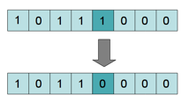
Mutation
simulates effect of errors that happen with low probability during duplication
With some low probability, portion of new individuals will have their bits flipped
maintains diversity in populations and inhibit premature convergence
Notes:
Its purpose is to maintain diversity within the population and inhibit premature convergence

Slide 21
Evaluation and Deletion
Evaluation
The evaluator decodes a chromosome and assigns it a fitness measure
Deletion
For generational GA - entire population is replaced with each iteration
For steady-state GA - a few members are replaced in each generation

Slide 22
Termination
The generational process is repeated until a termination condition has been reached. Common terminating conditions are:
A solution is found that satisfies minimum criteria
Fixed number of generations reached
Allocated budget (computation time/money) reached
The highest ranking solution's fitness is reaching or has reached a plateau such that successive iterations no longer produce better results
Manual inspection
Combinations of the above

Slide 23
Advantages of GA
Optimal feasible solution in a reduced computational time
Inherently parallel and easily distributed
Supports multi-objective optimization
Solved multi dimensional, non-differential, non-continuous, non-parametric problems
Modular and separate depending on its application
Multiple better solutions can be obtained

Slide 24
Advantages of GA
Easily understandable and has broad range of usage
Good for noisy environments
No need to worry about explicit definition
Flexible enough for hybrid applications
Numerous ways to speed up/ improve a GA-based application

Slide 25
Limitations
Limitations of the use of Genetic Algorithms
Cannot guarantee optimality
Can be sensitive to initial population
Repeated fitness function
Does not scale well with complexity
Difficult to operate on dynamic data set
Computationally expensive
Unable to solve some problems

Slide 26
Application Types
DOMAIN | APPLICATION TYPE
Control Design Scheduling Robotics Optimization Machine learning Signal processing Game Playing | Gas pipeline, Pole balancing Keyboard configuration, Semiconductor layout Resource allocation, Manufacturing Trajectory planning Travelling Salesman, Graph coloring, Set covering, Partitioning etc Designing neural networks, Improving/ classifying algorithms Filter designing Poker, Checkers

Slide 27
Related Algorithms
Harmony Search
Memetic Algorithm
Group Genetic Algorithm
Swarm Intelligence
Simulated Annealing
Tabu Search
Notes:
Harmony Search - Based on the ideas of musicians' behavior in searching for better harmonies. This algorithm is suitable for combinatorial optimization as well as parameter optimization.
Memetic Algorithm - It is the hybrid form of genetic algorithm and is a population-based method in which solutions are also subject to local improvement phases.. Inspired by Dawkins’ notion of a meme, it commonly takes the form of a population-based algorithm coupled with individual learning procedures capable of performing local refinements.
Group Genetic Algorithm - It is an evolution of GA where the focus is shifted from individual items, like in classical GAs, to groups or subset of items.
Swarm Intelligence - is a sub-field of evolutionary computing
Simulated Annealing (SA) - is a related global optimization technique that traverses the search space by testing random mutations on an individual solution. A mutation that increases fitness is always accepted. In SA parlance, one speaks of seeking the lowest energy instead of the maximum fitness.
Tabu Search (TS) - is similar to simulated annealing in that both traverse the solution space by testing mutations of an individual solution. While simulated annealing generates only one mutated solution, tabu search generates many mutated solutions and moves to the solution with the lowest energy of those generated

Slide 28
References
Wikipedia - Evolutionary Computing, Genetic Algorithm, Crossover, Mutation,
John Holland, Adaptation in Natural and Artificial Systems, University of Michigan Press, Ann Arbor, Michigan. 1975. ISBN 0-262-58111-6.
Michalewicz, Zbigniew (1996). Genetic Algorithms + Data Structures = Evolution Programs. Springer-Verlag. ISBN 978-3540606765.
Goldberg, D.E., Genetic Algorithms in Search Optimization and Machine Learning, Addison Wesley Publishing Co.Inc: Reading, MA, 1989
Schöneburg E., Heinzmann F., Feddersen S., Genetische Algorithmen und Evolutionsstrategien, Addison Wesley ISBN 3-89319-493-2, 1994
Youtube Lectures
Online helpful materials and blogs

Slide 29
Thank you

Slide 30
Example
MaxOne problem
maximize no. of ones in binary string
Is it trivial?

Slide 31
Example
Representation
An individual is encoded as a string of L
binary digits
Suppose that L = 10
Start with a population of 6 random strings.

Slide 32
Example
Initialization
s1 = 1111010101
s2 = 0111000101
s3 = 1110110101
s4 = 0100010011
s5 = 1110111101
s6 = 0100110000

Slide 33
Example
Evaluation
s1 = 1111010101 f (s1) = 7
s2 = 0111000101 f (s2) = 5
s3 = 1110110101 f (s3) = 7
s4 = 0100010011 f (s4) = 4
s5 = 1110111101 f (s5) = 8
s6 = 0100110000 f (s6) = 3

Slide 34
Example
Selection
Selection using roulette wheel method up to 6 times
s1` = 1111010101 (s1)
s2` = 1110110101 (s3)
s3` = 1110111101 (s5)
s4` = 0111000101 (s2)
s5` = 0100010011 (s4)
s6` = 1110111101 (s5)

Slide 35
Example
Crossover
Before crossover:
s1` = 1111010101 s5` = 0100010011
s2` = 1110110101 s6` = 1110111101
After crossover:
s1`` = 1110110101 s5`` = 0100011101
s2`` = 1111010101 s6`` = 1110110011

Slide 36
Example
Before applying mutation:
s1`` = 1110110101
s2`` = 1111010101
s3`` = 1110111101
s4`` = 0111000101
s5`` = 0100011101
s6`` = 1110110011

Slide 37
Example
After applying mutation:
s1``` = 1110100101 f (s1``` ) = 6
s2``` = 1111110100 f (s2``` ) = 7
s3``` = 1110101111 f (s3``` ) = 8
s4``` = 0111000101 f (s4``` ) = 5
s5``` = 0100011101 f (s5``` ) = 5
s6``` = 1110110001 f (s6``` ) = 6

Slide 38
Example
End of one generation
In one generation, the total population fitness changed from 34 to 37, thus improved by ~9%

