Slide 1
Simulation Of A Simple Evolutionary System
Mahendra Duwal Shrestha

Slide 2
Outline
Background
Question 1: Distance between finite population and infinite population
Question 2: Oscillation in finite population
Question 3: Oscillation in finite population under violation in mutation
Question 4: Oscillation in finite population under violation in crossover
Conclusion

Slide 3
Terms
Population P: Collection of binary string members of fixed length l
Population vector: Population represented as population vector p where p_{j} is the proportion of string j in the population.
Let population P = {00, 01, 01, 10, 11, 11}. Then p₃ = 2/6 = 1/3
R denotes set of length l binary strings
Let l = 4, x = 1101 Є R
Addition and multiplication of elements in R are bitwise operations modulo 2
For example,
x = 1101 , y = 1010
x + y = 1101 + 1010 = 0111
xy = 1101 · 1010 = 1000
x = 0010

Slide 4
Operators
Operations are under R
Linear fitness used with proportionate selection
Crossover and mutation both are mask based
Mask: Mask m is binary string of length l
Crossover : Choose two parents u and v , and exchange bits according to mask m following rule:
u' = um + vm , v' = um + vm
Ex: u = 11001011, v = 11011111, m = 11110000
11001011+11011111 -> {11001111, 11011011}
Mutation: Flip bits of a string with some mask
Ex: 11001001 + 01000000 -> 10001001
mutation mask

Slide 5
Finite Population GA
Two parents u and v selected to produce two offspring u' and v' through crossover and mutation
Keep one of u' and v' with uniform probability
Replace P by new generations formed
Process is repeated until system stops to improve or threshold is reached
Notes:
From initial population P, two parents u and v are selected.
u and v are crossed and mutated to produce two offspring u' and v'.
One of u' and v' are kept with uniform probability.
After offspring of initial population size are generated,
Initial population P is replaced by new generation of offspring.
The process is repeated until system stops to improve or some threshold is reached.

Slide 6
Infinite Population Model
Population modeled as population vector p
G is the function mapping p to the next generation
G(p)_{j} = the probability that string j occurs in the next generation
The evolution of p in infinite population model is the sequence
p → G(p) → G(G(p)) → · · ·

Slide 7
History
Haldane, in 1932, summarized population genetics basic models : Wright, Fisher and Haldane
Several people working with evolution-inspired algorithms in the 1950s and the 1960s – Box (1957), Friedman(1959), Bledsoe (1961), Bremermann (1962), and Reed, Toombs and Baricelli (1967)
In 1960s and 1970s, Holland and colleagues formalized and promoted population based algorithms with crossover and mutation
Vose (1999) presented efficient methods for computing with a haploid model
Notes:
Although their model computes infinite population trajectories, given a finite population represented by vector p (component p_i is the proportion of string i in the finite population), the infinite population model computes the expected proportion G(p)i of string i in the next generation.
This perhaps is the most direct connection between infinite population model and finite population GA
For large populations, the short term trajectory follows closely and with large probability, that path predicted by the infinite population model.

Slide 8

Random Heuristic Search
τ is stochastic transition rule that maps p to p'
Finite population sequence p, τ(p), τ²(p), ... forms Markov chain
τ(p) cannot be predicted with certainty
G(p) is the expected next generation Ɛ(τ(p))
The variance of the next generation is
Notes:
The probability that q is the next generation population vector is given current population vector p is given by equation 1.1.
p is population vector corresponding to population P (P chosen from some search space Ω)
τ(p) cannot be predicted by certainty because it is an stochastic function of random crossover and mutation
So we compute G(p) as E(t(p))
The variance of the next generation (with respect to the expected population) is

Slide 9
Question 1:
Distance Between Finite Population and Infinite Population

Slide 10
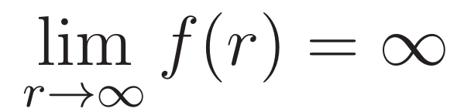
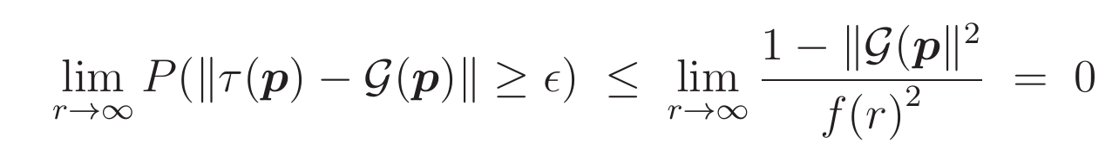
Distance: Chebyshev's Inequality
Let Є = f(r)/√r, where f(r) grows arbitrarily slowly and
From Chebyshev's inequality,
This suggests distance between τ(p) and G(p) might decrease as 1/√r
Notes:
The probability that q is the next generation population vector is given current population vector p is given by equation 1.1.

Slide 11
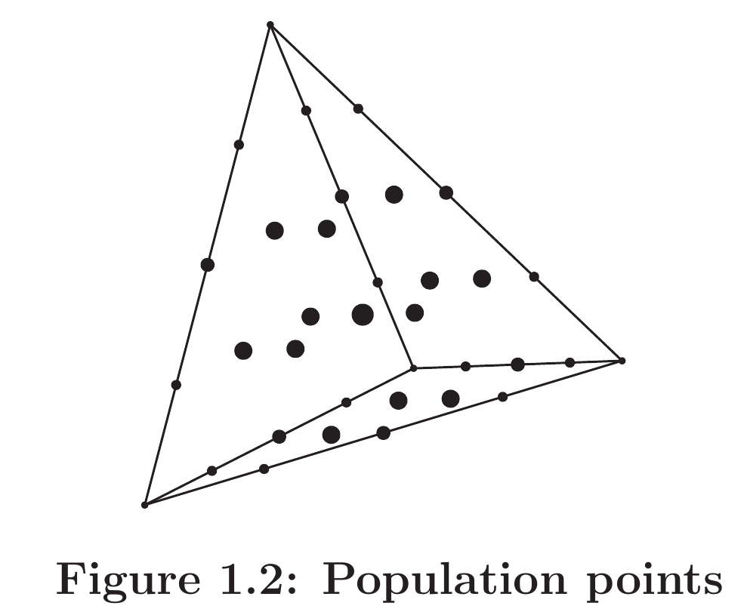
Distance: Population Points
Finite populations are represented by dots
Infinite population can be any where in the space
Distance between finite population and infinite population is O(1/√r)
This suggests distance between τ(p) and G(p) might decrease as 1/√r
Notes:
Finite populations are represented by dots
Smaller dots, lesser dispersion (more likely points)
Larger dots, higher dispersion (less likely)
Finite population can be only at lattice points
Infinite population can be any where in the space
Distance between finite population and infinite population is bounded by O(1/√r)

Slide 12
Distance: Jensen's Inequality
Let η be the random variable ||τ(p) − G(p)||
Then from Jensen's Inequality,
This also suggests distance might decrease as 1/√r
Notes:
Well, all of previous three slides and analysis are inequalities. The distance could be much smaller than 1/√r or equal to 1/√r.
We'll do simulations and see what happens.

Slide 13
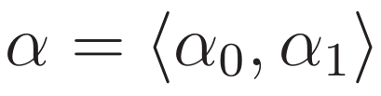



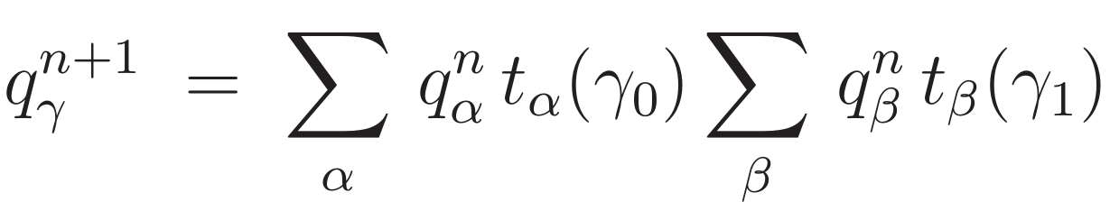
Diploid Population Model
Diploid genome
Haploid genome length l
→ population at generation n
→ prevalence of diploid α
→ probability that gamete g is produced from parent α
Notes:
The transmission function t_{α}(g) be the probability that gamete g is produced from parental genome α.

Slide 14
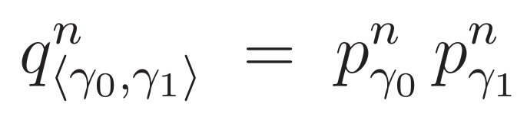
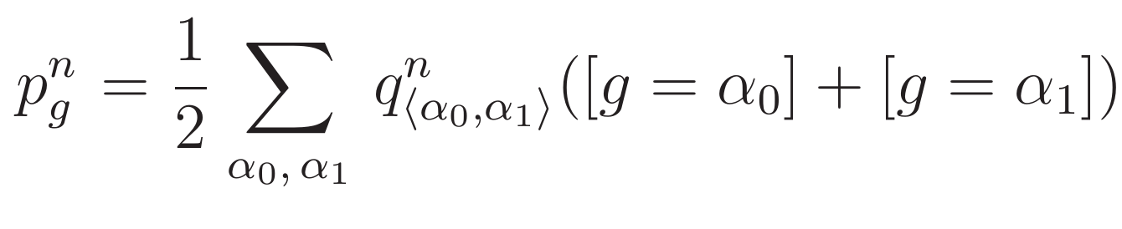
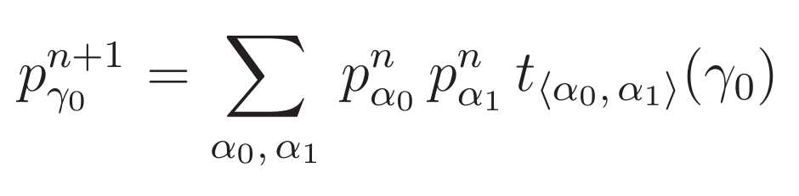
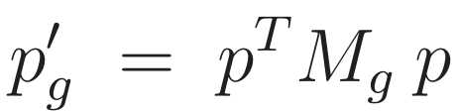
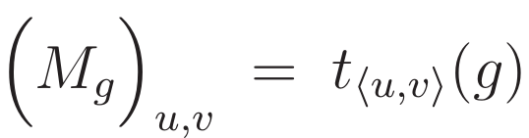
Diploid Model Reduction to Haploid Model
The weighted count of haploid g in generation n is,
Evolution equation in terms of haploid distributions p,
Matrix form:
where
Notes:
The transmission function t_{α}(g) be the probability that gamete g is produced from parental genome α.

Slide 15
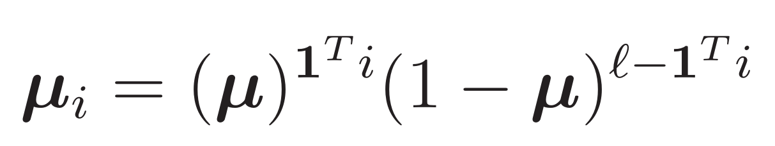
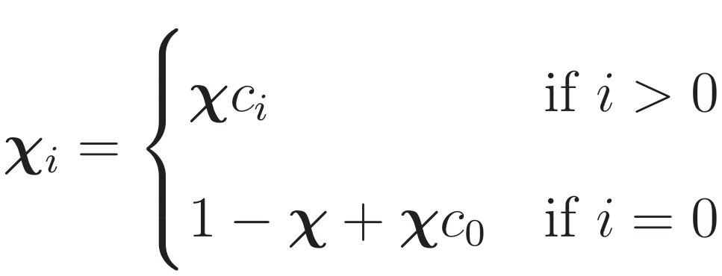

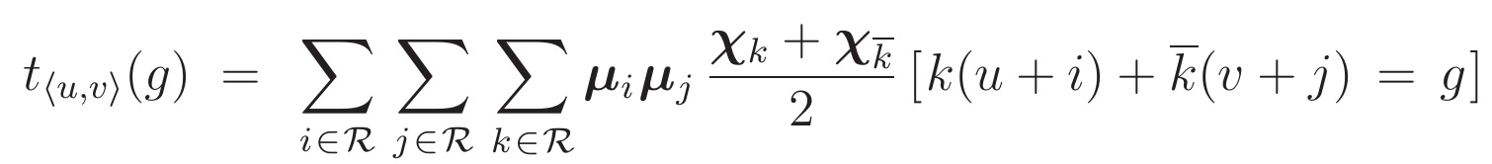

Specialization to Vose's Haploid Model
Mutation:
Crossover:
For uniform crossover,
Notes:
The transmission function t_{α}(g) be the probability that gamete g is produced from parental genome α.

Slide 16
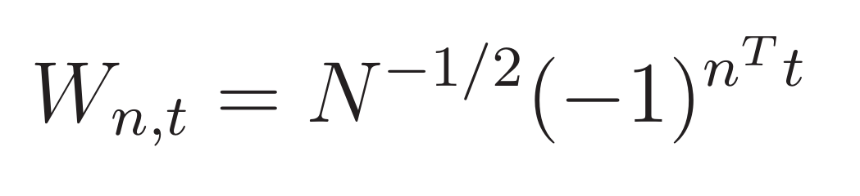


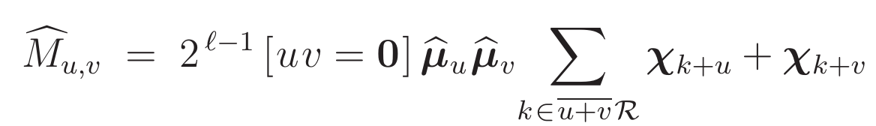
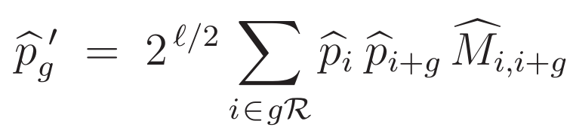

Walsh Basis
Mixing matrix in Walsh basis
Evolution eqn in Walsh basis
where
Notes:
The transmission function t_{α}(g) be the probability that gamete g is produced from parental genome α.

Slide 17
Computational Advantages
Specialization simplifies computation, which otherwise for diploid case would have been impractical
Only one mixing matrix as opposed to 2^{l} is needed to compute next generation
For l = 14, using 2¹⁴ mixing matrices with each having 2¹⁴ x 2¹⁴ entries would require 32 TB of memory, whereas one mixing matrix requires only 2 GB

Slide 18
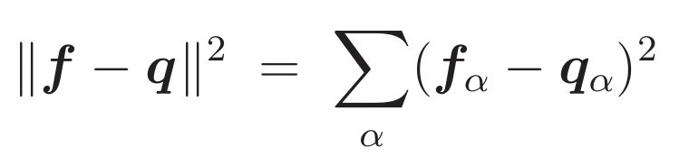
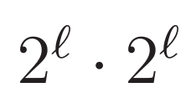
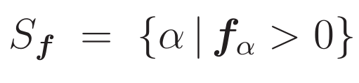
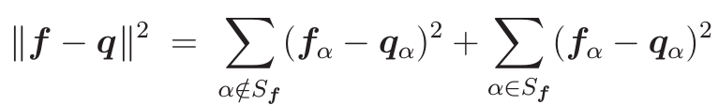
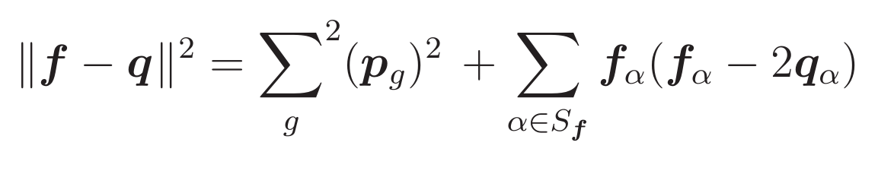

Distance Computation
Naive computation
terms
Our implementation
terms
Notes:
f represents finite diploid population
q represents infinite diploid population
S_{f} of f be the set of diploids occurring in the population f

Slide 19
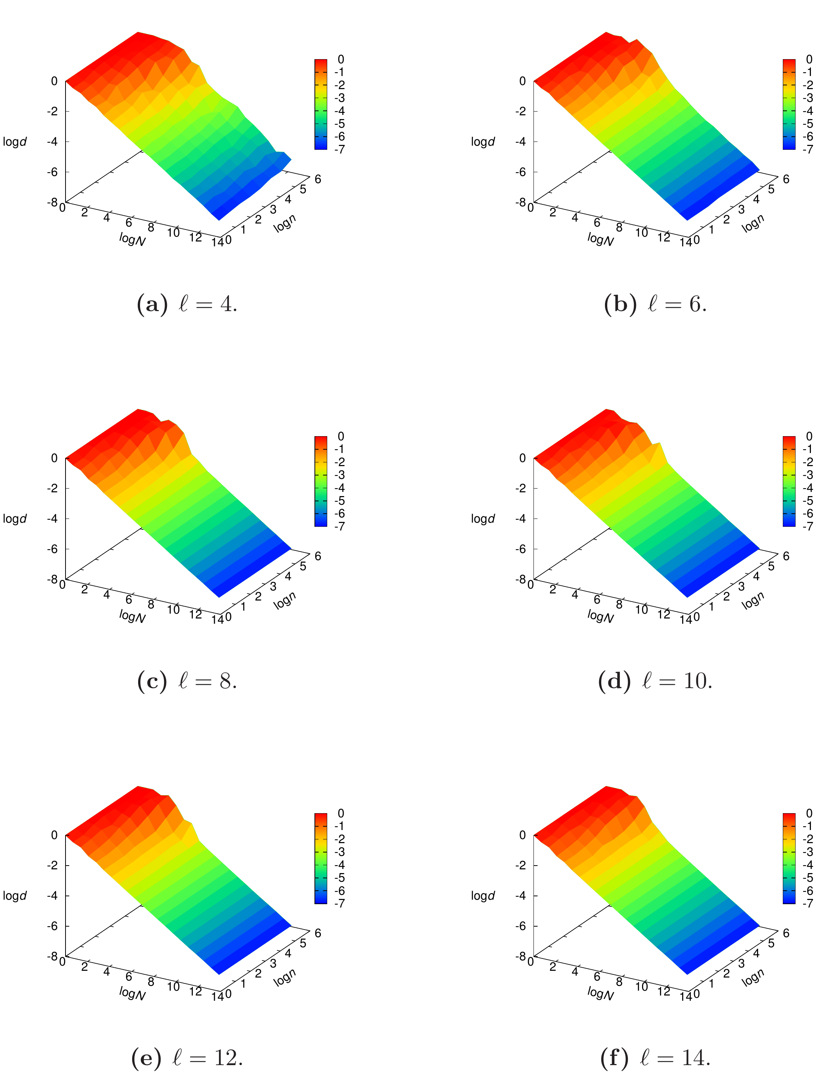
Distance: Convergence
χ = 0.1
μ = 0.001
Figure: Convergence of finite population behavior
Notes:
-Data shows a near linear dependence of log d on log N
-graphs show smoothing with increasing genome length
- finite haploid population trajectory converges as N->infty to infinite population model

Slide 20
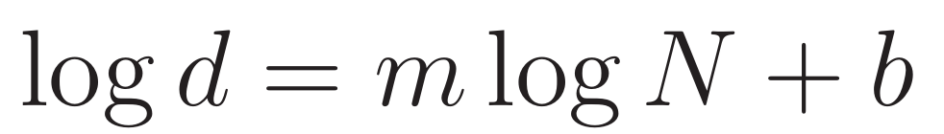
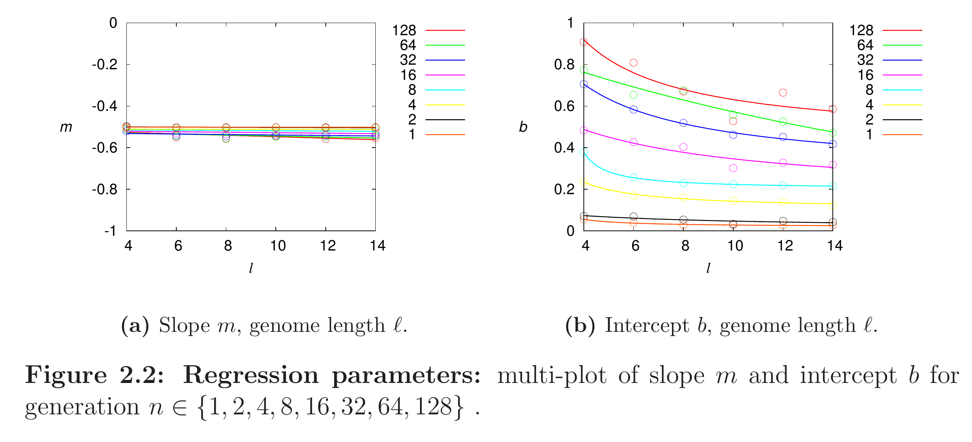
Distance: Regression
Figure: Regression parameters for generation n in {1, 2, 4, 8, 16, 32, 64, 128}}
d ≈ N^{m}e^{b}
From figure (a) above, m ≈ -0.5
d ≈ k / √N
Notes:
- but of particular interest is the linear trend exhibited above
- k = e^b decreases monotonically with genome length l, and increases monotonically with generation n
- increase in k for larger n seems to be a manifestation of the growing nonlinearity
- likely that the nonlinearity results partly from genetic drift experienced by finite populations
- partly because predicted distance is for single step case as generation increases difference between finite population and infinite population accumulates non linearly

Slide 21
Distance: Non-Linearity

Slide 22
Distance: Conclusion
Vose's infinite population model makes computation in diploid case efficient by reducing to the haploid case
Distance between finite diploid population and infinite diploid population can decrease like 1/√N

Slide 23
Question 2:
Oscillation in Finite Population Evolution

Slide 24
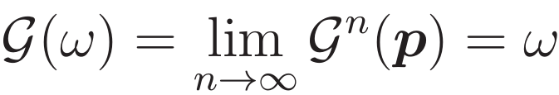
Limits
The sequence p, G(p), G²(p), … may converge to a fixed point
But under some circumstances, the sequence converges to a periodic orbit that oscillates between two fixed points, p* and q*

Slide 25
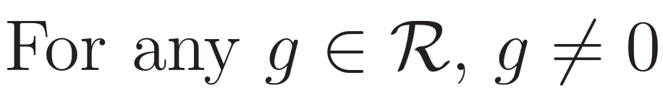
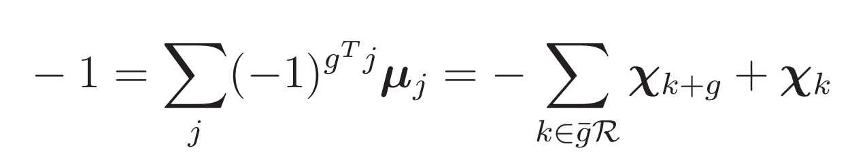
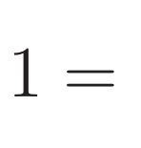
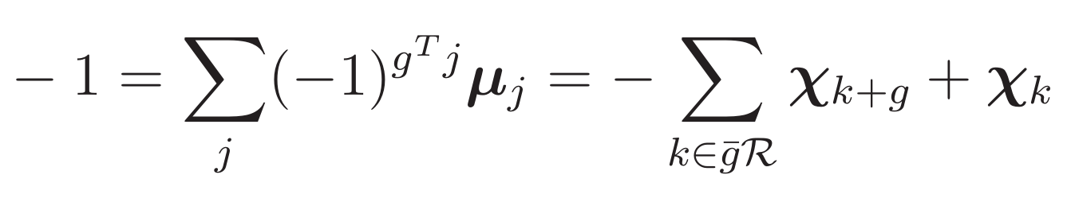
Necessary and Sufficient Conditions to Converge to a Periodic Orbit
Infinite populations converge to a periodic orbit.
Do finite populations also exhibit oscillation from random initial populations?
Notes:
Condition k ∈ ḡ R in equation 3.3 is k = g ̄i for some i ∈ R

Slide 26
Previous Related Works on Oscillation
Akin proved existence of cycling for continuous time 2-bit diploid model
Hasting studied cycling in populations with infinite 2-bit diploid population model
Wright and Bidwell provided examples when cycles in an infinite haploid population model occur with crossover and mutation for 3 bit and 4 bit populations
Wright and Agapie described cyclings in infinite population for up to 4 bits, and also presented data for cyclings in finite population
Notes:
where they compute a specific fitness function and a specific initial population for randomly generated mutation and crossover distributions

Slide 27
Difference From Previous Works
Akin's study was continuous time model and ours is discrete time model
Hastings' study was limited to two bits length, and includes only crossover but not mutation
Examples provided by Wright and Bidwell were for specific set parameter values for crossover, mutation and fitness
We study cyclic behavior for fixed fitness function and random: initial population, mutation and crossover distribution
Wright and Agapie used dynamic mutation that depends upon where population is in the population space while we use static mutation
Another difference between Wright and Agapie's work and ours is fitness
We study oscillation for higher bit length (up to 14), and actually oscillation conditions are independent of string length
We study oscillation for both haploid and diploid populations, and for both finite and infinite populations
We also visualize oscillation
Notes:
Wright and Bidwell compute a specific fitness function and a specific initial population for randomly generated mutation and crossover distributions in an attempt to find cyclic behavior

Slide 28
Simulation
Simulations were run for both haploid and diploid populations
Random initial population
l ∈ {8, 10, 12, 14}
N = {4096, 40960, 81920}
To visualize oscillation, distance between fixed points and population are plotted

Slide 29
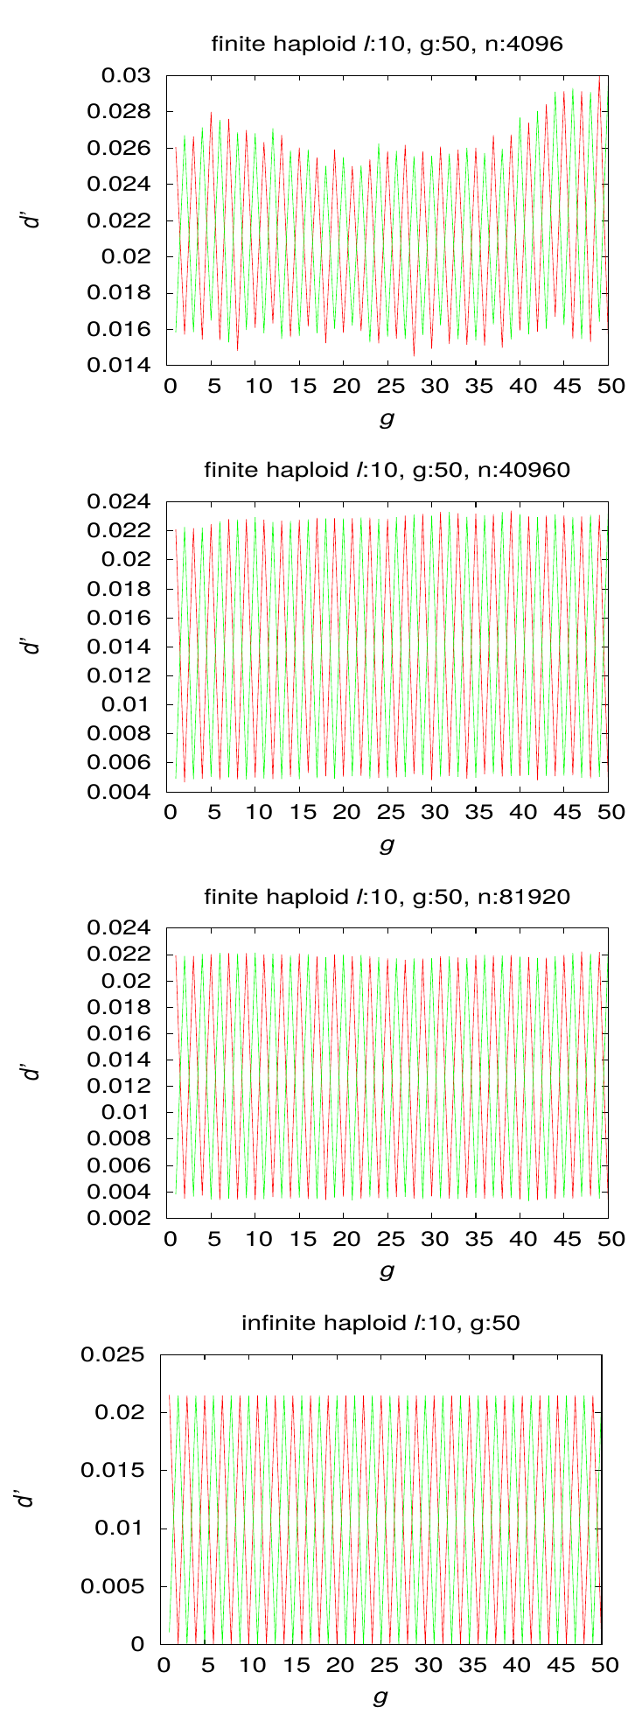
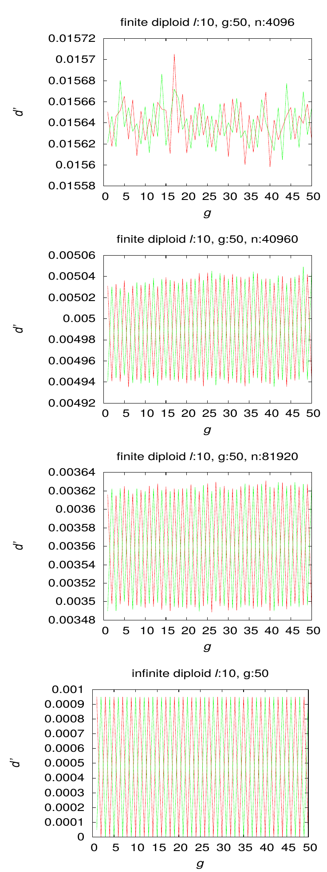
Results: Oscillation
Figure: Oscillation for l = 10

Slide 30
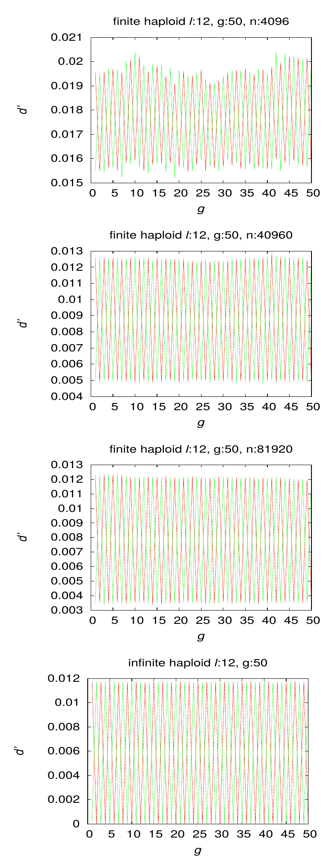
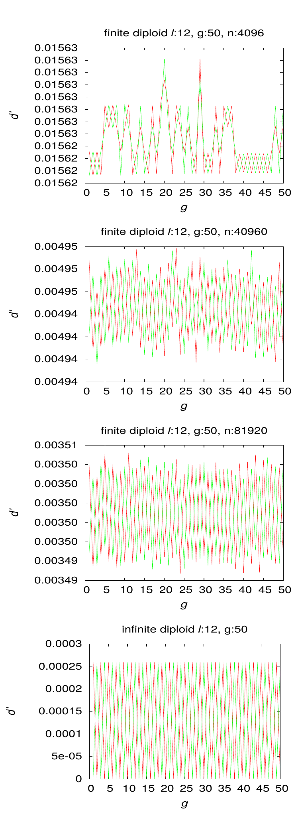
Results: Oscillation
Figure: Oscillation for l = 12
Notes:
As population size increases, oscillation approaches the behavior exhibited by infinite population
Also increase in l degrades oscillation in finite population

Slide 31
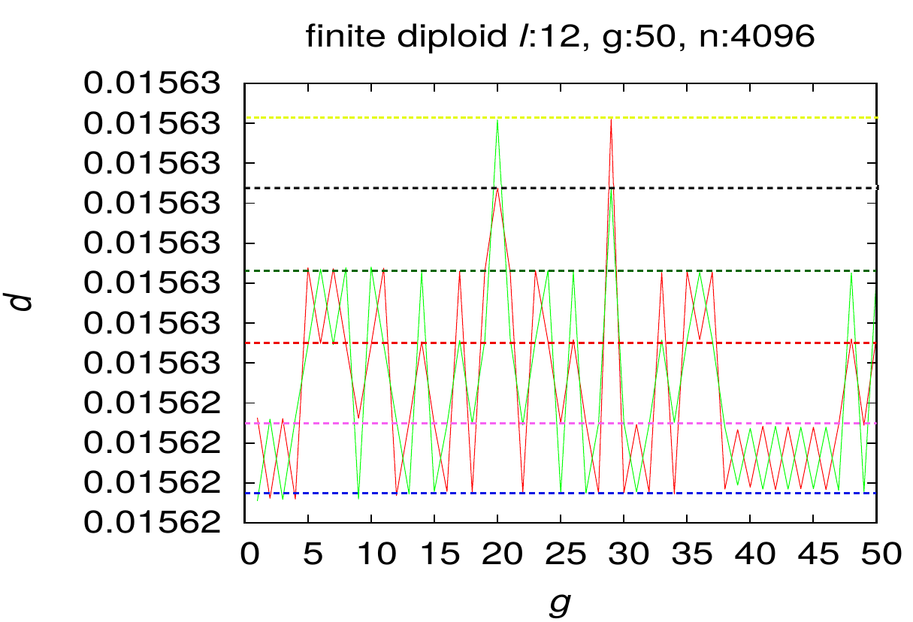
Results: Oscillation
Figure: Oscillation between different fixed points
Notes:
Zoomed in graph for l = 12 and population size 4096
See oscillation between other pairs of fixed points
Observed only for higher values of l in diploids and for small population size
MIght be because there could be fixed points for other distributions in the vicinity of finite population trajectory and get attracted to those fixed points
Also for smaller populations do not follow infinite population path as closely as larger populations do

Slide 32
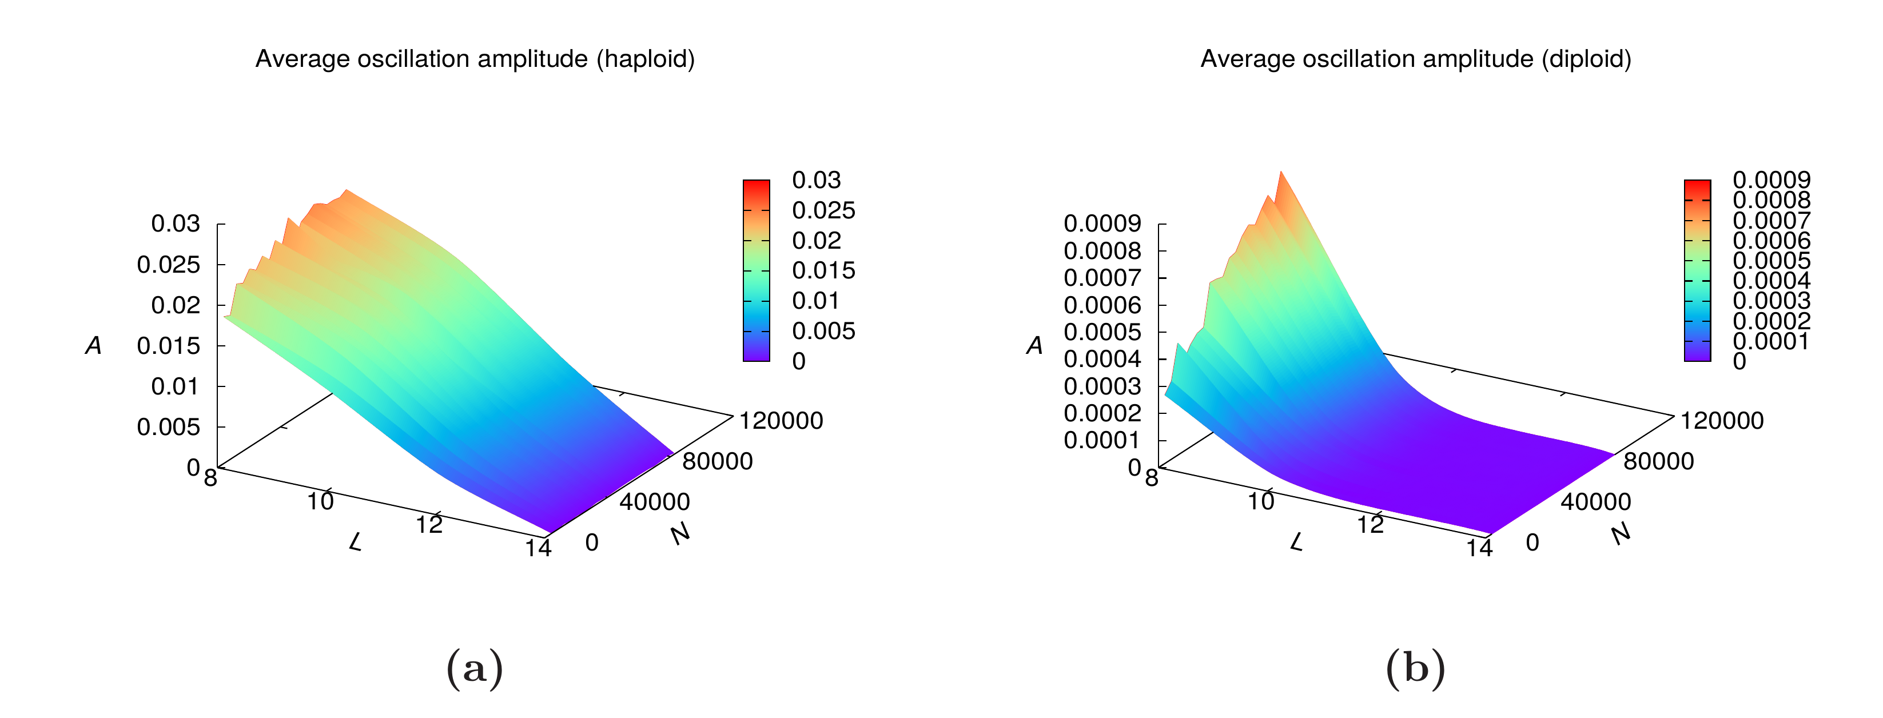
Results: Oscillation Amplitude
Figure: Average oscillation amplitude
Oscillation amplitude increases with increase in population size
Amplitude of oscillation decreases with increase in l

Slide 33
Oscillation: Conclusion
Finite population evolution exhibit approximate oscillation
Larger population exhibits better oscillation
As l increases, oscillation amplitude decreases
As population size increases, oscillation amplitude increases and randomness decreases
Finite population also oscillates between different pairs of fixed points for diploid population of smaller size and larger l

Slide 34
Question 3:
Oscillation Under Violation in Mutation

Slide 35
Robustness of Finite Population
A Markov chain is said to be irreducible if it is possible to get to any state from any state
A Markov chain is aperiodic if it can return to state i at irregular times
Markov chain is regular if it is both irreducible and aperiodic
Steady state distribution exists if Markov chain is regular
No periodic orbit exists for finite population
Can finite population exhibit approximate oscillation?

Slide 36
Violation in Mutation
Violation є is introduced in μ
μ₀ = є
μ_{i} := (1 − є)μ_{i}
This modification makes the Markov chain regular
No periodic orbits for infinite population
Notes:
This modification makes the Markov chain regular
Moreover, it ensures that No periodic orbits for infinite population

Slide 37
Simulation
є = {0.01, 0.1, 0.5}
l ∈ {8, 10, 12, 14}
N = {4096, 40960, 81920}
Distances of population to limits p* and q* without violation are plotted

Slide 38
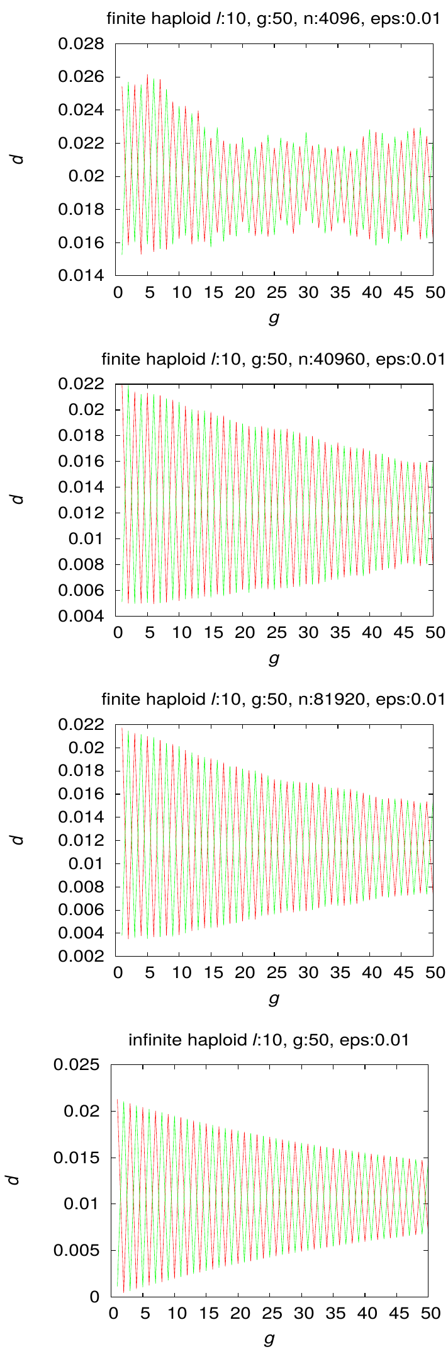
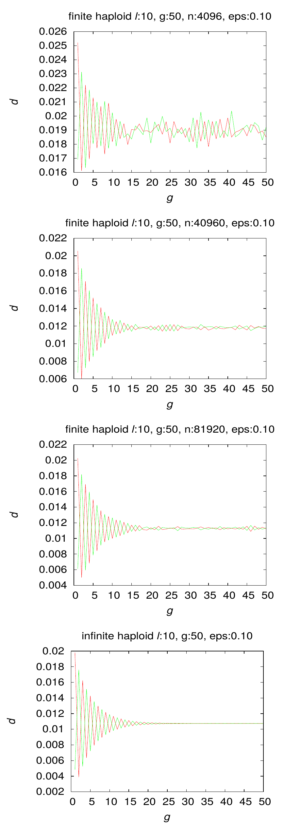
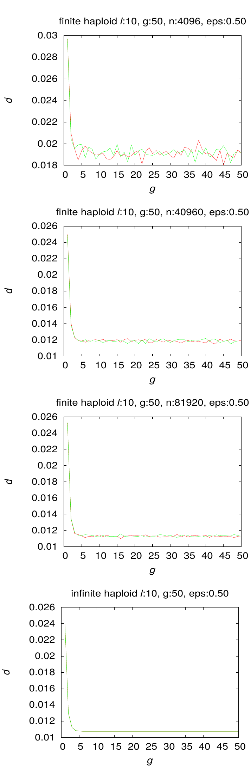
Results: Violation in Mutation
Figure: Oscillation under violation in mutation for haploids, l = 10

Slide 39
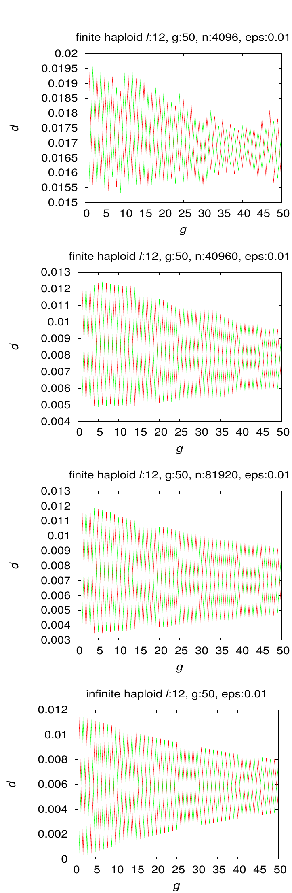
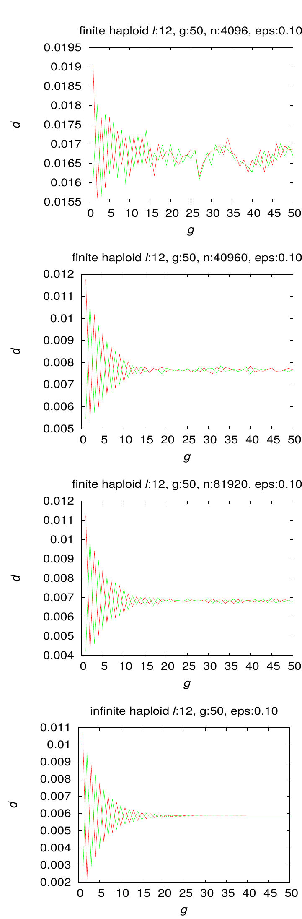
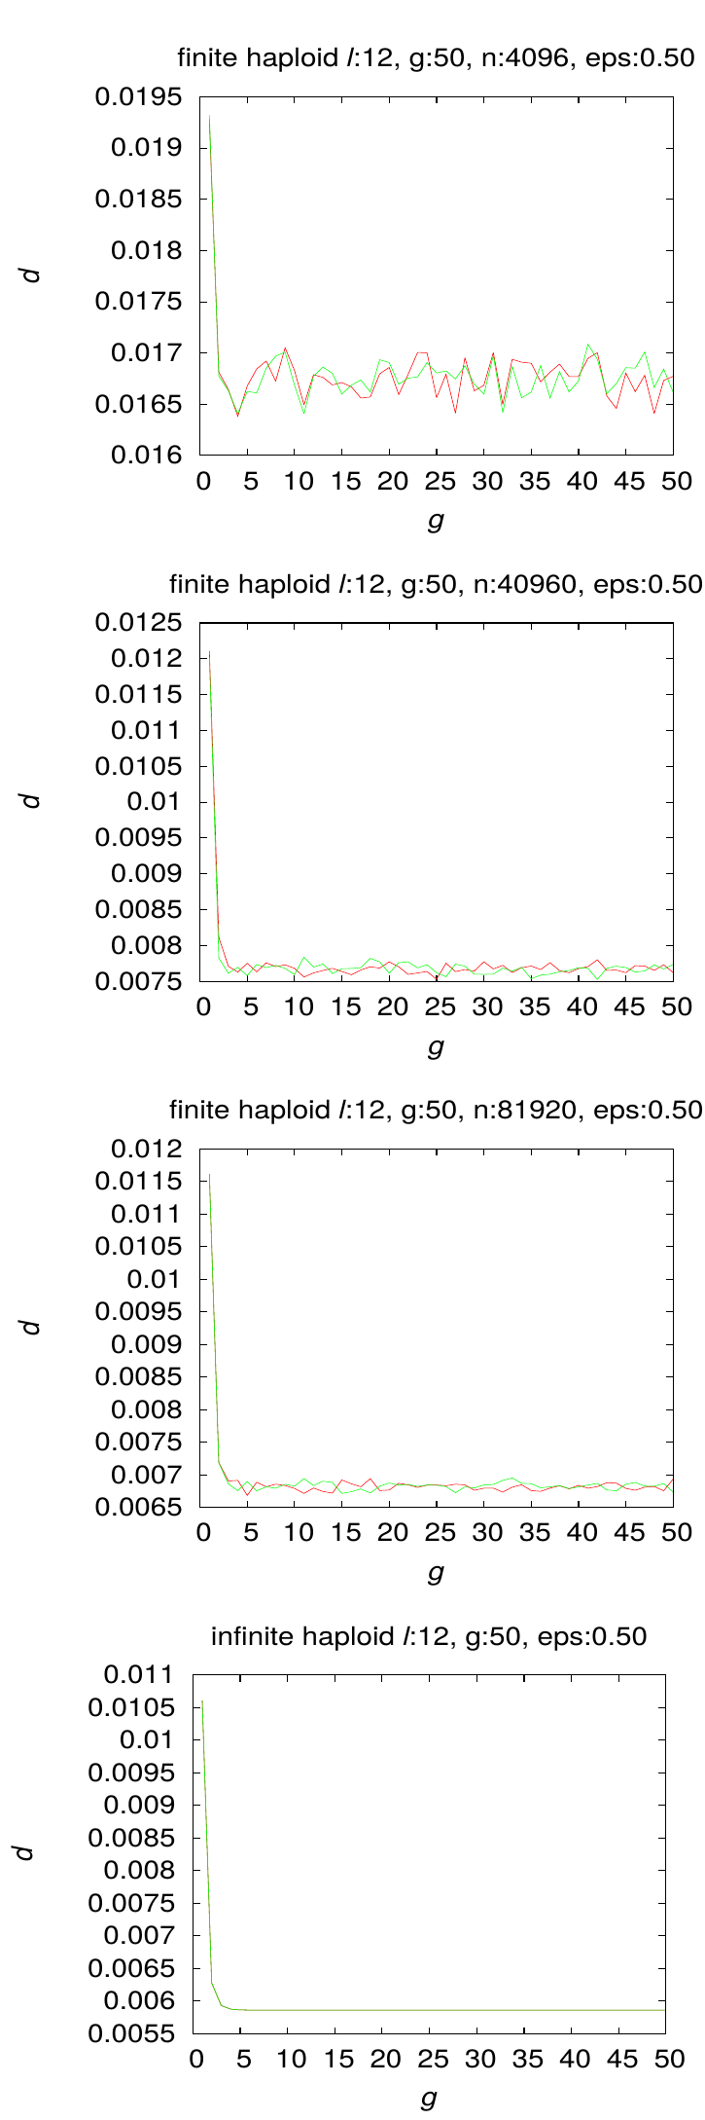
Results: Violation in Mutation
Figure: Oscillation under violation in mutation for haploids, l = 12

Slide 40
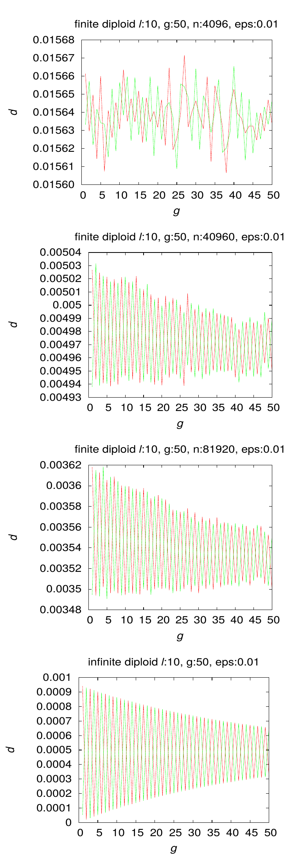
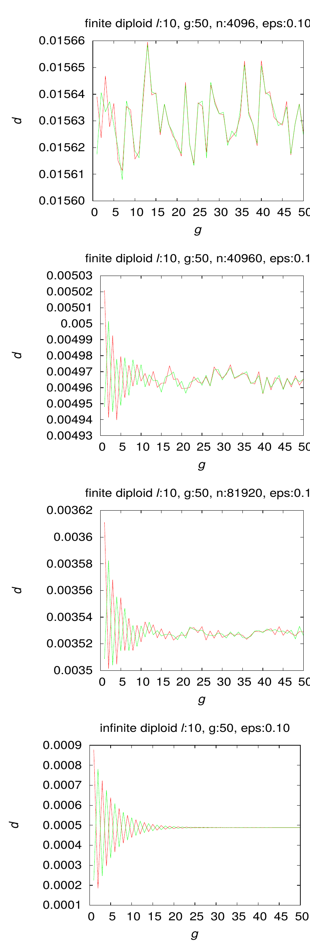
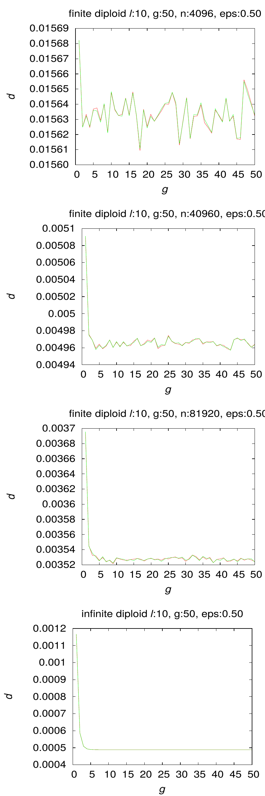
Results: Violation in Mutation
Figure: Oscillation under violation in mutation for diploids, l = 10

Slide 41
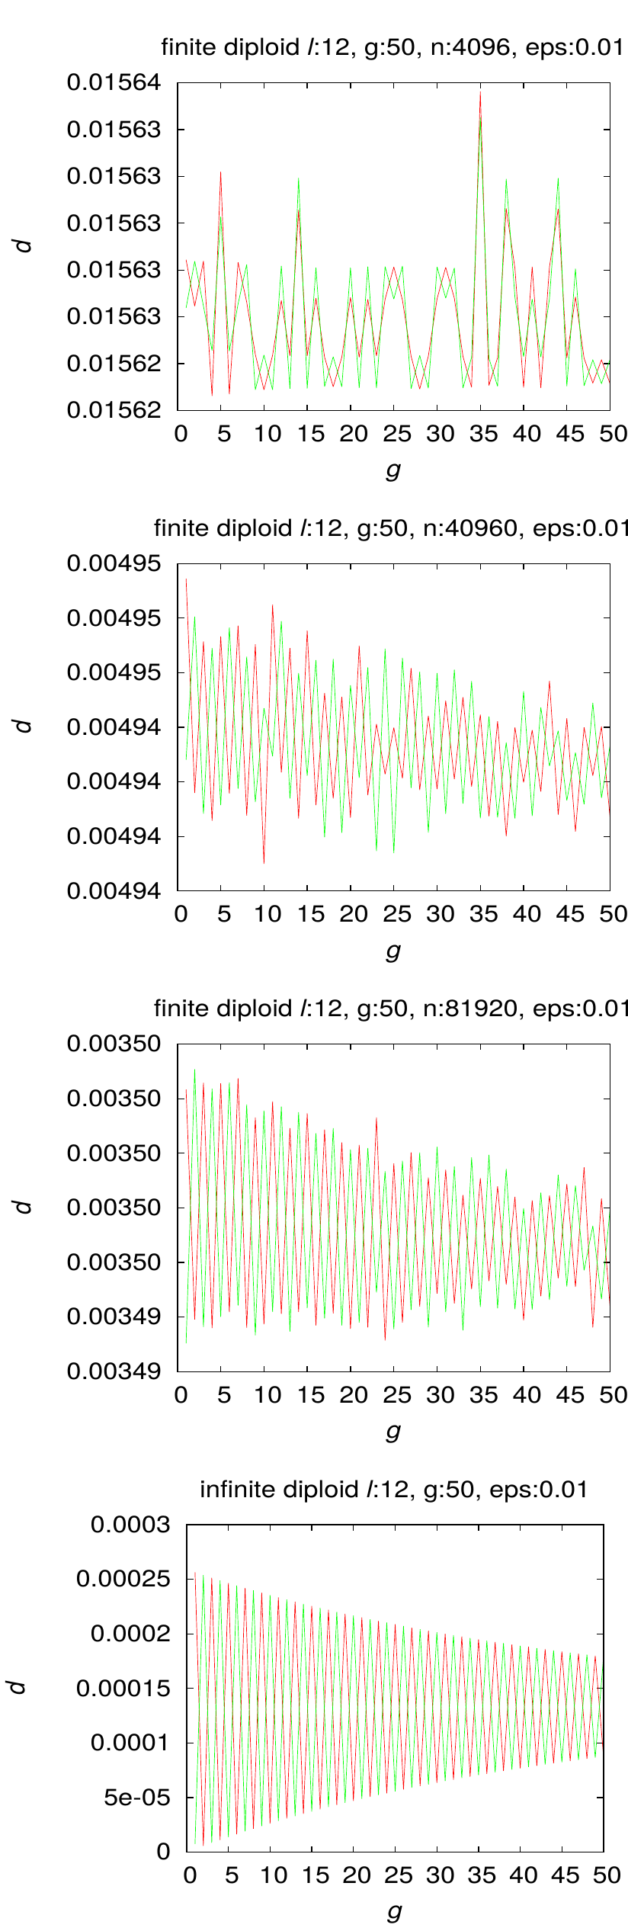
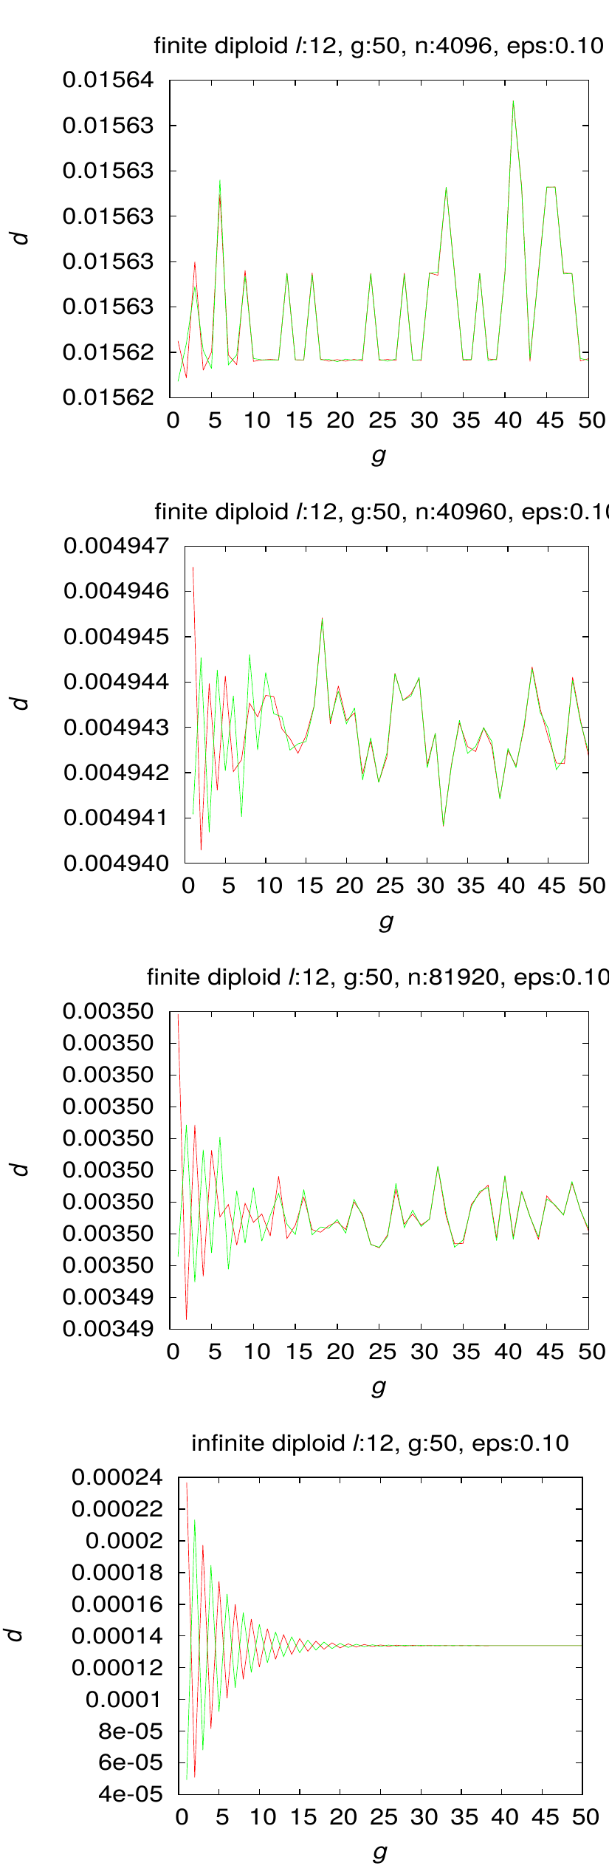
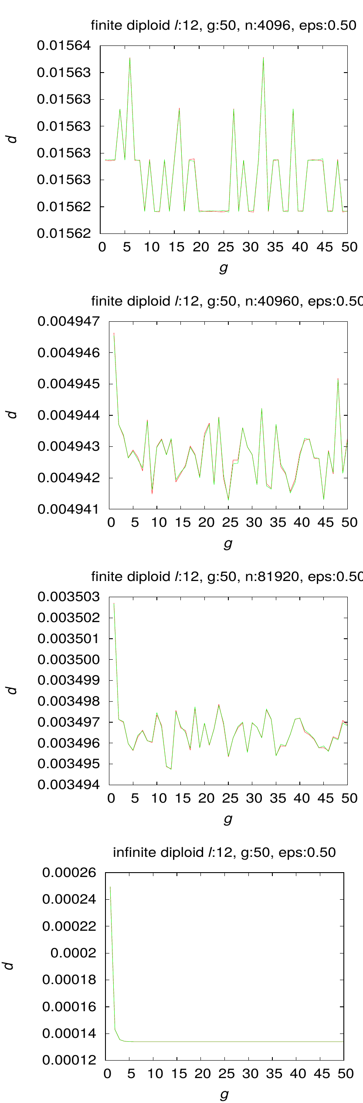
Results: Violation in Mutation
Figure: Oscillation under violation in mutation for diploids, l = 12

Slide 42
Violation in Mutation: Conclusion
Necessary condition for mutation distribution is violated so that no periodic orbit exists for infinite population
Violation makes Markov chain regular where every state is visited infinitely often
Finite population evolution exhibits approximate oscillation if the violation level is small
If violation is large, then finite population ceases to oscillate
As string length increases, oscillation degrades

Slide 43
Question 4:
Oscillation under Violation in Crossover

Slide 44
Robustness of Finite Population
Violation in crossover condition means no periodic orbit exists for infinite population
But we don't know if Markov chain is regular
Can finite population exhibit approximate oscillation?

Slide 45
Violation in Crossover
Violation є is introduced in χ
χ_{i} := (1 − є)χ_{i}
χ_{j} = є j is chosen where χ_{j} = 0

Slide 46
Simulation
є = {0.01, 0.1, 0.5}
l = {8,10,12,14}
N = {4096, 40960, 81920}
Distances of population to limits p* and q* without violation are plotted

Slide 47
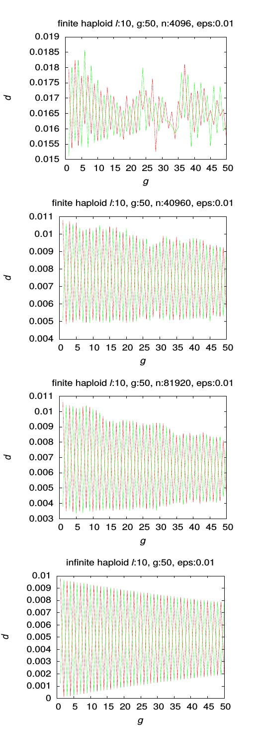
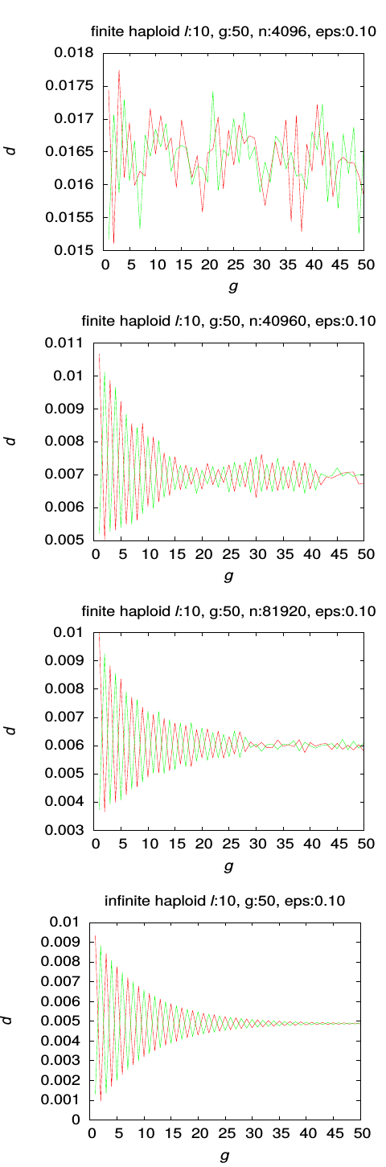
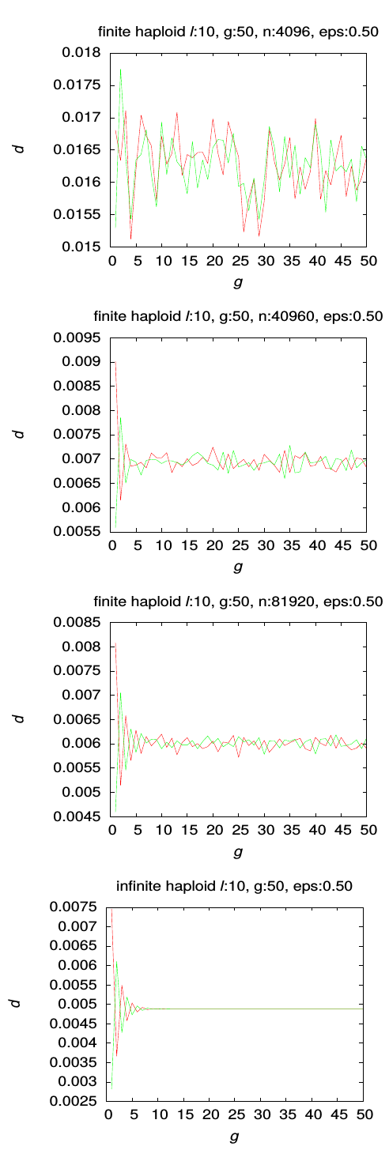
Results: Violation in Crossover
Figure: Oscillation under violation in crossover for haploids, l = 10

Slide 48



Results: Violation in Crossover
Figure: Oscillation under violation in crossover for haploids, l = 12

Slide 49



Results: Violation in Crossover
Figure: Oscillation under violation in crossover for diploids, l = 10

Slide 50



Results: Violation in Crossover
Figure: Oscillation under violation in crossover for diploids, l = 12

Slide 51
Violation in Crossover: Conclusion
Finite population evolution exhibits approximate oscillation if the violation level is small
If violation is large, then finite population ceases to oscillate
As string length increases, oscillation degrades
Dying out of oscillation is slower than in violation in mutation case
More randomness are observed with violation in crossover than in mutation
Notes:
Randomness – we don't have explanation for that

Slide 52
Conclusion

Slide 53
Conclusion
Vose's haploid model makes computation efficient in diploid case given uniform fitness by reducing to haploid case
Distance between finite population and infinite population can decrease like 1/√N
When necessary and sufficient conditions for infinite population to converge to a periodic orbit, finite population evolution also exhibits approximate oscillation
Even when Markov chain is regular, finite population exhibits approximate oscillation for smaller level of violation
When condition for crossover distribution is violated, Markov chain may not be regular
Finite population exhibits approximate oscillating behavior in case of violation of crossover distribution for smaller level of violation

