Slide 1
Analysis and Simulation Of A
Simple Evolutionary System
Mahendra Duwal Shrestha

Slide 2
Overview
Chapter 1
Background
Research Questions
Chapter 2
Diploid Model
Simulation and Results
Summary
Chapter 3
Infinite Population Limits
Simulation and Results
Summary

Slide 3
Chapter 4
Violation in Mutation
Simulation and Results
Summary
Chapter 5
Violation in Crossover
Simulation and Results
Summary
Chapter 6
Conclusion
Overview

Slide 4

Finite Population GA
Population P, size r, length l
Population members represented by binary strings (10010011)
Two parents u and v selected to produce two offsprings u' and v' through crossover and mutation
Keep one of u' and v' with uniform probability
Replace P by new generations formed after r offspring are generated
Process is repeated until system stops to improve or threshold is reached

Slide 5
Infinite Population Model
Population modeled as vector p
p_{j} is the proportion of string j in the population
G is the function mapping infinite population p to the next generation
G(p) is probability vector such that
G(p)_{j} = the probability that string j occurs in the next generation
The evolution of infinite population p is the sequence
p → G(p) → G(G(p)) → · · ·

Slide 6
Background
Several people working in the 1950s and the 1960s – like Box (1957), Friedman(1959), Bledsoe (1961), Bremermann (1962), and Reed, Toombs and Baricelli (1967) in evolution-inspired algorithms
Holland and colleagues formalized and promoted population based algorithms with crossover and mutation
In 1991, Vose and Liepins introduced model to compute infinite population trajectories
Given a finite population represented by vector p, the infinite population model computes the expected proportion G(p)i of string i in the next generation
Nix and Vose explored relationship of finite population GA and infinite population model
They proved the short term trajectory followed by a finite population is related to the evolutionary path determined by the infinite population model
Notes:
Although their model computes infinite population trajectories, given a finite population represented by vector p (component p_i is the proportion of string i in the finite population), the infinite population model computes the expected proportion G(p)i of string i in the next generation.
This perhaps is the most direct connection between infinite population model and finite population GA
For large populations, the short term trajectory follows closely and with large probability, that path predicted by the infinite population model.

Slide 7
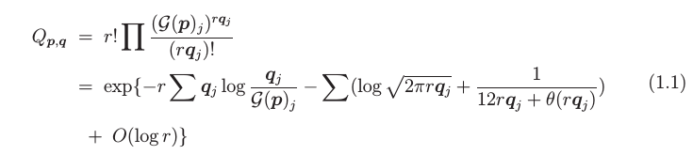
Random Heuristic Search
τ is stochastic transition rule that maps P to P'
p is population vector corresponding to population P (P chosen from some search space Ω)
Given population size r, a population vector p determines a population
The next population vector τ(p) cannot be predicted by certainty
G is a function that maps p to a vector whose ith component is the probability that the ith element of Ω is chosen
G(p) specifies distribution of population in the next generation
θ is a function such that 0<θ<1
Notes:
The probability that q is the next generation population vector is given current population vector p is given by equation 1.1.

Slide 8




Random Heuristic Search
Finite population sequence p, τ(p), τ²(p), ... forms Markov chain with transition matrix Q_{p,q}
G(p) is the expected next generation Ɛ(τ(p))
denotes discrepancy of q (how far q is from G(p))
indicates probability that q is next generation decreases exponentially with constant r as the discrepancy increases
measures dispersion of q
indicates the probability that q is the next generation decays exponentially with increasing dispersion

Slide 9
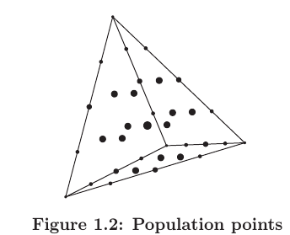

Random Heuristic Search
Finite populations are represented by dots
Smaller dots, lesser dispersion
Larger dots, higher dispersion
The variance of the next generation (with respect to the expected population) is

Slide 10
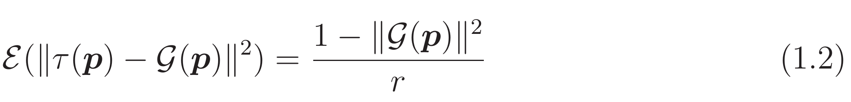
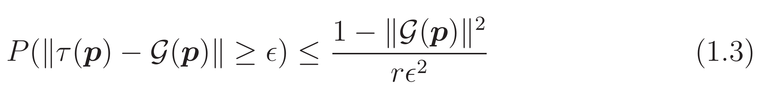
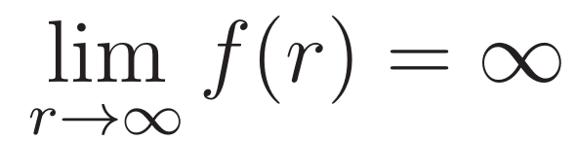
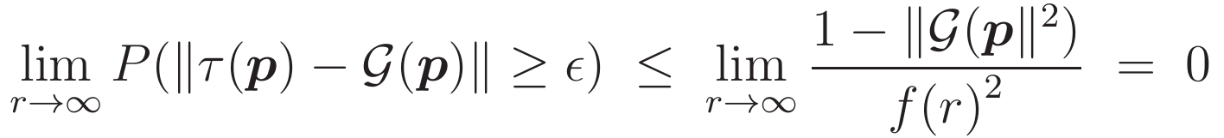
Research Question 1
Following Chebyshev's Inequality,
Let Є = f(r)/√r, where f(r) grows arbitrarily slowly and
Then, eqn 1.3 becomes
This suggests distance between τ(p) and G(p) might decrease as 1/√r
Notes:
The probability that q is the next generation population vector is given current population vector p is given by equation 1.1.

Slide 11
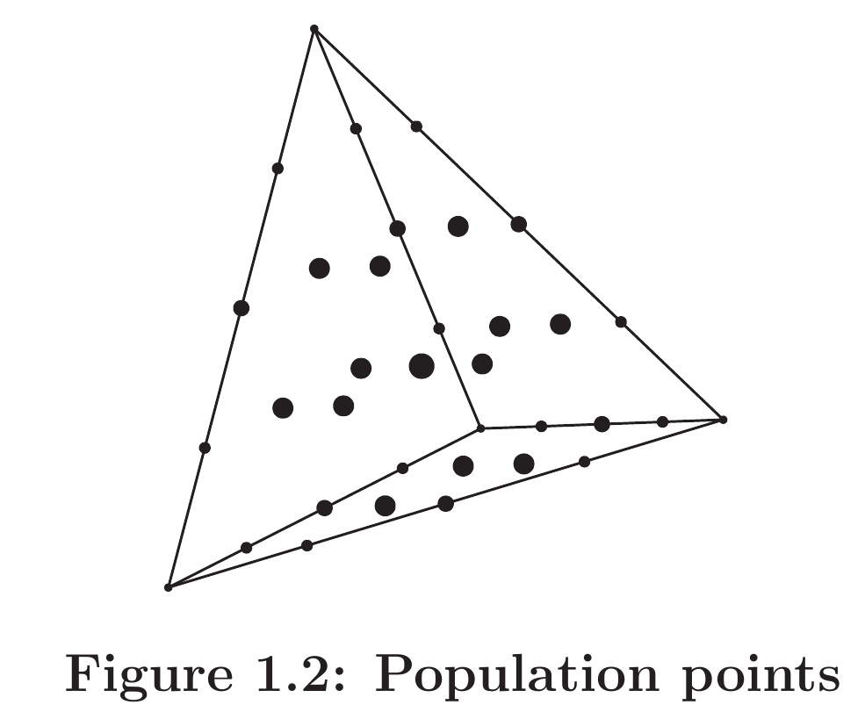
Research Question 1
Finite population can be only at lattice points
Infinite population can be any where in the space
Distance between finite population and infinite population is bounded by O(1/√r)
Let η be the random variable ||τ(p) − G(p)||, and let Φ(x) = x²
Then from Jensen's Inequality analysis, we get

Slide 12
Research Question 1

Slide 13
How it works

