Slide 1
Classroom language

Slide 2

You don’t understand something
Can you explain that again, please?

Slide 3
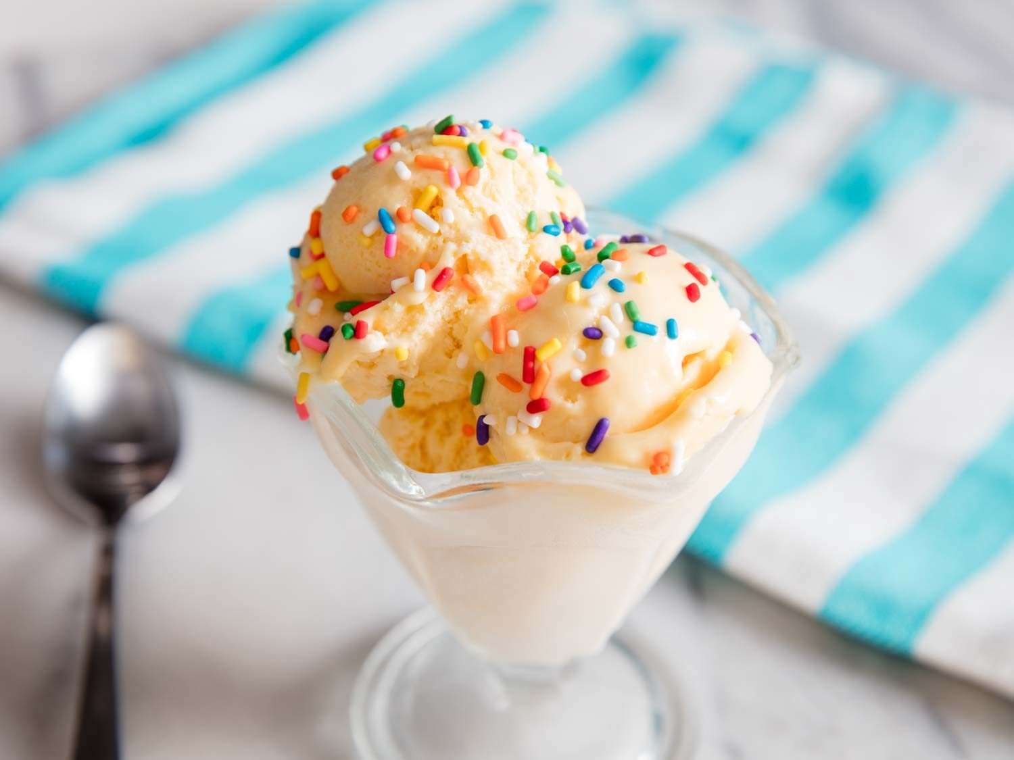
You don`t know the word «морозиво»
Excuse me, what’s the translation for the word?

Slide 4
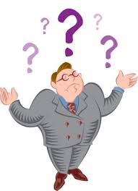
You don`t know the word «easy»
What’s the meaning of the word…?

Slide 5

You don`t know how to write a word
How do we spell it?

Slide 6

You don`t know how to pronounce the word „recipe”
How do we pronounce the word „recipe”?

