Slide 1


Slide 2


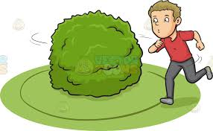
+
+
See you around

Slide 3
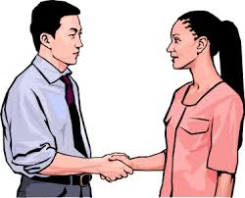


+
+
Pleased to meet you

Slide 4


+
Hey there!

Slide 5

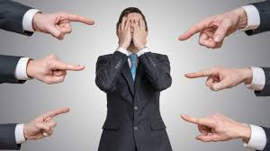

+
+
+
Nice to meet you, too!

Slide 6
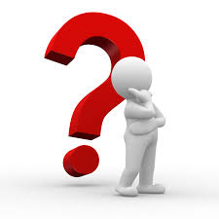
+
DO
+
+
DO
How do you do

Slide 7
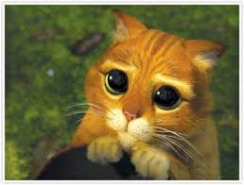
+
Please, meet

Slide 8
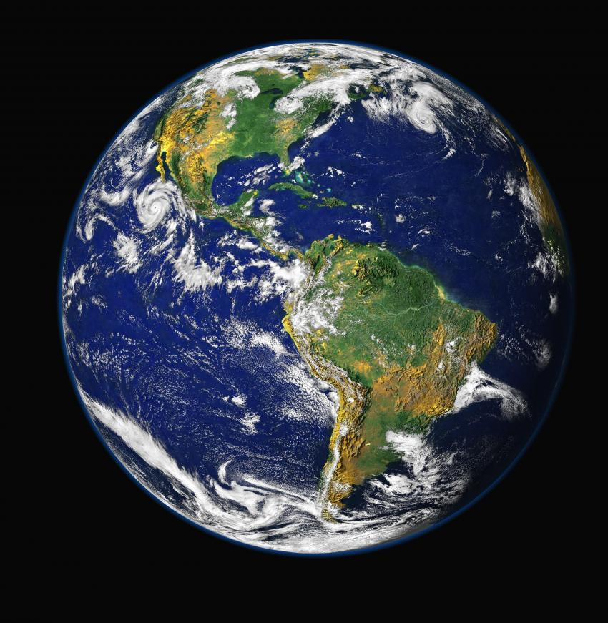
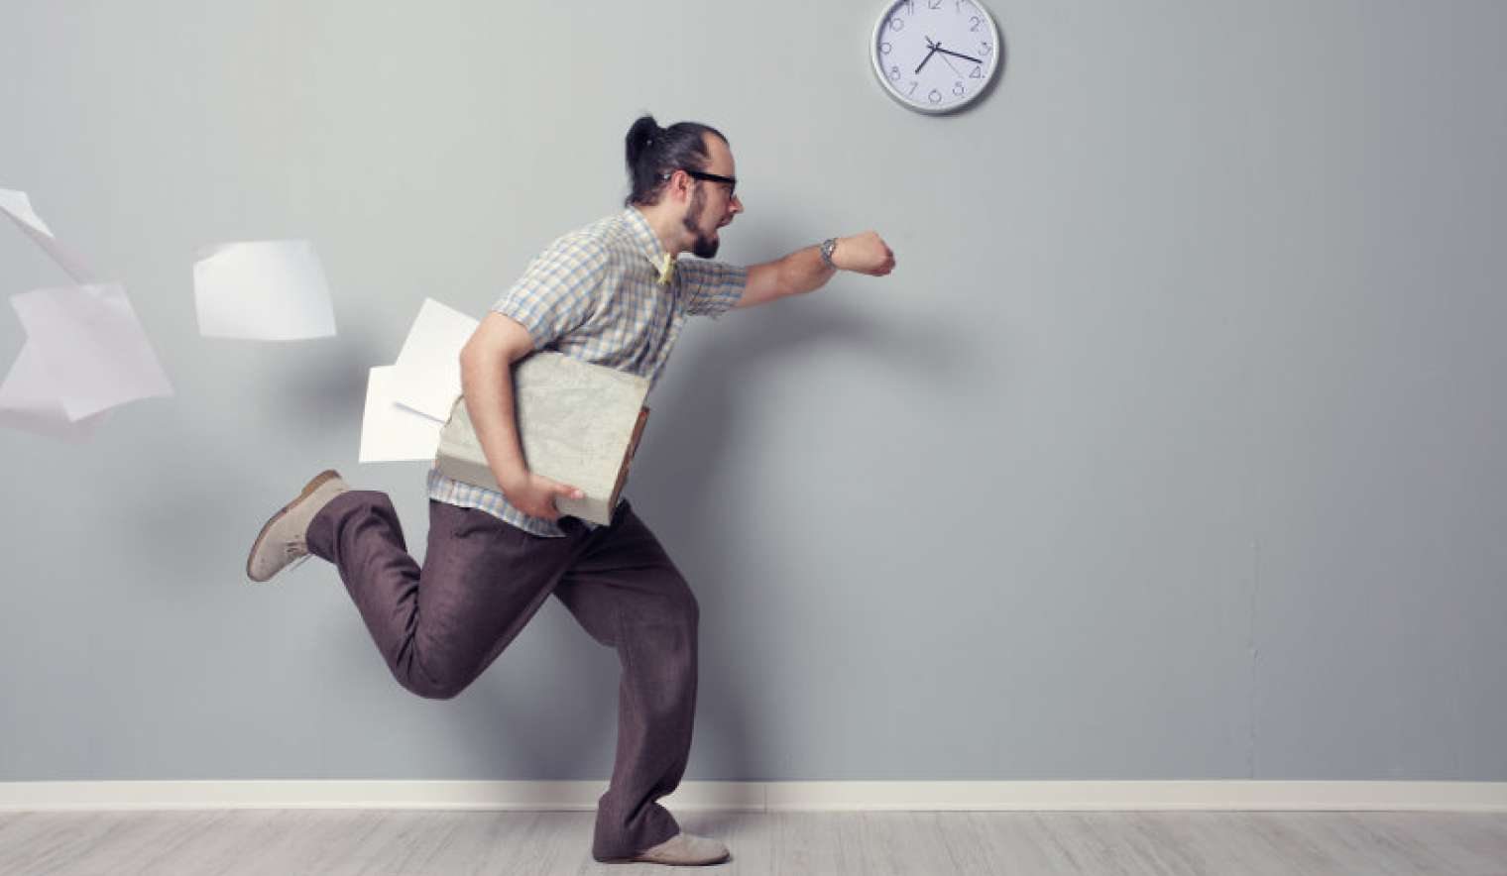
+
Laters!

Slide 9


+
Likewise

Slide 10
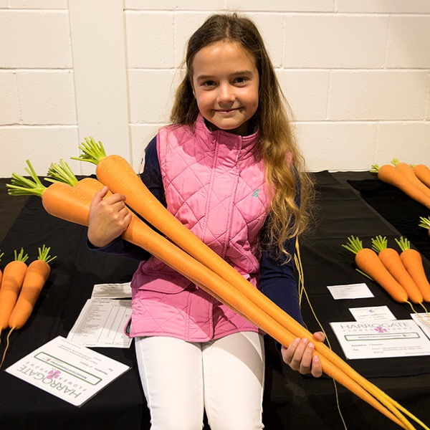
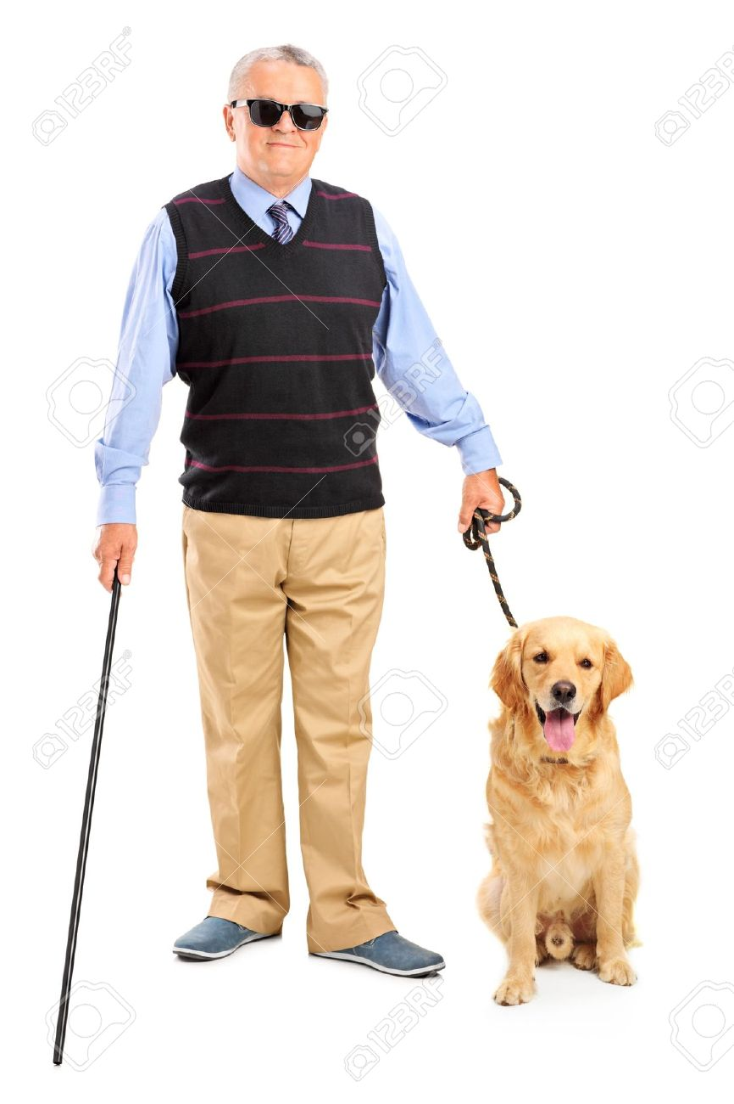
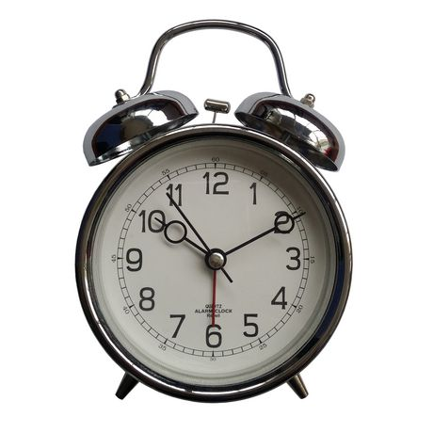
+
+
Long time no see

Slide 11
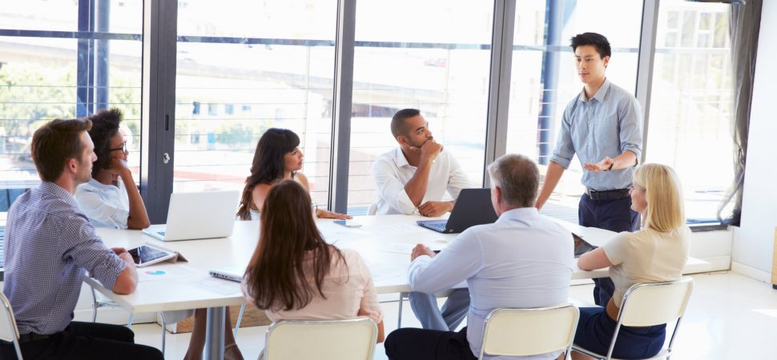
+
+
Nice meeting you

Slide 12
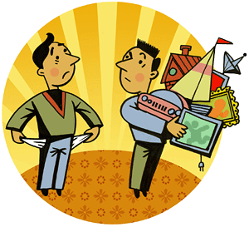



+
+
+
Have a good day

