Slide 1
Strategic Technology Trends for 2023: Superapps
Jason Wong
Dennis Gaughan
Mike Gotta
Adrian Leow
Koji Motoyoshi
Sandy Shen
October 2022

Slide 2
By 2027, more than 50% of the global population will be daily active users of multiple superapps.
Superapps
Gartner Strategic Planning Assumption

Slide 3
A superapp is an app that provides end-users (customers, partners or employees) with a set of core features plus access to independently created miniapps. The superapp is built as a platform to deliver a miniapps ecosystem that users can choose from to activate for consistent and personalized app experiences. There is no separate app store or marketplace for miniapps. They are discovered and activated by the superapp users, and once used, they can also be easily removed from the UI.
Gartner, October 2022

Slide 4
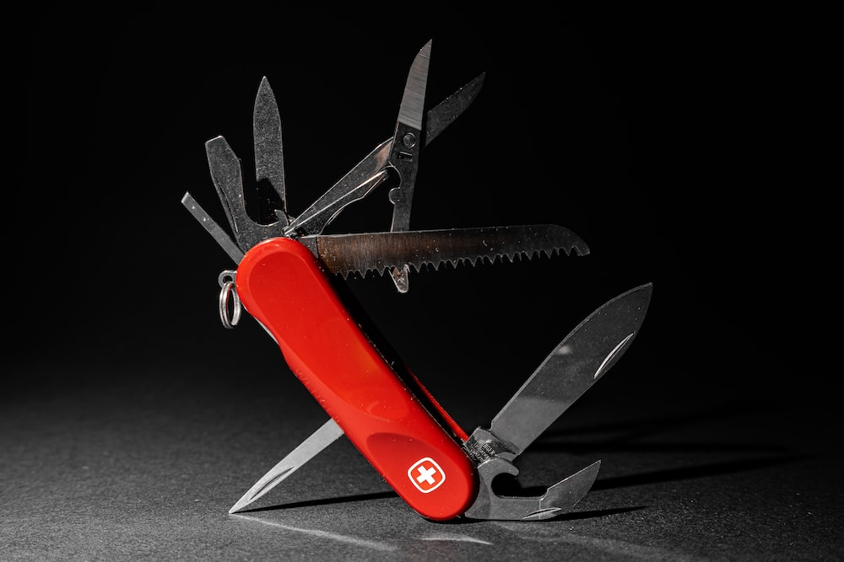
A superapp is like a Swiss army knife with many tools that serve multiple purposes, and the tools (miniapps) can be discovered, used and removed as the user needs.
Photo by Patrick on Unsplash.com

Slide 5
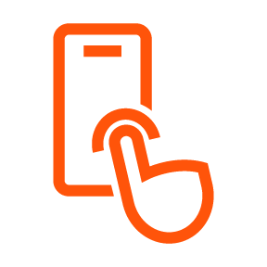
Key Characteristics Of A Superapp
Core features
User activated
App
Miniapp development
Data sharing
Ecosystem
Platform
Miniapp publication
Notes:
A superapp is more than just a composite mobile app. It is built as a platform to deliver modular miniapps that users can activate for personalized app experiences.

Slide 6
What Makes An App “Super”?
Key Capabilities | Traditional Web/Mobile App | Composite App/Portal | Superapp
1. Core features to draw in users (e.g., payments, communications) | Maybe | Maybe | Yes
2. Design and development framework for miniapps | No | Maybe | Yes
3. Publication mechanism for miniapps ecosystem | No | No | Yes
4. Data sharing between superapp and miniapps | No | Maybe | Yes
5. User discovery and activation of miniapps | No | No | Yes
Notes:
Although a superapp advances the concept of a composite application — aggregating services, features and functions into a single app — superapps are distinct in three key ways:
Multiple internal development teams and external partners can provide discrete services to users by building and deploying modular miniapps to the superapp.
App users can configure their superapp experience by selecting the miniapp they want to use when they need it in the superapp.
Data sharing is key, including simple user authentication, such as single-sign-on (SSO) and tracking user preferences or app usage history.
We expect superapps to continue to gain interest from early-adopter organizations that embrace composable business thinking.

Slide 7

Superapps Expansion Leads To Opportunities
FinTech
Healthcare
Digital Commerce
First-Mover Advantage
Customers
Partners
Employees
Notes:
Application and software engineering leaders can create superapps for customers that consolidate multiple mobile apps or related services to reduce UX friction (such as context switching) and development effort. They can also build superapps to provide a more engaging experience for their employees. These superapps can help achieve economies of scale and leverage the network effect of a larger user base and multiple providers. Most importantly, they can improve the UX by enabling users to activate their own toolboxes of miniapps and services.
A superapp serves as a platform for internally developed miniapps and for third-party, externally developed miniapps. Business partners to create an extended ecosystem for monetization by deploying miniapps to an established user base. This provider ecosystem also amplifies the superapp’s value by providing convenient access to a broader range of services within the app.

Slide 8
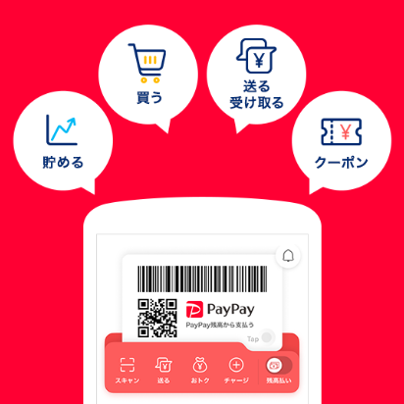
Example Case Study: PayPay
PayPay is a superapp with 50 million users in Japan
It offers financial management services, retail shopping and mobile payments
It provides third-party miniapps for buying cinema tickets, ordering food, bicycle sharing, and more
PayPay
Commerce
Photo from PayPay app in Google Play
Notes:
https://k-tai.watch.impress.co.jp/docs/news/1432932.html

Slide 9
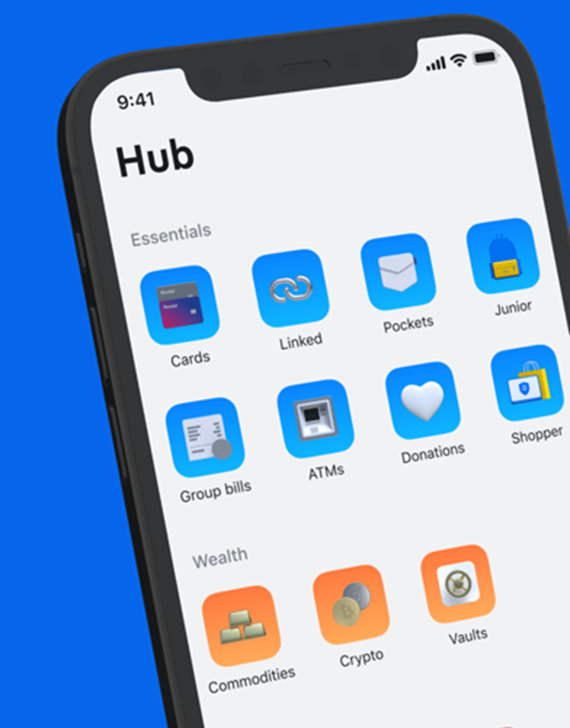
Example Case Study: Revolut
Revolut in a FinTech superapp with more than 20 million users
It offers digital banking services for consumers and have expanded their ecosystem into businesses, where SMBs and freelancers can offer services in the superapp
Revolut
FinTech
Photo from Justuseapp
Notes:
https://www.finextra.com/newsarticle/40646/revolut-surpasses-20-million-customer-milestone-on-seventh-anniversary

Slide 10
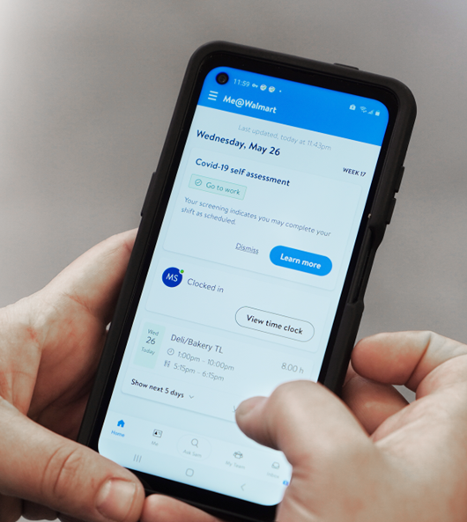
Example Case Study: Walmart
Me@Walmart app brings together personal and work needs of up to 2.3 million Walmart associates
Features of this app includes being able to manage work schedule, request time-off, swap shifts, take COVID-19 health assessment and more
Me@WalMart
Workforce
Photo from Walmart
Notes:
https://corporate.walmart.com/askwalmart/how-many-people-work-at-Walmart
https://corporate.walmart.com/me-walmart-app

Slide 11
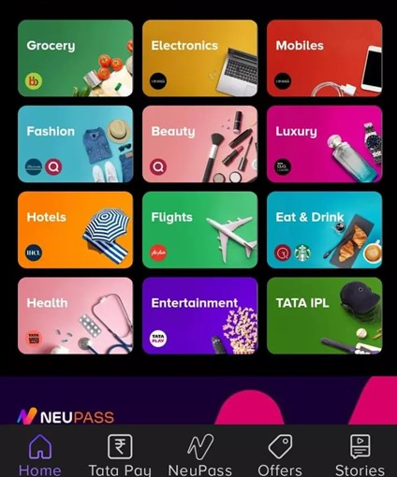
Example Case Study: Tata
Tata Neu allows 7+ million customers to buy everything from groceries to gadgets, and fitness to finance
It offers loyalty rewards with NeuPass and NeuCoins
It is open to having non-Tata brands on the platform in the future
Tata Neu
Commerce
Photo from Apple App Store
Notes:
https://www.business-standard.com/article/companies/tata-neu-app-downloaded-by-over-7-mn-users-in-seven-weeks-122071201228_1.html
https://economictimes.indiatimes.com/tech/technology/after-many-delays-tata-digital-unveils-super-app-tata-neu/articleshow/90709474.cms

Slide 12
Now Is The Time For Superapps Globally
Superapps are common in Asia, and they have expanded globally. The use case is not just for mass consumers, but also for customers, partners, and employees.
Digital native vendors in FinTech, digital commerce and healthcare are using the superapp model to disrupt current business and technology models. Creating a viable superapp provides a first-mover advantage in your industry to be at the center of an ecosystem of apps and services.
A superapp is more than just a mobile app. It is a platform engineered to power a composable ecosystem. Application and software engineering leaders must evaluate creating superapps for customers, partners and employees, as well as participating in related superapp ecosystems via miniapps.

Slide 13
Recommendations for IT Leaders
Increase superapp delivery model effectiveness by designing for people-centric products, processes and services. Start by addressing high-volume sales and commerce, resource and workforce management and collaboration opportunities.
Identify core, high-engagement features in your superapps (such as payments, communications, collaboration, services, entertainment) that will drive a critical mass of adopters so that third-party developers will want to serve those users.
To attract and support development partners, ensure a sound business model and organizational structure to scale the distributed development ecosystem for miniapps. This requires executive sponsorship, so prepare the partnership strategy and financial case for funding as a digital business initiative.
Offer an easy developer experience and convenient developer tools (such as APIs, design guidelines, software development kits and frameworks) for partners to build, test, register and submit miniapps for potential monetization.
Define security and data protection requirements by establishing governance reinforced with common platform implementation to satisfy security and data protection constraints.

Slide 14
Recommended Gartner Research
Top Strategic Technology Trends for 2023 David Groombridge, et al
Top Strategic Technology Trends for 2023: Superapps Jason Wong, Adrian Leow, Sandy Shen et al
Quick Answer: What Is a Superapp? Jason Wong, Arun Batchu, Oleksandr Matvitskyy, Adrian Leow
Hype Cycle for Software Engineering, 2022 Arun Batchu, Mark O'Neill, Joachim Herschmann

Slide 15
Gartner Experts

Slide 16

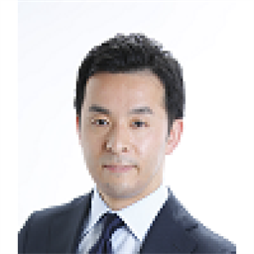

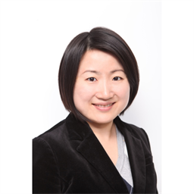
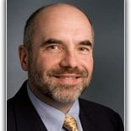
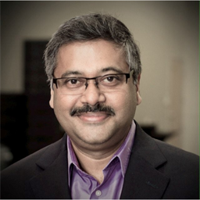

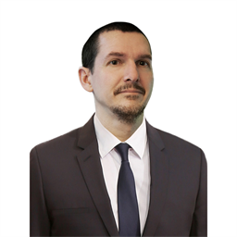
Gartner Analysts Covering Superapps
Jason Wong
Distinguished VP Analyst 9 years at Gartner
Koji Motoyoshi
VP Analyst 16 years at Gartner
Dennis Gaughan
Distinguished VP Analyst
15 years at Gartner
Sandy Shen
VP Analyst 19 years at Gartner
Mike Gotta
VP Analyst
10 years at Gartner
Arun Batchu
VP Analyst 3 years at Gartner
Adrian Leow
VP Analyst
9 years at Gartner
Keith Mann
Sr Director Analyst 7 years at Gartner

