Slide 1
RESTful Web Service from Scratch
100150
Creating a RESTful Web Service from Scratch
Mathew Welborn
PeopleSoft Developer / PeopleSoft Administrator
Packaging Corporation of America
MathewWelborn@boisepaper.com
https://github.com/mdwelborn/RECONNECT2016/

Slide 2



Introduction – Mathew Welborn
Washington State University (Winter of 2012)
Degrees in Computer Science / Management & Information Systems
Joined PCA in January 2013.
Started PeopleSoft HR development in Fall of 2013.
Switched to PeopleSoft Finance development in Fall of 2014.
Started system administrator duties in Fall of 2015.
Hobbies
Computer Gaming (League of Legends / Overwatch / World of Warcraft)
Coding / GNU Linux

Slide 3
Objective
Create synchronous RESTful web services that will push / pull user data between PeopleSoft and external system.
Provide from PeopleSoft to external system
User account information (existence check) - GET
User account creation - POST
Consume from external system from PeopleSoft
User account information (existence check) - GET
Push user information to external application. - PUT

Slide 4
Overview

Slide 5
Demo – External System
Show External System

Slide 6
What are RESTful Web Services?
Uses HTTP protocol / methods to send messages.
GET, POST, PUT, DELETE
The message format is typically JSON (JavaScript Object Notation).
Uses Standard HTTP Response Codes
2xx (success)
200 (Ok) / 201 (Created)
4xx (Client Error)
400 (Bad Request) / 404 (Not Found)
5xx (Server Error)

Slide 7
Creation Summary
Configure Integration Broker.
Create Documents / Messages
Create Web Service and Service Operations
Create Application Class for handler
Associate Service Operation handler with Application Class

Slide 8
Configure Integration Broker
Configure Gateway
Change URL of local gateway to the IP address of your PUM VM.
This is required for consuming RESTful web services from an external source.
Service Configuration
Change the REST Target locations to the IP address of your PUM VM.
This is that PeopleSoft will use as the base URL when defining service operations.
All that is needed when providing RESTful web services.

Slide 9
Demo - Configure Integration Broker
Demo

Slide 10
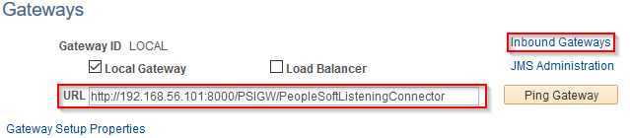
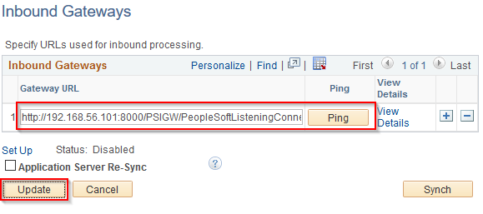
Configure Integration Broker
Gateways
Main Menu -> PeopleTools -> Integration Broker -> Configuration -> Gateways

Slide 11
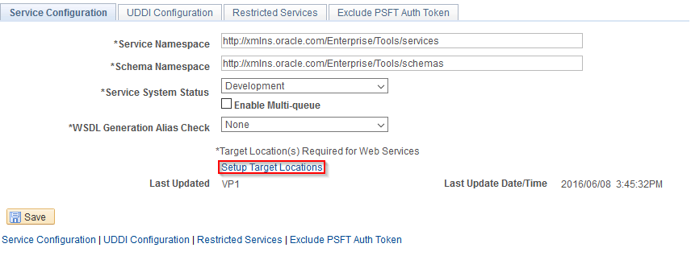
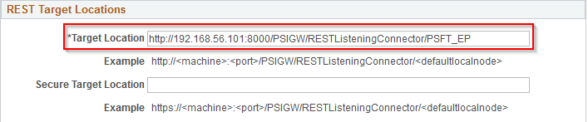
Configure Integration Broker
Service Configuration
Main Menu -> PeopleTools -> Integration Broker -> Configuration -> Service Configuration

Slide 12
Create Service
A RESTful web service is providing a resource.
URI: Uniform Resource Identifier
URL: Uniform Resource Locator
A URI that includes location and access method.
Example: http://www.myapp.com/api/users/mdwelborn
Name: Think of the resource you are providing. Think in nouns.
REST Checkbox: Determines if the web service is a REST web service or not.
Is Provider: Determines if you are providing or consuming the service.

Slide 13
Demo – Create Service
Demo

Slide 14
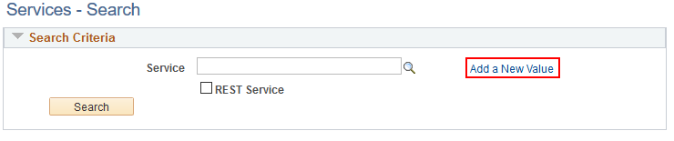
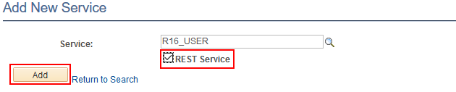
Create Service
Main Menu -> PeopleTools -> Integration Broker -> Integration Setup -> Services

Slide 15
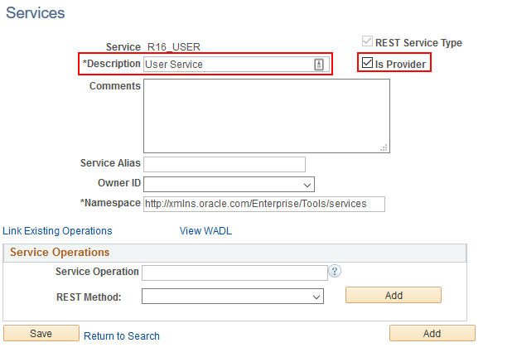
Create Service
Ensure the Provider checkbox is checked.

Slide 16
Create Service Operations Pt1
REST Method / HTTP Method: This is the HTTP method used.
DELETE: Used for deleting a resource.
GET: Used for retrieving information about a resource(s).
HEAD: Similar to get, but with no response body.
POST: Used to create a new resource.
PUT: Used to create / update a resource. I would limit it to update.
Method | URI
GET, HEAD, PUT, DELETE | users/{userId}
GET, POST | users/

Slide 17
Demo - Create Service Operations Pt1
Demo

Slide 18
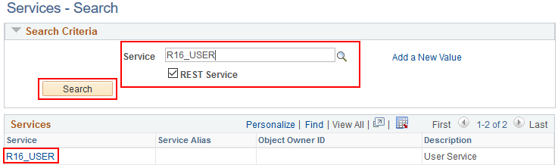
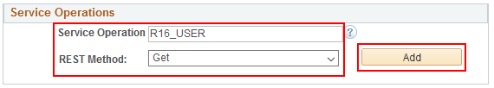
Create Service Operations Pt1
Main Menu -> PeopleTools -> Integration Broker -> Integration Setup -> Services (Find your service)
Add Service Operation. The method gets concatenated to the service operation to create the final name.

Slide 19
Messages
Integration Broker uses as a container for data transfer.
Message Types
Container Messages / Message Parts
Document Messages
Based on a document.
Nonrowset-based Messages
Defined by an XML Schema.
Rowset-based Messages
Based on PeopleSoft Records.

Slide 20
PeopleSoft Documents
What are they?
Data container / formatter.
XML
Relational
JSON
Used for document based messages.
Create using the Document Builder

Slide 21
Create Documents
Data Types
Primitives
Boolean, String, Text, Date, etc…
Compound
Document, Record, Complex Primitive
Collection
Multiple items of the same type

Slide 22
Demo - Create Documents
Demo

Slide 23
Create Documents
Creating Documents
Main Menu -> PeopleTools -> Documents -> Document Builder
Package: Logical grouping of documents.
Document: Name of the document.
Version: Document version. (I default to V1)

Slide 24
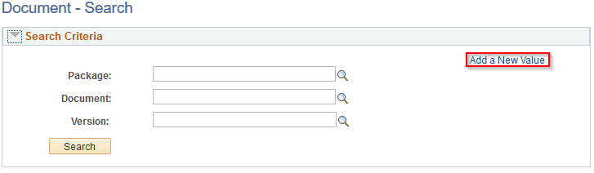
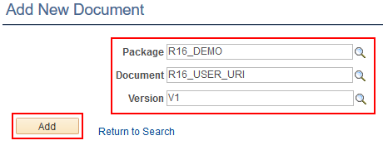
Create Documents (URI)

Slide 25
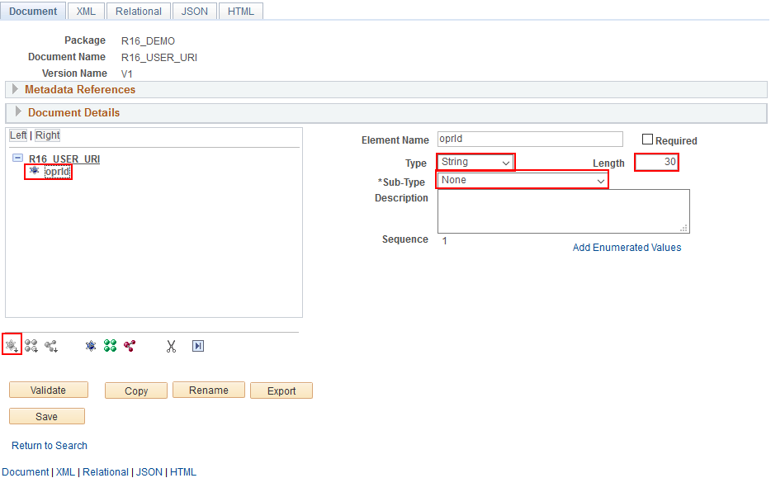
Create Documents (URI)
Create data with necessary components. In this case only primitives are used.

Slide 26
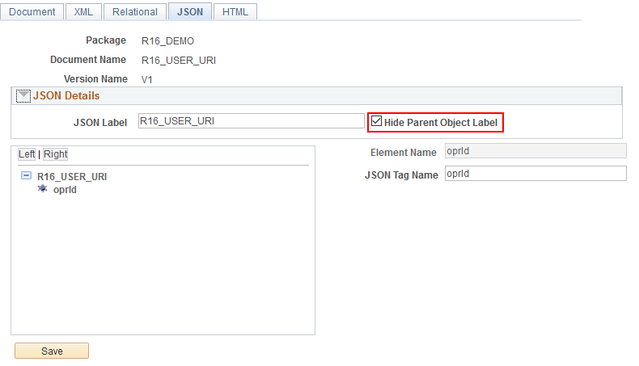
Create Documents (URI)
Check the Hide Parent Object Label. Otherwise your JSON will include the document name. { “R16_USER_URI”: { “oprId” : “USER1”}}

Slide 27
Create Message
Creating Messages
Types: Defines the message type.
Container (Combines Parts)
Document (1 to 1 mapping with document)
Nonrowset / Part Nonrowset
Rowset / Part Rowset

Slide 28
Demo - Create Messages
Demo

Slide 29
Create Message
Creating Messages
Main Menu -> PeopleTools -> Integration Broker -> Integration Setup -> Messages
Using a document type.

Slide 30
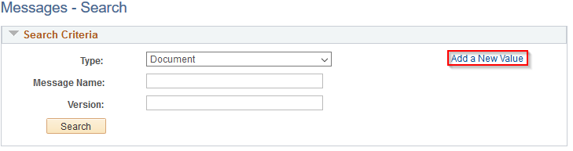
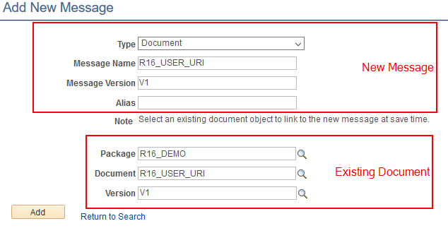
Create Message

Slide 31
Create Service Operations Pt2
Routings
Define the inbound / outbound nodes.
Message transformations
Service Operation Security
You must select permissions lists that have access to a specific service operation.
Provider Operations
Selected on the service operation.
Consumer Operations
Selected on the service operation routing.

Slide 32
Demo – Create Service Operations Pt2
Demo
(Messages / Routings)

Slide 33
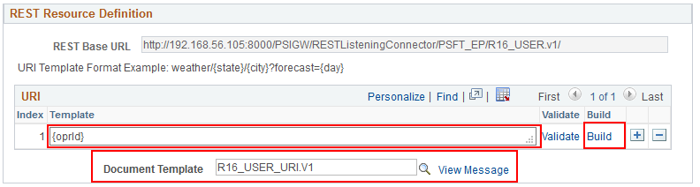
Create Service Operations Pt2
Rest Resource Definition
Defines the URI template to be used in the URL to locate a resource.
The document template is what is used to transfer the data delivered in the URI to PeopleCode.

Slide 34
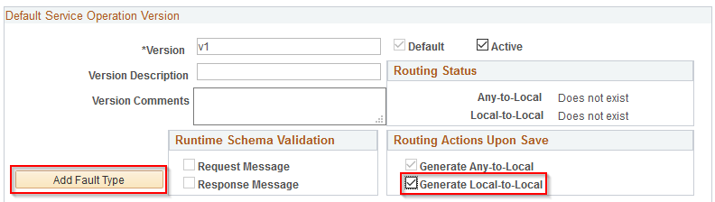
Create Service Operations Pt2
Service Operation Version
Generate Any-to-Local (Inbound)
Generate Local-to-Local (Internal)
Used for PS testing utilities.
Create Fault Type

Slide 35
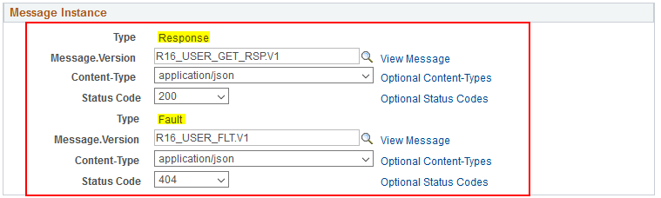
Create Service Operations Pt2
Message Instance
Map your created messages to their associated types.
Content-Type: application/(json/xml), text/(html/plain/xml)
Status Codes: Standard HTTP Status Codes. (2xx, 4xx)

Slide 36
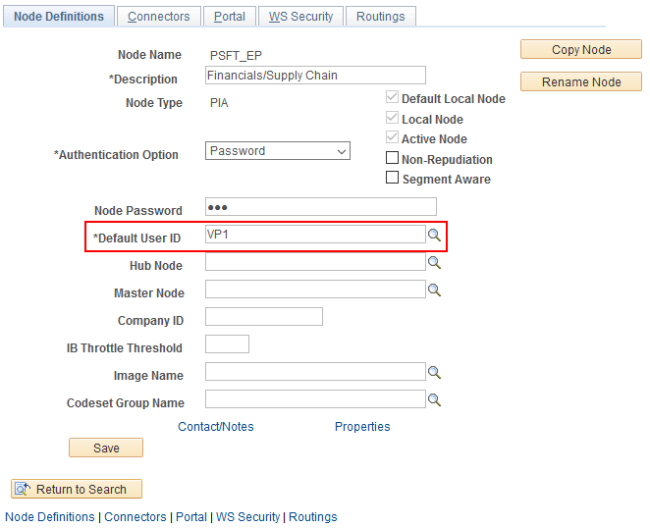
Create Service Operations Pt2
Service Operation Security
The NODE user must have a permission list that has access to the service operation. (Can only do once saved)

Slide 37
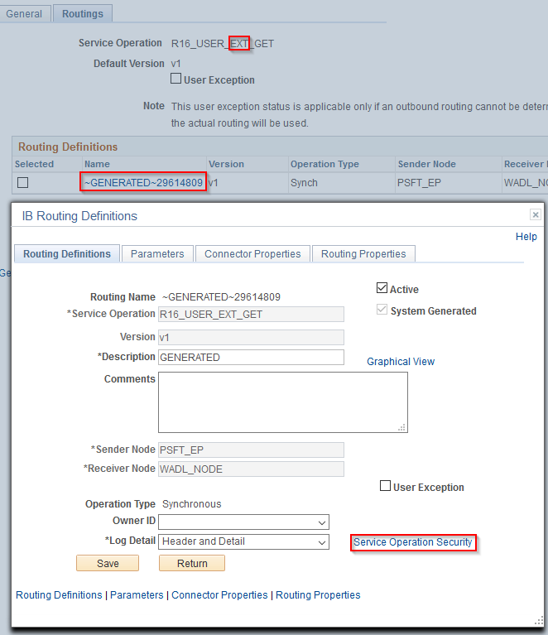
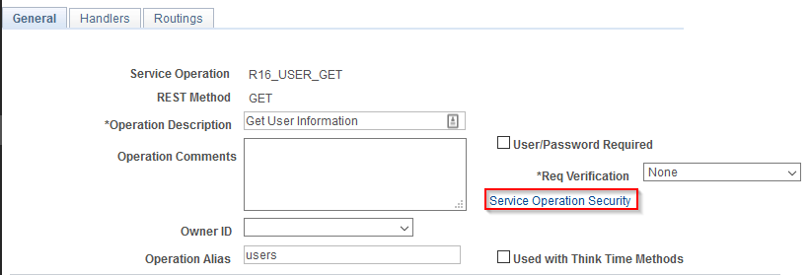
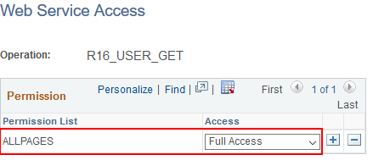
Create Service Operations Pt2
Consuming Service Operation via Routings
Provider Service Operation via Service Operation

Slide 38
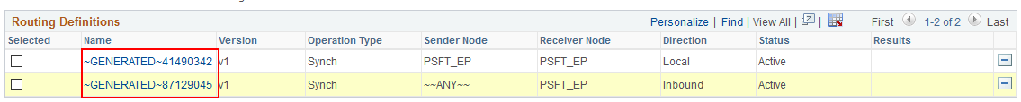
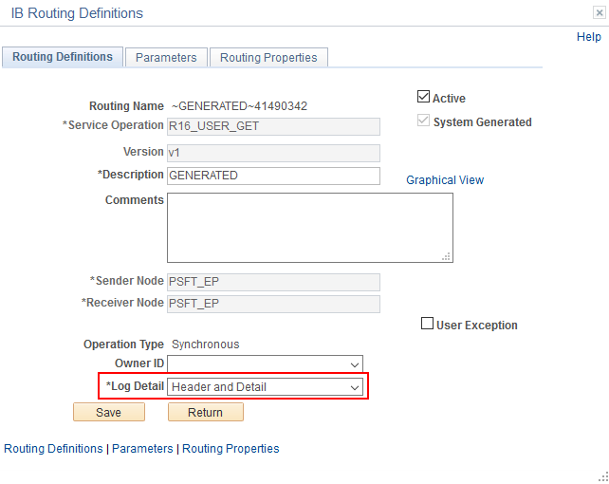
Create Service Operations Pt2
Routings
Once created change Log Detail to Header and Detail. Helpful for troubleshooting issues. I would do this for all created routings.

Slide 39
Create Handler Code
Service Operation Handler Code
Created with application packages / classes.
Needs to implement the PS_PT:Integration:IRequestHandler interface.
Must define OnRequest method.
OnError method has a default implementation, but I would define it for clarity.
Has two properties that can be set.
OnErrorHttpResponseCode
OnErrorContentType

Slide 40
Demo - Review / Associate Handler Code
Import Project / Demo

Slide 41
Create Handler Code
Class Signature
import PS_PT:Integration:IRequestHandler;
class R16_USER_SERVICE implements PS_PT:Integration:IRequestHandler
method R16_USER_SERVICE();
method OnRequest(&msgReq As Message) Returns Message;
method OnError(&msgReq As Message) Returns string;
private
method GetUser(&msgReq As Message) Returns Message;
method CreateUser(&msgReq As Message) Returns Message;
method GenerateGetRsp(&recOprDefn As Record) Returns Message;
method GeneratePostRsp(&recOprDefn As Record) Returns Message;
end-class;

Slide 42
Create Handler Code
Associating Handler with Service Operation
Handler Type
Varies by service operation and sync vs async.
Handler Implementation (Varies on Handler Type)
Application Class
Application Engine
Component Interface
Bulk Load

Slide 43
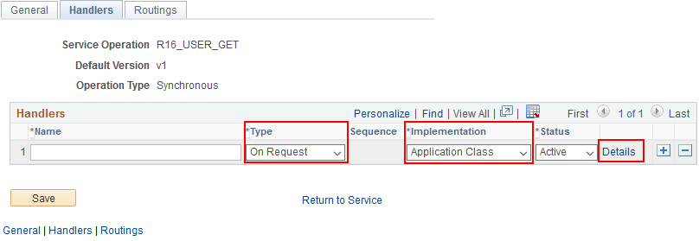
Associate Handler Code

Slide 44
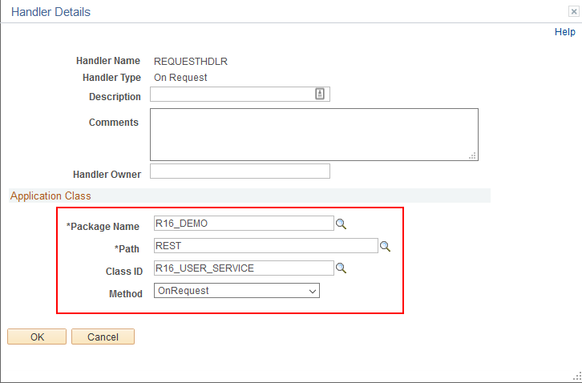
Associate Handler Code

Slide 45
Demo – Provider Service
Demo

Slide 46
External Service
External (Consuming) REST Web Service
R16_USER_EXT (Service)
R16_USER_EXT_GET (Service Operation)
http://192.168.56.1:8080/api/users/{oprId}
R16_USER_EXT_PUT (Service Operation)
http://192.168.56.1:8080/api/users/{oprId}
Component Record PeopleCode fires request
USERMAINT.PSOPRDEFN.SavePostChange

Slide 47
Demo - Consuming Service
Demo

Slide 48
Resources
GitHub (Java Source Code / PeopleSoft Project)
PeopleBooks
Document Classes API
Message Classes API
Integration Broker
Wikipedia
HTTP Status Codes
HTTP Methods
URL
URI
StackOverflow

Slide 49
100150

