Slide 1

OH~Bathroom~

Slide 2
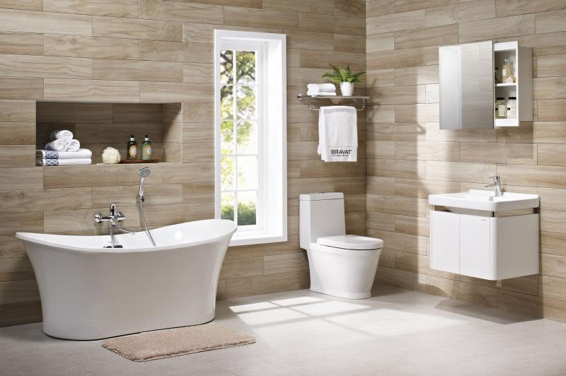
Built-in cabinet
It can make your storage more convenient and save the cost of buying cabinets.

Slide 3
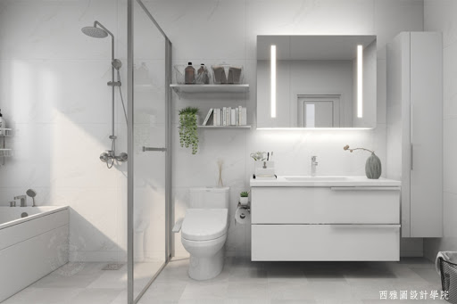
Dry and wet separation
It will make the bathroom more comfortable and there will be no water everywhere.

Slide 4
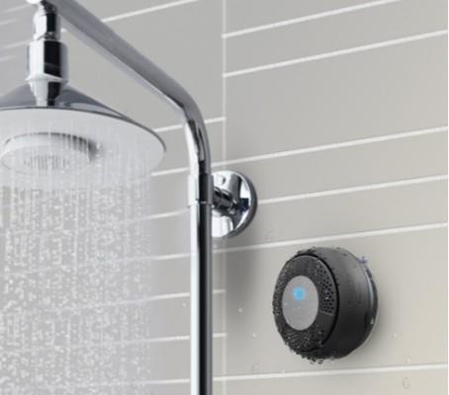
sound
It can make you more relaxed and rest in the shower, but I don't know why he installed two speakers.
KOHLER 衛浴
所推出之喇叭
TaoTronics TT-SK03
浴室藍牙喇叭

Slide 5
