Slide 1
Outline: Motivation
What is a Motivation?
How Motivations Affect Behavior
Types of Motives
Hunger
Eating Disorders: Obesity and Anorexia
Arousal

Slide 2
Definition
Motivation- the general term for the process of starting, directing, and maintaining physical and psychological activities.

Slide 3
How motivations affect behavior
Preferences for one activity over another
Vigor or intensity of response
Persistence of organized patterns of action towards a goal

Slide 4
Types of Motivations
  Primary/Simple Motives- serve biological needs; common to all animals (e.g., hunger etc.)
  Complex Motives-learned behaviors typically involving social interaction

Slide 5
Hunger as a motive
Stomach contractions.
Hunger is tied to blood glucose level.
Role of the hypothalamus
  Lateral portion- tells us when to eat
  Ventromedial portion- tells us when to stop eating
External Cues
  Diet
  Social Factors

Slide 6
Eating Disorder: Obesity
Bodily Factors
  Digestive apparatus
  Lower metabolic rate
Genetic Factors
  Twin studies
Behavioral Factors
  Externality Hypothesis

Slide 7
Eating Disorder: Anorexia Nervosa
Three phases:
  Phase 1: Increased concern for physical appearance
  Phase 2: Increased fear that eating will make them fat
  Phase 3: Problem admission and increased food intake
Treatments
Bulimia

Slide 8
What Causes Eating Disorders?
Hormonal Imbalance
Hypothalamic Dysfunction
Family Conflict
Control of Self
Fear of Sexuality
Cultural Pressures

Slide 9
Arousal as a Motivation
Sensory Deprivation Studies
  Humans are motivated to maintain an optimal level of arousal
Optimal Arousal is Task Dependent!
  Easy tasks- higher optimal level of arousal
  Moderately difficult tasks- medium level
  Difficult tasks- lower level of arousal

Slide 10
Outline: Learning I
What is Learning?
Types of Conditioning
  Classical Conditioning
  Operant Conditioning
Applications of Classical Conditioning
***Discussion of Test #1***

Slide 11
Definition
Learning = any relatively permanent change in behavior that occurs because of experience

Slide 12
Types of Conditioning
Classical Conditioning: learning associations between 2 stimulus events
  Pavlov’s dogs
  Little Albert
Operant (Instrumental) Conditioning: learning association between behavior and consequences

Slide 13
Classical Conditioning: Terms to Remember
Unconditioned (Not learned) Stimulus: stimulus elicits reflexive response; EX- smell of food
Unconditioned Response: reflexive (automatic) response; EX- salivation to smell of food
Conditioned (learned) Stimulus: an initially neutral stimulus that is often paired with the unconditioned stimulus; EX- bell
Conditioned Response: learned response ; EX- salivation to bell (very similar to unconditioned response but NOT the same)

Slide 14
Terms Con’t
Extinction: conditioned response disappears
Stimulus Generalization- conditioned response appears with similar stimuli; EX- different bells
Discrimination- conditioned response only appears with specific stimuli

Slide 15
Watson’s Little Albert
UCS: Loud noise
UCR: Albert cries
CS: Rat paired with loud noise
CR: Albert cries

Slide 16
Applications of Classical Conditioning
Alcoholism
Phobias
Taste aversion/animal training

Slide 17
Outline: Learning II
Operant (Instrumental) Conditioning
  Thorndike’s Puzzle Box
  B. F. Skinner
    Reinforcement
    Punishment
  Schedules of Reinforcement
  Applications
  A word about Superstition

Slide 18
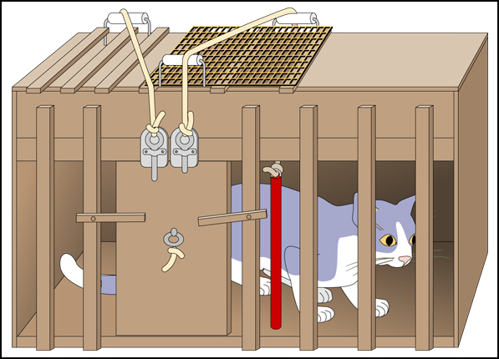
Thorndike’s Puzzle Box

Slide 19
Thorndike
Law of Effect: If a response is followed by a reward, it will be strengthened. If a response is followed by a punishment (or no reward), it will be weakened.

Slide 20
B. F. Skinner
Two Types of Reinforcement (increases behavior)
  Positive: when a response produces something; EX- rat presses lever to get food pellet
  Negative: when a response removes something; EX-people take aspirin to get rid of a headache
NEGATIVE REINFORCMENT IS NOT PUNISHMENT!!!

Slide 21
Punishment
Two Types of Punishment (decreases behavior)
  Positive: addition of something decreases behavior; EX-spanking that decreases child’s behavior
  Negative: take something away that decreases behavior; EX-removal of TV privileges to stop behavior

Slide 22
Terms to Remember
Primary Reinforcer: stimulus is naturally reinforcing because it satisfies a physiological need; EX- food
Primary Punisher: stimulus is inherently punishing; EX- pain
Secondary/Conditioned Reinforcer: learned reinforcers associated with other reinforcers; EX-money & gold stars for first graders
Secondary/Conditioned Punisher:
learned punishers associated with other punishers; EX-frown

Slide 23
Schedules of Reinforcement
Continuous: every time desired response occurs, it is reinforced
Fixed-Ratio: after a predetermined number of responses, reinforcement is given
Variable Ratio: reinforcement occurs after some average number of trials; cannot predict
Fixed Interval: reinforcement after specified time has elapsed
Variable Interval: reinforcement after average time interval has elapsed

Slide 24
Effects of Schedules
Partial or Intermittent Reinforcement Effect: partial reinforcement schedules lead to longest-lasting learning

Slide 25
Applications of Operant Conditioning
Behavior Modification (e.g., Autism)
  Shaping: reinforce behavior that is similar to desired response
Animal Training
  Chaining: reinforce each step in complex behavior until entire sequence is performed
Token Economies
A word about Superstition: coincidental reinforcement

Slide 26
Outline: Sensory Processes
Sensation and Perception
Psychophysics
  Thresholds
  Weber’s Law
The Senses

Slide 27
Terms to Remember
Sensation: the registration of the physical properties of the stimuli that we encounter
Perception: our psychological interpretations of these stimuli
Psychophysics: field of psychology that investigates the relationship between sensory experience and physical properties of stimuli

Slide 28
Psychophysics
Two Types of Sensory Thresholds
  Absolute: smallest amount of energy a person can detect; strenth of the signal you can detect 50% of the time
    Signal Detection Theory
  Difference: smallest difference in stimulation that can be detected when two things are compared
    Just Noticeable Difference- difference threshold from perspective of observer
    Weber’s Law: change necessary to produce JND is constant proportion of intensity of original stimulus

Slide 29
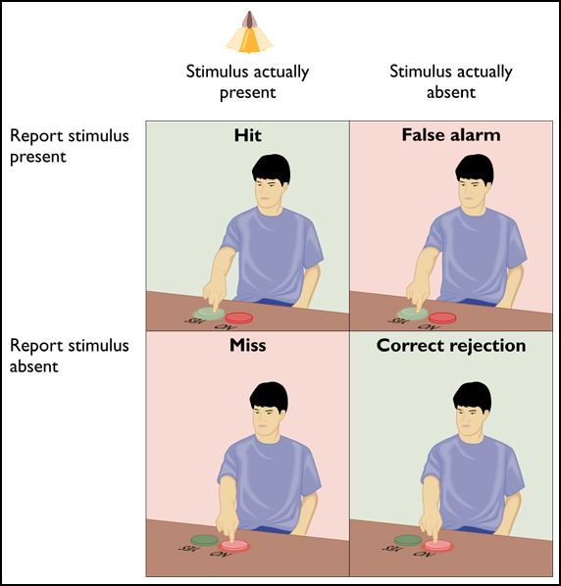
Signal Detection Theory
(Figure 4.34)

Slide 30
The Senses
Vestibular Senses: tells us about bodily orientation with respect to gravity
  Adaptation- less sensitive to continuously presented stimuli
Kinesthetic Senses: tells us about bodily orientation with respect to rest of body
Cutaneous/Skin Senses: touch, pressure, cold, warmth, pain

Slide 31
Senses Con’t
Taste/ Gustation: Chemical substance of food interacts with receptors on tongue (taste buds)
  % types of taste receptors (sweet, salty, bitter, sour, umami)
Smell/ Olfaction: Chemical substances in air interact with receptors in olfactory epithelium

Slide 32
Hearing/Audition
Stimulus: Sound waves moving through air or other substance that stimulate auditory receptors in ears
Three Characteristics of Sound Waves:
  Amplitude = Loudness; intensity measured in db (decibels)
  Frequency = Pitch; how rapidly air vibrates causes change in highness or lowness of sound; measured in Hz (Hertz)
  Complexity = Timbre; complexity of the wave allows us to discriminate between different sources of sound

Slide 33
Seeing/Vision
Vision is dominant sense in humans
Anatomy of the eye (Figure 4.2):
  Cornea: clear covering of eye
  Pupil: opening in the eye
  Iris: colored portion of eye; muscles vary size of pupil
  Lens: focuses light
  Retina: Light sensitive region of eye where photoreceptors dwell
    Cones- day vision & color, concentrated in fovea
    Rods- night vision and achromatic vision

Slide 34
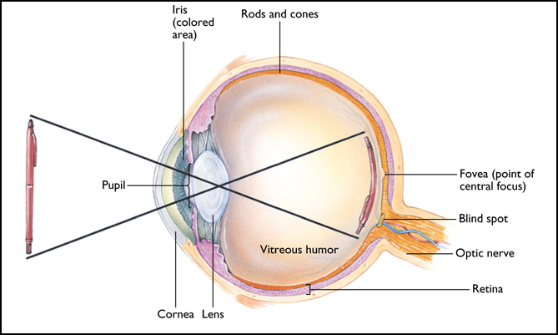

Slide 35
Characteristics of Light (Electromagnetic Waves)
Hue- color we perceive is related to wavelength (see Figure 4.1)
  Colorblindness- difficulty distinguishing 1 color from another
Brightness- intensity or amount of light you see
Saturation- vividness or purity of color

Slide 36
Outline: Perception
Definition of Perception
  Sensation vs. Perception
Functions of Perception
Depth Cues
  Binocular
  Monocular
Object Identification
Gestalt Psychology

Slide 37
Reminder!!!
Reading Report #1 – Due 3/2
To get an “A”
  Read the article – include entire reference on top of paper
  Summarize – one page, single spaced, size 12 (500-600 words)
    What is the purpose of the article?
    What is the problem being studied?
    What methodology was used?
    How was the problem investigated?
    What were the results?
    Do you have any Comments?
  Look at sample report on WebCT

Slide 38
Perception: A Definition
Perception involves converting neural impulses from the sensory systems into higher-order brain processes that interpret the sensory stimulation that is meaningful to the observer.

Slide 39
Sensation versus Perception
Perception: The process in which the brain organizes and interprets sensory information
Sensation vs. Perception
Sensation = the registration of physical characteristics of stimuli
Perception = our interpretation of that stimuli

Slide 40
Why do we need it?
It does 3 things:
  It selects the sensations that we pay attention to.
  It organizes the sensations into patterns and shapes.
  It interprets the sensations to help us explain and make judgments about the world (creates meaning).
We use it to answer:
  Where is it?
    Depth perception
  Where is it going?
    Movement & events
  What is it?
    Object identification

Slide 41
Depth Perception
Depth cues – features of the stimuli that indicate how far an object is from the observer, or from other objects in the world.
Two Types:
  Binocular – requires both eyes to see the cue; used for viewing objects that are close
  Monocular – only requires one eye; used for objects farther away

Slide 42
Binocular Depth Cues
Binocular Disparity – the eyes are 2.5 inches apart, so each eye sees a slightly different view of the same object
    Helps determine how far away the object is from you.
Convergence – As you focus on an object coming towards you, your eyes will turn inward slightly
    Helps determine how close an object is, compared to other objects in the visual field.

Slide 43

Monocular Depth Cues
Interposition/Occlusion
One object partially covers another because it’s closer to you.

Slide 44

Monocular Depth Cues
Linear Perspective
When two lines (which we know are parallel) seem to be converging

Slide 45

Monocular Depth Cues
Texture Gradient
At greater distances, the texture (or details) of the scene are packed together, telling us that objects in the distance are farther away.

Slide 46

Monocular Depth Cues
Relative Size
When looking at two objects, the larger object will appear to be closer

Slide 47
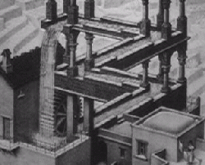
Impossible Figure

Slide 48
Perception of Movement
Induced/Apparent movement
Incorrectly perceiving that an object is moving, when it’s actually the background (or surrounding objects) that are moving.
  Example: Clouds crossing over the moon

Slide 49
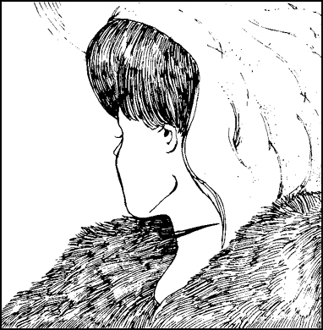
Object Identification
Form perception – we perceive objects as the individual parts, plus the relationship between the parts.
Reversible Figures – objects that can be perceived in more than one way.

Slide 50
Gestalt Psychology
Gestalt Psychology: A field of Psychology that focuses on our ability to perceive overall patterns.
Slogan: “The whole is different from the sum of its parts.”
  Visual perception is an active creation, not just the adding up of lines, dots, and other pieces.
  Objects cannot be broken down into the component parts, without losing identity
    Example: Music notes vs. the entire melody

Slide 51
Gestalt Laws of Grouping
Proximity – objects close together are perceived to be in the same group.
Similarity – objects that look similar (shape, color, size, etc.) are grouped together.
Continuation – We tend to fill in the gaps when lines are interrupted
Closure – When a familiar object is interrupted, we imagine the rest of the figure.

Slide 52

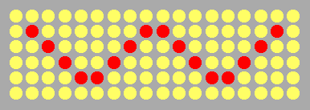
Proximity Similarity

Slide 53


Continuation Closure

Slide 54
Four Perceptual Constancies
Shape Constancy – we perceive things to be the same shape even though we look at it from different angles.
Size Constancy – we perceive an object to still be the same size, even though it’s coming closer to you and projecting a larger retinal image.
Location Constancy – we perceive things as staying in the same place, even as we move around relative to the object.
Color Constancy – we see an object as the same color even when the actual wavelengths hitting our retina changes.

Slide 55
Perceptual Expectation
Perceptual cues help us perceive reality. But, sometimes these cues can fool us.
Visual/Optical Illusions are misleading perceptions of reality – a sensation that is interpreted incorrectly
    Usually occur when the perception principles are extended, or used in areas where they don’t apply

Slide 56
Outline: Memory I
Definition of memory
Three Basic Processes
  Encoding
  Storage
  Retrieval
Multi-Store Model
  Sensory memory
  STM
  LTM
    Types of memory

Slide 57
What is memory?
“The persistence of information over time”
The study of memory focuses on 3 things:
  How do we get information?
  What do we do with it? (Where does it go?)
  How do we retrieve it later?

Slide 58
Three Basic Processes
(Failure of any one leads to forgetting)
Encoding/Acquisition – converting external information into a neural code that your brain can understand.
Storage/Retention – encoded data is stored until we need it again.
Retrieval – getting the information we stored back out

Slide 59
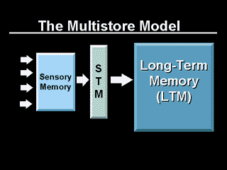
Multi-Store Model
3 separate mental processes interact to effectively store data.
This interaction provides a smooth transition from one level of processing to the next.

Slide 60
Sensory Memory
All incoming sensory data must pass through our sensory memory (filter).
Each sense holds an exact copy of the information for a brief period of time (1-2 seconds)
  Visual or “Iconic”
  Auditory or “Echoic”
This allows us to pick out the important stuff

Slide 61
Short Term Memory (STM)
Also called “Working” memory
  What is currently active
  Limited capacity (7+/-2)
  Maintain data (unrehearsed) about 30 sec
  Encoded information
  Can also be data from long term memory
How do we keep the data longer?
  Maintenance rehearsal or “rote repeating”

Slide 62
Long Term Memory (LTM)
LTM: Long term retention of data
  Unlimited Storage Capacity
  Relatively permanent
  Recall is dependant on how data was encoded
  Data is organized into patterns
  New data is added periodically
Two types of info stored in LTM:
  Declarative memories
  Procedural memories

Slide 63
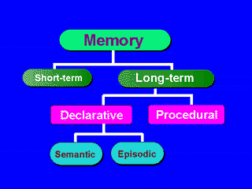
Components of LTM

Slide 64
Components of LTM
Declarative memory – knowing about things; facts of information
  Trivial Pursuit
Procedural memory – knowing how to do things; procedures
  How to drive a car

Slide 65
2 Types of Declarative Memory
Episodic – detailed memories from personal experiences or events
  High school graduation
Semantic – memories of general knowledge (facts, concepts, etc.)
  Semantic = meaning

