Slide 1
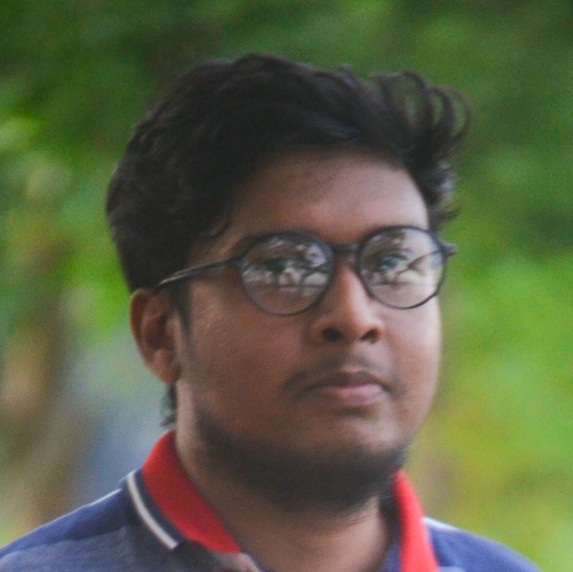



About me
I am a person who is positive about every aspect of life. There are many things I would like to do, to see and to experience. I tend to be calm, confident and will make my presence felt whatever I do.
Education
2023
BSc. Engineering (Pursuing)
Dhaka University of Engineering & Technology
Md Yamin
Gazipur
Department: CSE
2017
Diploma in Engineering
Munshiganj Polytechnic Institute
Proficiency Skills
Munshiganj
Department: Computer Technology
CGPA: 3.51
Cyber Sec
Achievements
Algorithms
Linux
2020
HULT Prize at DUET
2nd runner up
MS Office
Team: DUET FoodRangers
Professional Skills
2019
DUET TECHFEST 2K19
2nd runner up
JavaScript
ICT Olympiad
Projects
Python
C/C++
2020
eClassroom
Database Designer
Personal Skills
It is an android app where you can get your class routine and class materials easily.
Team Work
Contact
Creativity
Networking
mdyamin007@yahoo.vom
Leadership
+8801915395544
Jatrabari, Dhaka

