Slide 1

Course – Computer Organization and Architecture

Slide 2
Unit-5
Basic Processing Unit: Some Fundamental Concepts, Fundamental Concepts, Instruction Execution, Hardware Components, Instruction Fetch and Execution Steps, Control Signals, Hardwired Control
Parallel Computer Architecture: Processor Architecture and Technology Trends, Flynn’s Taxonomy of Parallel Architectures, Memory Organization of Parallel Computers: Computers with Distributed Memory Organization, Computers with Shared Memory organization, Thread-Level Parallelism: Simultaneous Multithreading, Multicore Processors

Slide 3
Basic Processing Unit
Some Fundamental Concepts,
Fundamental Concepts,
Instruction Execution,
Hardware Components,
Instruction Fetch and Execution Steps,
Control Signals,
Hardwired Control

Slide 4
Fundamental Concepts
Processor fetches one instruction at a time and perform the operation specified.
Instructions are fetched from successive memory locations until a branch or a jump instruction is encountered.
Processor keeps track of the address of the memory location containing the next instruction to be fetched using Program Counter (PC).
When an instruction is fetched, it is placed in the Instruction Register (IR), from where it is interpreted or decoded by the processor’s control circuitry. The IR holds the instruction until its execution is completed.

Slide 5
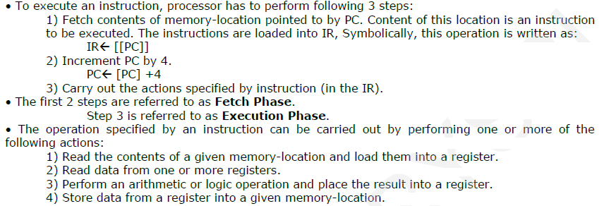
Fundamental Concepts

Slide 6
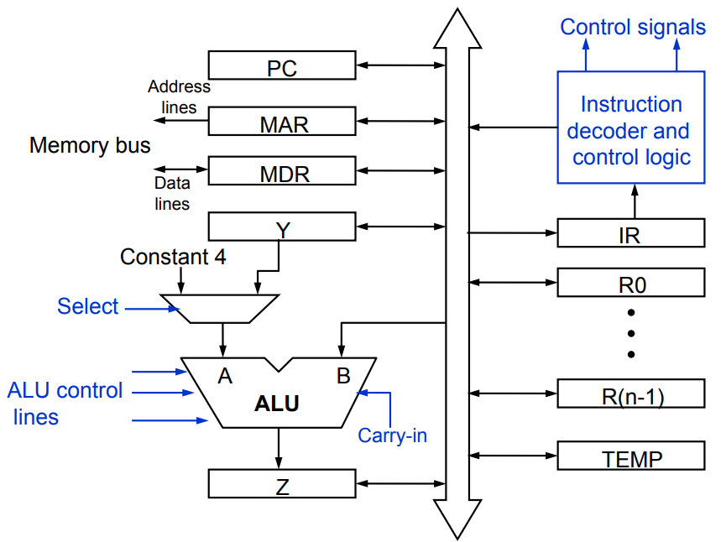
Single-Bus Organization of the Datapath inside processor
Internal
Processor Bus
MUX

Slide 7
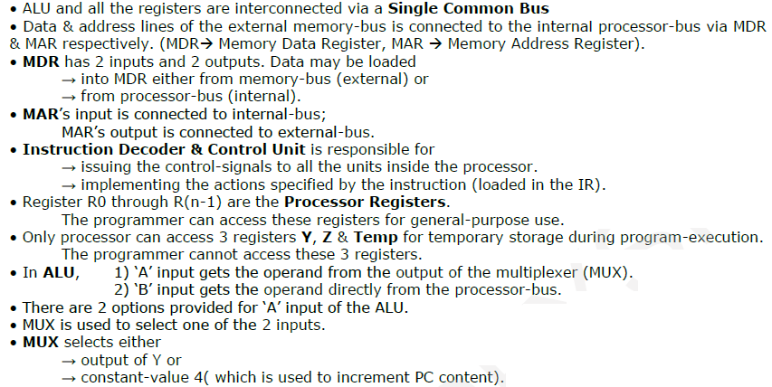
Single-Bus Organization of the Datapath inside processor

Slide 8
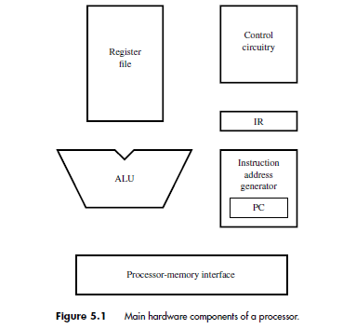
Main Hardware Components of a Processor
The processor communicates with the memory through the processor-memory interface, which transfers data from and to the memory during Read and Write operations.
The instruction address generator updates the contents of the PC after every instruction is fetched.
The register file is a memory unit whose storage locations are organized to form the processor’s general-purpose registers.
During execution, the contents of the registers named in an instruction that performs an arithmetic or logic operation are sent to the arithmetic and logic unit (ALU), which performs the required computation.
The results of the computation are stored in a register in the register file.

Slide 9
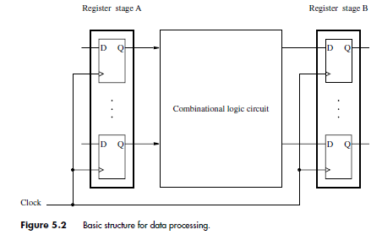
Data Processing Hardware
Data is stored in registers. These data are processed by combinational circuits, such as adders, and the results are placed into a register. Figure 5.2 illustrates this structure.
A clock signal is used to control the timing of data transfers.
The registers comprise edge-triggered flip-flops into which new data are loaded at the active edge of the clock.
We assume that the rising edge of the clock is the active edge. The clock period, which is the time between two successive rising edges, must be long enough to allow the combinational circuit to produce the correct result.

Slide 10
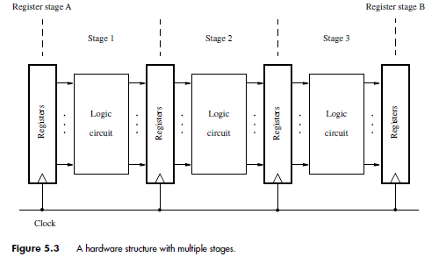
Data Processing Hardware
The operation performed by the combinational block in Figure 5.2 may be quite complex. It can often be broken down into several simpler steps, where each step is performed by a subcircuit of the original circuit.
These subcircuits can then be cascaded into a multistage structure as shown in Figure 5.3.
Then, if n stages are used, the operation will be completed in n clock cycles.
Since these combinational subcircuits are smaller, they can complete their operation in less time, and hence a shorter clock period can be used.
A key advantage of the multi-stage structure is that it is suitable for pipelined operation. Such a structure is particularly useful for implementing processors that have a RISC-style instruction set.

Slide 11
Instruction execution
We examine the actions involved in fetching and executing instructions. We illustrate these actions using a few representative RISC-style instructions.
Load Instructions
Arithmetic and Logic Instructions
Store Instructions

Slide 12
Load Instructions
Consider the instruction
Load R5, X(R7)
which uses the Index addressing mode to load a word of data from memory location X +[R7] into register R5.
Execution of this instruction involves the following actions: ??

Slide 13
Load Instructions
Consider the instruction
Load R5, X(R7)
which uses the Index addressing mode to load a word of data from memory location X +[R7] into register R5.
Execution of this instruction involves the following actions:
• Fetch the instruction from the memory.
• Increment the program counter.
• Decode the instruction to determine the operation to be performed.
• Read register R7.
• Add the immediate value X to the contents of R7.
• Use the sum X + [R7] as the effective address of the source operand, and read the contents of that location in the memory.
• Load the data received from the memory into the destination register, R5.

Slide 14
Load Instructions
Consider the instruction
Load R5, X(R7)
We will assume that the processor has five hardware stages, which is a commonly used arrangement in RISC-style processors.
Execution of each instruction is divided into five steps, such that each step is carried out by one hardware stage.
In this case, fetching and executing the Load instruction above can be completed as follows:
1. Fetch the instruction and increment the program counter.
2. Decode the instruction and read the contents of register R7 in the register file.
3. Compute the effective address.
4. Read the memory source operand.
5. Load the operand into the destination register, R5.

Slide 15
Arithmetic and Logic Instructions
Instructions that involve an arithmetic or logic operation can be executed using similar steps.
They differ from the Load instruction in two ways:
• There are either two source registers, or a source register and an immediate source operand.
• No access to memory operands is required.
A typical instruction of this type is
Add R3, R4, R5
It requires the following steps:
1. Fetch the instruction and increment the program counter.
2. Decode the instruction and read the contents of source registers R4 and R5.
3. Compute the sum [R4] + [R5].
4. Load the result into the destination register, R3.

Slide 16
Arithmetic and Logic Instructions
It is advantageous to use the same multistage processing hardware for as many instructions as possible.This can be achieved if we arrange for all instructions to be executed in the same number of steps.
To this end, the Add instruction should be extended to five steps, patterned along the steps of the Load instruction. Since no access to memory operands is required, we can insert a step in which no action takes place between steps 3 and 4 above.
The Add instruction would then be performed as follows:
1. Fetch the instruction and increment the program counter.
2. Decode the instruction and read registers R4 and R5.
3. Compute the sum [R4] + [R5].
4. No action.
5. Load the result into the destination register, R3.

Slide 17
Arithmetic and Logic Instructions
If the instruction uses an immediate operand, as in
Add R3, R4, #1000
the immediate value is given in the instruction word.
Once the instruction is loaded into the IR, the immediate value is available for use in the addition operation.
The same five-step sequence can be used, with steps 2 and 3 modified as:
2. Decode the instruction and read register R4.
3. Compute the sum [R4] + 1000.

Slide 18
Store Instructions
The five-step sequence used for the Load and Add instructions is also suitable for Store instructions, except that the final step of loading the result into a destination register is not required. The hardware stage responsible for this step takes no action.
For example, the instruction
Store R6, X(R8)
stores the contents of register R6 into memory location X + [R8]. It can be implemented as follows:
1. Fetch the instruction and increment the program counter.
2. Decode the instruction and read registers R6 and R8.
3. Compute the effective address X + [R8].
4. Store the contents of register R6 into memory location X + [R8].
5. No action.

Slide 19
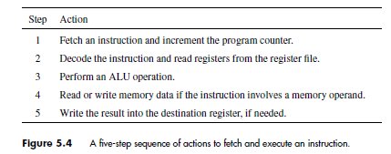
In summary, the five-step sequence of actions given in Figure 5.4 is suitable for all instructions in a RISC-style instruction set.
RISC-style instructions are one word long and only Load and Store instructions access operands in the memory.

Slide 20
Hardware Components
All instructions of a RISC-style processor can be executed using the five-step sequence in Figure 5.4.
Hence, the processor hardware may be organized in five stages, such that each stage performs the actions needed in one of the steps.
We now examine the components in Figure 5.1 to see how they may be organized in the multi-stage structure of Figure 5.3.

Slide 21
Register File
General-purpose registers are usually implemented in the form of a register file, which is a small and fast memory block.
It consists of an array of storage elements, with access circuitry that enables data to be read from or written into any register. The access circuitry is designed to enable two registers to be read at the same time, making their contents available at two separate outputs, A and B.
The register file has two address inputs that select the two registers to be read. These inputs are connected to the fields in the IR that specify the source registers, so that the required registers can be read.
The register file also has a data input, C, and a corresponding address input to select the register into which data are to be written. This address input is connected to the IR field that specifies the destination register of the instruction.

Slide 22
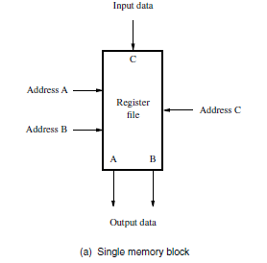
Register File
The inputs and outputs of any memory unit are often called input and output ports.
A memory unit that has two output ports is said to be dual-ported. Figure 5.5 shows two ways of realizing a dual-ported register file.
One possibility is to use a single set of registers with duplicate data paths and access circuitry that enable two registers to be read at the same time.

Slide 23
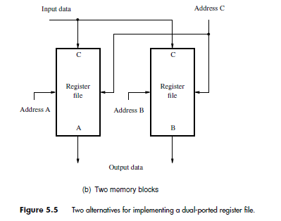
An alternative is to use two memory blocks, each containing one copy of the register file. Whenever data are written into a register, they are written into both copies of that register.
Thus, the two files have identical contents.
When an instruction requires data from two registers, one register is accessed in each file. In effect, the two register files together function as a single dual-ported register file.

Slide 24
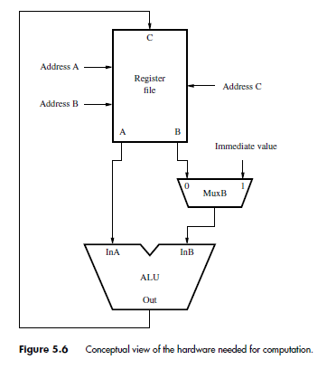
ALU
The arithmetic and logic unit is used to manipulate data.
It performs arithmetic operations such as addition and subtraction, and logic operations such as AND, OR, and XOR.
Conceptually, the register file and the ALU may be connected as shown in Figure 5.6.

Slide 25
ALU
When an instruction that performs an arithmetic or logic operation is being executed, the contents of the two registers specified in the instruction are read from the register file and become available at outputs A and B.
Output A is connected directly to the first input of the ALU, InA, and output B is connected to a multiplexer, MuxB.
The multiplexer selects either output B of the register file or the immediate value in the IR to be connected to the second ALU input, InB.
The output of the ALU is connected to the data input, C, of the register file so that the results of a computation can be loaded into the destination register.

Slide 26
Datapath
It is convenient to divide the processor hardware into two corresponding sections.
One section fetches instructions and the other executes them.
The section that fetches instructions is also responsible for decoding them and for generating the control signals that cause appropriate actions to take place in the execution section.
The execution section reads the data operands specified in an instruction, performs the required computations, and stores the results.
We now need to organize the hardware into a multi-stage structure with stages corresponding to the five steps in Figure 5.4. A possible structure is shown in Figure 5.7.

Slide 27
Datapath
The actions taken in each of the five stages are completed in one clock cycle.
Stage 1: An instruction is fetched in step 1 by hardware and placed into the IR.
It is decoded, and its source registers are read in step 2.
The information in the IR is used to generate the control signals for all subsequent steps. Therefore, the IR must continue to hold the instruction until its execution is completed.
It is necessary to insert registers between stages. Inter-stage registers hold the results produced in one stage so that they can be used as inputs to the next stage during the next clock cycle.

Slide 28
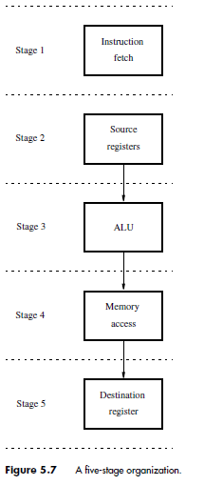
Datapath

Slide 29
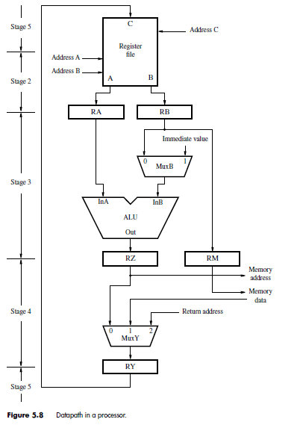
Datapath
The hardware in the figure is often referred to as the datapath.
This leads to the organization in Figure 5.8.
It corresponds to stages 2 to 5 in Figure 5.7.

Slide 30
Datapath
Stage 2: Data read from the register file are placed in registers RA and RB. Register RA provides the data to input InA of the ALU.
Multiplexer MuxB forwards either the contents of RB or the immediate value in the IR to the ALU’s second input, InB.
Stage 3: The ALU constitutes stage 3, and the result of the computation it performs is placed in register RZ.
Stage 5: Recall that for computational instructions, such as an Add instruction, no processing actions take place in step 4. During that step, multiplexer MuxY in Figure 5.8 selects register RZ to transfer the result of the computation to RY. The contents of RY are transferred to the register file in step 5 and loaded into the destination register.
For this reason, the register file is in both stages 2 and 5. It is a part of stage 2 because it contains the source registers and a part of stage 5 because it contains the destination register.
Stage 4: For Load and Store instructions, the effective address of the memory operand is computed by the ALU in step 3 and loaded into register RZ. From there, it is sent to the memory, which is stage 4. Since memory access is done in stage 4, another inter-stage register is needed to maintain correct data flow in the multi-stage structure. Register RM is introduced for this purpose. The data to be stored are moved from RB to RM in step 3, and from there to the memory in step 4. No action is taken in step 5 in this case.
In the case of a Load instruction, the data read from the memory are selected by multiplexer MuxY and placed in register RY, to be transferred to the register file in the next clock cycle. For a Store instruction, data are read from the register file, which is part of stage 2, and placed in register RB

Slide 31
Datapath
The subroutine call instructions saves the return address in a general-purpose register, which we call LINK for ease of reference.
Similarly, interrupt processing requires a return address to be saved. Assume that another general-purpose register, IRA, is used for this purpose.
Both of these actions require the contents of the program counter to be sent to the register file.
For this reason, multiplexer MuxY has a third input through which the return address can be routed to register RY, from where it can be sent to the register file. The return address is produced by the instruction address generator.

Slide 32
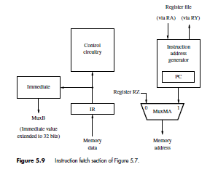
Instruction Fetch Section
The organization of the instruction fetch section of the processor is illustrated in Figure 5.9.
The addresses used to access the memory come from the PC when fetching instructions and from register RZ in the datapath when accessing instruction operands.
Multiplexer MuxMA selects one of these two sources to be sent to the processor-memory interface.
The PC is included in a larger block, the instruction address generator, which updates the contents of the PC after each instruction is fetched.
The instruction read from the memory is loaded into the IR, where it stays until its execution is completed and the next instruction is fetched.

Slide 33
Instruction Fetch Section
The contents of the IR are examined by the control circuitry to generate the signals needed to control all the processor’s hardware.
They are also used by the block labelled Immediate. An immediate value may be included in some instructions. A 16-bit immediate value is extended to 32 bits.
The extended value is then used either directly as an operand or to compute the effective address of an operand.
The Immediate block in Figure 5.9 generates the extended value and forwards it to MuxB in Figure 5.8 to be used in an ALU computation. It also generates the extended value to be used in computing the target address of branch instructions.
Notes:
loaded into the PC when executing branch and subroutine call instructions. One adder input
is connected to the PC. The second input is connected to a multiplexer, MuxINC, which
selects either the constant 4 or the branch offset to be added to the PC. The branch offset is
given in the immediate field of the IR and is sign-extended to 32 bits by the Immediate block
in Figure 5.9. The output of the adder is routed to the PC via a second multiplexer, MuxPC,
which selects between the adder and the output of register RA. The latter connection is
needed when executing subroutine linkage instructions. Register PC-Temp is needed to
hold the contents of the PC temporarily during the process of saving the subroutine or
interrupt return address.

Slide 34
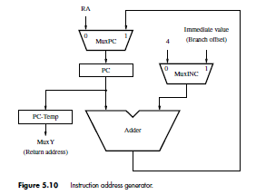
Instruction Fetch Section
The address generator circuit is shown in Figure 5.10.
An adder is used to increment the PC by 4 during straight-line execution. It is also used to compute a new value to be loaded into the PC when executing branch and subroutine call instructions.
One adder input is connected to the PC. The second input is connected to a multiplexer, MuxINC, which selects either the constant 4 or the branch offset to be added to the PC.
The branch offset is given in the immediate field of the IR and is sign-extended to 32 bits by the Immediate block in Figure 5.9.
The output of the adder is routed to the PC via a second multiplexer, MuxPC, which selects between the adder and the output of register RA. The latter connection is needed when executing subroutine linkage instructions. Register PC-Temp is needed to hold the contents of the PC temporarily during the process of saving the subroutine or interrupt return address.

Slide 35
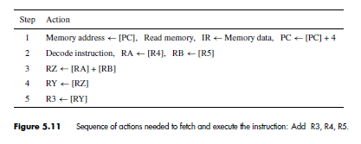
Instruction Fetch and Execution Steps
Consider again the instruction
Add R3, R4, R5
The steps for fetching and executing this instruction are given in Figure 5.11.

Slide 36
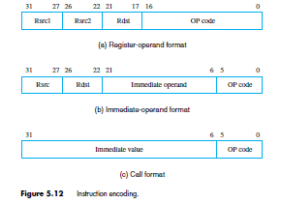
Instruction Fetch and Execution Steps
Add R3, R4, R5
Assume that the instruction is encoded as shown in Fig 5.12.
After the instruction has been fetched from the memory and placed in the IR, the source register addresses are available in fields IR31−27 and IR26−22.

Slide 37
Instruction Fetch and Execution Steps
These two fields are connected to the address inputs for ports A and B of the register file. As a result, registers R4 and R5 are read and their contents placed in registers RA and RB, respectively, at the end of step 2.
In the next step, the control circuitry sets MuxB to select input 0, thus connecting register RB to input InB of the ALU.
At the same time, it causes the ALU to perform an addition operation. Since register RA is connected to input InA, the ALU produces the required sum [RA] + [RB], which is loaded into register RZ at the end of step 3.

Slide 38
Instruction Fetch and Execution Steps
In step 4, multiplexer MuxY selects input 0, thus causing the contents of RZ to be transferred to RY.
The control circuitry connects the destination address field of the Add instruction, IR21−17, to the address input for port C of the register file.
In step 5, it issues a Write command to the register file, causing the contents of register RY to be written into register R3.

Slide 39
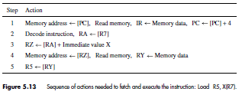
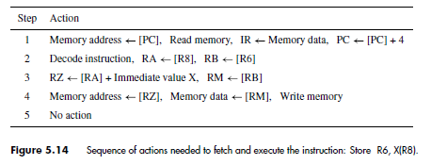
Instruction Fetch and Execution Steps
Load (Load R5,X(R7) and Store (Store R6,X(R8)) instructions are executed in a similar manner.
In this case, the address of the destination register is given in bit field IR26−22. The control hardware connects this field to the address input corresponding to input C of the register file.
The steps involved in executing these instructions are given in Figures 5.13 and 5.14.
In both examples, the memory address is specified using the Index mode, in which the index value X is given as an immediate value in the instruction. The immediate field of IR, extended as appropriate by the Immediate block in Figure 5.9, is selected by MuxB in step 3 and added to the contents of register RA. The resulting sum is the effective address of the operand.
Notes:
Note that the actions described in Figures 5.11, 5.13, and 5.14 do not show two registers
being read in step 2 in every case. To avoid confusion, only the registers needed by the
specific instruction described in the figure are mentioned, even though two registers are
always read.

Slide 40
Instruction Fetch and Execution Steps
In the discussion above, we assumed that memory Read and Write operations can be completed in one clock cycle. Is this a realistic assumption?
In general, accessing the main memory of a computer takes significantly longer than reading the contents of a register in the register file. However, most modern processors use cache memories which is much faster than the main memory.
It is usually implemented on the same chip as the processor, making it about as fast as the register file.
Thus, a memory Read or Write operation can be completed in one clock cycle when the data involved are available in the cache.
When the operation requires access to the main memory, the processor must wait for that operation to be completed.

Slide 41
Instruction Fetch and Execution Steps
We also assumed that the processor reads the source registers of the instruction in step 2, while it is still decoding the OP code of the instruction that has just been loaded into the IR.
Can these two tasks be completed in the same step? How can the control hardware know which registers to read before it completes decoding the instruction?
This is possible because source register addresses are specified using the same bit positions in all instructions.
The hardware reads the registers whose addresses are in these bit positions once the instruction is loaded into the IR.
Their contents are loaded into registers RA and RB at the end of step 2.
If these data are needed by the instruction, they will be available for use in step 3. If not, they will be ignored by subsequent hardware stages.

Slide 42
Branching
Instructions are fetched from sequential word locations in the memory during straight-line program execution. Whenever an instruction is fetched, the processor increments the PC by 4 to point to the next word.
This execution pattern continues until a branch or subroutine call instruction loads a new address into the PC.
Subroutine call instructions also save the return address, to be used when returning to the calling program.
In this section we examine the actions needed to implement these instructions.
Interrupts from I/O devices and software interrupt instructions are handled in a similar manner.
Branch instructions specify the branch target address relative to the PC. A branch offset given as an immediate value in the instruction is added to the current contents of the PC.
The number of bits used for this offset is considerably less than the word length of the computer, because space is needed within the instruction to specify the OP code and the branch condition.
Hence, the range of addresses that can be reached by a branch instruction is limited.

Slide 43
Branching
Subroutine call instructions can reach a larger range of addresses. Because they do not include a condition, more bits are available to specify the target address.
Also, most RISC-style computers have Jump and Call instructions that use a general-purpose register to specify a full 32-bit address.
The details vary from one computer to another.

Slide 44
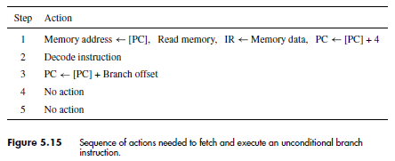
Branch Instructions
The sequence of steps for implementing an unconditional branch instruction is given in Figure 5.15.
The instruction is fetched and the PC is incremented as usual in step 1.
After the instruction has been decoded in step 2, multiplexer MuxINC selects the branch offset in the IR to be added to the PC in step 3.
This is the address that will be used to fetch the next instruction.
Execution of a Branch instruction is completed in step 3. No action is taken in steps 4 and 5.
The branch offset is the distance between the branch target and the memory location following the branch instruction.
The reason for this can be seen clearly in Figure 5.15. The PC is incremented by 4 in step 1, at the time the branch instruction is fetched.
Then, the branch target address is computed in step 3 by adding the branch offset to the updated contents of the PC.

Slide 45
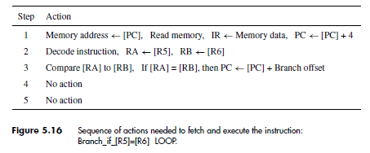
Branch Instructions
The sequence in Figure 5.15 can be readily modified to implement conditional branch instructions.
In processors that do not use condition-code flags, the branch instruction specifies a compare-and-test operation that determines the branch condition.
For example, the instruction
Branch_if_[R5]=[R6] LOOP
results in a branch if the contents of registers R5 and R6 are identical.
When this instruction is executed, the register contents are compared, and if they are equal, a branch is made to location LOOP.
Figure 5.16 shows how this instruction may be executed.

Slide 46
Branch Instructions
Registers R5 and R6 are read in step 2, as usual, and compared in step 3.
The comparison could be done by performing the subtraction operation [R5] − [R6] in the ALU.
The ALU generates signals that indicate whether the result of the subtraction is positive, negative, or zero.
The ALU may also generate signals to show whether arithmetic overflow has occurred and whether the operation produced a carry-out.
The control circuitry examines these signals to test the condition given in the branch instruction.

Slide 47
Branch Instructions
In the example above, it checks whether the result of the subtraction is equal to zero.
If it is, the branch target address is loaded into the PC, to be used to fetch the next instruction.
Otherwise, the contents of the PC remain at the incremented value computed in step 1, and straight-line execution continues.
According to the sequence of steps in Figure 5.16, the two actions of comparing the register contents and testing the result are both carried out in step 3.
Hence, the clock cycle must be long enough for the two actions to be completed, one after the other. For this reason, it is desirable that the comparison be done as quickly as possible.

Slide 48
Branch Instructions
A subtraction operation in the ALU is time consuming, and is not needed in this case.
A simpler and faster comparator circuit can examine the contents of registers RA and RB and produce the required condition signals, which indicate the conditions greater than, equal, less than, etc.
A comparator is not shown separately in Figure 5.8 as it can be a part of the ALU block.

Slide 49
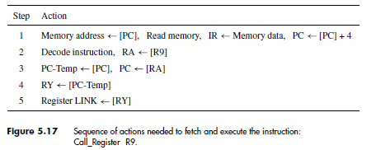
Subroutine Call Instructions
Subroutine calls and returns are implemented in a similar manner to branch instructions.
The address of the subroutine may either be computed using an immediate value given in the instruction or it may be given in full in one of the general-purpose registers. Figure 5.17 gives the sequence of actions for the instruction
Call_Register R9
which calls a subroutine whose address is in register R9.
The contents of that register are read and placed in RA in step 2.
During step 3, multiplexer MuxPC selects its 0 input, thus transferring the data in register RA to be loaded into the PC.

Slide 50
Subroutine Call Instructions
Assume that the return address of the subroutine, which is the previous contents of the PC, is to be saved in a general-purpose register called LINK in the register file.
Data are written into the register file in step 5. Hence, it is not possible to send the return address directly to the register file in step 3.
To maintain correct data flow in the five-stage structure, the processor saves the return address in a temporary register, PC-Temp.
From there, the return address is transferred to register RY in step 4, then to register LINK in step 5.

Slide 51
Subroutine Call Instructions
The address LINK is built into the control circuitry.
Subroutine return instructions transfer the value saved in register LINK back to the PC.
The encoding of the Return-from-subroutine instruction is such that the address of register LINK appears in bits IR31−27.
This is the field connected to Address A of the register file.
Hence, once the instruction is fetched, register LINK is read and its contents are placed in RA, from where they can be transferred to the PC via MuxPC in Figure 5.10.
Return-from interrupt instructions are handled in a similar manner, except that a different register is used to hold the return address.

Slide 52
Waiting for Memory
The role of the processor-memory interface circuit is to control data transfers between the processor and the memory.
We pointed out earlier that modern processors use fast, on-chip cache memories.
Most of the time, the instruction or data referenced in memory Read and Write operations are found in the cache, in which case the operation is completed in one clock cycle.
When the requested information is not in the cache and has to be fetched from the main memory, several clock cycles may be needed.
The interface circuit must inform the processor’s control circuitry about such situations, to delay subsequent execution steps until the memory operation is completed.
Assume that the processor-memory interface circuit generates a signal called Memory Function Completed (MFC).
It asserts this signal when a requested memory Read or Write operation has been completed.
The processor’s control circuitry checks this signal during any processing step in which it issues a memory Read or Write request, to determine when it can proceed to the next step.

Slide 53
Waiting for Memory
When the requested data are found in the cache, the interface circuit asserts the MFC signal before the end of the same clock cycle in which the memory request is issued. Hence, instruction execution continues uninterrupted.
If access to the main memory is required, the interface circuit delays asserting MFC until the operation is completed.
In this case, the processor’s control circuitry must extend the duration of the execution step for as many clock cycles as needed, until MFC is asserted.
We will use the command Wait for MFC to indicate that a given execution step must be extended, if necessary, until a memory operation is completed. When MFC is received, the actions specified in the step are completed, and the processor proceeds to the next step in the execution sequence.

Slide 54
Waiting for Memory
Step 1 of the execution sequence of any instruction involves fetching the instruction from the memory.
Therefore, it must include a Wait for MFC command, as follows:
Memory address←[PC], Read memory, Wait for MFC,
IR←Memory data, PC←[PC] + 4
The Wait for MFC command is also needed in step 4 of Load and Store instructions in Figures 5.13 and 5.14.
Most of the time, the requested information is found in the cache, so the MFC signal is generated quickly, and the step is completed in one clock cycle.
When an access involves the main memory, the MFC response is delayed, and the step is extended to several clock cycles.

Slide 55
Control Signal
The operation of the processor’s hardware components is governed by control signals.
These signals determine which multiplexer input is selected, what operation is performed by the ALU, and so on.
Next we discuss the signals needed to control the operation of the components in Figures 5.8 to 5.10.
It is instructive to begin by recalling how data flow through the four stages of the data path.
In each clock cycle, the results of the actions that take place in one stage are stored in inter-stage registers, to be available for use by the next stage in the next clock cycle.
Since data are transferred from one stage to the next in every clock cycle, inter-stage registers are always enabled. This is the case for registers RA, RB, RZ, RY, RM, and PC-Temp.
The contents of the other registers, namely, the PC, the IR, and the register file, must not be changed in every clock cycle. New data are loaded into these registers only when called for in a particular processing step. They must be enabled only at those times.

Slide 56
Control Signal

Slide 57
Control Signal
The role of the multiplexers is to select the data to be operated on in any given stage.
For example, MuxB in stage 3 of Figure 5.8 selects the immediate field in the IR for instructions that use an immediate source operand. It also selects that field for instructions that use immediate data as an offset when computing the effective address of a memory operand. Otherwise, it selects register RB.
The data selected by the multiplexer are used by the ALU. Examination of Figures 5.11, 5.13, and 5.14 shows that the ALU is used only in step 3, and hence the selection made by MuxB matters only during that step.
To simplify the required control circuit, the same selection can be maintained in all execution steps.
A similar observation can be made about MuxY. However, MuxMA in Figure 5.9 must change its selection in different execution steps. It selects the PC as the source of the memory address during step 1, when a new instruction is being fetched.
During step 4 of Load and Store instructions, it selects register RZ, which contains the effective address of the memory operand.

Slide 58
Control Signal
Figures 5.18, 5.19, and 5.20 show the required control signals.
The register file has three 5-bit address inputs, allowing access to 32 general-purpose registers.
Two of these inputs, Address A and Address B, determine which registers are to be read. They are connected to fields IR31−27 and IR26−22 in the instruction register.
The third address input, Address C, selects the destination register, into which the input data at port C are to be written. Multiplexer MuxC selects the source of that address.
We have assumed that three-register instructions use bits IR21−17 and other instructions use IR26−22 to specify the destination register, as in Fig 5.12.

Slide 59
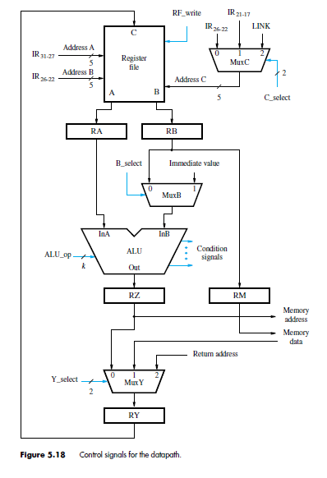
Control Signal

Slide 60
Control Signal
The third input of the multiplexer is the address of the link register used in subroutine linkage instructions. New data are loaded into the selected register only when the control signal RF write is asserted.
Multiplexers are controlled by signals that select which input data appear at the multiplexer’s output. For example, when B select is equal to 0, MuxB selects the contents of register RB to be available at input InB of the ALU.
Note that two bits are needed to control MuxC and MuxY, because each multiplexer selects one of three inputs.
The operation performed by the ALU is determined by a k-bit control code, ALU op, which can specify up to 2k distinct operations, such as Add, Subtract, AND, OR, and XOR.
When an instruction calls for two values to be compared, a comparator performs the comparison. The comparator generates condition signals that indicate the result of the comparison.
These signals are examined by the control circuitry during the execution of conditional branch instructions to determine whether the branch condition is true or false.

Slide 61
Control Signal
The interface between the processor and the memory and the control signals associated with the instruction register are presented in Figure 5.19.
Two signals, MEM_read and MEM_write are used to initiate a memory Read or a memory Write operation.
When the requested operation has been completed, the interface asserts the MFC signal (Memory Fetch Complete).
The instruction register has a control signal, IR_enable, which enables a new instruction to be loaded into the register.
During a fetch step, it must be activated only after the MFC signal is asserted.
We have assumed that the Immediate block handles three possible formats for the immediate value: a sign-extended 16-bit value, a zero-extended 16-bit value, and a 26-bit value that is handled in a special way .
Hence, its control signal, Extend, comprises two bits.

Slide 62
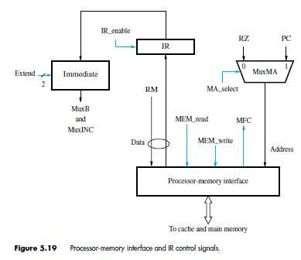
Control Signal
The interface between the processor and the memory and the control signals associated with the instruction register are presented in Fig 5.19.

Slide 63
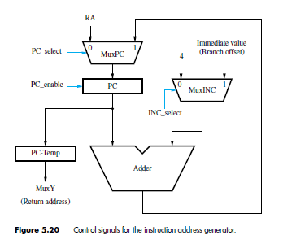
Control Signal
The signals that control the operation of the instruction address generator are shown in Figure 5.20.
The INC select signal selects the value to be added to the PC, either the constant 4 or the branch offset specified in the instruction.
The PC select signal selects either the updated address or the contents of register RA to be loaded into the PC when the PC_enable control signal is activated.

Slide 64
Hardwired Control
We now examine how the processor generates the control signals that cause the fetch and execute actions to take place in the correct sequence and at the right time.
There are two basic approaches: hardwired control and microprogrammed control.
Hardwired control unit is a sequential circuit that generates control signals, which is discussed here.
Microprogrammed control unit is a unit with microinstructions in the control memory to generate control signals.

Slide 65
Hardwired Control
An instruction is executed in a sequence of steps, where each step requires one clock cycle.
Hence, a step counter may be used to keep track of the progress of execution.
Several actions are performed in each step, depending on the instruction being executed.
In some cases, such as for branch instructions, the actions taken depend on tests applied to the result of a computation or a comparison operation.
External signals, such as interrupt requests, may also influence the actions to be performed.
Thus, the setting of the control signals depends on:
• Contents of the step counter
• Contents of the instruction register
• The result of a computation or a comparison operation
• External input signals, such as interrupt requests

Slide 66
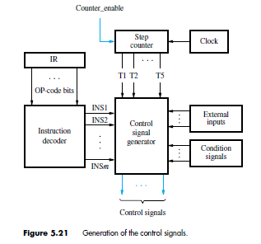
Hardwired Control
The circuitry that generates the control signals may be organized as shown in Figure 5.21.

Slide 67
Hardwired Control
The instruction decoder interprets the OP-code and addressing mode information in the IR and sets to 1 the corresponding INSi output.
During each clock cycle, one of the outputs T1 to T5 of the step counter is set to 1 to indicate which of the five steps involved in fetching and executing instructions is being carried out.
Since all instructions are completed in five steps, a modulo-5 counter may be used.
The control signal generator is a combinational circuit that produces the necessary control signals based on all its inputs.
The required settings of the control signals can be determined from the action sequences that implement each of the instructions represented by the signals INS1 to INSm.

Slide 68
Hardwired Control
As an example, consider step 1 in the instruction execution process. This is the step in which a new instruction is fetched from the memory. It is identified by signal T1 being asserted.

Slide 69
Hardwired Control
During that clock period, the MA_select signal in Figure 5.19 is set to 1 to select the PC as the source of the memory address, and MEM_read is activated to initiate a memory Read operation.
The data received from the memory are loaded into the IR by activating IR_enable when the memory’s response signal, MFC, is asserted.
At the same time, the PC is incremented by 4, by setting the INC_select signal in Figure 5.20 to 0 and PC_select to 1.
The PC_enable signal is activated to cause the new value to be loaded into the PC at the positive edge of the clock marking the end of step T1.

Slide 70
Hardwired Control : Datapath Control Signals
Instructions that handle data include Load, Store, and all computational instructions.
They perform various data movement and manipulation operations using the processor’s datapath, whose control signals are shown in Figures 5.18 and 5.19.
Once an instruction is loaded into the IR, the instruction decoder interprets its contents to determine the actions needed.
At the same time, the source registers are read and their contents become available at the A and B outputs of the register file.
As mentioned earlier, inter-stage registers RA, RB, RZ, RM, and RY are always enabled.
This means that data flow automatically from one datapath stage to the next on every active edge of the clock signal.
The desired setting of various control signals can be determined by examining the actions taken in each execution step of every instruction. For example, the RF_write signal is set to 1 in step T5 during execution of an instruction that writes data into the register file.
It may be generated by the logic expression
RF_write = T5 ・ (ALU + Load + Call)
where ALU stands for all instructions that perform arithmetic or logic operations, Load
stands for all Load instructions, and Call stands for all subroutine-call and software-interrupt
instructions. The RF_write signal is a function of both the instruction and the timing signals.
But, as mentioned earlier, the setting of some of the multiplexers need not change from one
timing step to another. In this case, the multiplexer’s select signal can be implemented as
a function of the instruction only. For example,
B_select = Immediate
where Immediate stands for all instructions that use an immediate value in the IR. We
encourage the reader to examine other control signals and derive the appropriate logic
expressions for them, based on the execution steps of various instructions.

Slide 71
Hardwired Control : Datapath Control Signals
The desired setting of various control signals can be determined by examining the actions taken in each execution step of every instruction. For example, the RF_write signal is set to 1 in step T5 during execution of an instruction that writes data into the register file.
It may be generated by the logic expression
RF_write = T5 ・ (ALU + Load + Call)
where ALU stands for all instructions that perform arithmetic or logic operations, Load stands for all Load instructions, and Call stands for all subroutine-call and software-interrupt instructions.
The RF_write signal is a function of both the instruction and the timing signals.
But, as mentioned earlier, the setting of some of the multiplexers need not change from one timing step to another.
In this case, the multiplexer’s select signal can be implemented as a function of the instruction only. For example, B_select = Immediate
where Immediate stands for all instructions that use an immediate value in the IR.
We encourage the reader to examine other control signals and derive the appropriate logic expressions for them, based on the execution steps of various instructions.

Slide 72
Parallel Computer Architecture
Parallel Computer Architecture:Processor Architecture and Technology Trends, Flynn’s Taxonomy of Parallel Architectures, Memory Organization of Parallel Computers: Computers with Distributed Memory Organization, Computers with Shared Memory organization,
Thread-Level Parallelism: Simultaneous Multithreading, Multicore Processors

Slide 73
What is Parallel Computing ?
Serial vs Parallel Computing

Slide 74
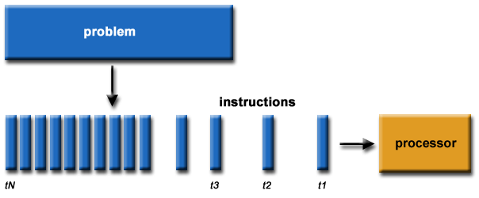
Serial Computing
Traditionally, software has been written for serial computation: A problem is broken into a discrete series of instructions
Instructions are executed sequentially one after another
Executed on a single processor
Only one instruction may execute at any moment in time

Slide 75
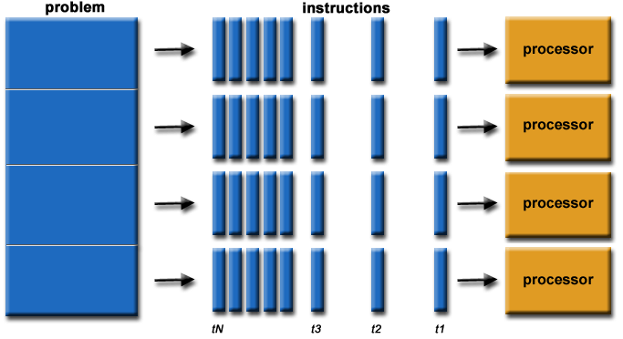
Parallel Computing
In the simplest sense, parallel computing is the simultaneous use of multiple compute resources to solve a computational problem: A problem is broken into discrete parts that can be solved concurrently
Each part is further broken down to a series of instructions
Instructions from each part execute simultaneously on different processors
An overall control/coordination mechanism is employed

Slide 76
Internal Parallelism Levels
Question:
List and Explain different levels of Internal Parallelism ?

Slide 77
Internal Parallelism Levels
The increase of the number of transistors and the increase in clock speed has lead to a significant increase in the performance of computer systems. An overview of such architectural improvements is given below.
Four phases of microprocessor design trends can be observed which are mainly driven by the internal use of parallelism:
1. Bit level parallelism
2. Parallelism by pipelining
3. Parallelism by multiple functional units
4. Parallelism at process or thread level

Slide 78
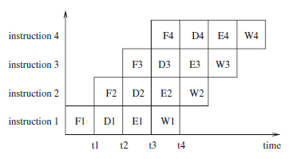
Internal Parallelism Levels
1. Bit level parallelism: 1970 to ~1985
the word size used by the processors for operations increased stepwise from 4 bits, 8 bit, 16 bit, 32, 64 bit microprocessors
The trend has stopped at a word size of 64 bits, since this gives sufficient accuracy for floating point numbers and covers a sufficiently large address space of 264 bytes.
2. Parallelism by pipelining: ~1985 through today
Instruction level parallelism (ILP): The idea of pipelining at instruction level is an overlapping of the execution of multiple instructions.
The execution of each instruction is partitioned into several steps which are performed by dedicated hardware units (pipeline stages) one after another. A typical partitioning could result in the following steps:
(a) fetch: fetch the next instruction to be executed from memory;
(b) decode: decode the instruction fetched in step (a);
(c) execute: load the operands specified and execute the instruction;
(d) write-back: write the result into the target register/memory.
Overlapping execution of four independent instructions by pipelining.
The execution of each instruction is split into four stages:
fetch (F), decode (D), execute (E), and write back (W).

Slide 79
Internal Parallelism Levels (Contd…)
3. Parallelism by multiple functional units:
Many processors are multiple-issue processors.
They use multiple, independent functional units like ALUs (arithmetic logical units), FPUs (floating-point units), load/store units, or branch units.
These units can work in parallel, i.e., different independent instructions can be executed in parallel by different functional units. Thus, the average execution rate of instructions can be increased.
4. Parallelism at process or thread level:
The three techniques described so far assume a single sequential control flow which is provided by the compiler and which determines the execution order if there are dependencies between instructions.
An alternative approach is to use add multiple, independent processor cores onto a single processor chip.
This approach has been used for typical desktop processors since 2005. The resulting processor chips are called multicore processors. Example: Dual Core, Quadcore processor

Slide 80
Flynn’s Taxonomy of Parallel Computers
Question:
List and Explain different classifications of Parallel Computer according to Flynn’s Taxonomy ?

Slide 81
Flynn’s Taxonomy of Parallel Computers
Flynn’s Taxonomy: Classification according to important characteristics of a parallel computer. A simple model for such a classification
is given by Flynn’s taxonomy. This taxonomy characterizes parallel
computers according to the global control and the resulting data and control flows.
Four categories are distinguished based on:
How Many Instruction Streams?
How Many Data Streams?
Single-Instruction, Single-Data (SISD)
Multiple-Instruction, Single-Data (MISD)
Single-Instruction, Multiple-Data (SIMD)
Multiple-Instruction, Multiple-Data (MIMD)

Slide 82
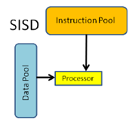
Flynn’s Taxonomy of Parallel Computers
Flynn’s Taxonomy: Classification according to important characteristics of a parallel computer.
Four categories are distinguished based on:
How Many Instruction Streams
How Many Data Streams
Single-Instruction, Single-Data (SISD)
Multiple-Instruction, Single-Data (MISD)
Single-Instruction, Multiple-Data (SIMD)
Multiple-Instruction, Multiple-Data (MIMD)
 | Instruction Stream | Data Stream
SSID | 1 | 1
MISD
SIMD
MIMD

Slide 83
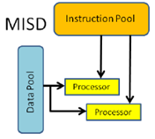
Flynn’s Taxonomy of Parallel Computers
Flynn’s Taxonomy: Classification according to important characteristics of a parallel computer.
Four categories are distinguished based on:
How Many Instruction Streams
How Many Data Streams
Single-Instruction, Single-Data (SISD)
Multiple-Instruction, Single-Data (MISD)
Single-Instruction, Multiple-Data (SIMD)
Multiple-Instruction, Multiple-Data (MIMD)
 | Instruction Stream | Data Stream
SSID | 1 | 1
MISD | >1 | 1
SIMD
MIMD

Slide 84
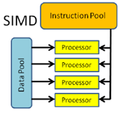
Flynn’s Taxonomy of Parallel Computers
Flynn’s Taxonomy: Classification according to important characteristics of a parallel computer.
Four categories are distinguished based on:
How Many Instruction Streams
How Many Data Streams
Single-Instruction, Single-Data (SISD)
Multiple-Instruction, Single-Data (MISD)
Single-Instruction, Multiple-Data (SIMD)
Multiple-Instruction, Multiple-Data (MIMD)
 | Instruction Stream | Data Stream
SSID | 1 | 1
MISD | >1 | 1
SIMD | 1 | >1
MIMD

Slide 85
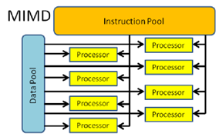
Flynn’s Taxonomy of Parallel Computers
Flynn’s Taxonomy: Classification according to important characteristics of a parallel computer.
Four categories are distinguished based on:
How Many Instruction Streams
How Many Data Streams
Single-Instruction, Single-Data (SISD)
Multiple-Instruction, Single-Data (MISD)
Single-Instruction, Multiple-Data (SIMD)
Multiple-Instruction, Multiple-Data (MIMD)
 | Instruction Stream | Data Stream
SSID | 1 | 1
MISD | >1 | 1
SIMD | 1 | >1
MIMD | >1 | >1

Slide 86
Flynn’s Taxonomy of Parallel Computers (Contd…)
1. Single-Instruction, Single-Data (SISD): There is one processing element which has access to a single program and data storage. In each step, the processing element loads an instruction and the corresponding data and executes the instruction. The result is stored back in the data storage. Thus, SISD is the conventional sequential computer according to the von Neumann model.
2. Multiple-Instruction, Single-Data (MISD): There are multiple processing elements each of which has a private program memory, but there is only one common access to a single global data memory. In each step, each processing element obtains the same data element from the data memory and loads an instruction from its private program memory. These possibly different instructions are then executed in parallel by the processing elements using the previously obtained (identical) data element as operand. This execution model is very restrictive and no commercial parallel computer of this type has ever been built.

Slide 87
Flynn’s Taxonomy of Parallel Computers (Contd…)
3. Single-Instruction, Multiple-Data (SIMD): There are multiple processing elements each of which has a private access to a (shared or distributed) data memory. But there is only one program memory from which a special control processor fetches and dispatches instructions. In each step, each processing element obtains from the control processor the same instruction and loads a separate data element through its private data access on which the instruction is performed. Thus, the instruction is synchronously applied in parallel by all processing elements to different data elements.
For applications with a significant degree of data parallelism, the SIMD approach can be very efficient. Examples are multimedia applications or computer graphics algorithms to generate realistic three-dimensional views of computer-generated environments.
4. Multiple-Instruction, Multiple-Data (MIMD): There are multiple processing elements each of which has a separate instruction and data access to a (shared or distributed) program and data memory. In each step, each processing element loads a separate instruction and a separate data element, applies the instruction to the data element, and stores a possible result back into the data storage. The processing elements work asynchronously with each other. Multicore processors or cluster systems are examples for the MIMD model.

Slide 88
Memory Organization of Parallel Computers
A Further classification of MIMD computers can be done according to their memory organization:
1. Computers with Distributed Memory Organization
2. Computers with Shared Memory Organization

Slide 89
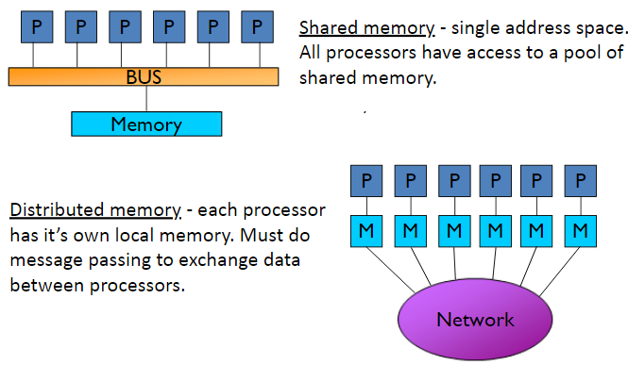
Shared vs. Distributed Memory
The simplest and most useful way to classify modern parallel computers is by their memory model:
Shared memory and Distributed memory

Slide 90
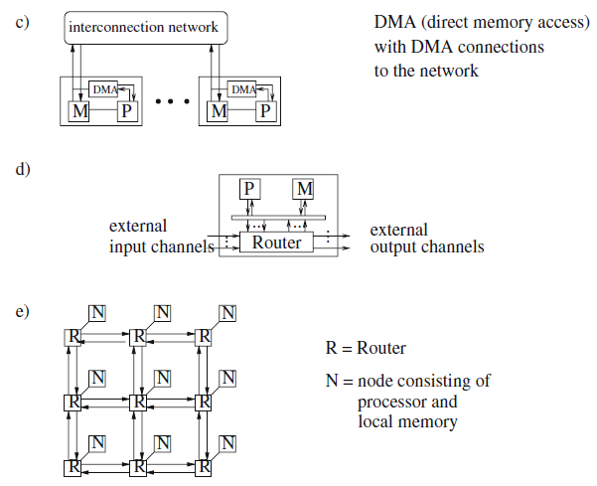
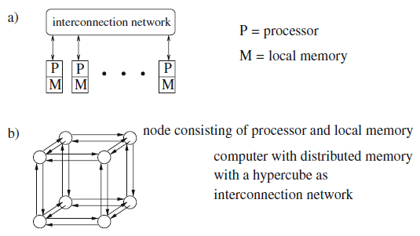
Illustration of computers with distributed memory
To perform message passing, two processes PA and PB on different nodes A and B issue corresponding send and receive operations. When PB needs data from the local memory of node A, PA performs a send operation containing the data for the destination process PB. PB performs a receive operation specifying a receive buffer to store the data from the source process PA from which the data are expected.
Illustration of computers with distributed memory: (a) abstract structure,
(b) computer with distributed memory and hypercube as interconnection structure,
(c) DMA (direct memory access), (d) processor–memory node with router, and (e) interconnection network in the form of a mesh to connect the routers of the different processor–memory nodes

Slide 91
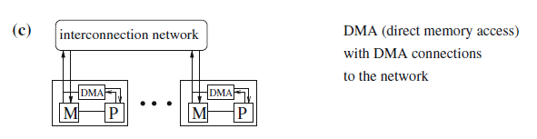
Illustration of computers with distributed memory
Illustration of computers with distributed memory: (c) DMA (direct memory access),
The execution of communication operations can be decoupled from the processor’s operations by adding a DMA controller (DMA - direct memory access) to the nodes to control the data transfer between the local memory and the I/O controller.
This enables data transfer from or to the local memory without participation of the processor and allows asynchronous communication.
A processor can issue a send operation to the DMA controller and can then continue local operations while the DMA controller executes the send operation.

Slide 92
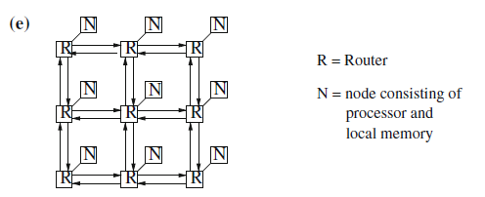
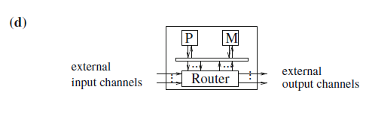
Illustration of computers with distributed memory
Illustration of computers with distributed memory: (d) processor–memory node with router,
Communication between nodes that do not have a direct connection must be controlled by software to send a message along a path of direct interconnections.
Therefore, communication times between nodes that are not directly connected can be much larger than communication times between direct neighbors. Thus, it is still more efficient to use algorithms with communication according to the given network structure.
A further decoupling can be obtained by putting routers into the network.
The routers form the actual network over which communication can be performed. The nodes are connected to the routers, see Fig. 2.3 e).
Hardware supported routing reduces communication times as messages for processors on remote nodes can be forwarded by the routers along a preselected path without interaction of the processors in the nodes along the path.

Slide 93
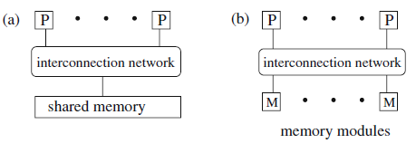
Illustration of a computer with shared memory
Computers with a physically shared memory are also called shared memory machines (SMMs); the shared memory is also called global memory.
SMMs consist of a number of processors or cores, a shared physical memory (global memory) and an interconnection network to connect the processors with the memory. The shared memory can be implemented as a set of memory modules.
Physically, the global memory usually consists of separate memory modules providing a common address space which can be accessed by all processors
Illustration of a computer with shared memory: (a) abstract view and (b) implementation of the shared memory with memory modules

Slide 94
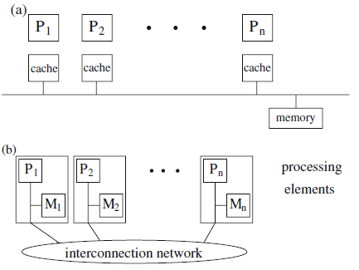
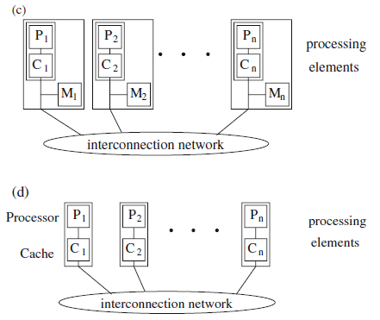
Illustration of the architecture of computers with shared memory:
In contrast to single SMP systems, the access time in Distributed Shared Memory (DSM) systems depends on the location of a data value in the global memory, since an access to a data value in the local SMP memory is faster than an access to a data value in the memory of another SMP node.
These systems are therefore also called NUMAs (nonuniform memory access). Since single SMP systems have a uniform memory latency for all processors, they are also called UMAs (uniform memory access).
Illustration of the architecture of computers with shared memory: (a) SMP – symmetric multiprocessors, (b) NUMA – non-uniform memory access, (c) CC-NUMA – cache-coherent NUMA, and (d) COMA – cache-only memory access
Notes:
Coherent :forming an unified whole

Slide 95
Thread-Level Parallelism

Slide 96
What is Thread w.r.t Computers ?
Thread: A Process (or Program) with own instructions and data
Each thread has all the state (instructions, data, PC, register state, and so on) necessary to allow it to execute.
It can be distinguished between kernel threads that are managed by the operating system, and user threads that are explicitly generated and controlled by the parallel program.
Notes:
Parallel programs for SMMs are often based on the execution of threads. A thread is a separate control flow which shares data with other threads via a global address space. It can be distinguished between kernel threads that are managed by the operating system, and user threads that are explicitly generated and controlled by the parallel program

Slide 97
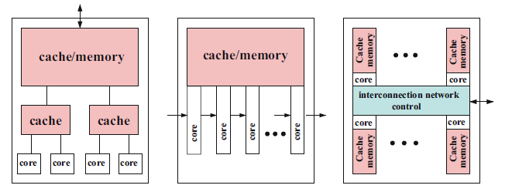
Thread-Level Parallelism
Multi-Core Processors: Placement of multiple independent execution cores with all execution resources onto a single processor chip.
Design choices for multicore chips
Hierarchical design

Slide 98
Thread-Level Parallelism
Multi-Core Processors: Placement of multiple independent execution cores with all execution resources onto a single processor chip.
Design choices for multicore chips
Hierarchical design
Pipelined design

Slide 99
Thread-Level Parallelism
Multi-Core Processors: Placement of multiple independent execution cores with all execution resources onto a single processor chip.
Design choices for multicore chips
Hierarchical design
Pipelined design
Network-based design

Slide 100
Announcements

Slide 101
Thanks for Listening
THANK YOU
☺
All the best for your exams.

