Slide 1
COMBINATIONAL LOGIC CIRCUITS
3
LEACH, MALVINO & SAHA

Slide 2
Boolean Laws and Theorem
Basic Laws
  The Commutative Laws
A+B=B+A
AB=BA
  The Associative laws
A+(B+C)=(A+B)+C
A(BC)=(AB)C
  The Distributive law
A(B+C)=AB+AC

Slide 3
Boolean Laws and Theorem
OR Operations
  A+0=A
  A+A=A
  A+1=1
  A+A=1
AND Operations
  A.1=A
  A.A=A
  A.0=0
  A.A=0

Slide 4
Boolean Laws and Theorem
Double Inversion and De Morgan’s Theorem
  Double-inversion Rule is
A=A
  De Morgan’s theorem
A+B=A. B
AB=A+B
Duality Theorem
  Starting with a Boolean relation, you can derive another Boolean relation by
Changing each OR sign to an AND sign
Changing each AND sign to an OR sign
Complementing any 0 or 1 appearing in the expression

Slide 5
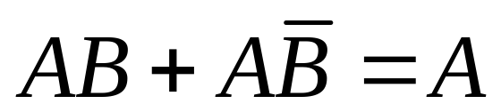
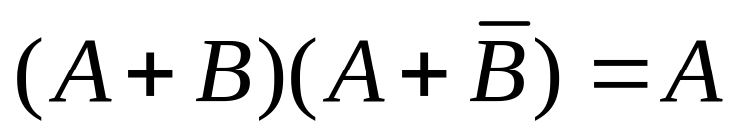
Covering and Combination
The covering rule, where one term covers the condition of the other term so that the other term becomes redundant, can be represented in dual form as
A + AB = A
A(A+B) = A
The combining rules are,

Slide 6
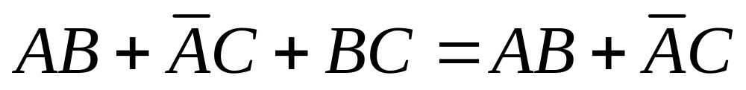
Consensus theorem
The consensus theorem finds a redundant term which is a consensus of two other terms. The idea is that if the consensus term is true then any of the other two terms is true and thus it becomes redundant. This can be expressed in dual form as

Slide 7
End of class

Slide 8
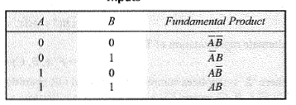
Sum of Product
The fundamental Product is called “min term”
A’B ‘ is high when A and B are low
Products A' B', A'B, AB', AB are represented by m₀ m₁ m₂ and m₃ respectively

Slide 9
Sum-of-Product Method
Here is how to get the sum-of-products solution, given a truth table, you have to locate each output 1 in the truth table and write down the fundamental product. For instance, the first output 1 appears for an input of A=0,B=1 and C=1. The corresponding fundamental product is ABC. To get the sum of products equation, all you have to is OR the fundamental products.
A | B | C | Y
0 0 0 0 1 1 1 1 | 0 0 1 1 0 0 1 1 | 0 1 0 1 0 1 0 1 | 0 0 0 1 A B C 0 1 A B C 1 A B C 1 A B C
Y=ABC+ABC+ABC+ABC

Slide 10
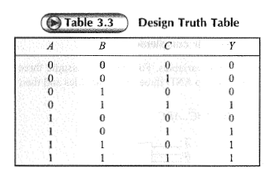

Other name
Y =A’BC+ AB’C+ ABC’+ ABC
Canonical Sum form
Y = F(A, B, C)
  = Σm (3, 5, 6, 7)

Slide 11
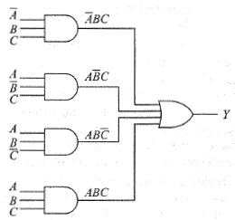
AND-OR is equivalent to NAND-NAND
TTL logic is not available for 4 input OR gate
7420 is a 4-input NAND gate.

Slide 12
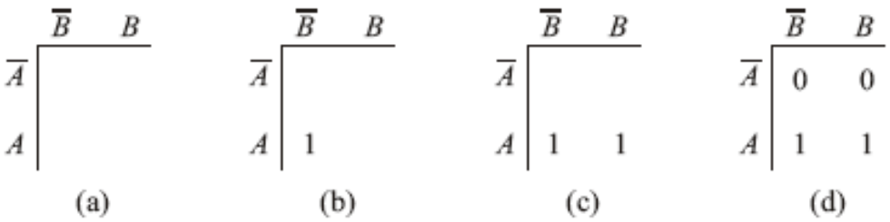
Truth Table to Karnaugh Map
A Karnaugh map is a visual display of the fundamental products needed for sum-of-product solution.
The vertical column has A’ followed by A, and horizontal row has B’ followed by B.
The first output 1 appears for A=1 and B=0.
The fundamental product for this input condition is AB’.
Enter this fundamental product on the Karnaugh map as shown in figure b.
This 1 represent the product AB because the 1 is in row A and column B
A | B | Y
0 0 1 1 | 0 1 0 1 | 0 0 1 1

Slide 13
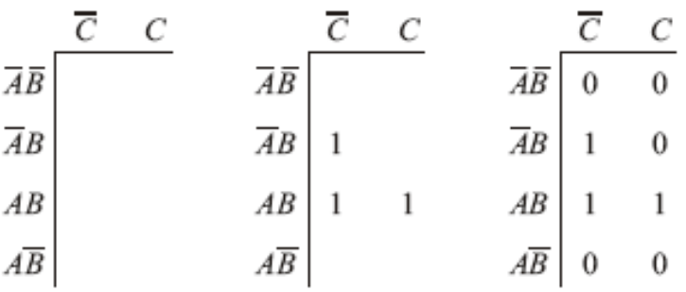

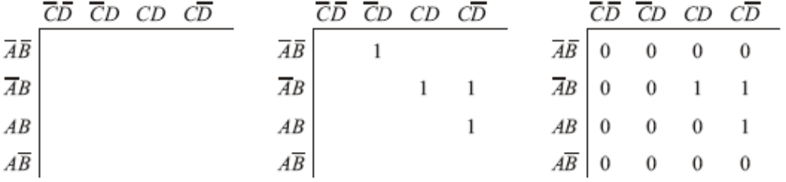
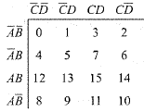
Truth Table to Karnaugh Map
Three Variable Maps
Four Variable Maps

Slide 14
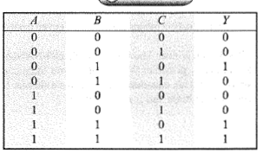
Truth Table – Example – Reduction in k-map size

Slide 15
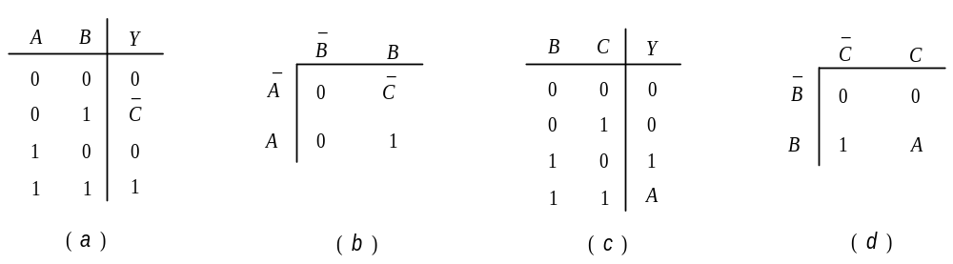
Entered variable map
This reduces the Karnaugh map size by one degree i.e. a three variable problem that requires 2³=8 locations in Karnaugh map will require 2(3-1) = 4 locations in entered variable map.
This technique is particularly useful for mapping problems with more than four input variables.
Entered variable map of truth table shown.

Slide 16
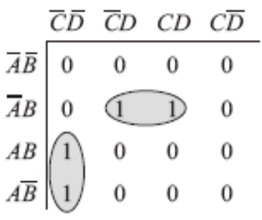
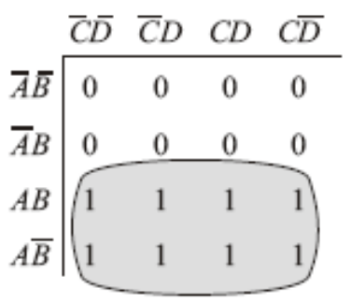
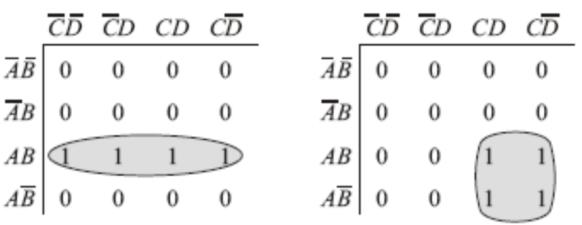
Pairs, Quads and Octets
Pairs
Octates
Y=ACD+ABD
Y=A
Quades
Y=AB
Y=AC

Slide 17
Karnaugh Simplification
Enter a 1 on the Karnaugh map for each fundamental product that produces a 1 output in the truth table. Enter 0s elsewhere.
Encircle the octets, quads, and pairs. Remember to roll and overlap to get the largest group possible.
If any isolated 1s remain, encircle each.
Eliminate any redundant group.
Write the Boolean equation by ORing the products corresponding to encircled groups.

Slide 18
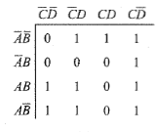
Simplification steps
Start with Octet, quad and followed by Pair

Slide 19
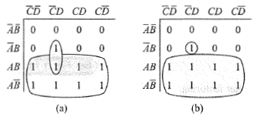
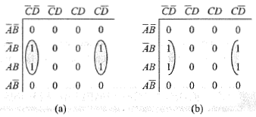
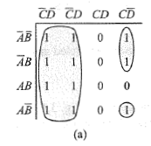
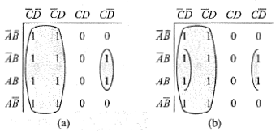
Yet another example
Is this the best grouping?

Slide 20
End of class

Slide 21
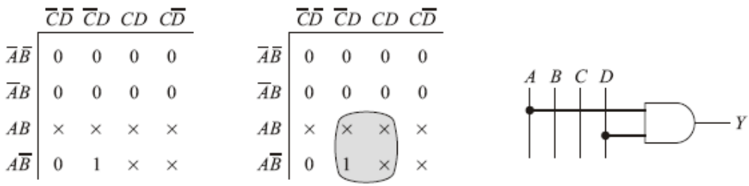
Don’t-Care Condition
In some digital systems, certain input condition never occurs during normal operation; therefore, the corresponding output never appears. Since the output never appears, it is indicated by an X in the truth table. The X is called a don’t-care condition. You can let it equal either 0 or 1, whichever produces a simpler logic circuit.

Slide 22
Product-of-sum Method
Given a truth table, you identify the fundamental sums needed for a logic design.
Then by ANDing these sums, you get the product-of-sum equation corresponding to the truth table.
Note: With SOP the fundamental sum produces an output 0 for the corresponding input condition
A 0 0 0 0 1 1 1 1 | B 0 0 1 1 0 0 1 1 | C 0 1 0 1 0 1 0 1 | Y 0→A+B+c 1 1 0→A+B+C 1 1 0→A+B+C 1
Locate each output 0 in the
truth table and write down its
Fundamental sum

Slide 23
Conversion between SOP and POS
We have seen that SOP representation is obtained by considering ones in a truth table while POS comes considering zeros. In SOP, each one at output gives one AND term which is finally ORed. In POS, each zero gives one OR term which is finally ANDed. Thus SOP and POS occupy complementary locations in a truth table and one representation can be obtained from the other by
    (i) identifying complementary locations
    (ii) changing minterm to maxterm or reverse
    (iii) changing summation by product or reverse.

Slide 24
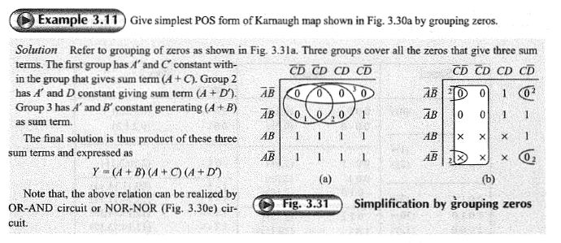
Product-of-sum Simplification using K-Map

Slide 25

Simplification by QUINE-McCLUSKY method.
Karnaugh map depends on the user’s ability to identify patterns that gives largest size.
Also the method becomes difficult to adapt for simplification of 5 or more variables.
Quine-McClusky method is a systematic approach for logic simplification that does not have these limitations and also can easily be implemented in a digital computer.
Quine-McClusky method involves preparation of two tables;
  one determines prime implicants
  selects essential prime implicants to get minimal expression.

Slide 26
Simplification by QUINE-McCLUSKY method.
Determination Of Prime Implicants
  Prime implicants are expressions with least number of literals that represents all the terms given in a truth table.
  Prime implicants are examined to get essential prime implicants for a particular expression that avoids any type of duplication.

Slide 27
Simplification by QUINE-McCLUSKY method
Determination Of Prime Implicants Example
  In stage 1 of the process, we find out all the terms that gives output 1 from truth table and put them in different groups depending on how many 1 input variable combinations (ABCD) have.
  In stage 2, we first try to combine first and second group of stage 1, on a member to member basis. The rule is to see if only one binary digit is differing between two members and we mark that position by ‘–’.
  In stage 3, we combine members of different groups of stage 2 in a similar way. Now it will have two ‘–’ elements in each combination.
  In the example considered, there is no stage 4 for this problem as no two members of stage 3 has only one digit changing among them.

Slide 28
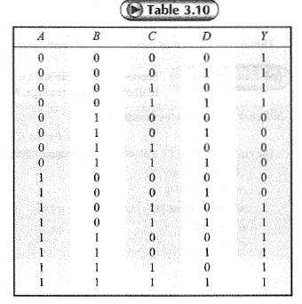
Example

Slide 29
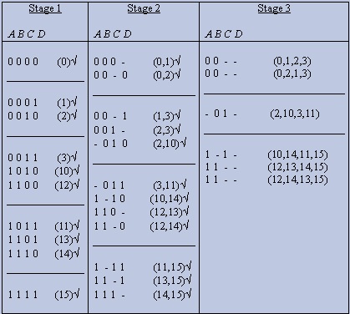
Simplification by QUINE-McCLUSKY method
Determination Of Prime Implicants
  The rule is all the terms that are not ticked at any stage is treated as prime implicants for that problem. Here, we get four of them from stage 3, namely A′B′, B′C, AC, AB and none from previous stage as all the terms there are ticked (√).

Slide 30
Stage 2 and 3

Slide 31
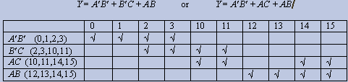
Simplification by QUINE-McCLUSKY method
Selection Of Prime Implicants
  To select essential prime implicants and remove redundancy or duplication among them.
  For this, we prepare a table as shown in Figure that along the row lists all the prime implicants and along columns lists all minterms.
  The cross-point of a row and column is ticked if the term is covered by corresponding prime implicant.

Slide 32
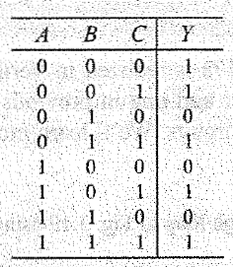
Problems

Slide 33
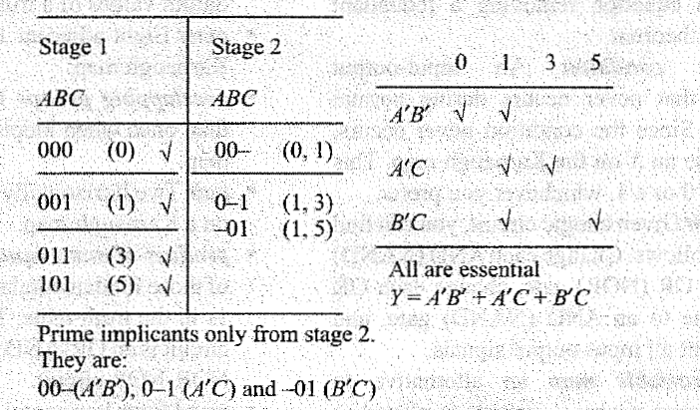
Solution

Slide 34
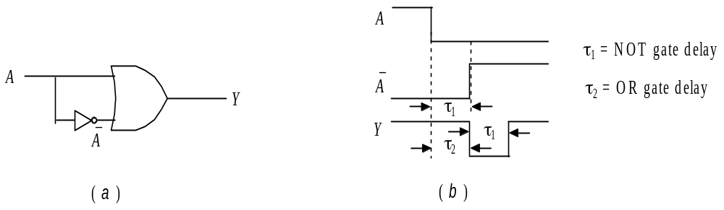
Hazards and hazard covers
STATIC-1 HAZARD
  This type of hazard occurs when Y=A+A′ type of situation appears for a logic circuit for certain combination of other inputs and A makes a transition 1→0.
  An A+A′ condition should always generate 1 at the output i.e. static-1. But the NOT gate output takes finite time to become 1 following 1→0 transition of A.
  Thus for the OR gate there are two zeros appearing at its input for that small duration resulting a 0 at its output.
  The width of this zero is in nanosecond order and is called a glitch.

Slide 35
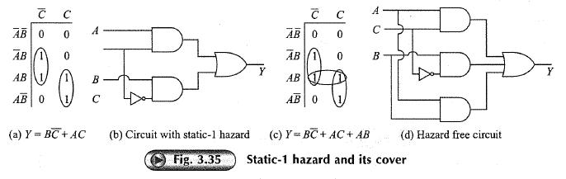
Hazard free circuit , Static-1

Slide 36
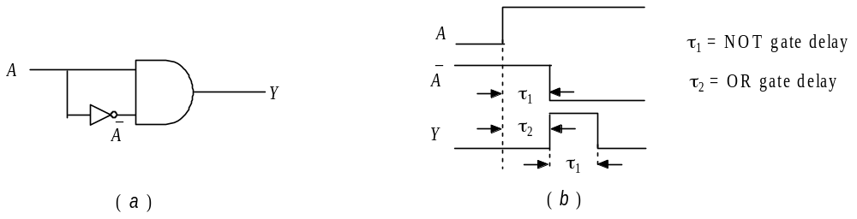
Hazards and hazard covers
STATIC-0 HAZARD
  This type of hazard occurs when Y=A.A′ kind of situation occurs in a logic circuit for certain combination of other inputs and A makes a transition 0→1.
  An A.A′ condition should always generate 0 at the output i.e. static-0.
  But the NOT gate output takes finite time to become 0 following a 0→1 transition of A.
  Thus for final AND gate there are two ones appearing at its input for a small duration resulting a 1 at its output.

Slide 37
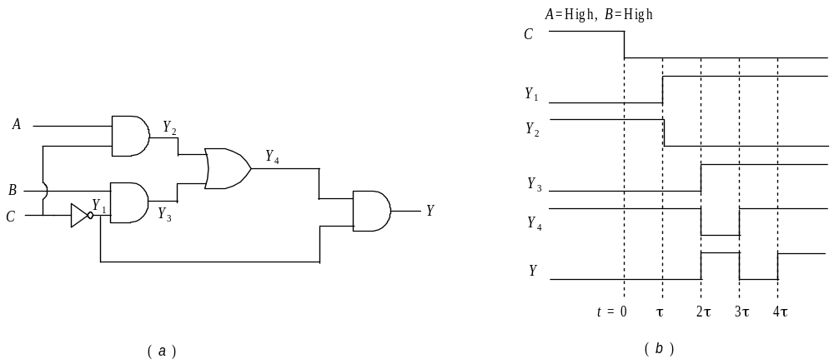
Hazards and hazard covers
DYNAMIC HAZARD
  Dynamic hazard occurs when circuit output makes multiple transitions before it settles to a final value while the logic equation asks for only one transition. An output transition designed as 1→0 may give 1→0→1→0 when such hazard occurs and a 0→1 can behave like 0→1→0→1. The output of logic equation in dynamic hazard degenerates into Y=A+A′.A or Y=(A+A′).A kind of relations for certain combinations of the other input variables.

Slide 38
End of Chapter

Slide 39
HDL IMPLEMENATION MODELS
Dataflow Modelling
    Verilog provides a keyword assign and a set of operators to describe a circuit through its behavior or function. Here, we do not explicitly need to define any gate structure using and, or etc. and it is not necessary to use intermediate variables through wire showing gate level interconnections.
Relational Operation Symbol Less than < Less than or equal to <= Greater than > Equal to == Not equal to != Logical Operation(for expressions) Symbol Logical NOT ! Logical AND && Logical OR || | Bit-wise Operation Symbol Bit-wise NOT ~ Bit-wise AND & Bit-wise OR | Bit-wise Ex-OR ^ Arithmetic Operation Symbol Binary addition + Binary subtraction - Binary multiplication * Binary division /
A partial list of Verilog operator
module fig2_24a(A,B,C,D,Y); input A,B,C,D; output Y; assign Y=(A&B)|(C&D); //One statement is enough endmodule | module testckt(a,b,c,x,y); input a,b,c; output x,y; assign x=~((a|b)|c); // NOR through NOT-OR assign y=~((a|b)&(b|c)); // NAND by NOT-AND endmodule
Compare the data flow model of two circuits

Slide 40
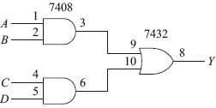
HDL IMPLEMENATION MODELS
Behavioral Modelling
    In a behavioral model, statements are executed sequentially following algorithmic description. It is ideally suited to describe a sequential logic circuit. However, it is also possible to describe combinatorial circuits with this but may not be a preferred model in most of the occasions
    It always uses always keyword followed by a sensitivity list.
module fig2_24a(A,B,C,D,Y); input A,B,C,D; output Y; reg Y; // Y is output after procedural assignment within always block, hence as reg. always @ (A or B or C or D) //A,B,C,D form sensitivity list, note keyword or if ((A==1)&&(B == 1)) // If A,B both are 1 Y=1; // Assignment through equal sign not keyword assign else if ((C==1)&&(D == 1)) // if C,D both are 1 Y=1; else // for all other combinations of A,B,C,D Y=0; endmodule
behavioral code for circuit given in fig2_4a.

