Slide 1
FLIP-FLOPS
8
LEACH, MALVINO & SAHA

Slide 2
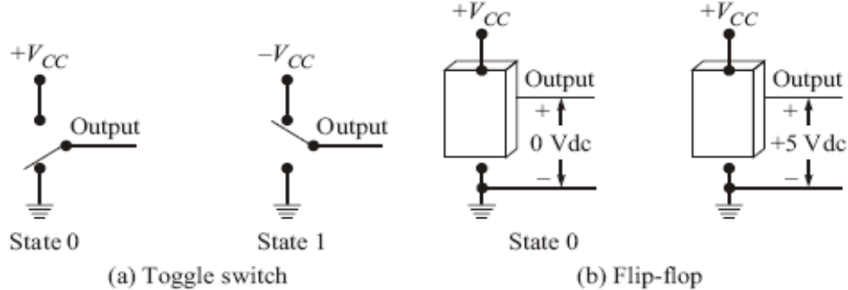
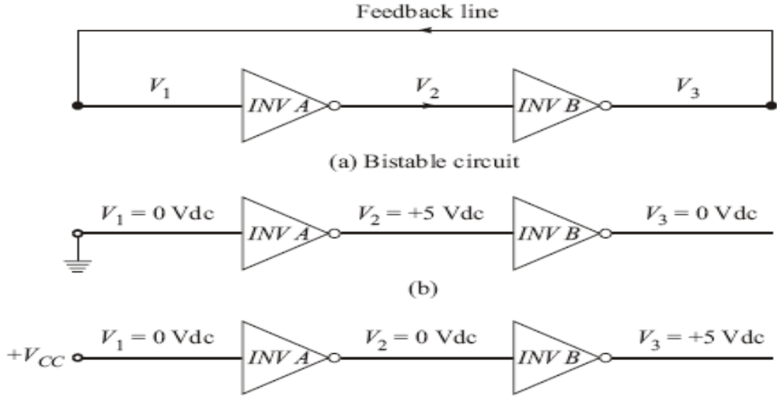
RS Flip-Flop
A flip-flop is a bistable electronic circuit that has two stable states—that is, its output is either 0 or +5vdc
Basic Idea

Slide 3
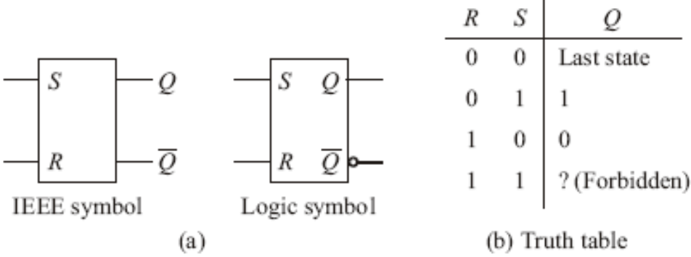
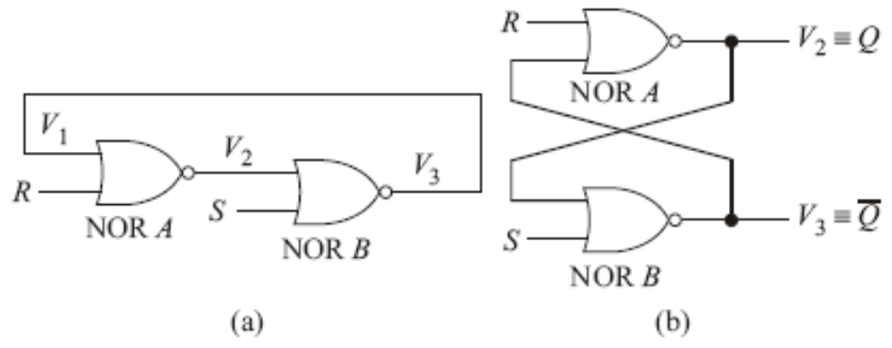
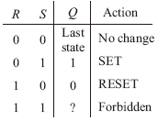
RS Flip-Flop
Standard logic symbol of RS flip-flop
NOR-Gate Latch
NOR-gate flip-flop
Truth table for a NOR-gate RS flip-flop

Slide 4
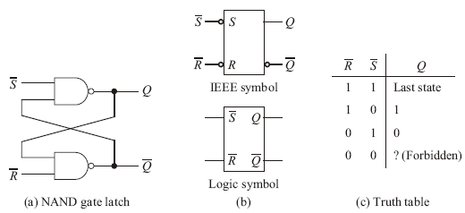
RS Flip-Flop
NAND-Gate Latch

Slide 5
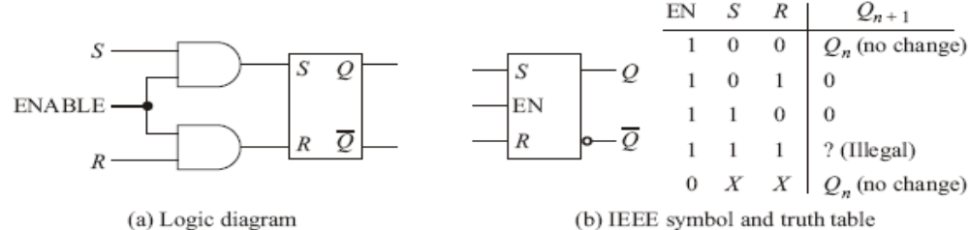
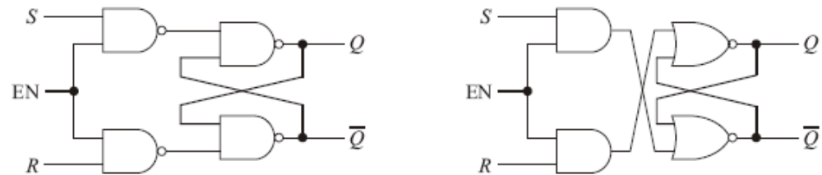
Gated flip-flops
Clocked RS flip-flop
  It is possible to strobe or clock the flip-lop in order to store information (set it or reset it) at any time, and then hold the stored information for any desired period of time.
  Two different realization for a clocked RS flip-flop

Slide 6
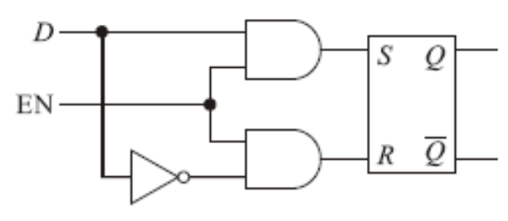
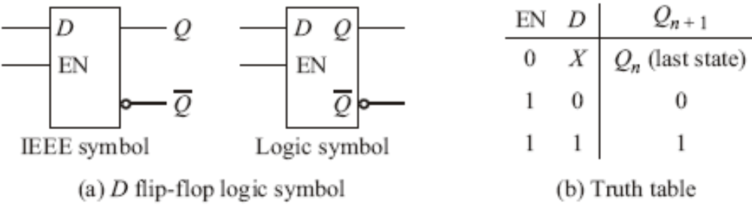
Gated flip-flops
Clocked D flip-flop
A D flip-flop
D flip-flop logic symbol

Slide 7
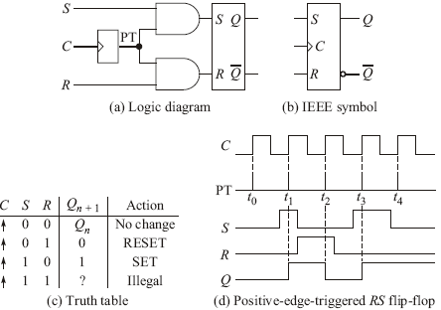
Edge-Triggered RS flip-flop
Positive-Edge triggered RS flip-flop
  S and R inputs affect Q only while the positive pulse is high, and they need to be static only during this very short time.

Slide 8
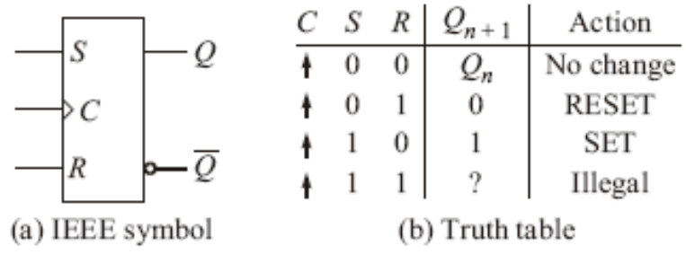
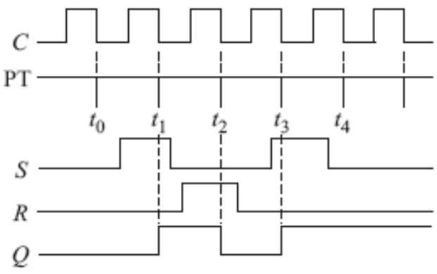
Edge-Triggered RS flip-flop
Negative-edge triggered RS flip-flop
  On the IEEE symbol, the small bubble on the clock input (C) means active low. This bubble, along with the dynamic input indicator, means negative-edge triggering.

Slide 9
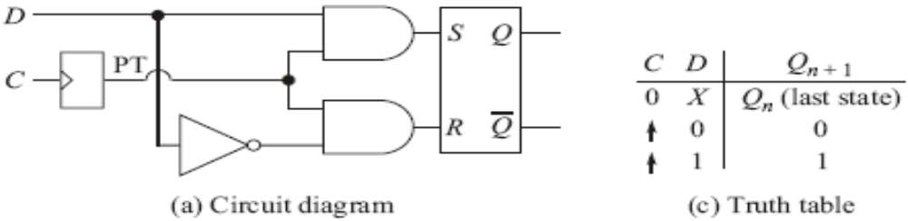
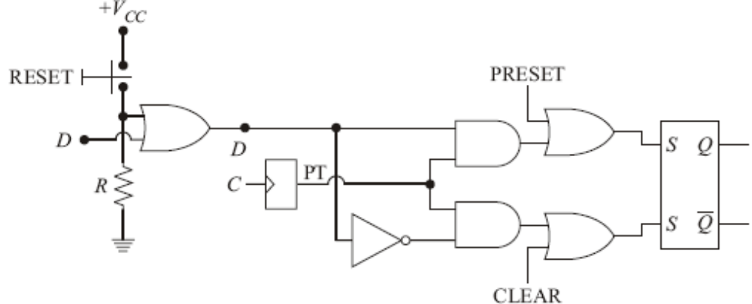
Edge-triggered D flip-flop
Positive-edge-triggered D flip-flop
When power is first applied, flip-flops come up in random states. To get some computer started, an operator has a push a RESET button. This sends a CLEAR or RESET signal to flip-flops. Also, its necessary in some digital system to preset certain flip-flops.
PRESET and CLEAR functions

Slide 10
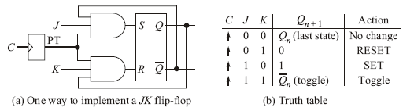
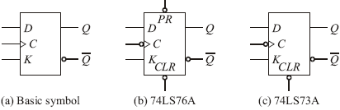
Edge-Triggered JK flip-flop
Positive-edge-triggered JK flip-flops
JK flip-flop Symbols

Slide 11
End of class

Slide 12
Flip flop timing
Diodes and transistors cannot switch states immediately.
It always takes a small amount of time to turn a diode on or off. Likewise, it takes time for a transistor to switch from saturation to cutoff, and vice versa.
For bipolar diodes and transistors, the switching time is in the nanosecond region.

Slide 13
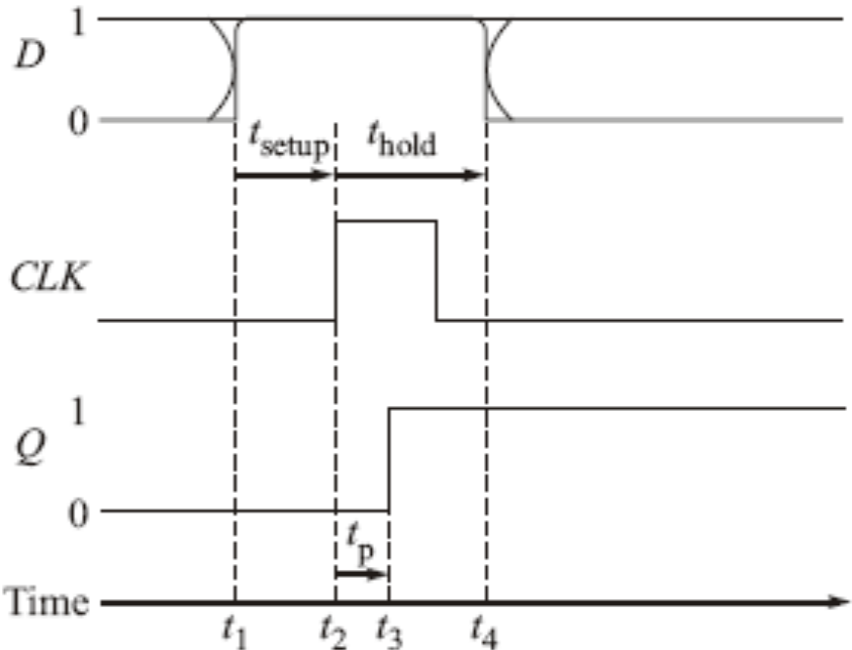

Slide 14
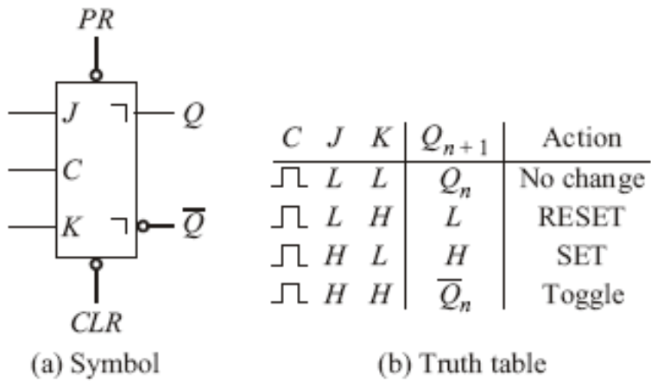
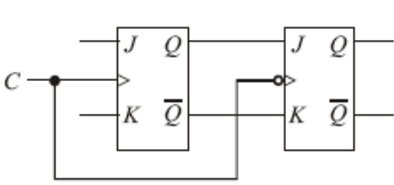
JK master-slave flip-flop
The master is set according to J and K while the clock is high; the contents of the master are then shifted into the slave (Q changes state) when the clock goes low. This particular flip-flop might be referred to as pulse-triggered, to distinguish it from the edge-triggered flip-flop.
Master-slave flip-lop
7476 JK master flip-flop

Slide 15
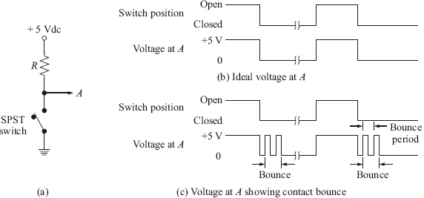
Switch content bounce circuits
Any mechanical switching device consists of a moving contact arm restrained by some sort of a spring system. As a result, when the arm is moved from one stable position to the other, the arm bounces.

Slide 16
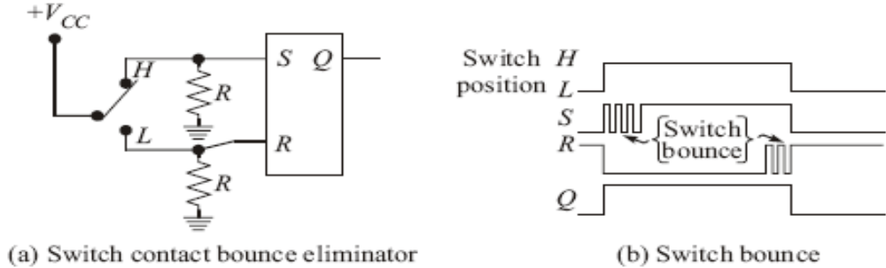
Switch content bounce circuits
A simple RS latch debounce circuit.

Slide 17
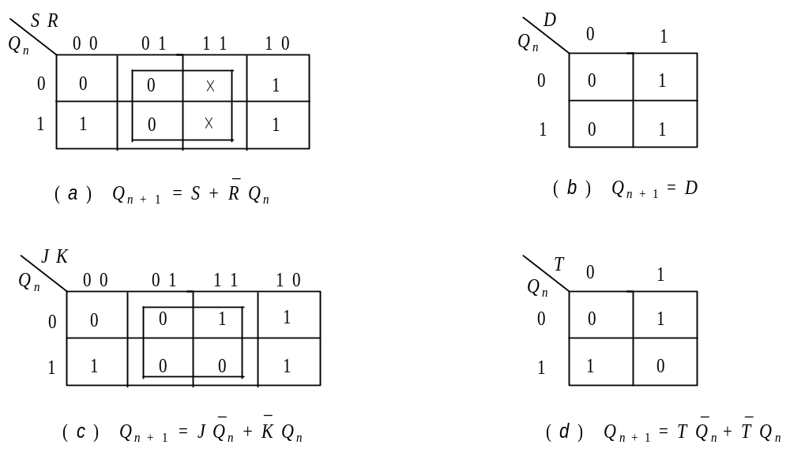

Various representations of flip-flops
CHARACTERISTIC EQUATIONS OF FLIP-FLOPS
  The characteristic equations of flip-flops are useful in analysis circuits made of them. Here, next output Qn+1 is expressed as a function of present output Qn and input to flip-flops.
Characteristic equations of (a)SR Flip Flop (b)D Flip Flop (c)JK Flip Flop and (d)T Flip Flop

Slide 18
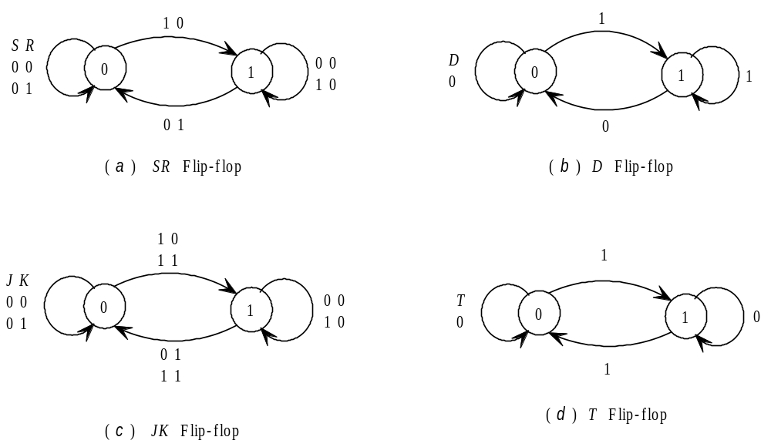
Various representations of flip-flops
FLIP FLOPS AS FINITE STATE MACHINE
  In a sequential logic circuit the value of all the memory elements at a given time define the state of that circuit at that time. Finite State Machine (FSM) concept offers a better alternative to truth table in understanding progress of sequential logic with time.
State transition diagram of (a)SR flip-flop (b)D flip-flop (c) JK flip-flop and (d)T flip-flop

Slide 19

Various representations of flip-flops
Flip-Flop Excitation Table
  In synthesis or design problem excitation tables are very useful and its importance is analogous to that of truth table in analysis problem. Excitation table of a flip-flop is looking at its truth table in a reverse way. Here, flip-flop input is presented as a dependent function of transition Qn→ Qn+1 and comes later in the table.
Excitation table of flip-flops
Note that, JK flip-flop has maximum number of don’t care ‘×’ states and D Flip Flop input simply follows the value to which transition is made.

Slide 20
End of class
End of chapter 8
Next Class – Register(chapter 9)

