Slide 1
Predicting the Popularity of Reddit Posts
Zhaohui Qu, Dylan Mendonca, Shi Hu, Baiwu Zhang, Navaneetha Krishnan
August 18, 2020
Notes:
18 3.5 - 3 - 3 - 3 - 2
Hi, good afternoon. The topic of our project is prediction of cholesterol level without taking blood test.

Slide 2
Presentation Outline
Data Exploration
Outlier Removal
Feature Engineering
Clustering & Categorization
Model 1 - Baseline
Model 2 - Two Stages
Hyperparameter tuning
Conclusion
Presenter: Zhaohui

Slide 3

Project Outline
Background
Reddit is a social news website where users create posts, which other users can "upvote" or "downvote".
The benefits of predicting post popularity
Build recommender systems
Provide targeted advertising
Primary Goal:
Combine feature engineering and ML-based approaches to predict the popularity of reddit posts.
Unpopular
Very Popular
Presenter: Zhaohui
Notes:
Reddit is a social news website where users create posts containing either links or text, which other users can "upvote" or "downvote". The amount of upvotes a post receives determines its popularity and thereby impacts its visibility on the site. Ability to predict popularity of a topic is beneficial in various ways. Reddit can formulate more effective marketing strategies, for example by using predicted popularity to build recommender systems and provide targeted advertising

Slide 4
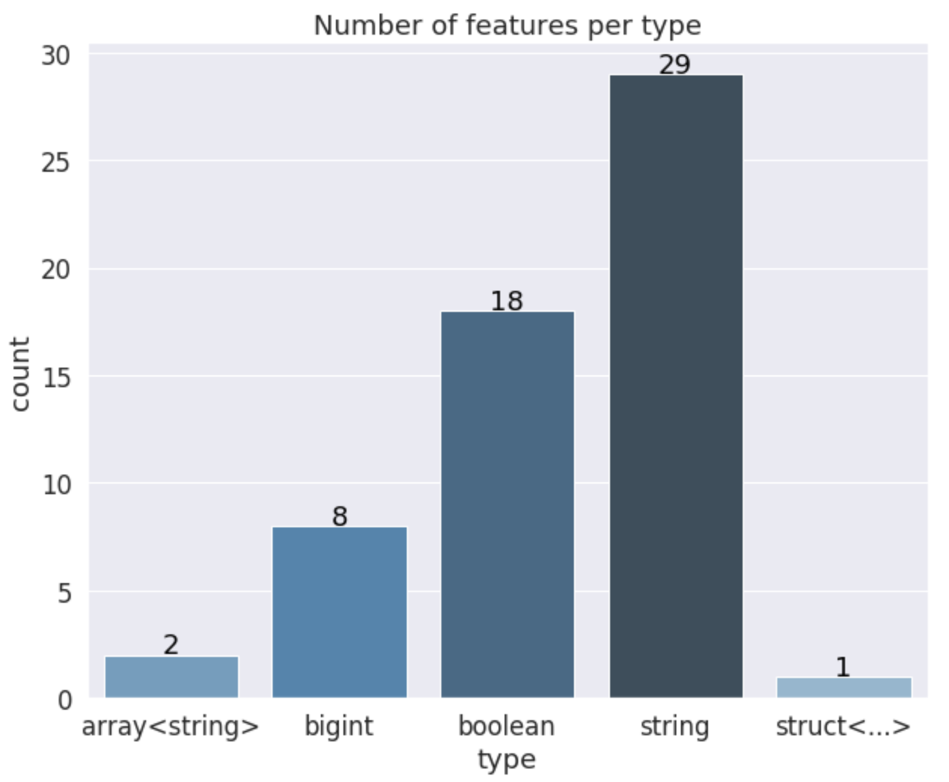
Data Exploration
58 explanatory variables describing (almost) every aspect of reddit posts
There are 12525 rows in the training set
There are 12556 rows in the testing set
Score : The popularity of post
Title : Raw text post title
Num_comments : The number of comments on the submission.
Presenter: Zhaohui

Slide 5
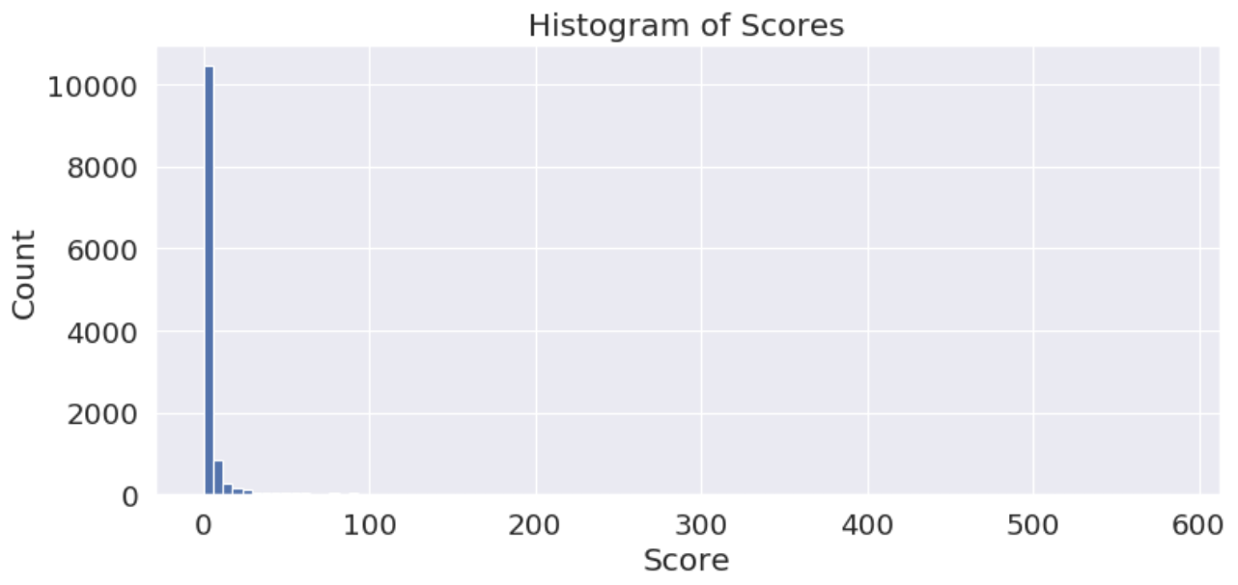
Data Exploration
Target : Score of posts
Statistical Summary of Scores
Count | 12525
Mean | 7.512
Std | 29.104
Min | 0.000
25% | 0.000
50% | 0.000
75% | 3.000
Max | 583.000
Presenter: Zhaohui

Slide 6
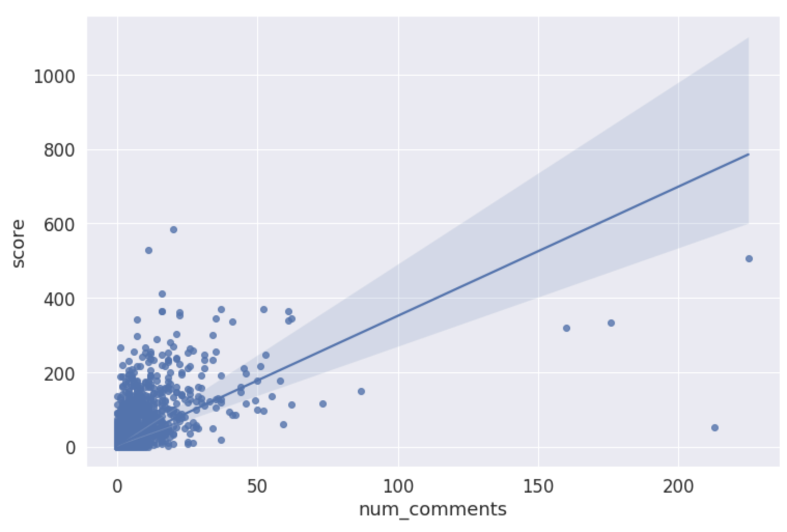
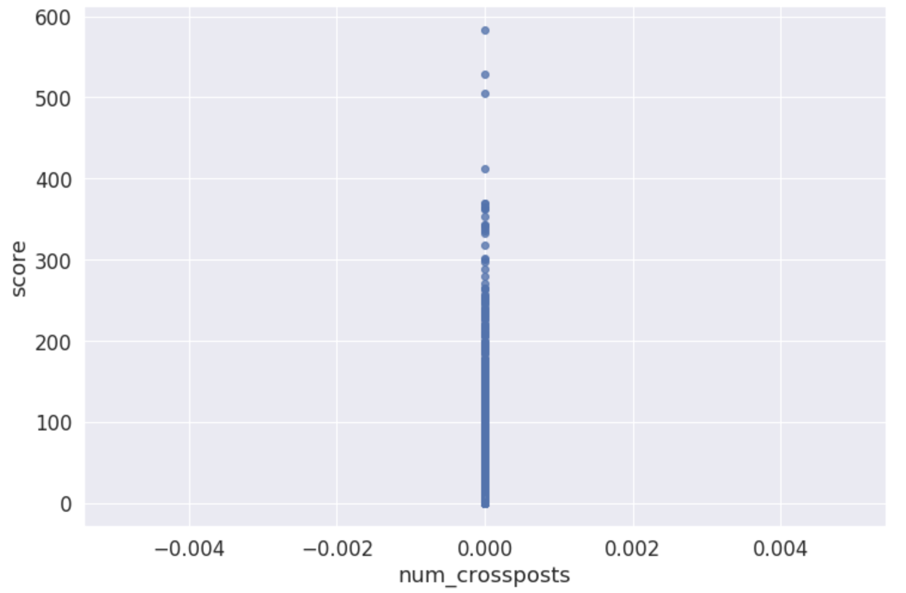
Data Exploration
Relationship with numerical variables
Presenter: Zhaohui

Slide 7
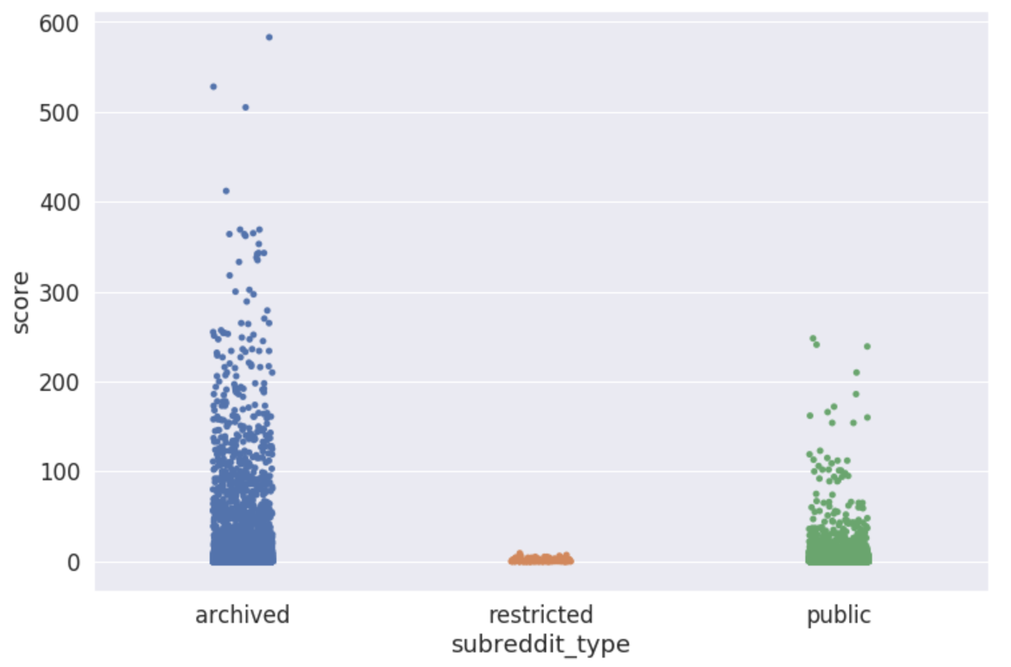
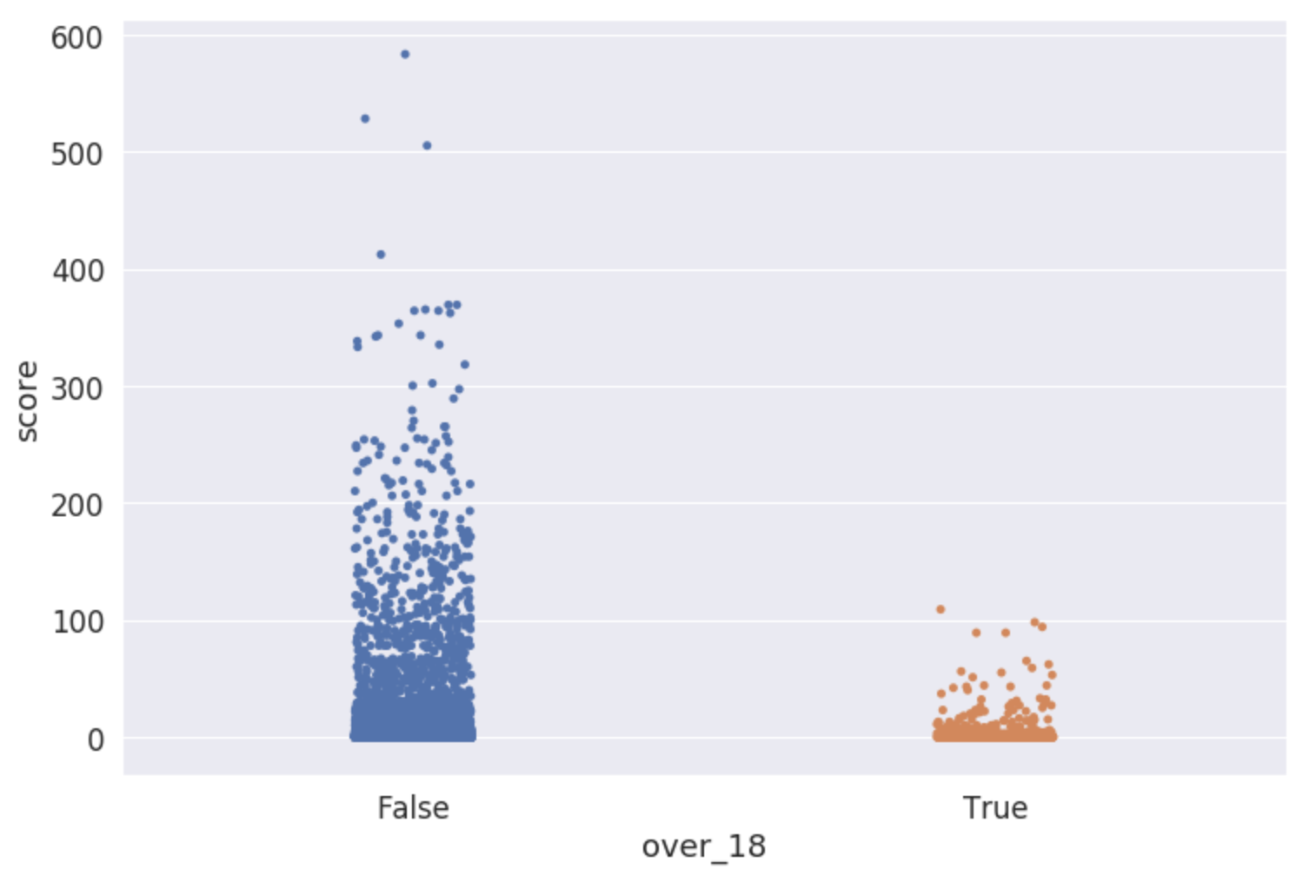
Data Exploration
Relationship with categorical variables
Presenter: Zhaohui

Slide 8
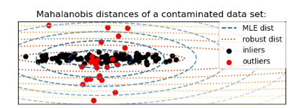
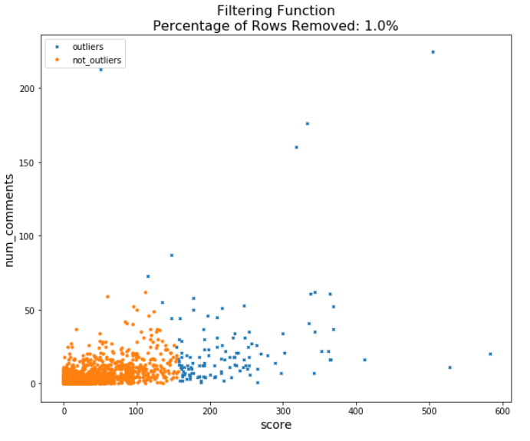
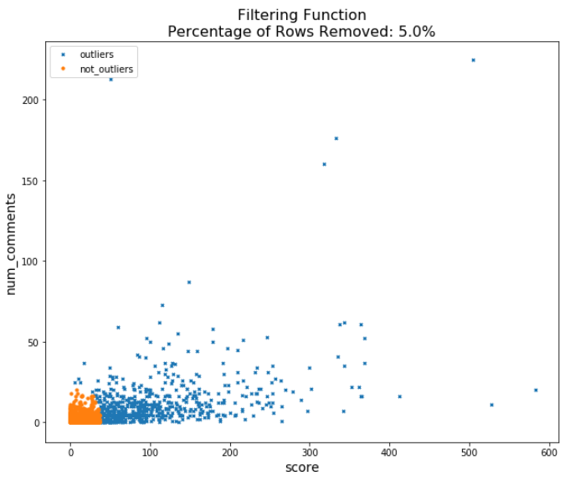
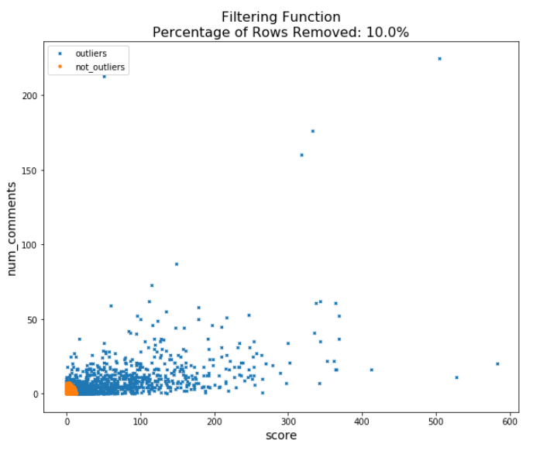
Outlier Detection
Outliers were filtered using Elliptic Envelope function
We decided against filtering as it removed rare instances of high popularity posts
Presenter: Dylan
Outlier Not Outlier
Notes:
Dylan
Main points:
Interested in filtering outliers on continuous numerical variables
ELliptic envelope appleid to the continuous numerical data of num comments and scores
Even removing 5% wipes out all the big scores which we want to keep because we can assume that these outliers fall into a bucket

Slide 9
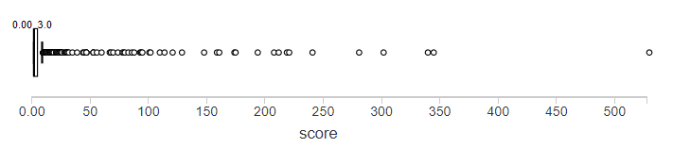
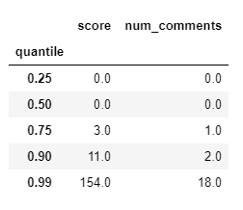
90% of the data falls within a score of 11 while the range is 154!

Slide 10
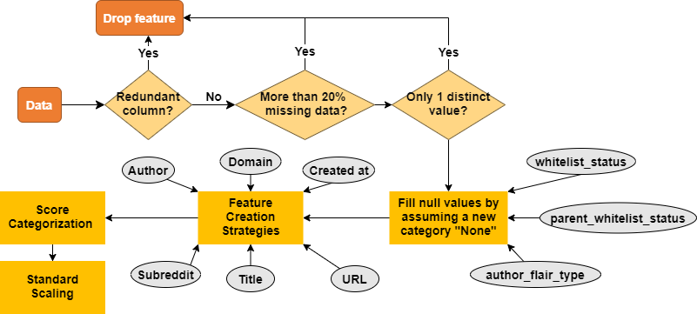
Feature Engineering Approach
Start here
Presenter: Dylan

Slide 11
Feature Engineering Approach, contd.
Presenter: Dylan
Notes:
Redundant columns (id, subreddit_id, etc.)

Slide 12
Feature Engineering Approach, contd.
Presenter: Dylan
Notes:
UTC, TF IDF, URLs, numerical and categorical conversion, categories, column drop

Slide 13
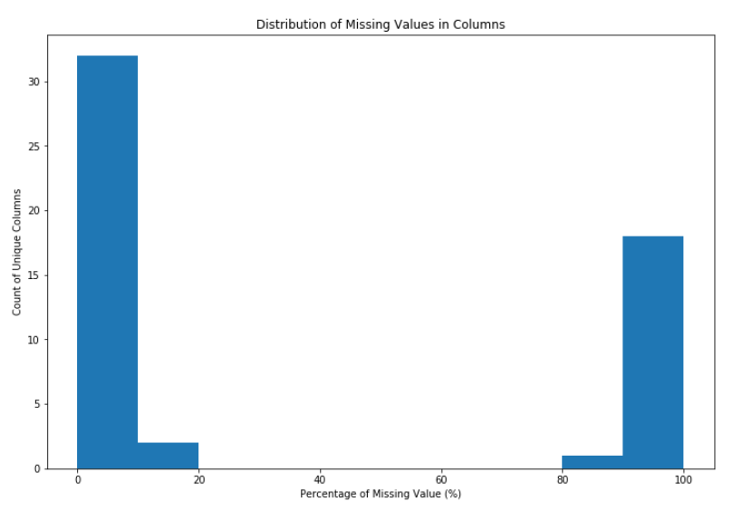
Feature Engineering Approach, contd.
Group of columns with less than 20% missing values
Group of columns with lots of missing values!
Presenter: Dylan
Notes:
UTC, TF IDF, URLs, numerical and categorical conversion, categories, column drop

Slide 14
Feature Engineering Approach, contd.
Presenter: Dylan
Notes:
UTC, TF IDF, URLs, numerical and categorical conversion, categories, column drop

Slide 15
Feature Engineering Approach, contd.
Presenter: Dylan
Notes:
The null values in this column mean that they haven’t opted for the whitelist option, or that they don’t have flair, so we impute with a new category

Slide 16
Feature Engineering Approach, contd.
Presenter: Dylan
Notes:
This is quite extensive to go into so I will give a brief overview starting from bottom right and going clockwise:
Regular expressions were used to clean .com, www. Https, ?param=31232, .info, and obtain string data which was then put through a TF IDF
Title was put through TF IDF
Subreddits, authors, domains were converted into avg number of comments using window functions
Months and days were extracted from the creation timestamp

Slide 17
Feature Engineering Approach, contd.
Input
Process
Output
1
URL
Regular Expression Extractor
Cleaned URL
2
Title
Cleaned URL
TF-IDF Title (Dim = 30)
TF-IDF URL (Dim = 30)
Vector Representation
3
Created Timestamp
Timestamp Extraction
Created Month
Created Day
4
Subreddit
Author
Domain
Window Function Over Number of Comments
Subreddit Avg
Author Avg
Domain Avg
Presenter: Dylan
Notes:
This is quite extensive to go into so I will give a brief overview starting from bottom right and going clockwise:
Regular expressions were used to clean .com, www. Https, ?param=31232, .info, and obtain string data which was then put through a TF IDF
Title was put through TF IDF
Subreddits, authors, domains were converted into avg number of comments using window functions
Months and days were extracted from the creation timestamp

Slide 18
Input | Process | Output
URL | Regular Expression Extractor | Cleaned URL
Cleaned URL Title | TF-IDF | Vectorized Strings
Created Timestamp | Timestamp Extraction | Created Hour Created Day
Subreddit Author Domain | Window Functions over Num Comments | Subreddit Avg Author Avg Domain Avg

Slide 19
Feature Engineering Approach, contd.
Presenter: Dylan
Notes:
Scores were categorized

Slide 20
Feature Engineering Approach, contd.
Presenter: Dylan
Notes:
Scores were categorized

Slide 21
Feature Engineering Approach, contd.
Score Range | Category
Notes:
Scores were categorized
Add a graph

Slide 22
Framework to Solve Problem
This diagram can be modified to include the final pipeline we use, i.e. Inputs, Feature engineering, Outlier removal, 0/0+ classifier, Final classifier.
I included the diagram as a useful reference
Inputs
Supervised ML Algorithms
Outputs
Reddit Dataset
XXX Features
XXX Rows
XXX Null values, etc
Include information about dataset here
Supervised Models:
Linear
Non-Linear
Tree-based
Categorical Prediction:
Include info here
Notes:
UTC time, TF IDF,

Slide 23
Categorization
We argue that predicting fine-grained categories can lead to same business usages as predicting raw scores. We turn this regression problem into a classification problem.
Advantages:
Easier to deal with imbalanced data (0 and 0+)
No need to normalize scores / outlier detections
More tools available for classification problems
Easier to measure model performance
Less prone to overfitting
Disadvantage:
Predictions are less precise than predicting raw scores
Presenter: Shi
Notes:
Baiwu: include 0/0+ classifier, turning for high precision; get the metrics;
Dylan: feature engineering slide, clean notebook. Slide 4.
Hushi: clustering for the second classifier
Alex: slide 3, slide 2
Krish: Conclusion and Future Recommendations

Slide 24
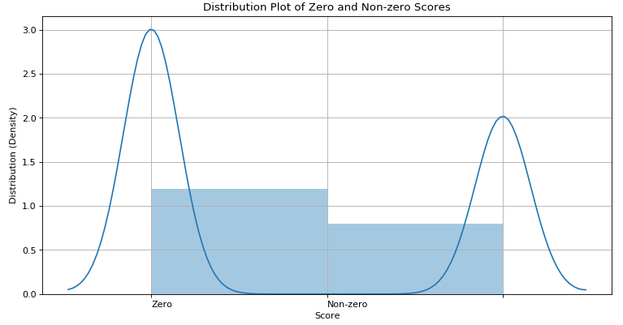
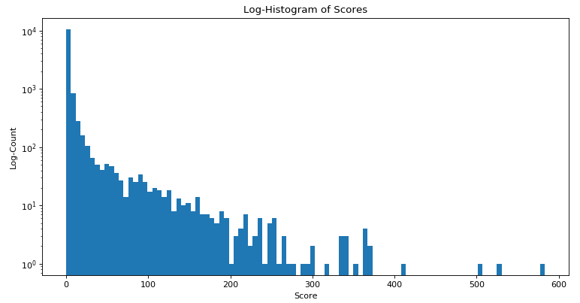
Categorization
Distribution of Raw Score:
Presenter: Shi
Notes:
Baiwu: include 0/0+ classifier, turning for high precision; get the metrics;
Dylan: feature engineering slide, clean notebook. Slide 4.
Hushi: clustering for the second classifier
Alex: slide 3, slide 2
Krish: Conclusion and Future Recommendations

Slide 25

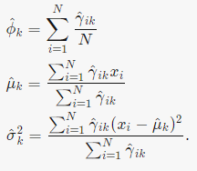
Clustering
Gaussian Mixture Model (GMM)
Initialization
Expectation
Maximization
Presenter: Shi

Slide 26
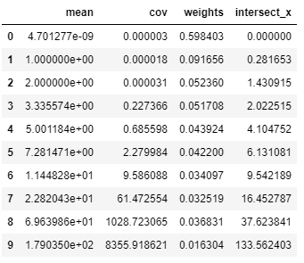
Clustering
Results
Presenter: Shi

Slide 27
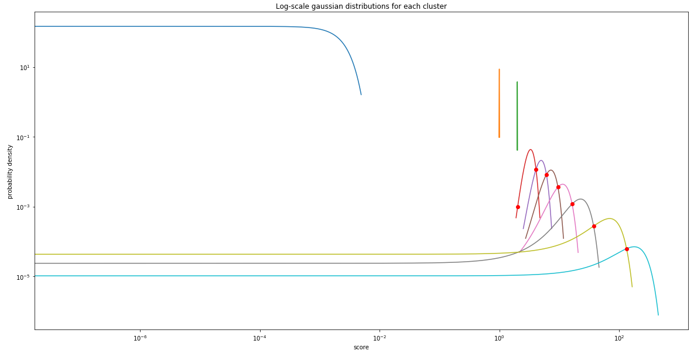
Clustering
Results
Presenter: Shi

Slide 28
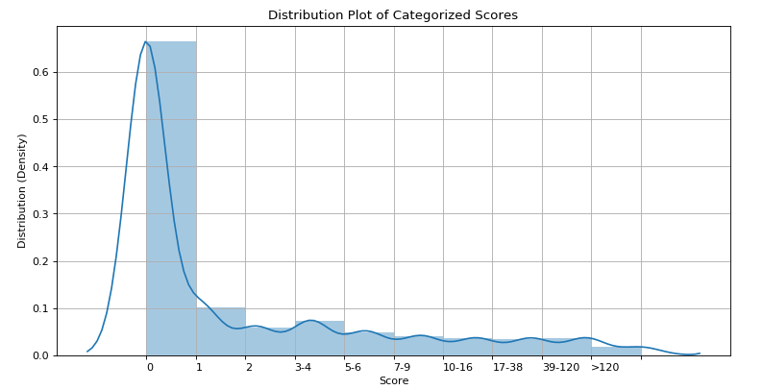
Categorization
We categorize scores into 10 categories:
Class | 0 | 1 | 2 | 3 | 4 | 5 | 6 | 7 | 8 | 9
Score | 0 | 1 | 2 | 3-4 | 5-6 | 7-9 | 10-16 | 17-37 | 38-133 | >133
Category Distribution
Presenter: Shi

Slide 29
Baseline Model
Multiclass Classifiers
Model | Train Accuracy | Train F1 | Test Accuracy | Test F1
Logistic Regression | 69.2% | 64.4% | 67.6% | 61.8%
Decision Tree | 68.2% | 61.4% | 66.7% | 59.7%
Random Forest | 61.9% | 47.9% | 64.7% | 51.4%
Winner
Presenter: Baiwu

Slide 30
2-Stage Model
Stage 1:
A binary Classifier to classify for 0/0+
Goal: High precision on 0 class
Intent: To filter out as many 0s as possible.
Stage 2:
A multiclass classifier for all classes
Goal: Overall high accuracy / F1
Intent: Classify rest of the data as good as possible.
Presenter: Baiwu

Slide 31
2-Stage Model(Stage 1): 0/0+ Classifier
Objective:
Filter out the majority posts with 0 score, and create a balanced dataset for Stage 2
Method: Logistic Regression
Results: Recalled 7093 0 classes, with a precision of 84%.
 | 0 Class | 0+ Classes | Total
Predict 0 | 7093 (84.0%) | 1352 (16.0%) | 8445 (100%)
Predict 0+ | 402 (9.9%) | 3678 (90.1%) | 4080 (100%)
Stage 2 Data
Presenter: Baiwu

Slide 32
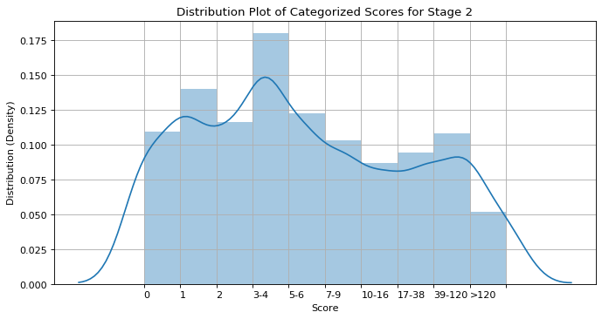
2-Stage Model(Stage 1): 0/0+ Classifier
Presenter: Baiwu

Slide 33
2-Stage Model(Stage 2): Multiclass Classifier
Objective:
Predict 10 score categories for rest of the data.
Methods & Results :
With Stage 1 & 2 Combined:
Model | 2-Stage Classifier
Train Accuracy | 69.7%
Train F1 | 65.6%
Test Accuracy | 67.9%
Test F1 | 62.6%
Model | Accuracy
Logistic Regression | 40.3%
Presenter: Baiwu

Slide 34
Final Model
Model | Train Accuracy | Train F1 | Test Accuracy | Test F1 | OOT Accuracy | OOT F1
2-Stage Classifier | 69.7% | 65.6% | 67.9% | 62.6% | 72.4% | 66.0%
Baseline Classifier | 69.2% | 64.4% | 67.6% | 61.8% | 72.1% | 66.2%
Presenter: Baiwu

Slide 35
Hyper Parameter Tuning
Hyper Parameter Tuning includes:
Stage 1:
Stage 2
Best Stage 1: Regularization Parameter: { 0.01 } ; Elastic Net Parameter : {0.8 } Fit Intercept : { True}
Best Stage 2: Regularization Parameter : { 0.01 } ; Elastic Net Parameter : {0.6 } Fit Intercept : { False}
Regularization Parameter : { 0, 0.01, 0.03, 0.1 }
Elastic Net Parameter : {0.6, 0.8 }
Fit Intercept : { True, False }
Regularization Parameter : { 0.01, 0.03 }
Elastic Net Parameter : {0.6, 0.8 }
Fit Intercept : { True, False }
Presenter: Navaneetha
Notes:
The ML lib library consists of tools for tuning the ML algorithms and Pipelines. The Built-in Cross Validation function and other such tools allow users to optimise the hyperparameters. The ParamGridBuilder was used to construct the parameter grid. By default, sets of parameters from the parameter grid are evaluated in serial. Parameter evaluation can be done in parallel by setting parallelism with a value of 2 or more (a value of 1 will be serial) before running the model.
Here we tried to tune our best model i.e., the Logistic Regression model over two stages. The hyperparameters chosen were the regularisation parameter, elastic Net Param and fit Intercept. The best hyper parameter values for each parameter was found and applied it to the final model. Unfortunately, for our case hypertuning the parameters did not affect much of the model’s accuracy.

Slide 36


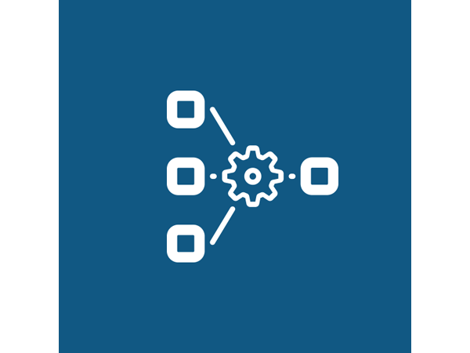
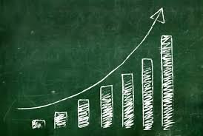
Findings/Conclusion
Highly imbalanced data
Hyper-Parameter tuning is computationally expensive
Increased Performance for Two-stage classifier
Feature Engineering
Presenter: Navaneetha
Notes:
These are some of the important findings and conclusion from our project.
Here, after initial data exploration we found that the data was highly imbalanced, by plotting the distribution of the scores. The target variable i.e., score column is not evenly distributed and majority of the scores as zero. Predicting the score as a raw number didn’t turn out good, so we went on with converting the regression problem to a classification problem by bucketing the scores into different categories.
The given dataset consists of various features out of which most of them did not provide useful meaning to the model until feature engineering was brought to the game. Feature engineering helped us create useful features from columns such as url, timestamp and so on. The initial model accuracies before any sort of feature engineering was too low compared to the models final accuracy after feature extraction.
Tuning the hyper parameters are computationally expensive, that is most of the time the cluster either crashes or times out.
It is pretty evident from the results, that the two stage classifier provides better accuracy than a single stage classifier. As my friend explained we combined the predictions from stage 1 and stage 2 classifiers and then finally evaluated both of them using the MultiClass Classification Evaluator with accuracy and F1 score chosen as our final metrics for performance evaluation.

Slide 37




Future Recommendations
Evaluating the importance of Outlier removal
Explore more on hyperparameter tuning
Explore the title column using Word2Vec or GLOVE
Develop regression models and compare their performance
Presenter: Navaneetha
Notes:
Outlier Removal:
Evaluating the importance of outlier removal
As discussed earlier removing even 1% could potentially wipe out a whole category of scores, which might not result in better performance.
Feature Engineering:
Tuning number of features from TF-IDF
Trying different word embedders
Hyper-Parameter Tuning:
Model:
Our assumption was that we were doing a classification. We could compare the performance of classification to regression

Slide 38


