Slide 1
Predicting the Price of Bitcoin Using LSTMs
APS 1052
Dylan Mendonca - Daniel Gershanik

Slide 2
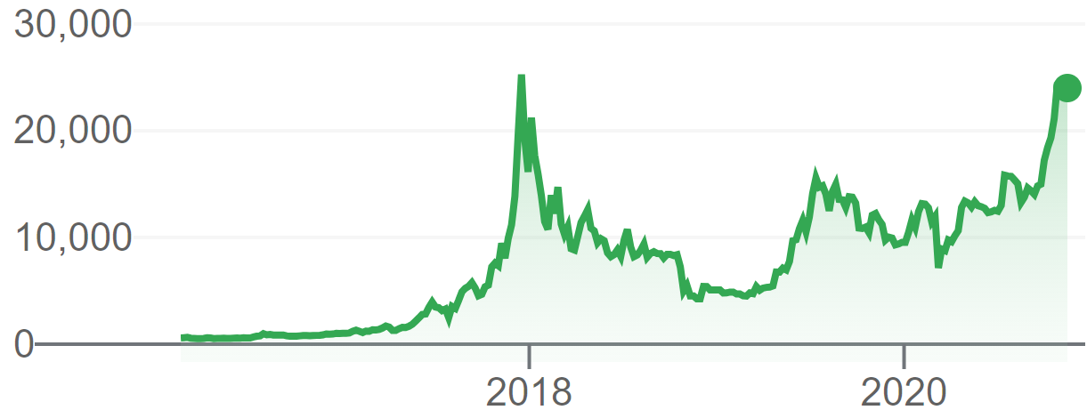
Project Goals & Motivation
Predicting next day price of Bitcoin
Bitcoin is a very popular trading vehicle
Price of Bitcoin has increased substantially over the last two years, now matching its previous pre 2018 crash highs

Slide 3

Bitcoin
P2P decentralized digital currency
Abbreviated as BTC
Initially released in January 2009
Most popular and well known crypto currency in the world
Currently the total circulating supply of bitcoin is roughly 18,574,612
Bitcoin supply is fixed at 21,000,000 coins

Slide 4
Bitcoin
Bitcoin USD exchange rate is 1 BTC = 23,074 USD
Bitcoin has a Total Market Cap of 427,809,749,739 USD
Bitcoin 24-hour trading volume is 40,885,000,000 USD
Bitcoin market is open 24 hours per day 7 days per week

Slide 5
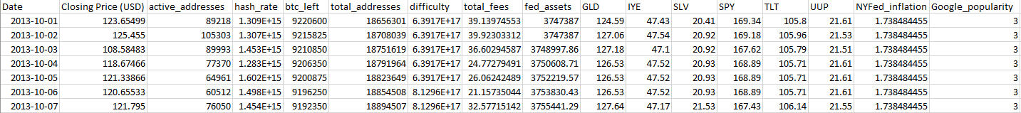
Training Data
Training data has daily intervals
Training data was compiled from a number of different sources
Contains 17 columns
16 features (including closing price) were used to predict the Closing Price
Date range 2013/10/01 - 2020/10/09

Slide 6

Training Data - Glassnode
The data fields Closing Price, active addresses, hash rate, btc left, total addresses, difficulty, total fees, fed assets were obtained from glassnode. Each is explained in the next slide.

Slide 7
Training Data - Glassnode
Closing Price: closing price of bitcoin in USD
Active addresses: total number of unique address that either sent or received bitcoin
Hash rate: measure of compute power in the network
Bitcoins left: number of bitcoins left to be mined
Difficulty: measure of how difficult it is to mine a bitcoin
Total fees: total transaction fees per day
Fed assets: federal reserve balance sheet

Slide 8

Training Data - WRDS
The ETFs GLD, IYE, SPY, TLT, UUP were obtained from WRDS. Each is explained in greater detail in the next slide.

Slide 9
Training Data - WRDS
GLD: SPRD Gold Shares track the price of a gold bullion
IYE: tracks an index composed of US energy sector equites
SPY: S&P 500 tracks the performance of 500 large companies listed on US stock exchanges
TLT: tracks an index composed of US treasury bonds with remaining maturity of greater than 20 years.
UUP: tracks the relative performance of the USD.

Slide 10

Training Data - Federal Reserve Bank of New York
NYFed Inflation: Captures sustained movements in inflation from a broad range of indicators. Obtained from the New York Federal Reserve website.

Slide 11
Training Data - Google Analytics
Google popularity: measures interest over time for the search term bitcoin. The value is relative to a search term’s peak popularity, where a value of 50 means the term is half as popular as it ever was.

Slide 12
Training Data - Train Test Split
Training Set
Validation Set
Testing Set
64%
16%
20%

Slide 13
Training Data - Data Preprocessing
ETF price is only only available for trading days, during non trading hours/days that data is forward filled
Inflation and google trends data is gathered monthly, and forward filled for the remainder of the month
Best window size is 21
We look back 20 days and try to predict the price on the 21st day
We tried window sizes of 7,14, and 28 days

Slide 14
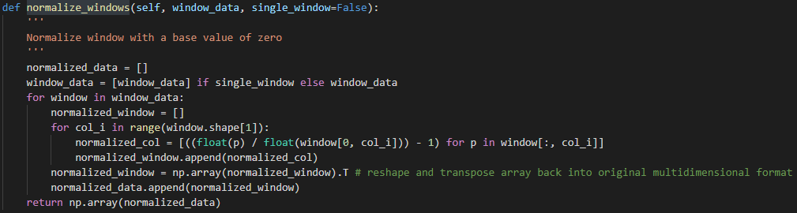
Training Data - Data Preprocessing
Window normalization is used

Slide 15
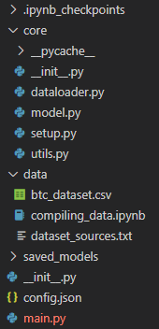
Code - File Structure
main.py acts as a wrapper, the program can be launched by running this file.
config.json contains all model setting including data file name, train test split, model hyperparameters and model structure.
core folder contains all helper functions required by main.py

Slide 16
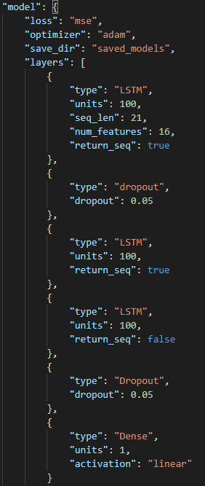
Code - ML Model
A Stacked-LSTM model is used for prediction
Dropout used to control overfitting
Its structure is outlined in config.json file
The model is implemented using Tensorflow 2.0 (Keras)

Slide 17
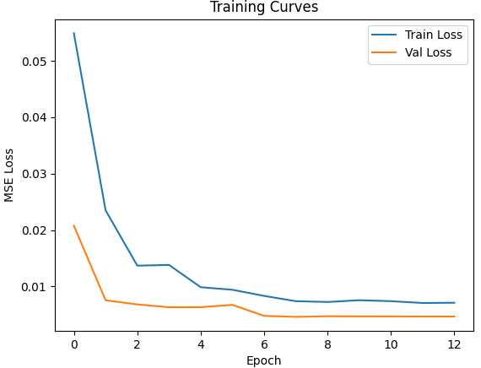
Results - Training and Testing Loss

Slide 18
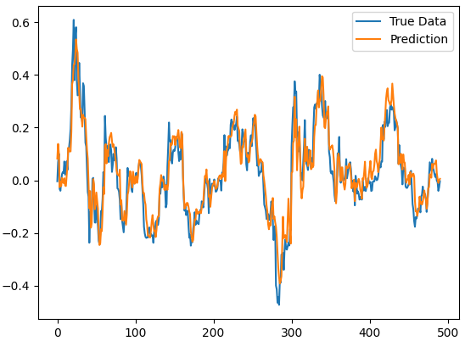
Results - Next Day Normalized Price Prediction
Normalized price prediction was used to create a trading strategy
If normalized price predicted is greater than 0, buy bitcoin
Otherwise, sell it

Slide 19
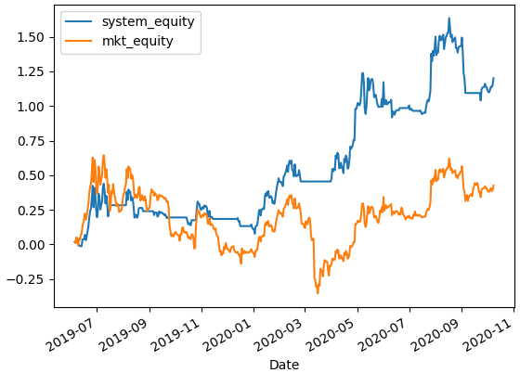
Results - Change in Equity Over Time
Trading system versus Market (holding Bitcoin) on Test Set

Slide 20
Results - Metrics
Market CGAR: 19.9%
Market Sharpe: 0.6
System CGAR: 49.8%
System Sharpe: 1.2

