Slide 1
JUKEBOX PROJECT
Submitted by
Punit
Under the Guidance of
Mr Vishal Uniyal

Slide 2
INTRODUCTION
Jukebox is a music application for user to play songs as well as podcasts . user can also search the song and make this playlist according to their interest which is being displayed in this application.

Slide 3
OBJECTIVE
The primary purpose of this musical application
is to play music available in the databases of the service, compose custom playlists and search similar songs by displaying various options.

Slide 4
MODULES:
Create new user
Login existing user
Play songs
Play podcast
Display songs
Display podcasts
Display playlist
Make playlist
Search song
Search podcast

Slide 5
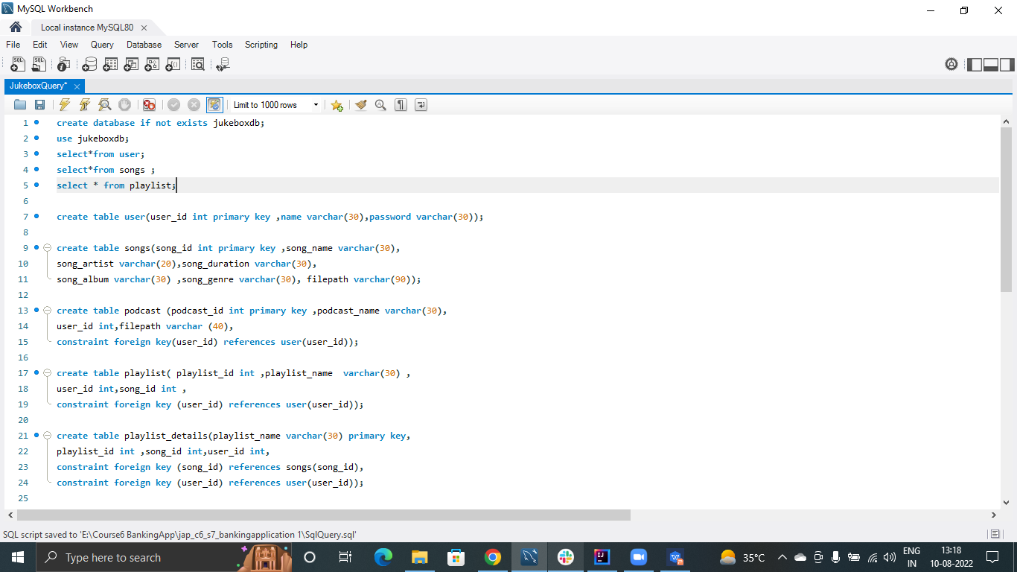
MySQL Table

Slide 6
Software Required
Operating System
Intellij
MySQL Workbench

Slide 7
Hardware Required
Computer
RAM
Processor

Slide 8
FEATURES
Registration and Login Authentication
User friendly interface
Easy and Fast response
Music categorization
Music collection
Flexible to access
Playlist feature

Slide 9
ADVANTAGES
Less time consumption
Offline listen to all music
User can create their profile easily
User can create their playlist easily
Login authentiction
Proper data mainatining
Searching option by name

Slide 10
LIMITATIONS
* Limited collection of song
* Limited collection of podcast

Slide 11
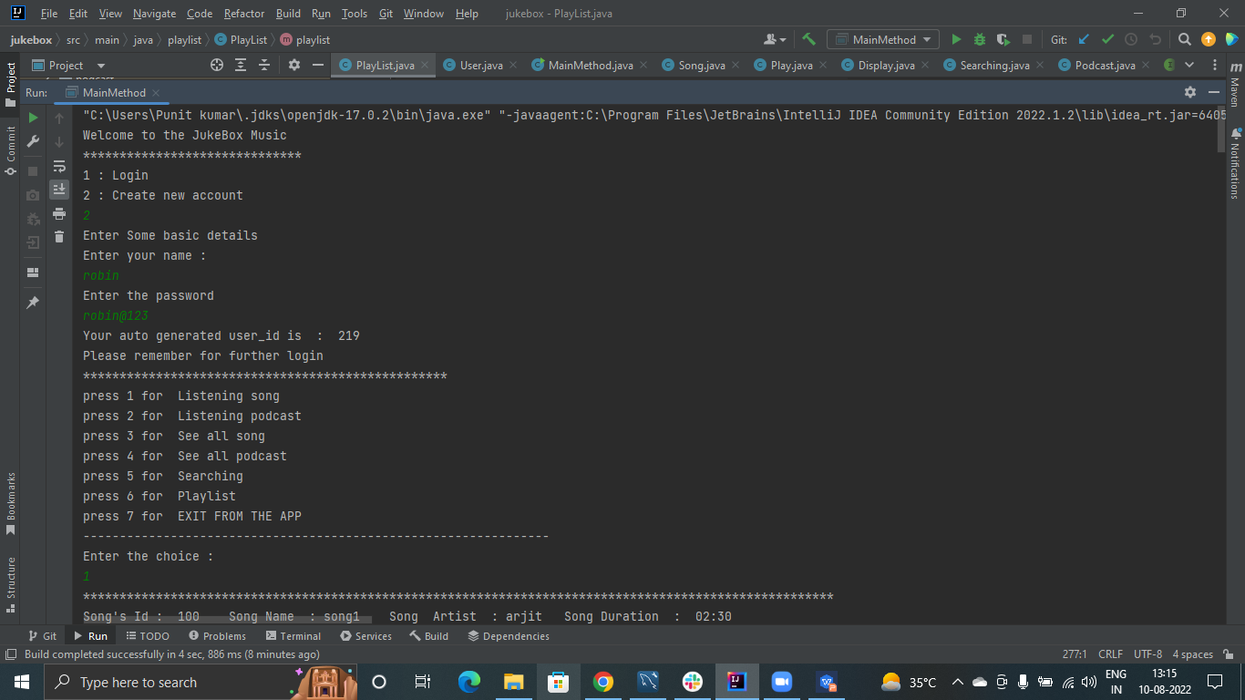
OUTPUT WINDOW

Slide 12
THANK YOU!

