Slide 1


Mini Project (CSE7102)
REVIEW-1
29-08-2026
Presidency
School of Computer Science and Engineering

Slide 2
AI-POWERED TRAFFIC MANAGEMENT SYSTEM
CSS7102- Mini Project Review-2
Project ID: PRJ_555
Panel No: 28
Group members details:
Under the Supervision of,
Thummalapalli Lakshmi Vara Prasad
School of Computer Science and Engineering
Presidency University
Sl.No | Student Name | Roll Number
1 | Mohammed Zaid | 20231COM0024
2 | Syed Mohammed Rabi | 20231COM0081
3 | N Kushal | 20231COM0018
Name of the Program: Computer Engineering
Name of the HoD: Dr. Gopalkrishna Shyam
Name of the Program Project Coordinator: Ms. Sumita Guddin
Name of the School Project Coordinators: Mr. Muthuraju V

Slide 3
INDEX
Problem statement
Objectives
Literature/research understanding
Methodology and architecture
Implementation progress
Individual contribution

Slide 4
Problem Statement – AI-Based Traffic Management System
Urban areas are facing increasing traffic congestion due to the rapid growth in the number of vehicles, limited roa
capacity, accidents, inefficient traffic signal timing, and unpredictable traffic patterns. Traditional traffic management
systems generally operate using fixed-time traffic signals, which do not dynamically respond to real-time traffic conditions.
This can result in unnecessary waiting times, fuel consumption, air pollution, and delays for emergency vehicles.
The AI-Based Traffic Management System aims to address these problems by using Artificial Intelligence and
Computer Vision to monitor and analyze traffic conditions in real time. The system can detect and count vehiclesfrom
camera footage, estimate traffic density, identify congested areas, and dynamically adjust traffic signal timings
according to the current traffic situation.

Slide 5
Objectives
1. To detect and count vehicles in real time using AI-based computer vision techniques.
2. To analyze traffic density at intersections and identify congested traffic lanes.
3. To dynamically optimize traffic signal timings based on real-time traffic conditions.
4. To reduce vehicle waiting time and traffic congestion by improving the flow of vehicles through intersections.
5. To provide traffic insights and alerts that can support efficient urban traffic management and mobility planning.

Slide 6
Literature / Research Understanding
1. AI-Based Adaptive Traffic Signal Control
Recent studies use Reinforcement Learning (RL) and Deep Reinforcement Learning (DRL) to dynamically control traffic signals based on traffic conditions.
DQN/D3QN-based approaches have been used to reduce waiting time and improve traffic efficiency.
2. Computer Vision for Traffic Monitoring
Camera-based systems can provide traffic information such as vehicle count, lane occupancy and traffic density, which can be used as input for intelligent signal control.
Research indicates that ordinary camera-based traffic data can be sufficient for some signal-control applications.
3. Multi-Intersection Traffic Management
Recent research explores DRL and graph-based models for coordinating signals across multiple intersections rather than optimizing only one junction.
4. Existing Real-World Application
Google Green Light uses AI and Google Maps driving trends to recommend optimized traffic-light timings. Google reports that the system is deployed in 100+ cities, including Kolkata, India.
Limitations Identified
Many research systems are evaluated mainly in simulation environments rather than diverse real-world road conditions.
Advanced RL models can require significant training data and computational resources.
Deploying adaptive control across existing intersections can be difficult because of infrastructure and integration costs.
Research Gap
There is a need for a practical, low-cost AI-based system that combines real-time camera-based vehicle detection and traffic-density estimation with adaptive signal control, while remaining suitable for implementation in real urban intersections.

Slide 7
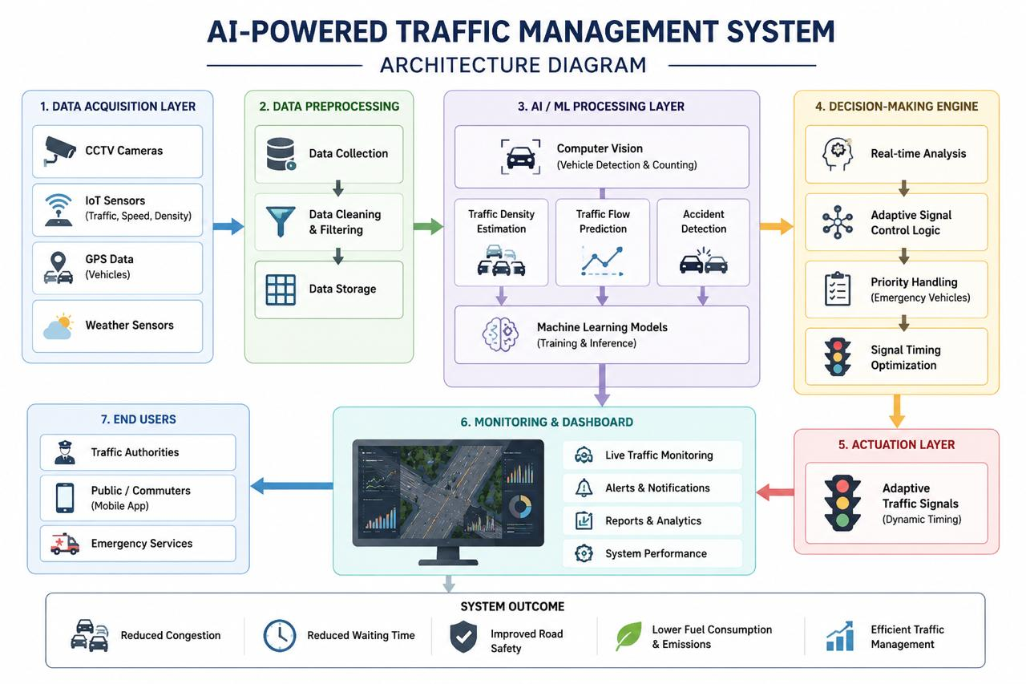
Methodology and Architecture
METHODOLOGY
1. Traffic Data Collection
2. Vehicle Detection & Counting
3. Traffic Density Analysis
4. Intelligent Signal Control
5. Monitoring & Output
Camera/IoT data → AI analysis → Adaptive signals → Monitoring

Slide 8
Implementation Progress
Completed Modules
• AI Traffic Management Dashboard & 4-Way Intersection
• Vehicle Count & Traffic Density Visualization
• Adaptive Traffic Signal Control
• Signal Timer & Cycle Management
• Emergency Vehicle Priority
• Traffic Event Log & Flow Chart
• Video Upload & Playback
• Controller Configuration Panel
Technologies
• HTML5, CSS3, JavaScript
• YOLOv8, Python, OpenCV & Flask – Planned Integration
Testing Status
Dashboard & Lane Visualization.

Slide 9
Individual Contribution
Mohammed Zaid – Development & Implementation
• Handled front-end and back-end development and core coding.
• Worked on system integration and implementation.
• Performed debugging, testing, and technical troubleshooting.
Syed Mohammed Rabi – Project Analysis & Presentation
• Analysed project requirements, system workflow, and layout.
• Contributed to project planning and technical discussions.
• Prepared and organized the PowerPoint presentation.
N Kushal – Research & Documentation
• Conducted project-related research and technical analysis.
• Prepared the research paper draft and documentation.
• Collected relevant references and supported project discussions.

Slide 10
Github Link
GitHub Repository
https://github.com/mdzaidddd2005-tech/AI-Based-Traffic-Management-System.git

Slide 11
Conclusion
• The project proposes an AI-Based Traffic Management System for intelligent and adaptive traffic control.
• A functional traffic management dashboard has been developed to monitor a 4-way intersection, vehicle counts,
lane density, signal status, and traffic flow.
• Density-based signal control and emergency priority logic have been implemented in the current prototype.
• The system provides a foundation for integrating real-time AI vehicle detection using YOLO and computer vision.
• The next phase will focus on connecting actual traffic-video detection with the signal-control module and
evaluating the system under realistic traffic conditions.

Slide 12
References (APA Format)
1. Redmon, J., Divvala, S., Girshick, R., & Farhadi, A. (2016). You only look once: Unified, real-time object detection. CVPR, 779–788.
2. Jocher, G., Chaurasia, A., & Qiu, J. (2023). Ultralytics YOLOv8. Ultralytics. https://docs.ultralytics.com
3. Lin, T.-Y., et al. (2014). Microsoft COCO: Common objects in context. ECCV.
4. Bradski, G. (2000). The OpenCV library. Dr. Dobb’s Journal of Software Tools.
5. López, P. A., et al. (2018). Microscopic traffic simulation using SUMO. IEEE ITSC, 2575–2582.
6. Hunt, P. B., Robertson, D. I., Bretherton, R. D., & Winton, R. I. (1982). The SCOOT on-line traffic signal optimisation technique. Traffic Engineering & Control, 23, 190–192.
7. Wiering, M. (2000). Multi-agent reinforcement learning for traffic light control. ICML, 1151–1158.
8. Genders, W., & Razavi, S. (2016). Using a deep reinforcement learning agent for traffic signal control. arXiv:1611.01142.
9. Wei, H., Zheng, G., Yao, H., & Li, Z. (2018). IntelliLight: A reinforcement learning approach for intelligent traffic light control. ACM SIGKDD, 2496–2505.
10. Bazzan, A. L. C., & Klügl, F. (2014). A review on agent-based technology for traffic and transportation. The Knowledge Engineering Review, 29(3), 375–403.

Slide 13


