Slide 1
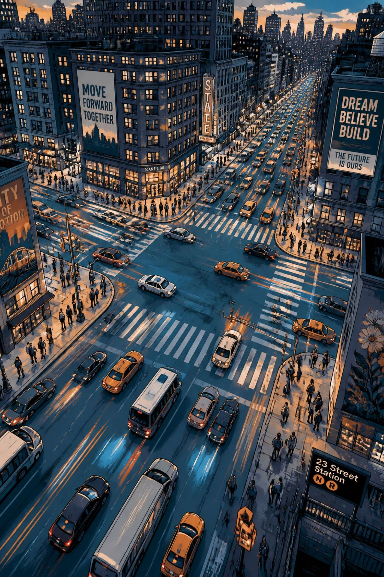
AI-POWERED TRAFFIC MANAGEMENT SYSTEM
Smart, adaptive, data-driven urban mobility — Mini Project presentation designed for traffic engineers and evaluators.
MOHAMMED ZAID
N KUSHAL
SYED MOHAMMED RABI
20231COM0024
20231COM0018
20231COM0081

Slide 2
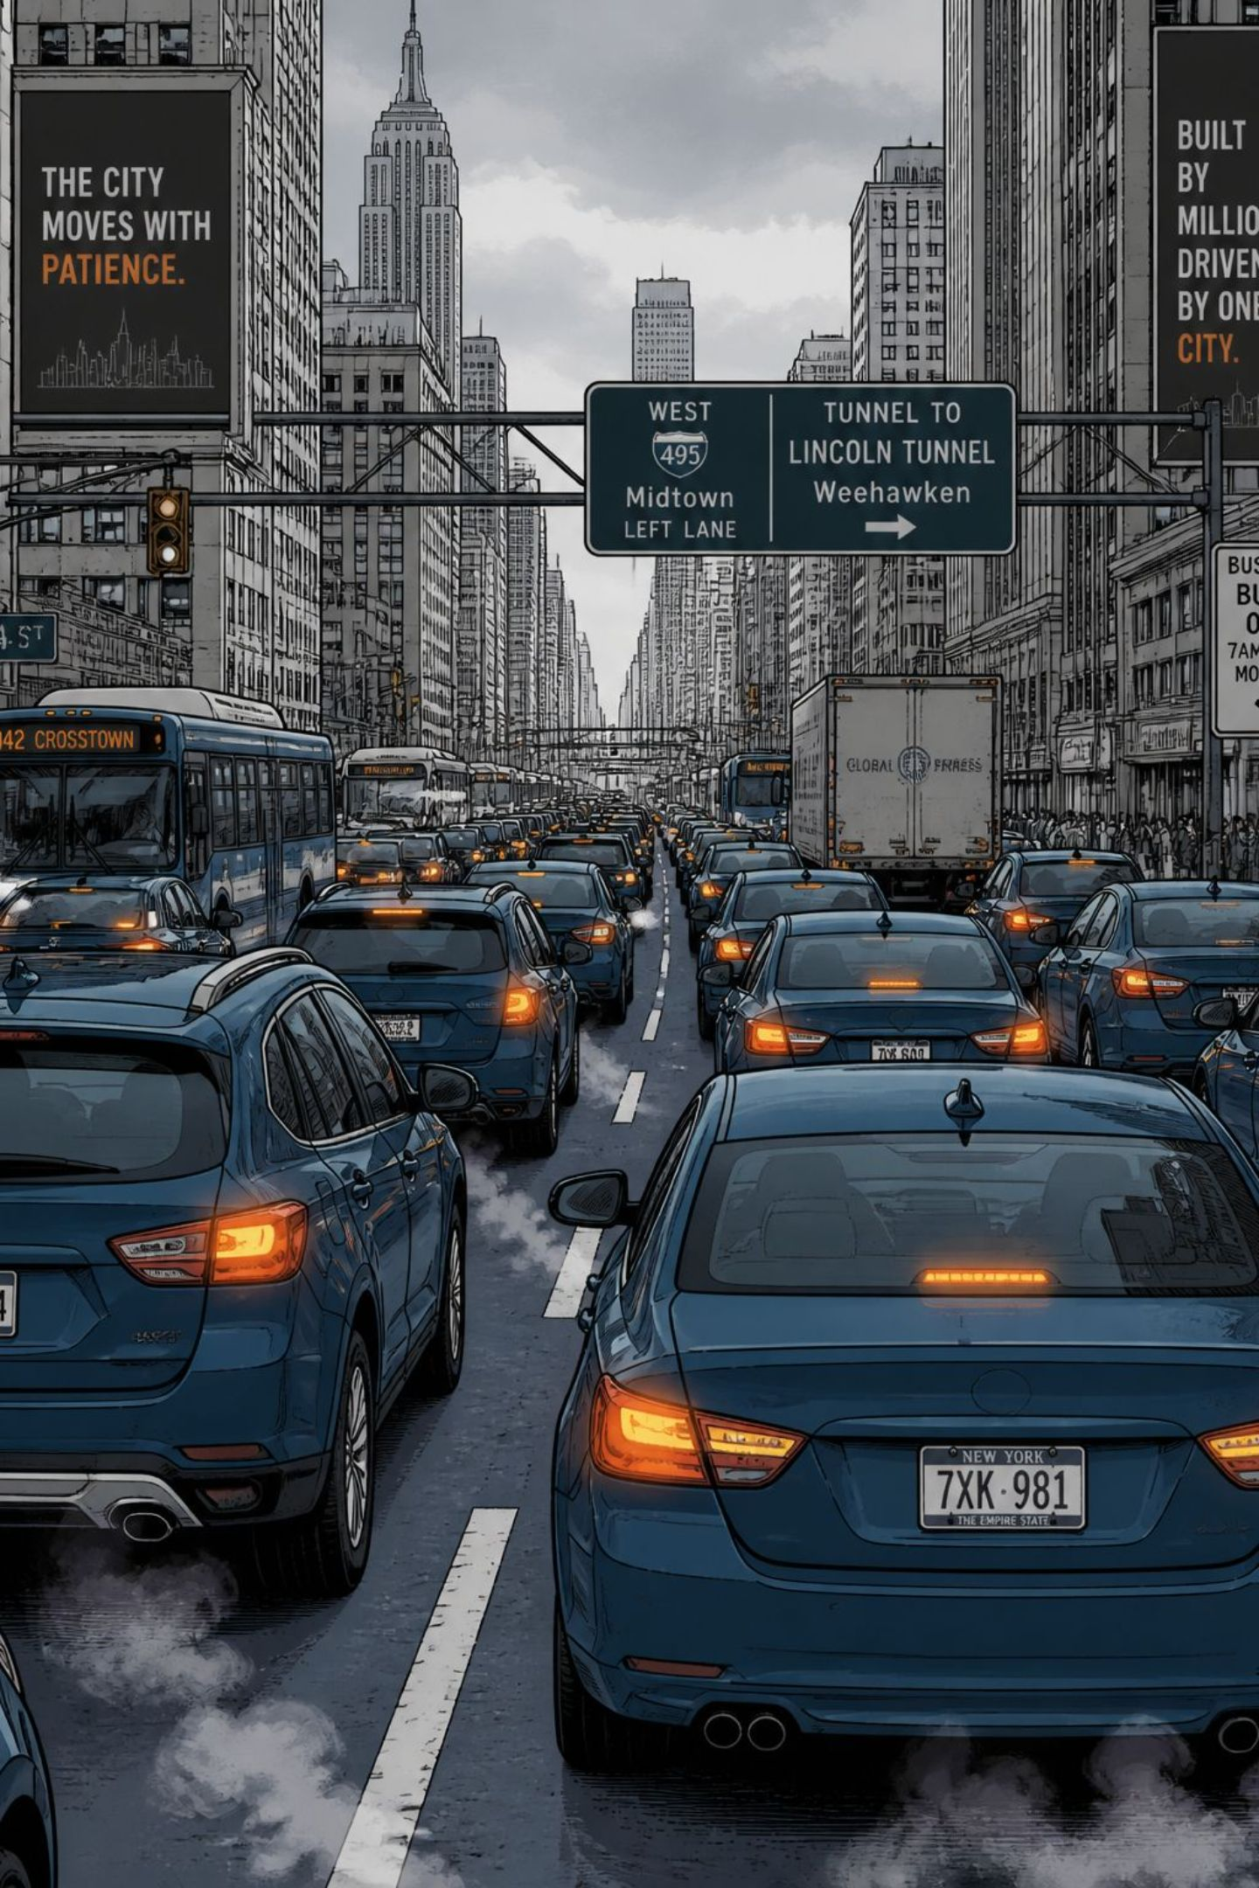
Introduction
Urban traffic congestion increases travel time, fuel use, and emissions. Fixed-time signals cannot adapt to rapid changes. By combining computer vision, IoT, and machine learning, an AI system monitors traffic in real time to improve flow, safety, and emergency response.

Slide 3
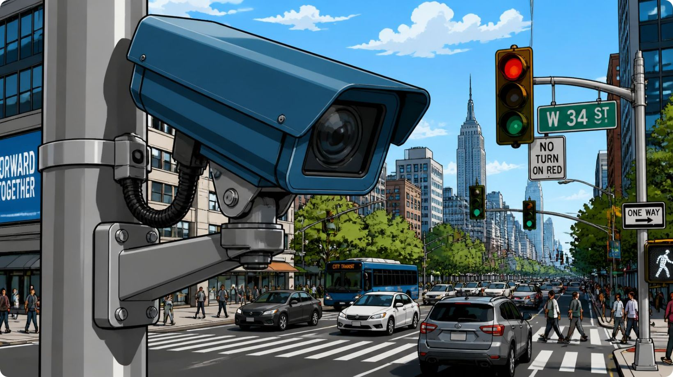
Problem Statement
Traffic density varies across hours and locations.
Fixed timings produce avoidable queues and delays.
Accidents and obstructions cause sudden disruptions.
Manual monitoring is slow and not scalable.
Need: an intelligent real-time system for responsive control.

Slide 4
Objectives
Detection
Estimation
Optimization
Safety & Priority
Automatically detect and count vehicles and road users.
Estimate density, queue lengths, and congestion levels.
Dynamically optimize signal timings using AI policies.
Detect incidents and prioritize emergency vehicles.
Prediction
Operations
Short-term traffic forecasting for proactive control.
Provide a real-time dashboard and historical analytics for authorities.

Slide 5
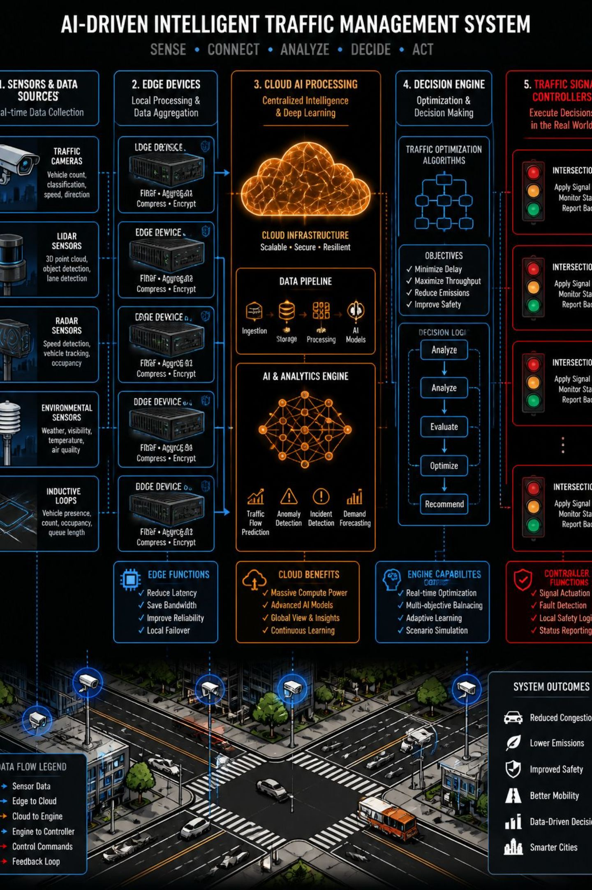
System Architecture
Flow: Data Collection → AI Processing (edge & cloud) → Decision Engine → Traffic Control & Dashboard. Cameras and IoT sensors capture video and telemetry; edge modules run fast inference; centralized engine evaluates policies and issues control commands. Dashboard provides operators situational awareness and alerts.

Slide 6
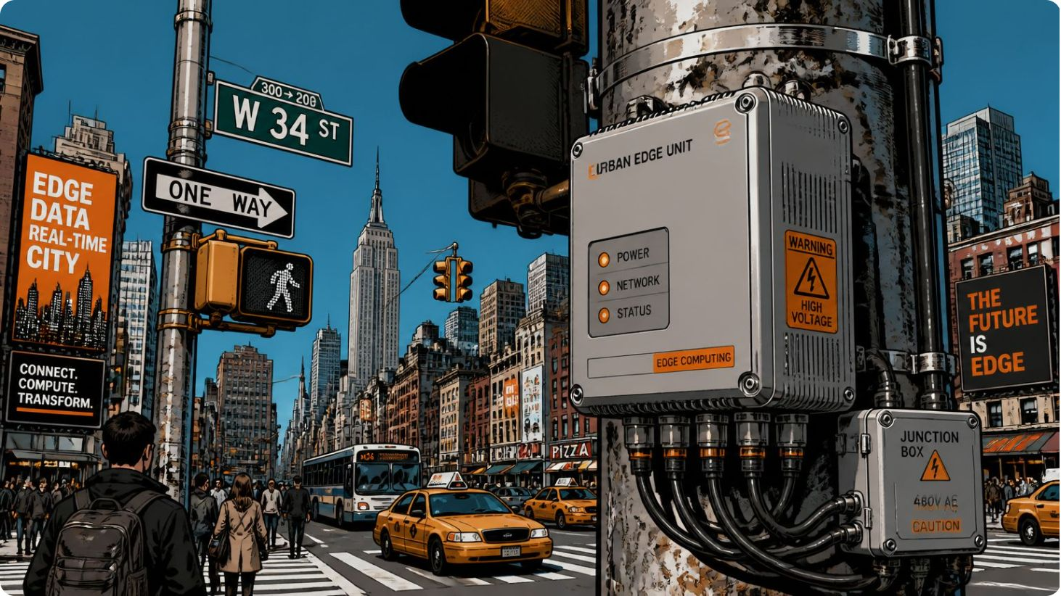
AI & Machine Learning Technologies
Computer Vision: real-time detection, tracking, and re-identification.
YOLO / CNN: lightweight detection models for vehicles, pedestrians, cyclists.
Time-series ML: short-term traffic forecasting (LSTM / Transformer variants).
Reinforcement Learning: adaptive signal control optimizing delay and throughput.
Edge AI: low-latency inference near intersections to reduce bandwidth and response time.

Slide 7
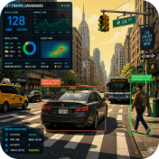
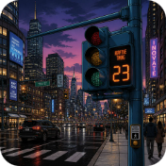
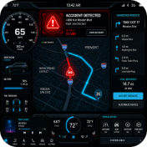

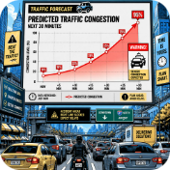
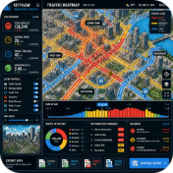
Key Features
Real-time Detection
Adaptive Control
Incident Alerts
Emergency Priority
Automatic detection of accidents and obstructions with operator notifications.
Accurate vehicle, pedestrian, and bicycle detection and counting at intersections.
Signal timing optimized per-cycle to minimize delay and queue length.
Preemption and prioritized green phases for emergency vehicles.
Prediction
Analytics
Short-term forecasts to enable proactive phasing and corridor coordination.
Historical reporting for performance evaluation and strategic planning.

Slide 8

System Workflow
Capture
Edge Inference
Aggregate Metrics
Forecast & Act
This closed-loop workflow enables sub-minute responsiveness and continuous model retraining with labeled events from the dashboard.

Slide 9

Technology Stack
Frontend: HTML, CSS, JavaScript for operator UI.
Backend: Python with Flask or FastAPI for APIs and orchestration.
AI: OpenCV, YOLO-family detectors, TensorFlow / PyTorch for model training/inference.
Database: MySQL for telemetry and event logs.
Hardware: CCTV cameras, edge devices (Raspberry Pi/industrial NPU), IoT sensors.
Cloud: AWS / Azure / GCP for scalable model training and data storage.
Communication: MQTT / HTTP APIs for reliable command and telemetry exchange.

Slide 10
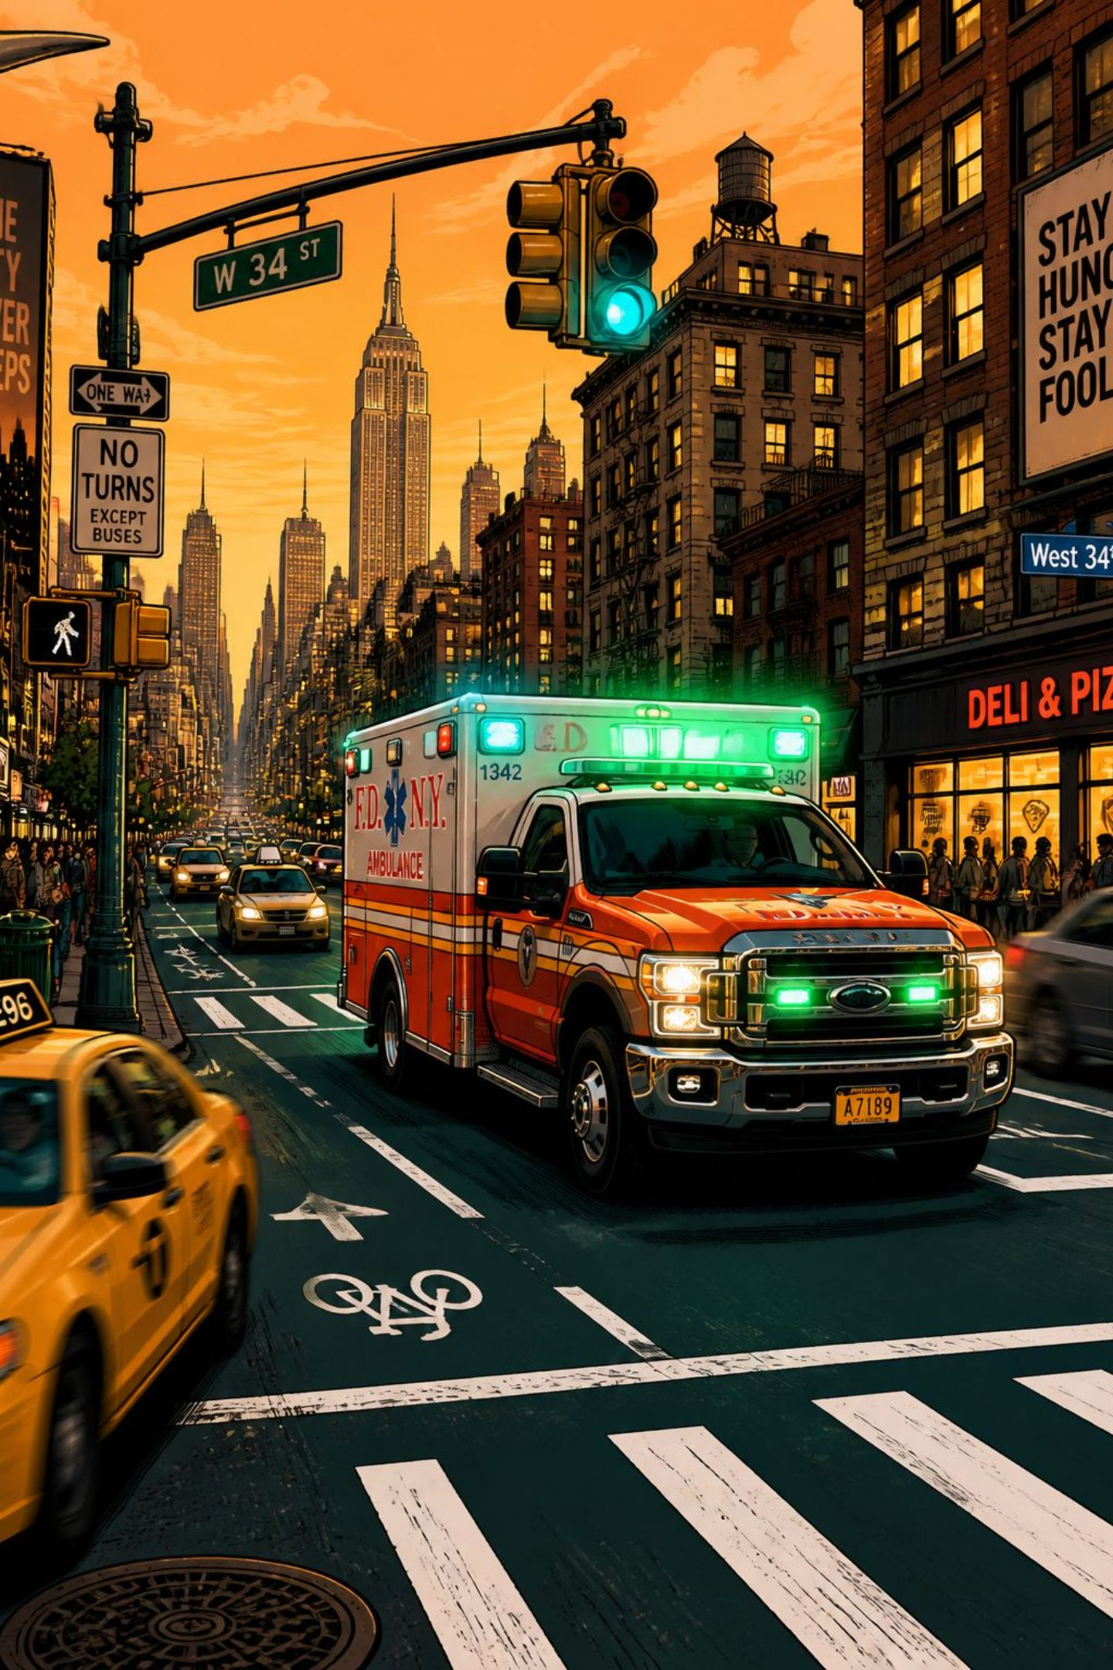

Expected Results & Impact
Operational Benefits
Safety & Response
Environmental
Lower fuel consumption and emissions through smoother traffic flow.
Reduced congestion and waiting time; improved intersection throughput.
Faster incident detection and reduced emergency response times via priority control.
Strategic Value
Data-driven decisions for traffic authorities and scalable integration into smart-city platforms.
Next steps: pilot at 2–3 intersections, measure delays and queue lengths for 30 days, refine RL reward function, and prepare deployment plan.

Slide 11




Transformative Benefits
Our AI-powered system delivers a multifaceted impact, enhancing urban mobility, safety, and environmental sustainability.
Optimized Flow
Enhanced Safety
Greener Cities
Data-Driven Decisions
Significantly reduce congestion, travel times, and queue lengths at intersections.
Accelerate incident response and provide priority routing for emergency vehicles.
Lower fuel consumption and carbon emissions through smoother, more efficient traffic movement.
Equip authorities with real-time insights and analytics for strategic urban planning.

Slide 12




Future Scope
Our AI-powered system lays the foundation for continuous innovation, with several key areas targeted for future development and enhancement.
V2X Communication
Autonomous Vehicle Interoperability
Integrate direct data exchange with connected vehicles (V2X) for advanced coordination and safety warnings.
Develop seamless coordination protocols with self-driving fleets to further optimize traffic flow and safety.
Predictive Maintenance
Smart City Integration
Implement AI-driven analysis of traffic infrastructure to anticipate and prevent equipment failures.
Expand integration with broader smart city platforms for environmental monitoring and intelligent urban planning.

Slide 13
Conclusion
Transforming Urban Mobility for a Smarter Future
The AI-Powered Traffic Management System offers a holistic solution to urban congestion, leveraging cutting-edge AI and machine learning to create safer, more efficient, and sustainable cities. By optimizing traffic flow, enhancing emergency response, and providing actionable insights, we are building the foundation for the smart cities of tomorrow.

Slide 14
Thank You
For Your Attention. Questions?

