Slide 1
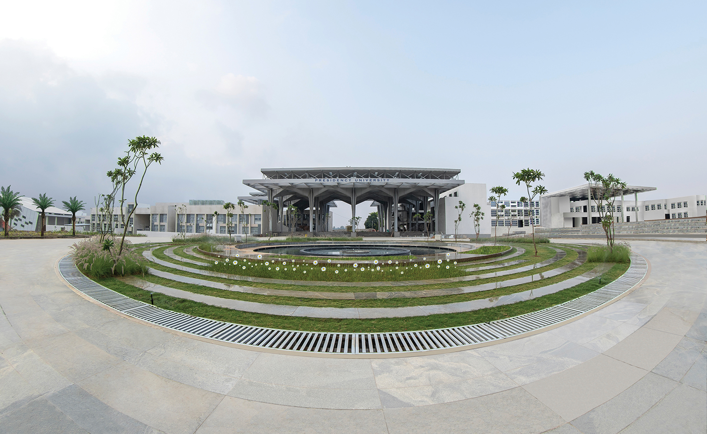

Mini Project (CSE7102)
REVIEW-1
29-08-2026
Presidency
School of Computer Science and Engineering

Slide 2
AI-POWERED TRAFFIC MANAGEMENT SYSTEM
CSS7102- Mini Project Review-1
Project ID: PRJ_555
Panel No: 28
Group members details:
Under the Supervision of, Thummalapalli Lakshmi Vara Prasad School of Computer Science and Engineering Presidency University
Sl.No | Student Name | Roll Number
1 | Mohammed Zaid | 20231COM0024
2 | Syed Mohammed Rabi | 20231COM0081
3 | N Kushal | 20231COM0018
Name of the Program: Computer Engineering Name of the HoD: Dr. Gopalkrishna Shyam Name of the Program Project Coordinator: Ms. Sumita Guddin Name of the School Project Coordinators: Mr. Muthuraju V

Slide 3
INDEX
Problem Statement
Git Hub Link
Introduction
Literature Review
Architecture Diagram
Analysis of Problem Statement/Output Expected
Timeline of the Project(Gantt Chart)
References

Slide 4
Problem Statement Number:
Category (Hardware / Software / Both): Software Problem Description: Urban traffic congestion is a major challenge due to increasing vehicle density, limited road capacity, accidents, and inefficient traffic-signal operation. Conventional fixed-time signals fail to adapt to real-time traffic changes. Difficulty Level: Advanced

Slide 5
Github Link
The Github link provided should have public access permission. Github Link: https://github.com/mdzaidddd2005-tech/AI-Based-Traffic-Management-System.git

Slide 6
Introduction
About the project: The AI-Based Traffic Management System proposes an intelligent approach to traffic control by combining Computer Vision, YOLO-based vehicle detection, vehicle counting, traffic-density analysis, and adaptive signal timing.

Slide 7
Literature Review
Literature Review
• Fixed-Time Signals → Simple but non-adaptive
• Sensor-Based Control → Detects vehicles but limited coverage
• CCTV Monitoring → Visual but often manual
• AI Vehicle Detection (YOLO) → Real-time detection, needs computing resources
• Adaptive Control → AI-driven, complex but effective
Research Gap: No integrated system for detection + counting + density estimation + adaptive timing.

Slide 8
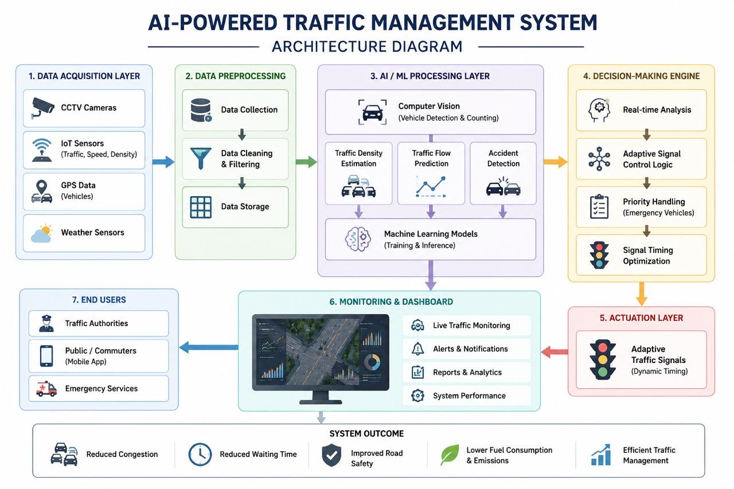
Architecture Diagram

Slide 9
Analysis of Problem Statement /Output Expected
Expected Output
• Vehicle detection with bounding boxes
• Vehicle classification (car, bike, bus, truck)
• Lane-wise vehicle counts
• Density levels (Low, Medium, High)
• Adaptive green-light timing
• Dashboard with real-time monitoring

Slide 10
Analysis of Problem Statement (contd...)
Software Requirements:
• Python
• OpenCV & YOLO
• TensorFlow / PyTorch
• Flask / FastAPI
• MySQL / MongoDB
• HTML, CSS & JavaScript
• VS Code / Jupyter Notebook
• Windows / Linux

Slide 11
Analysis of Problem Statement (contd...)
Hardware Requirements:
• Computer/Laptop with minimum 8 GB RAM
• Intel i5 / AMD Ryzen 5 or higher
• CCTV / IP Camera
• Raspberry Pi or edge device
• IoT sensors for traffic monitoring
• Internet/Wi-Fi connectivity
• GPU (optional) for faster AI model processing

Slide 12
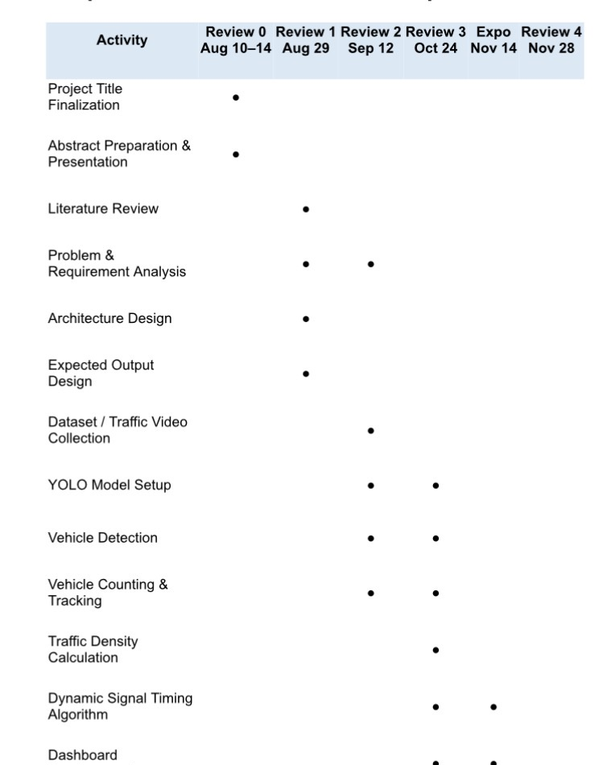
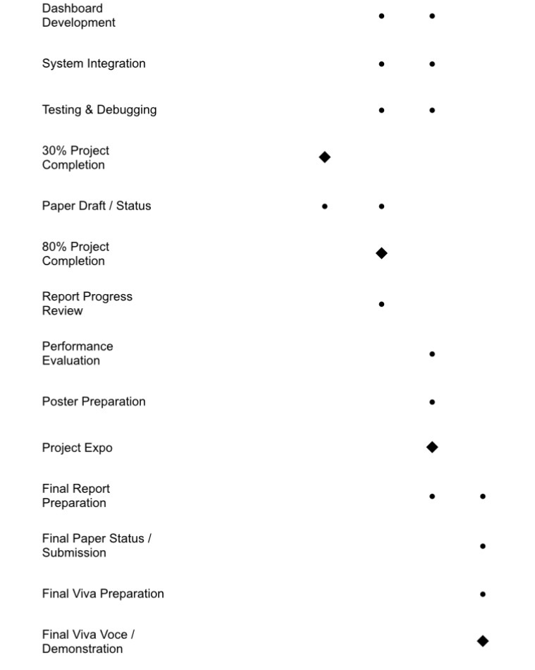
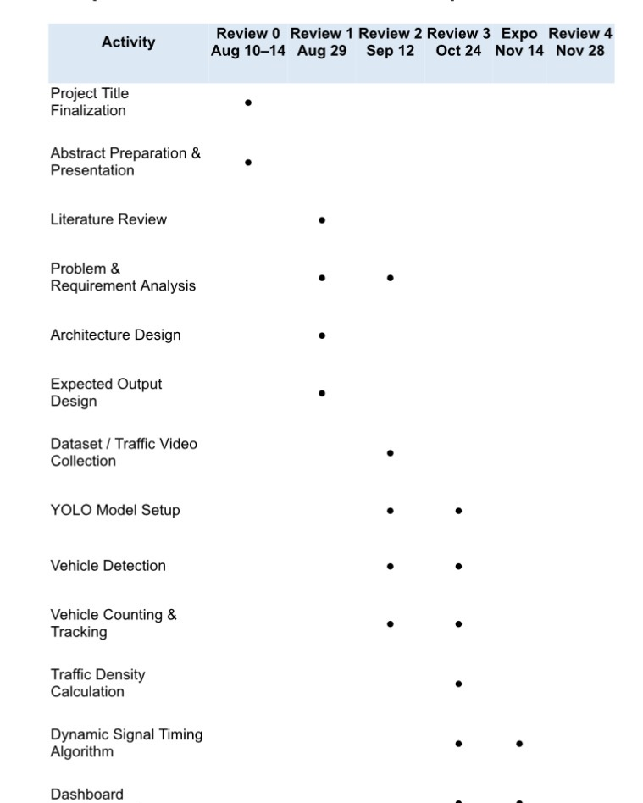

Timeline of the Project (Gantt Chart)

Slide 13
References (IEEE Paper format)
References
• Xiao et al. (2026) — Survey on AI-based intelligent traffic signal control using reinforcement learning.
• Zhao et al. (2024) — Review of deep reinforcement learning for traffic signal control.
• Haydari & Yilmaz (2022) — Survey of deep reinforcement learning in intelligent transportation systems.
• Noaeen et al. (2022) — Systematic review of reinforcement learning for urban traffic signals.
• Patil et al. (2026) — Review of AI techniques for traffic signal control.
• Redmon et al. (2016) — YOLO-based real-time vehicle and object detection.

Slide 14


