Slide 1
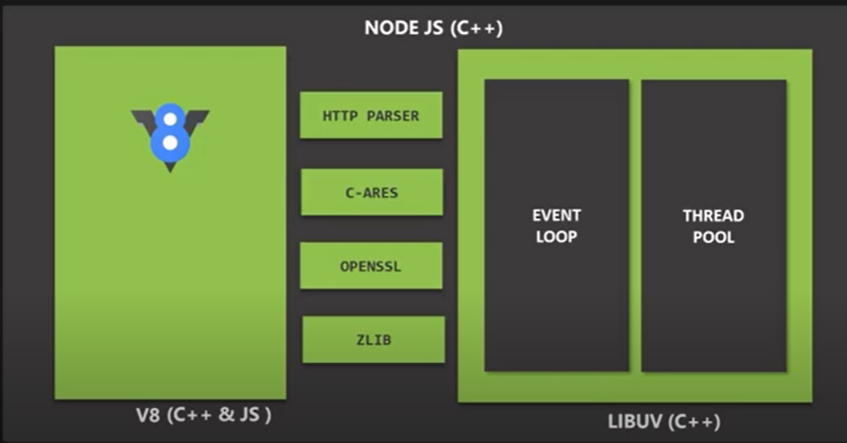
1. NodeJS has v8 as engine and LIBUV
2. Since browser has only V8 engine, it does not
access file system for security reason. V8 engine is written in javascript and C++
3. However, LiBUV allows NodeJS to allow file system and
networking . LIBUV completely written in C++.
4. EventLoop is responsible for executing easy task like callback function and netword IOS
5. Thread pool for heavy task like file access and compression

Slide 2
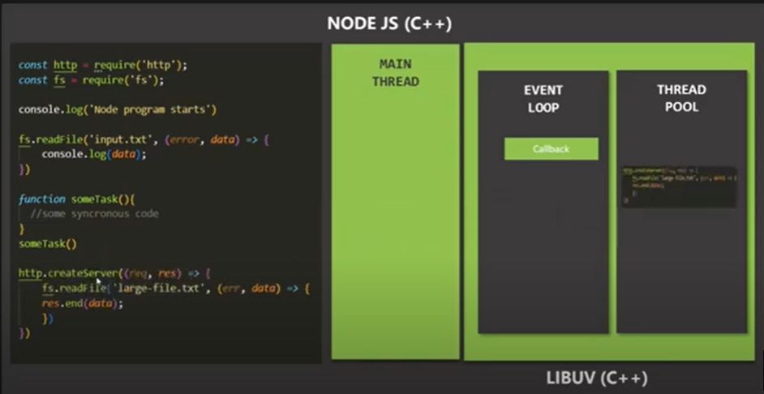
All top level code like someTask() and console.log is exceuted in Main Thread.
Top level code means the one which does not have callback function
All other codes which runs asynchronously Runs in background
And that background in Thread Pool.
So function here like readFile and createServer runs in Thread Pool
After the above function is done with processing in Thread pool, the callback attached to these functions are moved into EventLoop and waits inside the EventLoop
The callback is exceuted in Mainthread when MainThread is empty
So when all the top level function execution done in MainThread, then callback function sitting in EventLoop gets chance to be run in MainThread

Slide 3
9. The callback functions is pushed by EvenLoop into MainThread
10. Important point: If the callback is heavy task job like reading file as depicted in the diagram, it is not executed in MainThread. It is again moved back to ThreadPool from MainThread
11. In NodeJS there are 4 Threads in Thread pools. We can configure it upto 1024 Threads.
12. NodejS offloads all heavy tasks ultimately to Thread pool
13. Note: Thread in ThreadPool is different from MainThread.
14. note: All Toplevel code exceuted in MainThread . All Aynchronous function exceuted in ThreadPool and once done call back is passed to EventLoop.
15. Callback is passed into MainThread if Main Thread is emplty
16. If Callback is light => Event Loop moves callback into MainThread.
17. If Callback is heavy=> Event Loop moves back callback into ThreadPool.
18. The role of EventLoop is just an orchestration

Slide 4
Event Loop
EventLoop has multiple phases
Each phases has its own callback queue.

Slide 5
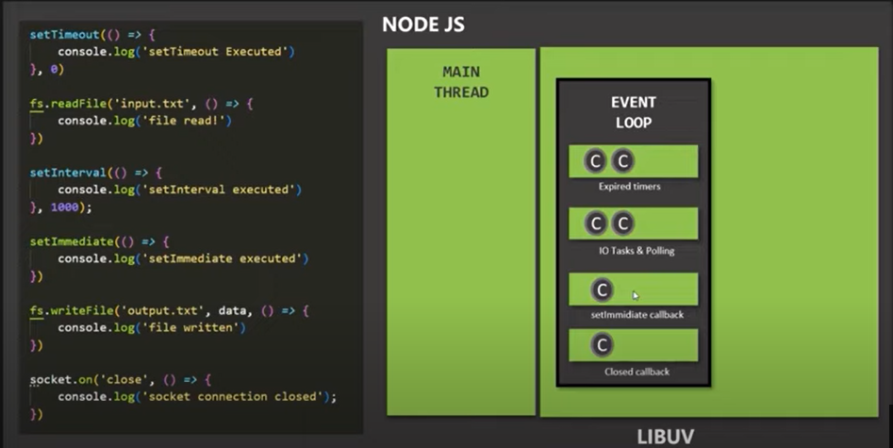

Event Loop phases
First Phase: Timer
Second Phase: File/IO
Third Phase: setImmediate
Fourth Phase: end operations

Slide 6
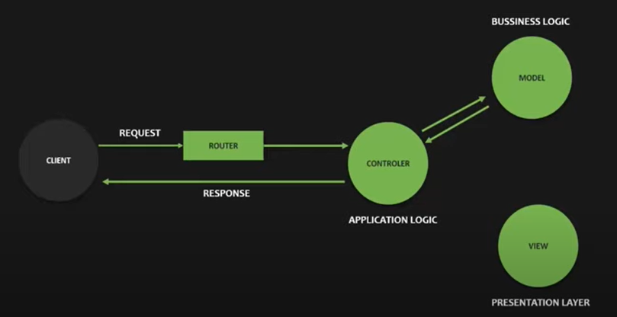
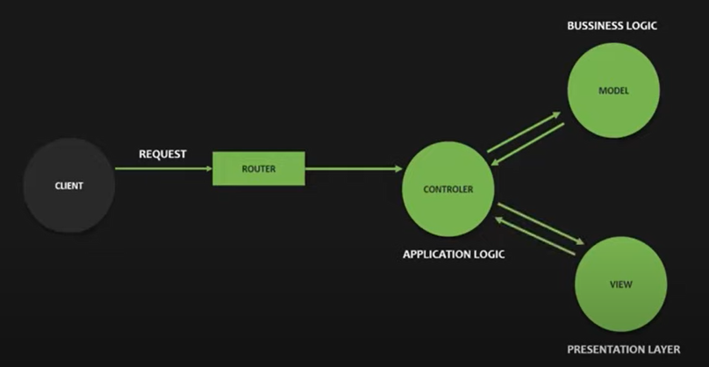

Slide 7
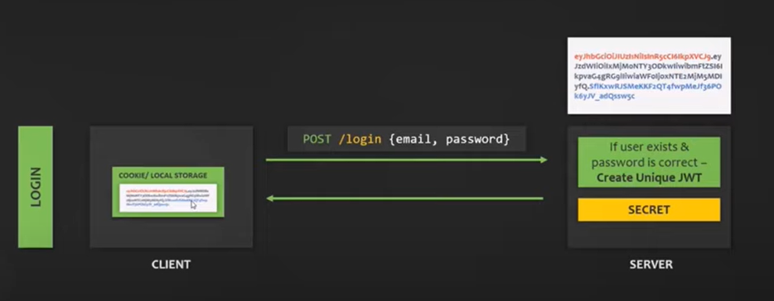
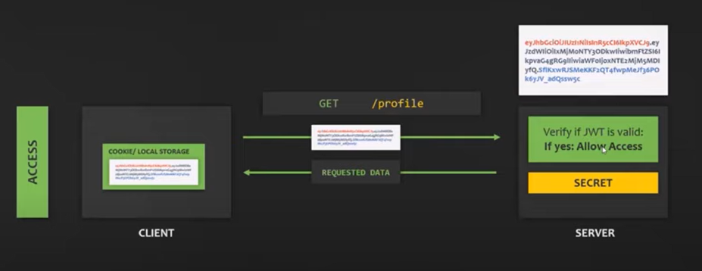

Slide 8
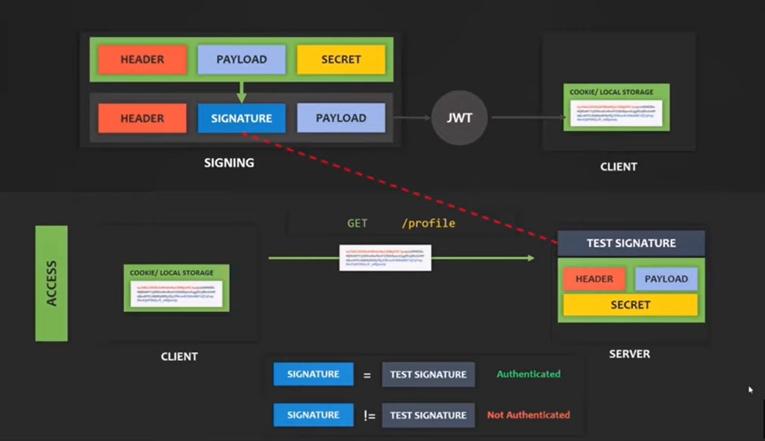

Slide 9
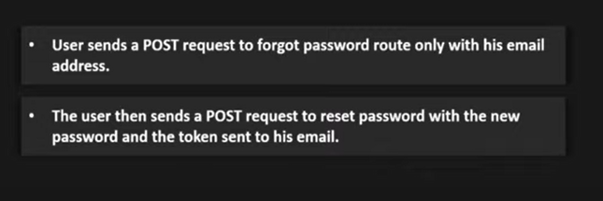
Password Reset Functionality

Slide 10
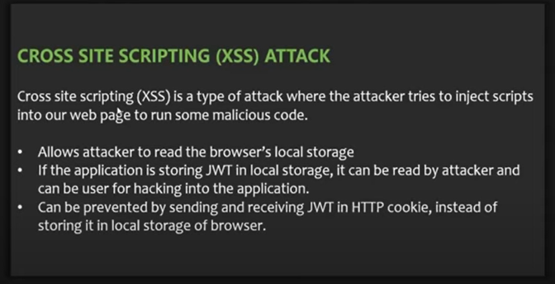
Security measures
Saving JWT on local storage of browser is security prone
So use HTTP Cookie to send and receive JWT
Browser can ONLY send and receive HTTP Cookie but CAN NOT access or modify cookie
Cookie is small piece of text that server can send to the client
When client receives it, it will automatically stores it and send it back to server for all subsequent requests

Slide 11
Security measures
Rate Limit: Apply rateLimit middleware to check number of request coming from same IP within a specified window.
Helmet: Apply helmet middleware so that browser can set various headers for security
Data Limit: Apply middleware for amount of data coming in request. If amount of requested data is more, extra gets truncated.
Data Sanitization
install express-mongo-santize
It prevents noSQL query attack
Apply xss clean from xss-clean : it cleans any html input which is malicious
Preventing Parameter Pollution

