Slide 1
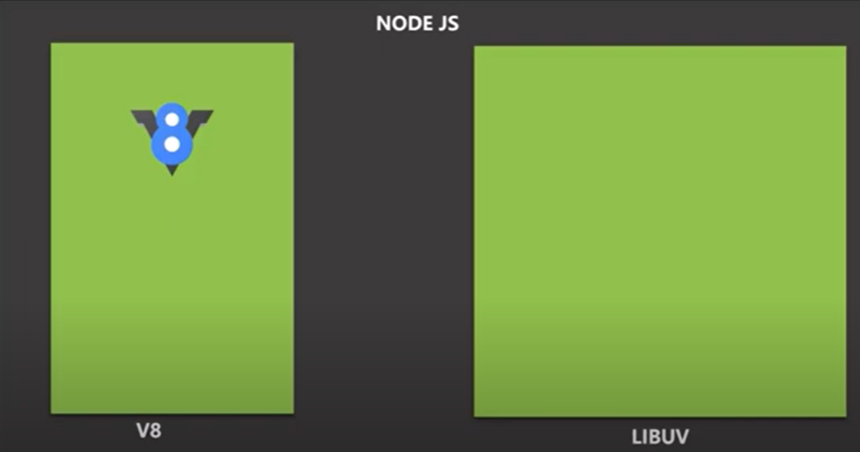
1. NodeJS has v8 as engine and LIBUV
2. Since browser has only V8 engine, it does not
access file system for security reason
3. However, LiBUV allows NodeJS to allow file system and
networking

