Slide 1
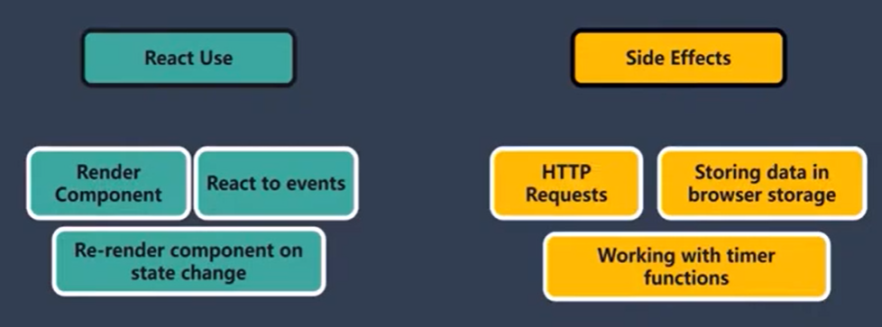

Slide 2


Slide 3


Slide 4


Slide 5
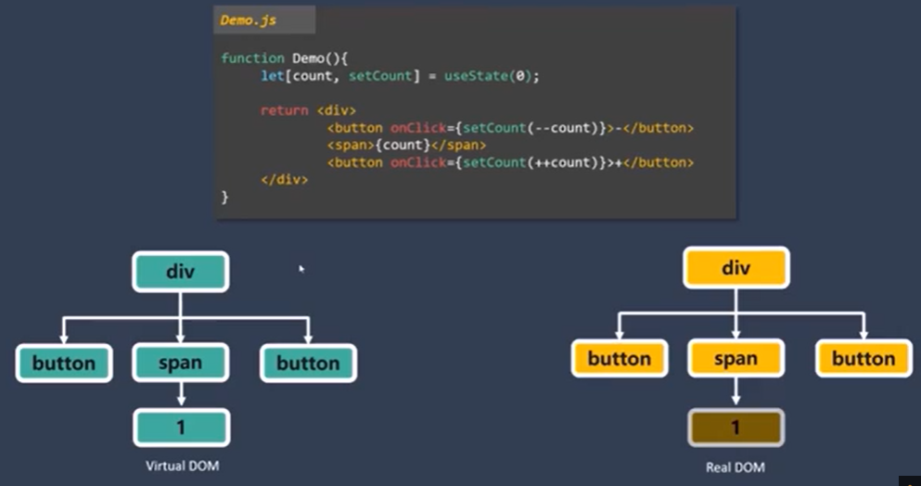
Whenever state changes, the react component is re-evaluated.
Re-evaluation means re-render of Virtual DOM in memory, NOT Real DOM on browser
The only difference between Virtual DOM and Real DOM is updated, NOT the entire Real DOM.
Important Point: If a component and its child component re-evaluated/re-execcuted, and there is no difference between Virtual and Real DOM, the real DOM is not re-rendered. SO if this is the case, can we AVOID even the re-evaluation of react component and its comparison with Real DOM. We can do using memo hook.

Slide 6
5. React.memo compares old props with new props. If no changes, then it does not reevaluate and compare with Real DOM
6. So there are 2 things
Comparison between props
.Reevaluation of component and comparison with Real DOM
7. So the strategy is that if props does NOT change much, use React.memo.
8. So don’t use React.memo blindly

Slide 7
