Slide 1
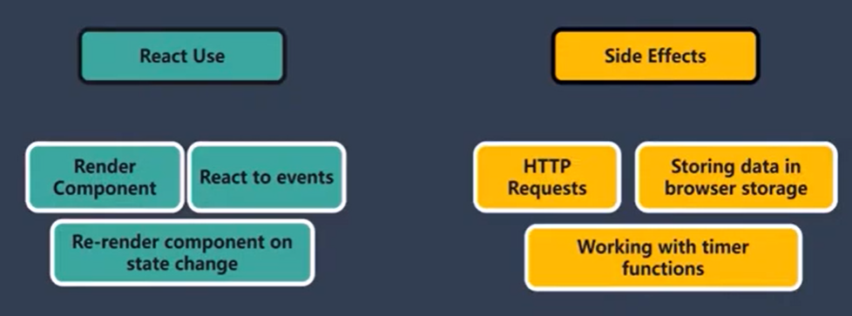

Slide 2


Slide 3
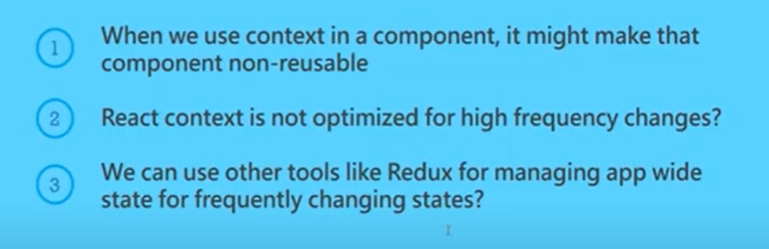

Slide 4
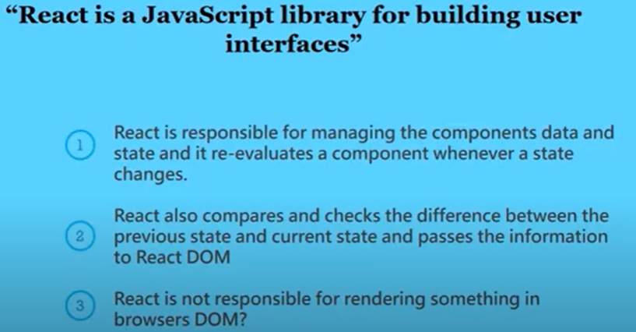

Slide 5
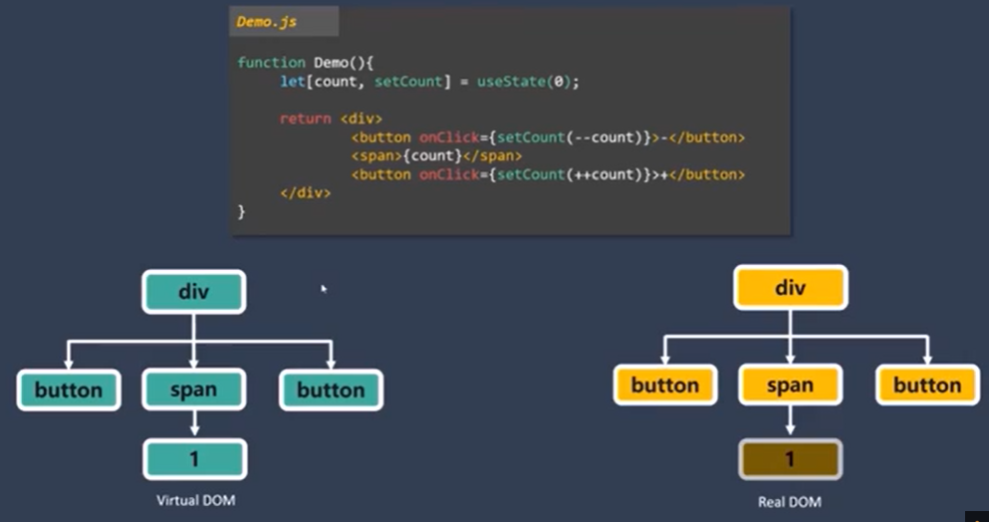
Whenever state changes, the react component is re-evaluated.
Re-evaluation means re-render of Virtual DOM in memory, NOT Real DOM on browser
The only difference between Virtual DOM and Real DOM is updated, NOT the entire Real DOM.

