Slide 1
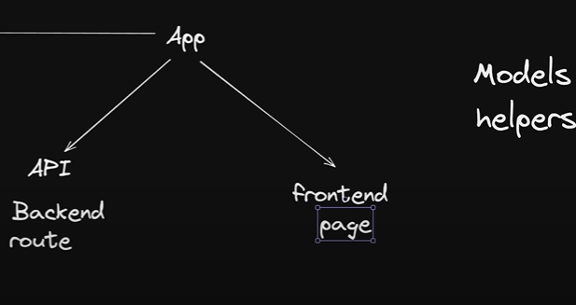


models
helpers

Slide 2
dependencies
npm i axios bcryptjs jsonwebtoken nodemailer react-hot-toast mongoose

Slide 3
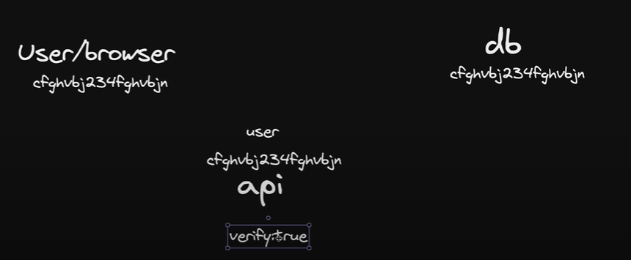
1
2
3
5
4
6

Slide 4
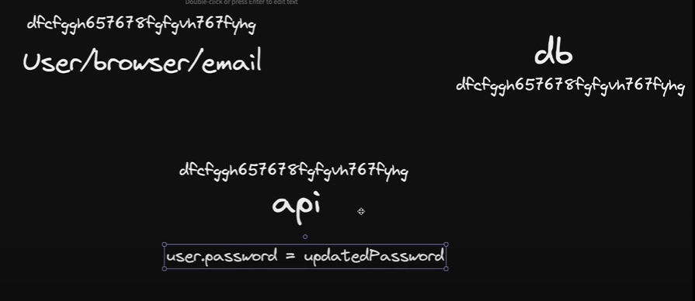
1
2
3
5
4
6

