Slide 1
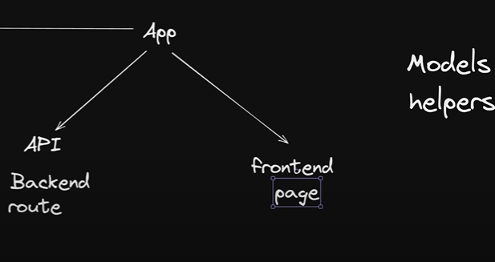


models
helpers

Slide 2
dependencies
npm i axios bcryptjs jsonwebtoken nodemailer react-hot-toast mongoose

